Slide 1
Dynamic Linking
Instructor: Robert Utterback
Lecture 20
Notes:
HW presentation
Exam next Monday! Practice exam on website, will go through it on Friday. Be sure to give the problems a try!

Slide 2
Target Addressing Example
Loop code from earlier example
Assume Loop at location 60000
Loop: sll $t1, $s3, 2 | 60000 | 0 | 0 | 19 | 9 | 4 | 0
add $t1, $t1, $s6 | 60004 | 0 | 9 | 22 | 9 | 0 | 32
lw $t0, 0($t1) | 60008 | 35 | 9 | 8 | 0
bne $t0, $s5, Exit | 60012 | 5 | 8 | 21 | 2
addi $s3, $s3, 1 | 60016 | 8 | 19 | 19 | 1
j Loop | 60020 | 2 | 15000
Exit: … | 60024
Notes:
15000 = 0011 1010 1001 1000
60020 = 1110 1010 0111 0100
60000 = 1110 1010 0110 0000

Slide 3
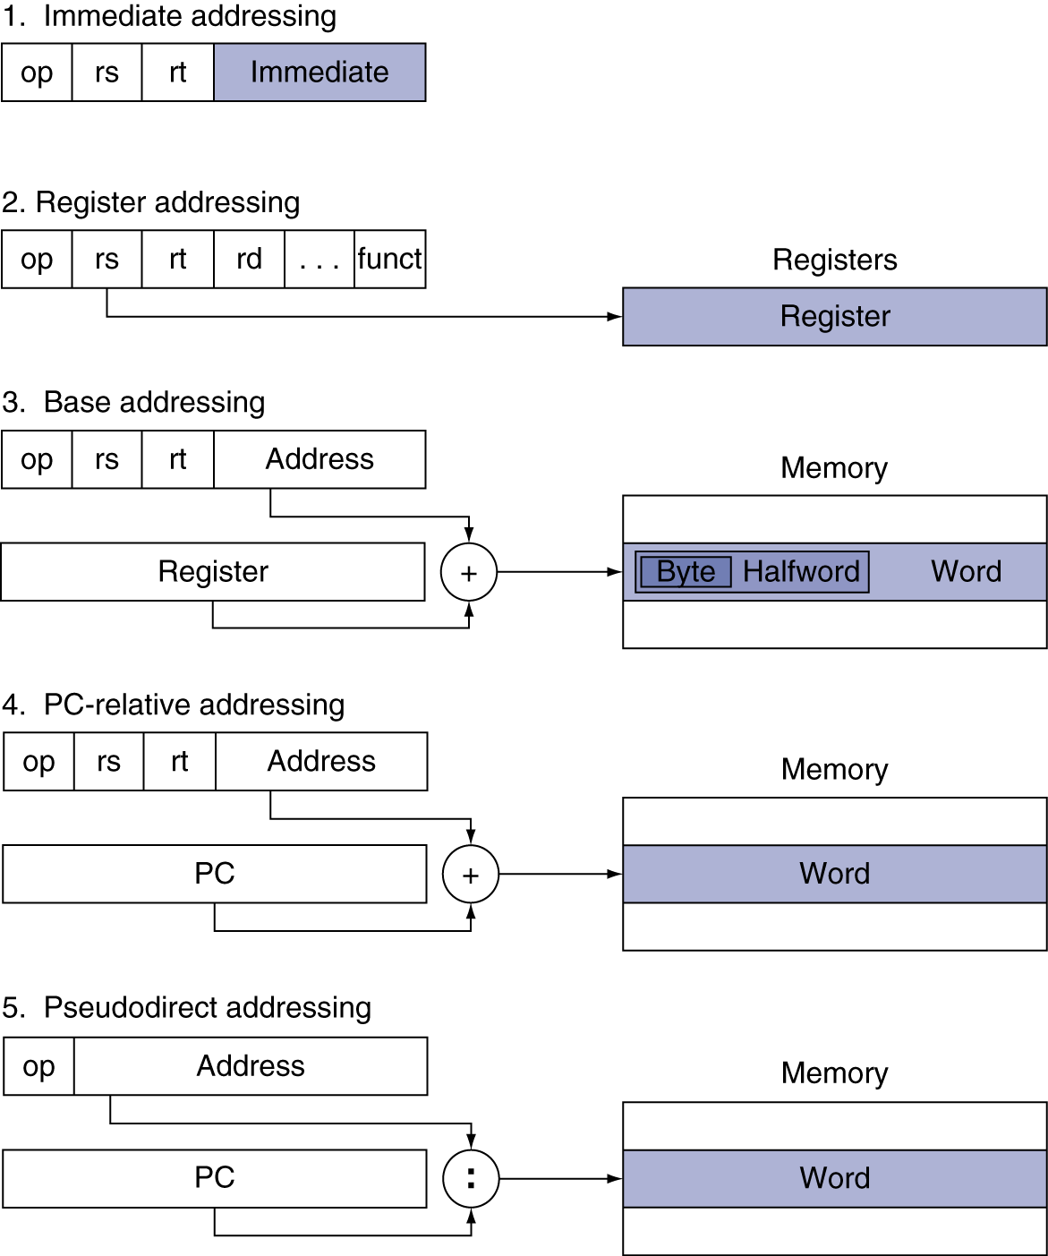
Addressing Mode Summary
Notes:
Example of 1? (addi)
Example of 2? (jr, add, etc.)
3? (lw,sw)
4? (bne)
5? (j,jal)

Slide 4
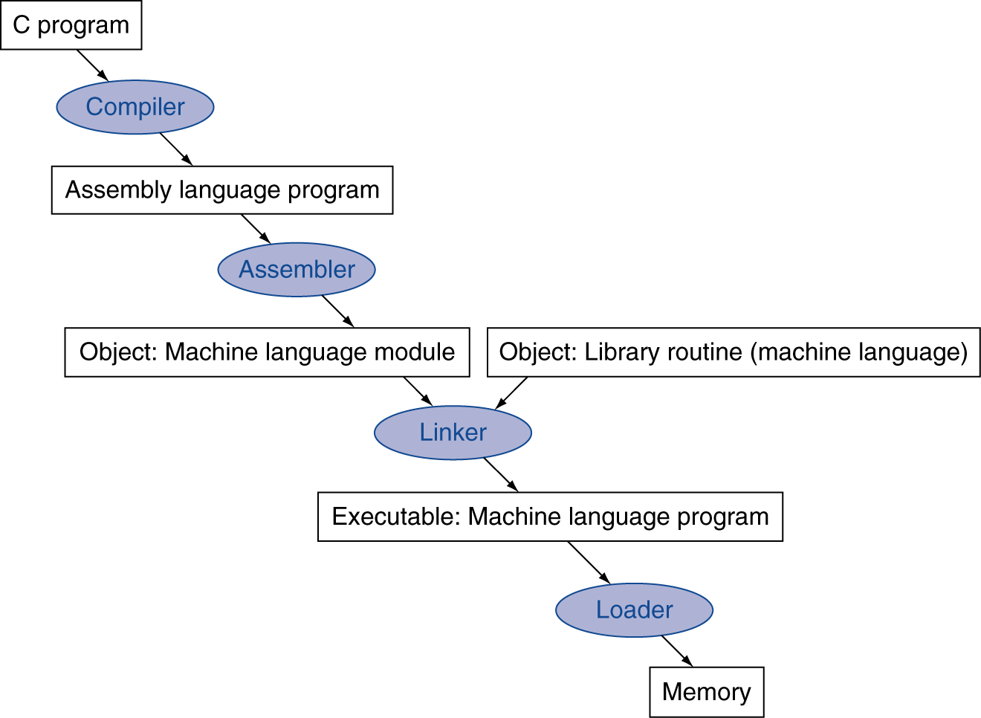
Translation and Startup
Many compilers produce object modules directly
§2.12 Translating and Starting a Program
Static linking
Notes:
When we have said compiler previously, really we mean this whole process, which often happens automatically for us.
This is an overview of the process, now let’s go into detail…

Slide 5
Problems with Static Linking
Static linking problems:
Many programs use the same library code (C stdlib, C++ stdlib, etc…)
Need to recompile to change library version used
Slow bug fixes

Slide 6
Dynamic Linking
Only link/load library procedure when it is called
Avoids image bloat caused by static linking of all (transitively) referenced libraries
Automatically picks up new library versions
Requires procedure code to be “relocatable”
Notes:
Relocatable – skipping details, just need to be careful about our jumps.

Slide 7
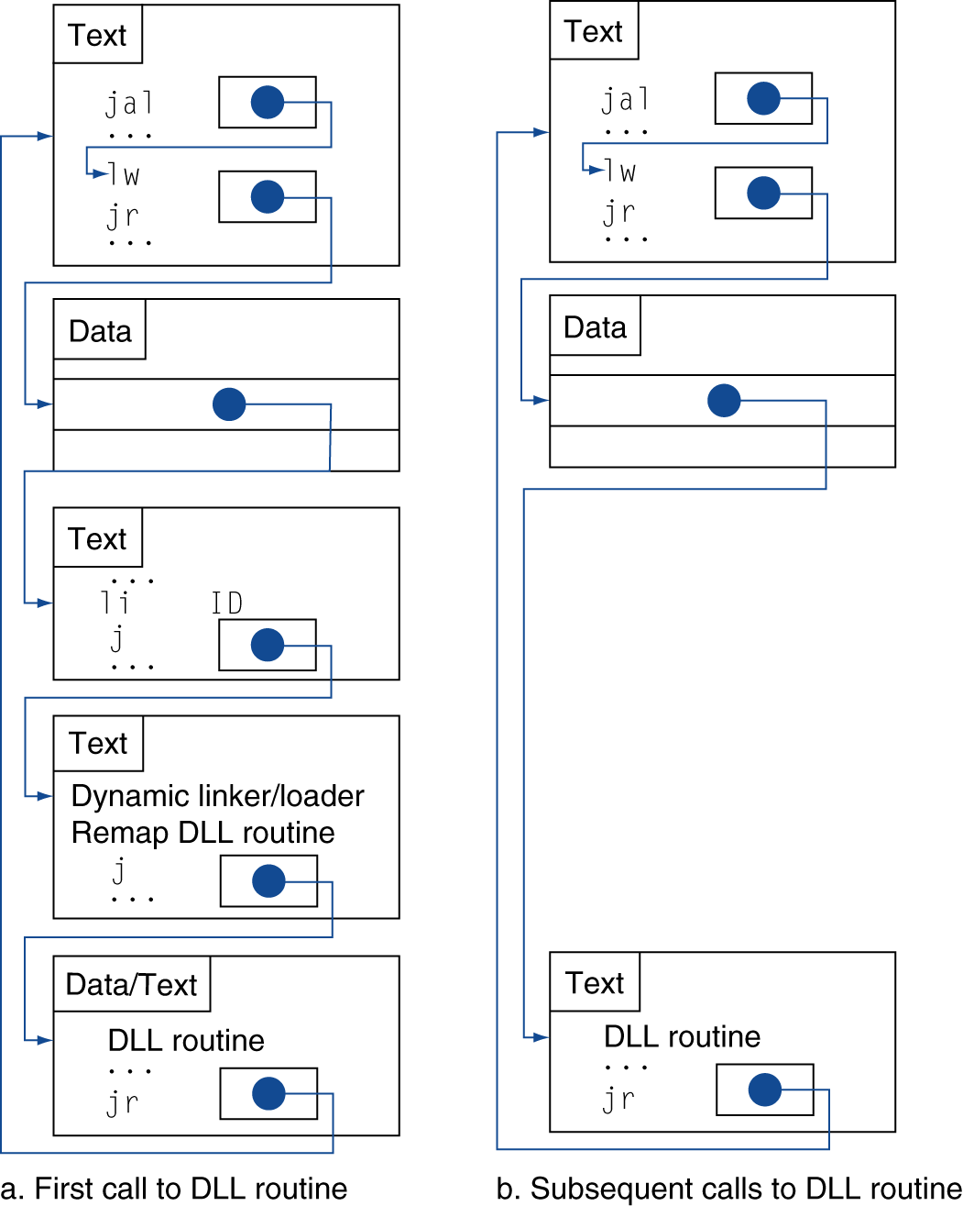
Lazy Linkage
Indirection table
Stub: Loads routine ID, Jump to linker/loader
Linker/loader code
Dynamically mapped code
Notes:
All problems in computer science can be solved by indirection.

Slide 8
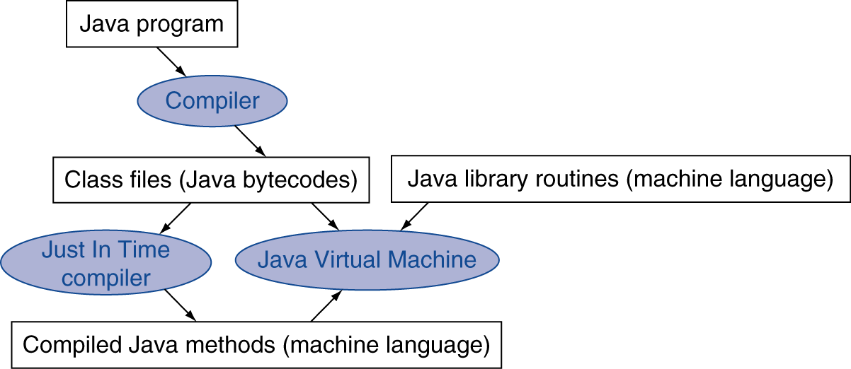
Starting Java Applications
Simple portable instruction set for the JVM
Compiles bytecodes of “hot” methods into native code for host machine
Interprets bytecodes

Slide 9
C Sort Example
Illustrates use of assembly instructions for a C insertion sort function
Swap procedure (leaf)
void swap(int v[], int k) { int temp; temp = v[k]; v[k] = v[k+1]; v[k+1] = temp; }
v in $a0, k in $a1, temp in $t0
§2.13 A C Sort Example to Put It All Together

Slide 10
The Procedure Swap
swap: sll $t1, $a1, 2 # $t1 = k * 4
add $t1, $a0, $t1 # $t1 = v+(k*4)
# (address of v[k])
lw $t0, 0($t1) # $t0 (temp) = v[k]
lw $t2, 4($t1) # $t2 = v[k+1]
sw $t2, 0($t1) # v[k] = $t2 (v[k+1])
sw $t0, 4($t1) # v[k+1] = $t0 (temp)
jr $ra # return to calling routine

Slide 11
The Sort Procedure in C
Non-leaf (calls swap)
void sort (int v[], int n)
{
int i, j;
for (i = 0; i < n; i += 1) {
for (j = i – 1;
j >= 0 && v[j] > v[j + 1];
j -= 1) {
swap(v,j);
}
}
}
v in $a0, k in $a1, i in $s0, j in $s1
Notes:
Book incorrectly calls it bubble sort

Slide 12
The Procedure Body
move $s2, $a0 # save $a0 into $s2
move $s3, $a1 # save $a1 into $s3
move $s0, $zero # i = 0
for1tst: slt $t0, $s0, $s3 # $t0 = 0 if $s0 ≥ $s3 (i ≥ n)
beq $t0, $zero, exit1 # go to exit1 if $s0 ≥ $s3 (i ≥ n)
addi $s1, $s0, –1 # j = i – 1
for2tst: slti $t0, $s1, 0 # $t0 = 1 if $s1 < 0 (j < 0)
bne $t0, $zero, exit2 # go to exit2 if $s1 < 0 (j < 0)
sll $t1, $s1, 2 # $t1 = j * 4
add $t2, $s2, $t1 # $t2 = v + (j * 4)
lw $t3, 0($t2) # $t3 = v[j]
lw $t4, 4($t2) # $t4 = v[j + 1]
slt $t0, $t4, $t3 # $t0 = 0 if $t4 ≥ $t3
beq $t0, $zero, exit2 # go to exit2 if $t4 ≥ $t3
move $a0, $s2 # 1st param of swap is v (old $a0)
move $a1, $s1 # 2nd param of swap is j
jal swap # call swap procedure
addi $s1, $s1, –1 # j –= 1
j for2tst # jump to test of inner loop
exit2: addi $s0, $s0, 1 # i += 1
j for1tst # jump to test of outer loop
Move params
Outer loop
Inner loop
Pass params & call
Inner loop
Outer loop

Slide 13
The Full Procedure
sort: addi $sp,$sp, –20 # make room on stack for 5 registers
sw $ra, 16($sp) # save $ra on stack
sw $s3,12($sp) # save $s3 on stack
sw $s2, 8($sp) # save $s2 on stack
sw $s1, 4($sp) # save $s1 on stack
sw $s0, 0($sp) # save $s0 on stack
… # procedure body
…
exit1: lw $s0, 0($sp) # restore $s0 from stack
lw $s1, 4($sp) # restore $s1 from stack
lw $s2, 8($sp) # restore $s2 from stack
lw $s3,12($sp) # restore $s3 from stack
lw $ra,16($sp) # restore $ra from stack
addi $sp,$sp, 20 # restore stack pointer
jr $ra # return to calling routine

