Slide 1
Arrays vs. Pointers
Instructor: Robert Utterback
Lecture 20
Notes:
Arrays vs. pointers is the most important thing, though we’ll touch on some other tidbits to finish up chapter 2.

Slide 2
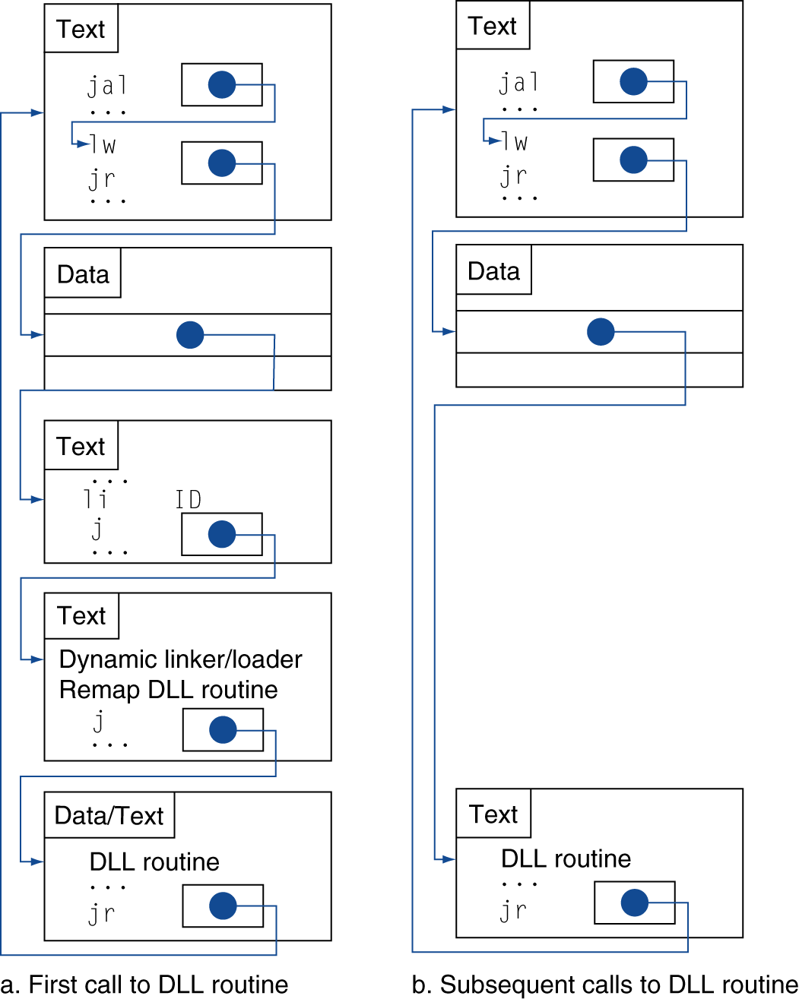
Lazy Linkage
Indirection table
Stub: Loads routine ID, Jump to linker/loader
Linker/loader code
Dynamically mapped code
Notes:
All problems in computer science can be solved by indirection.

Slide 3
Effect of Compiler Optimization
Compiled with gcc for Pentium 4 under Linux
Notes:
Notice that instruction count is lowest with O1, but best CPI is none! Best performance metric is just execution time!

Slide 4
Effect of Language and Algorithm
Notes:
Optimization doesn’t help quicksort as much b/c it’s a faster algorithm overall…

Slide 5
Lessons Learnt
Instruction count and CPI are not good performance indicators in isolation
Compiler optimizations are sensitive to the algorithm
Java/JIT compiled code is significantly faster than JVM interpreted
Comparable to optimized C in some cases
Nothing can fix a dumb algorithm!

Slide 6
Arrays vs. Pointers
Array indexing involves
Multiplying index by element size
Adding to array base address
Pointers correspond directly to memory addresses
Can avoid indexing complexity
§2.14 Arrays versus Pointers

Slide 7
Example: Clearing and Array
clear1(int array[], int size) { int i; for (i = 0; i < size; i += 1) array[i] = 0; } | clear2(int *array, int size) { int *p; for (p = &array[0]; p < &array[size]; p = p + 1) *p = 0; }
move $t0,$zero # i = 0 loop1: sll $t1,$t0,2 # $t1 = i * 4 add $t2,$a0,$t1 # $t2 = # &array[i] sw $zero, 0($t2) # array[i] = 0 addi $t0,$t0,1 # i = i + 1 slt $t3,$t0,$a1 # $t3 = # (i < size) bne $t3,$zero,loop1 # if (…) # goto loop1 | move $t0,$a0 # p = & array[0] sll $t1,$a1,2 # $t1 = size * 4 add $t2,$a0,$t1 # $t2 = # &array[size] loop2: sw $zero,0($t0) # Memory[p] = 0 addi $t0,$t0,4 # p = p + 4 slt $t3,$t0,$t2 # $t3 = #(p<&array[size]) bne $t3,$zero,loop2 # if (…) # goto loop2
Notes:
Using an index: adding to this, then calculating the memory address
Pointer: just keep the address you need directly, and add to this pointer value

Slide 8
Comparison of Array vs. Ptr
Multiply “strength reduced” to shift
Array version requires shift to be inside loop
Part of index calculation for incremented i
c.f. incrementing pointer
Compiler can achieve same effect as manual use of pointers
Induction variable elimination
Better to make program clearer and safer

Slide 9
ARM & MIPS Similarities
ARM: the most popular embedded core
Similar basic set of instructions to MIPS
§2.16 Real Stuff: ARM Instructions
 | ARM | MIPS
Date announced | 1985 | 1985
Instruction size | 32 bits | 32 bits
Address space | 32-bit flat | 32-bit flat
Data alignment | Aligned | Aligned
Data addressing modes | 9 | 3
Registers | 15 × 32-bit | 31 × 32-bit
Input/output | Memory mapped | Memory mapped

Slide 10
Compare and Branch in ARM
Uses condition codes for result of an arithmetic/logical instruction
Negative, zero, carry, overflow
Compare instructions to set condition codes without keeping the result
Each instruction can be conditional
Top 4 bits of instruction word: condition value
Can avoid branches over single instructions
Notes:
Top 4 bits correspond to the 4 condition codes

Slide 11
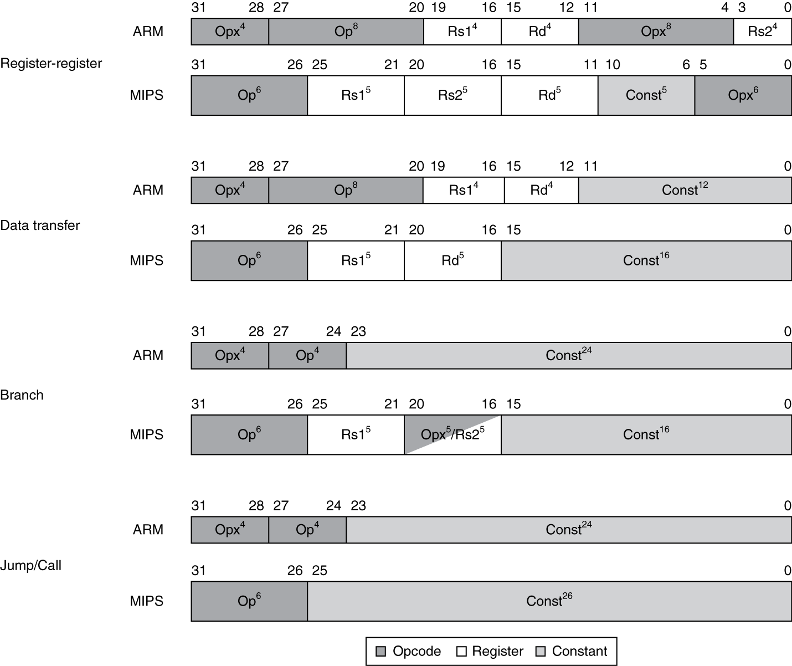
Instruction Encoding

Slide 12
The Intel x86 ISA
Evolution with backward compatibility
8080 (1974): 8-bit microprocessor
Accumulator, plus 3 index-register pairs
8086 (1978): 16-bit extension to 8080
Complex instruction set (CISC)
8087 (1980): floating-point coprocessor
Adds FP instructions and register stack
80286 (1982): 24-bit addresses, MMU
Segmented memory mapping and protection
80386 (1985): 32-bit extension (now IA-32)
Additional addressing modes and operations
Paged memory mapping as well as segments
§2.17 Real Stuff: x86 Instructions

Slide 13
The Intel x86 ISA
Further evolution…
i486 (1989): pipelined, on-chip caches and FPU
Compatible competitors: AMD, Cyrix, …
Pentium (1993): superscalar, 64-bit datapath
Later versions added MMX (Multi-Media eXtension) instructions
The infamous FDIV bug
Pentium Pro (1995), Pentium II (1997)
New microarchitecture (see Colwell, The Pentium Chronicles)
Pentium III (1999)
Added SSE (Streaming SIMD Extensions) and associated registers
Pentium 4 (2001)
New microarchitecture
Added SSE2 instructions

Slide 14
The Intel x86 ISA
And further…
AMD64 (2003): extended architecture to 64 bits
EM64T – Extended Memory 64 Technology (2004)
AMD64 adopted by Intel (with refinements)
Added SSE3 instructions
Intel Core (2006)
Added SSE4 instructions, virtual machine support
AMD64 (announced 2007): SSE5 instructions
Intel declined to follow, instead…
Advanced Vector Extension (announced 2008)
Longer SSE registers, more instructions
If Intel didn’t extend with compatibility, its competitors would!
Technical elegance ≠ market success

Slide 15
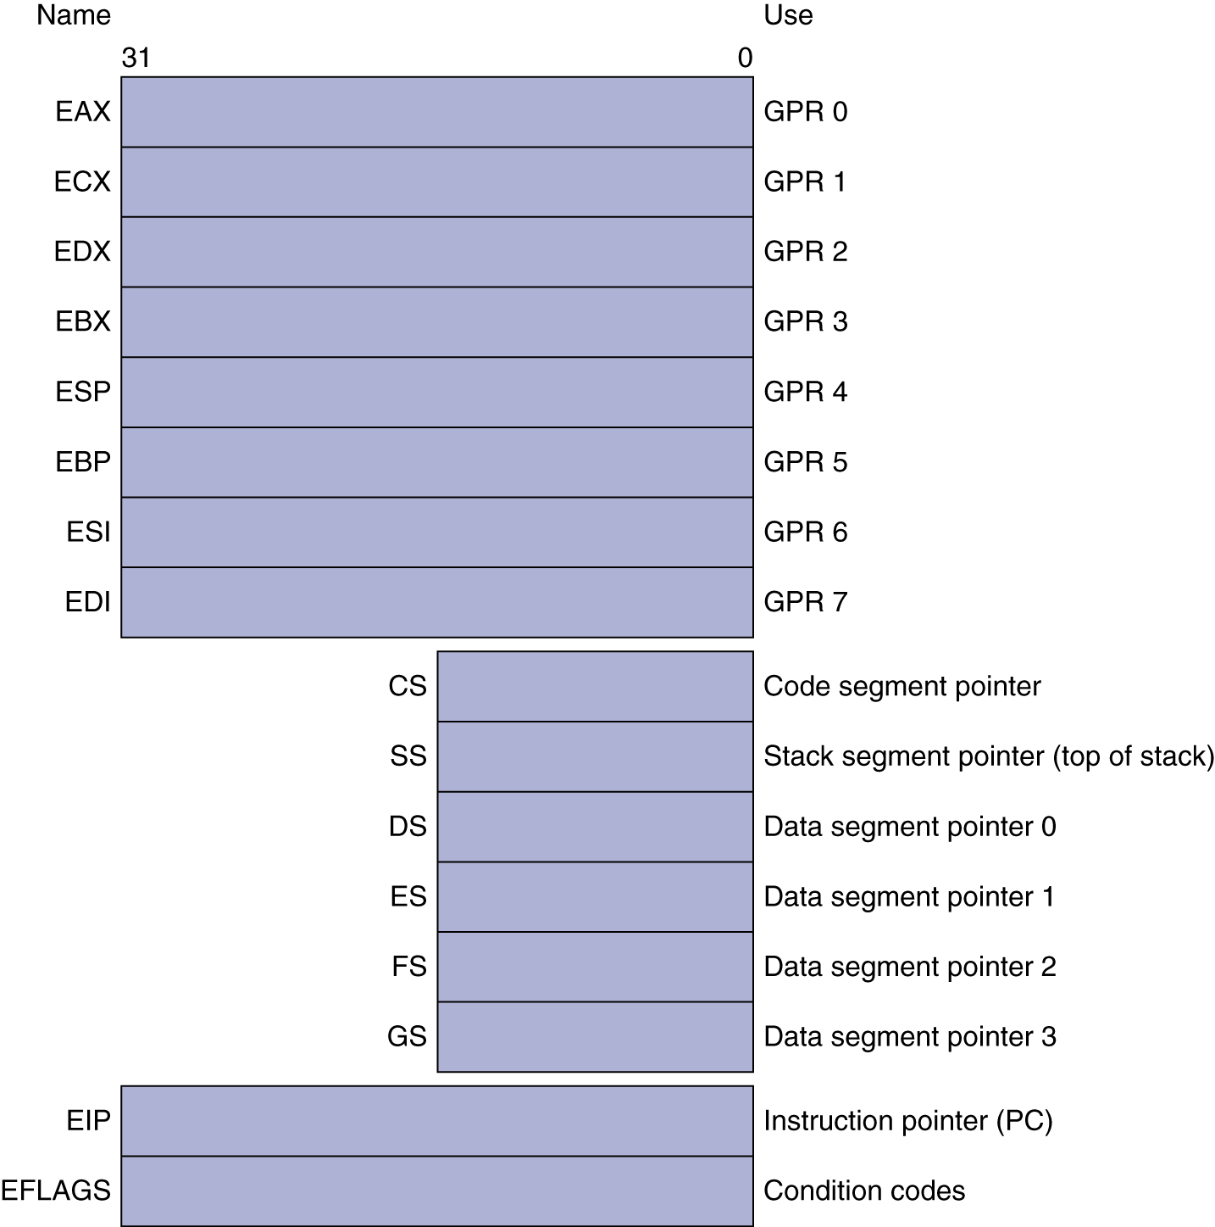
Basic x86 Registers

Slide 16
Basic x86 Addressing Modes
Two operands per instruction
Source/dest operand | Second source operand
Register | Register
Register | Immediate
Register | Memory
Memory | Register
Memory | Immediate
Memory addressing modes
Address in register
Address = R_{base} + displacement
Address = R_{base} + 2^{scale} × R_{index} (scale = 0, 1, 2, or 3)
Address = R_{base} + 2^{scale} × R_{index} + displacement

Slide 17
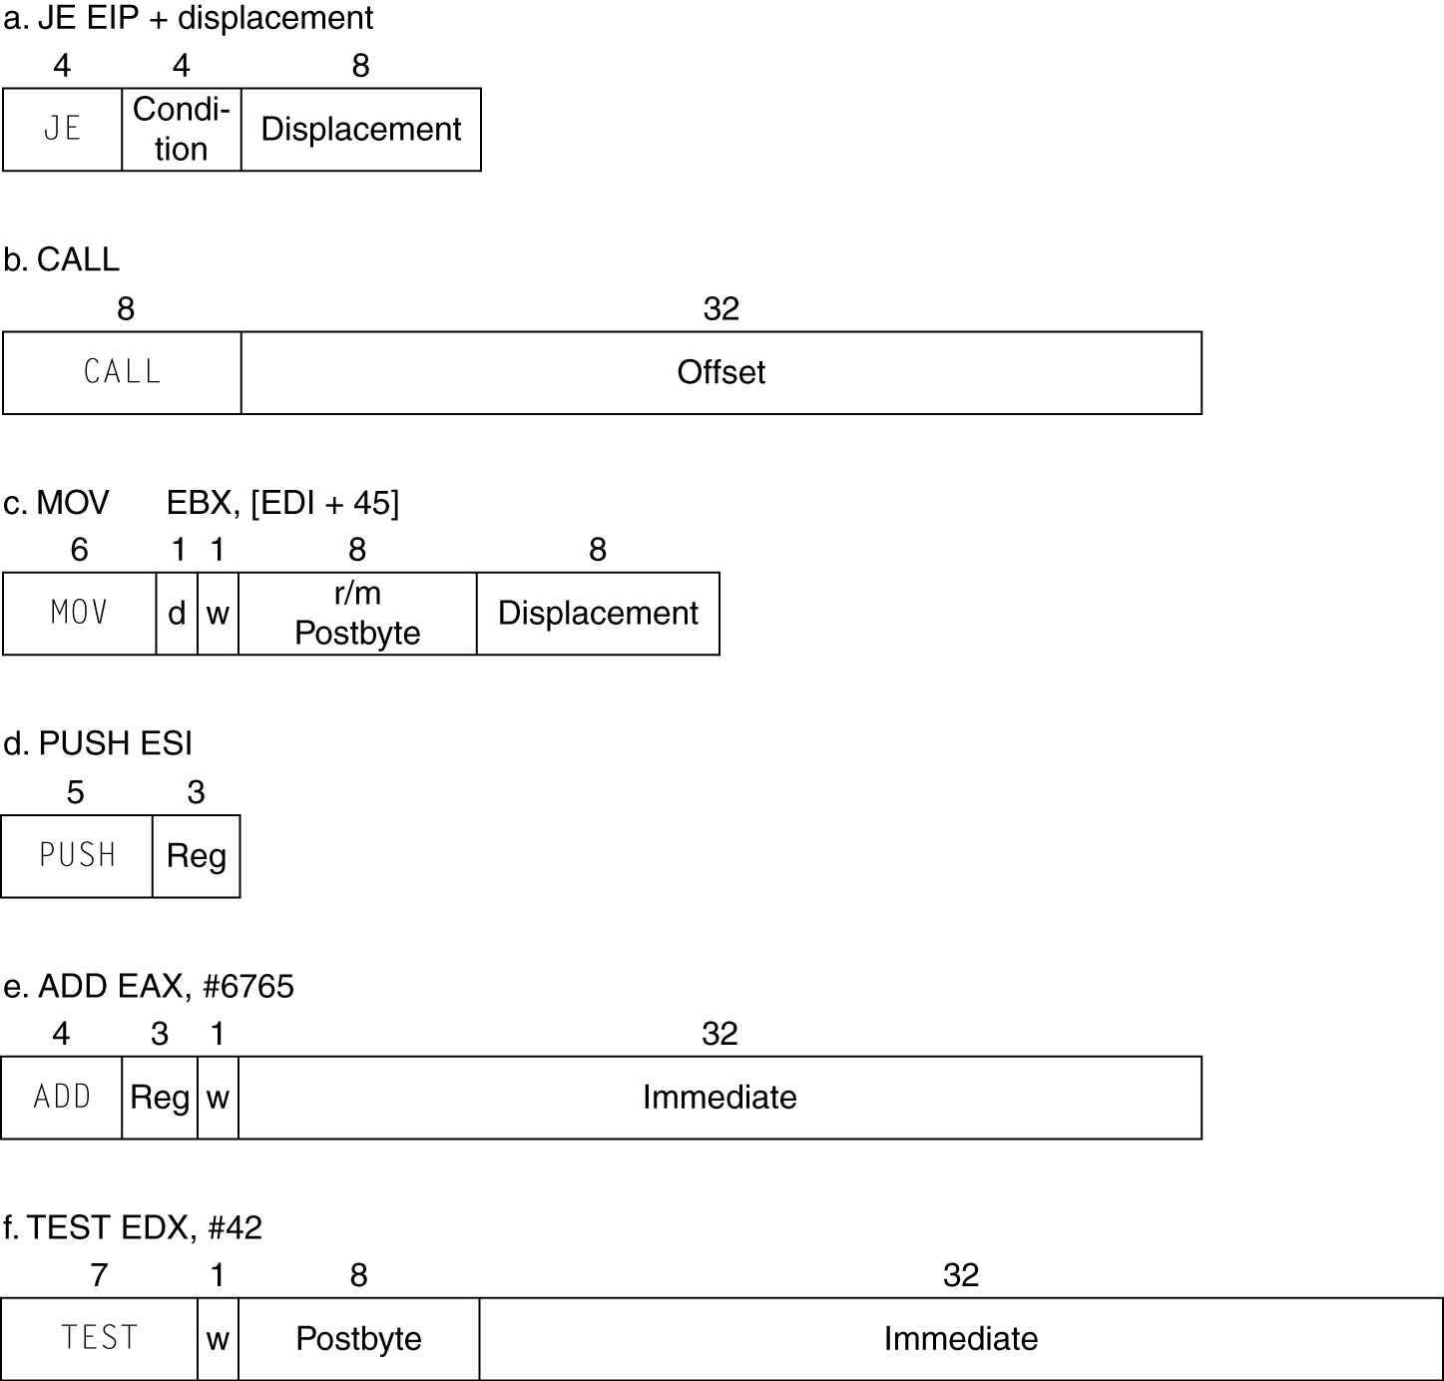
x86 Instruction Encoding
Variable length encoding
Postfix bytes specify addressing mode
Prefix bytes modify operation
Operand length, repetition, locking, …

Slide 18
Implementing IA-32
Complex instruction set makes implementation difficult
Hardware translates instructions to simpler microoperations
Simple instructions: 1–1
Complex instructions: 1–many
Microengine similar to RISC
Market share makes this economically viable
Comparable performance to RISC
Compilers avoid complex instructions
Notes:
Large Market share = high revenue = pay lots of people a lot of money to work on it

Slide 19
ARM v8 Instructions
In moving to 64-bit, ARM did a complete overhaul
ARM v8 resembles MIPS
Changes from v7:
No conditional execution field
Immediate field is 12-bit constant
Dropped load/store multiple
PC is no longer a GPR
GPR set expanded to 32
Addressing modes work for all word sizes
Divide instruction
Branch if equal/branch if not equal instructions
§2.18 Real Stuff: ARM v8 (64-bit) Instructions

Slide 20
Fallacies
Powerful instruction ⇒ higher performance
Fewer instructions required
But complex instructions are hard to implement
May slow down all instructions, including simple ones
Compilers are good at making fast code from simple instructions
Use assembly code for high performance
But modern compilers are better at dealing with modern processors
More lines of code ⇒ more errors and less productivity
§2.19 Fallacies and Pitfalls
Notes:
But we still want to understand the assembly to understand the ISA and write better C code.

Slide 21
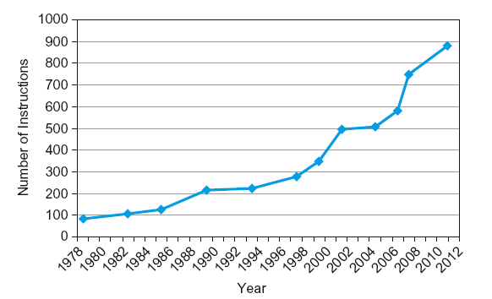
Fallacies
Backward compatibility ⇒ instruction set doesn’t change
But they do accrete more instructions
x86 instruction set

Slide 22
Pitfalls
Sequential words are not at sequential addresses
Increment by 4, not by 1!
Keeping a pointer to an automatic variable after procedure returns
e.g., passing pointer back via an argument
Pointer becomes invalid when stack popped
Notes:
Give a quick example.

Slide 23
Concluding Remarks
Design principles
1. Simplicity favors regularity
2. Smaller is faster
3. Make the common case fast
4. Good design demands good compromises
Layers of software/hardware
Compiler, assembler, hardware
MIPS: typical of RISC ISAs
c.f. x86
§2.20 Concluding Remarks

Slide 24
Concluding Remarks
Measure MIPS instruction executions in benchmark programs
Consider making the common case fast
Consider compromises
Instruction class | MIPS examples | SPEC2006 Int | SPEC2006 FP
Arithmetic | add, sub, addi | 16% | 48%
Data transfer | lw, sw, lb, lbu, lh, lhu, sb, lui | 35% | 36%
Logical | and, or, nor, andi, ori, sll, srl | 12% | 4%
Cond. Branch | beq, bne, slt, slti, sltiu | 34% | 8%
Jump | j, jr, jal | 2% | 0%

