Slide 1
Floating Point Arithmetic
Instructor: Robert Utterback
Lecture 29

Slide 2
IEEE Floating-Point Format
single: 8 bits double: 11 bits
single: 23 bits double: 52 bits
S
Exponent
Fraction
S: sign bit (0 ⇒ non-negative, 1 ⇒ negative)
Normalize significand: 1.0 ≤ |significand| < 2.0
Always has a leading pre-binary-point 1 bit, so no need to represent it explicitly (hidden bit)
Significand is Fraction with the “1.” restored
Exponent: excess representation: actual exponent + Bias
Ensures exponent is unsigned
Single: Bias = 127; Double: Bias = 1203
Notes:
Consider a 4-digit decimal example
9.999 × 10¹ + 1.610 × 10^{–1}
Q: How would you do it?

Slide 3
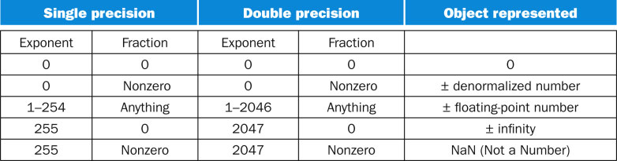
FP Encoding

Slide 4
Floating-Point Addition
Now consider a 4-digit binary example
1.000₂ × 2^{–1} + –1.110₂ × 2^{–2}
1. Align binary points
Shift number with smaller exponent
1.000₂ × 2^{–1} + –0.111₂ × 2^{–1}
2. Add significands
1.000₂ × 2^{–1} + –0.111₂ × 2–1 = 0.001₂ × 2^{–1}
3. Normalize result & check for over/underflow
1.000₂ × 2^{–4}, with no over/underflow
4. Round and renormalize if necessary
1.000₂ × 2^{–4} (no change) = 0.0625
Notes:
First, what are these numbers in base 10?
(0.5 + –0.4375)

Slide 5
FP Adder Hardware
Much more complex than integer adder
Doing it in one clock cycle would take too long
Much longer than integer operations
Slower clock would penalize all instructions
FP adder usually takes several cycles
Can be pipelined (multiple adds in progress at same time)

Slide 6
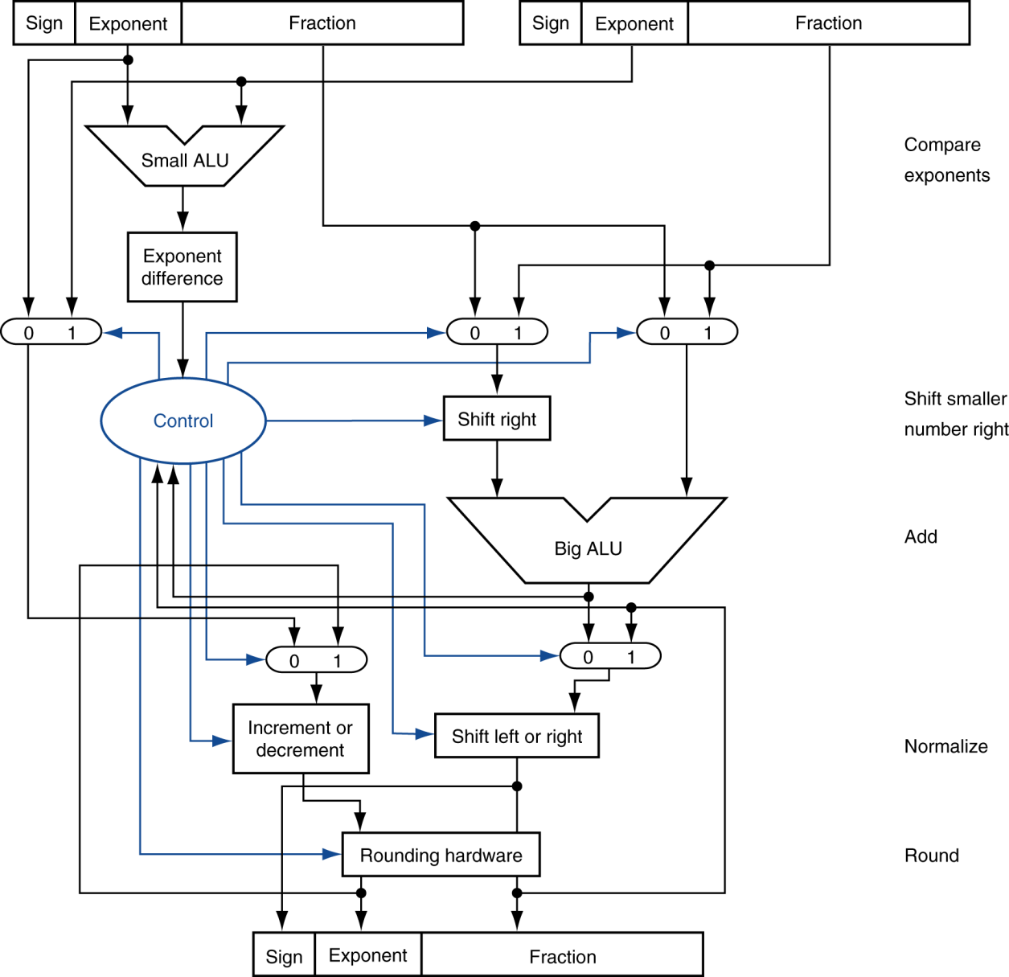
FP Adder Hardware
Step 1
Step 2
Step 3
Step 4
Notes:
Now multiplication: 1.110 × 10¹⁰ × 9.200 × 10^{–5}
Q: How would you do it?

Slide 7
Floating-Point Multiplication
Consider a 4-digit decimal example
1.110 × 10¹⁰ × 9.200 × 10^{–5}
1. Add exponents
For biased exponents, subtract bias from sum
New exponent = 10 + –5 = 5
2. Multiply significands
1.110 × 9.200 = 10.212 ⇒ 10.212 × 10⁵
3. Normalize result & check for over/underflow
1.0212 × 10⁶
4. Round and renormalize if necessary
1.021 × 10⁶
5. Determine sign of result from signs of operands
+1.021 × 10⁶

Slide 8
Floating-Point Multiplication
Now consider a 4-digit binary example
1.000₂ × 2^{–1} × –1.110₂ × 2^{–2} (0.5 × –0.4375)
1. Add exponents
Unbiased: –1 + –2 = –3
Biased: (–1 + 127) + (–2 + 127) = –3 + 254 – 127 = –3 + 127
2. Multiply significands
1.000₂ × 1.110₂ = 1.1102 ⇒ 1.110₂ × 2^{–3}
3. Normalize result & check for over/underflow
1.110₂ × 2^{–3} (no change) with no over/underflow
4. Round and renormalize if necessary
1.110₂ × 2^{–3} (no change)
5. Determine sign: +ve × –ve ⇒ –ve
–1.110₂ × 2^{–3} = –0.21875

Slide 9
FP Arithmetic Hardware
FP multiplier is of similar complexity to FP adder
But uses a multiplier for significands instead of an adder
FP arithmetic hardware usually does
Addition, subtraction, multiplication, division, reciprocal, square-root
FP ↔ integer conversion
Operations usually takes several cycles
Can be pipelined

Slide 10
FP Instructions in MIPS
FP hardware is coprocessor 1
Adjunct processor that extends the ISA
Separate FP registers
32 single-precision: $f0, $f1, … $f31
Paired for double-precision: $f0/$f1, $f2/$f3, …
Release 2 of MIPs ISA supports 32 × 64-bit FP reg’s
FP instructions operate only on FP registers
Programs generally don’t do integer ops on FP data, or vice versa
More registers with minimal code-size impact

Slide 11
FP Instructions in MIPS
FP load and store instructions
lwc1, ldc1, swc1, sdc1
e.g., ldc1 $f8, 32($sp)
Floating point argument registers
NOT $a1, $a2, etc.
$f12, $f13, $f14, $f15
Floating point return value
NOT $v0
$f0

Slide 12
FP Instructions in MIPS
Single-precision arithmetic
add.s, sub.s, mul.s, div.s
e.g., add.s $f0, $f1, $f6
Double-precision arithmetic
add.d, sub.d, mul.d, div.d
e.g., mul.d $f4, $f4, $f6
Single- and double-precision comparison
c.xx.s, c.xx.d (xx is eq, lt, le, …)
Sets or clears FP condition-code bit
e.g. c.lt.s $f3, $f4
Branch on FP condition code true or false
bc1t, bc1f
e.g., bc1t TargetLabel

Slide 13
FP Example: °F to °C
C code:
float f2c (float fahr) { return ((5.0/9.0)*(fahr - 32.0)); }
fahr in $f12, result in $f0, literals in global memory space
Compiled MIPS code:
f2c: lwc1 $f16, const5($gp) lwc1 $f18, const9($gp) div.s $f16, $f16, $f18 lwc1 $f18, const32($gp) sub.s $f18, $f12, $f18 mul.s $f0, $f16, $f18 jr $ra
Notes:
Q: Write the code!
Also li.s and li.d

Slide 14
FP Example: Array Multiplication
X = X + Y × Z
All 32 × 32 matrices, 64-bit double-precision elements
C code:
void mm (double x[32][32], double y[32][32], double z[32][32]) { for (int i = 0; i != 32; i++) for (int j = 0; j != 32; j++) for (int k = 0; k != 32; k++) x[i][j] = x[i][j] + y[i][k] * z[k][j]; }
Addresses of x, y, z in $a0, $a1, $a2, and i, j, k in $s0, $s1, $s2
Notes:
Explain basic idea behind a matrix; they will see it a lot in Linear Algebra. Used in all kinds of places, e.g., computer graphics, scientific calculations, machine learning, etc.
Actual index calculation for, e.g., x[i][j] is tricky
Need the ith row and jth column.
First need to figure out which “slot” we’re in: i * size of row = i * 32, then add column number (j)
Then: how big is each slot? 8 bytes, so take that value * 8, then add to start of array. Whew!
That’s the actual byte address we need to load.

