Slide 1
Pointers vs. Arrays
Instructor: Robert Utterback
Lecture 25

Slide 2
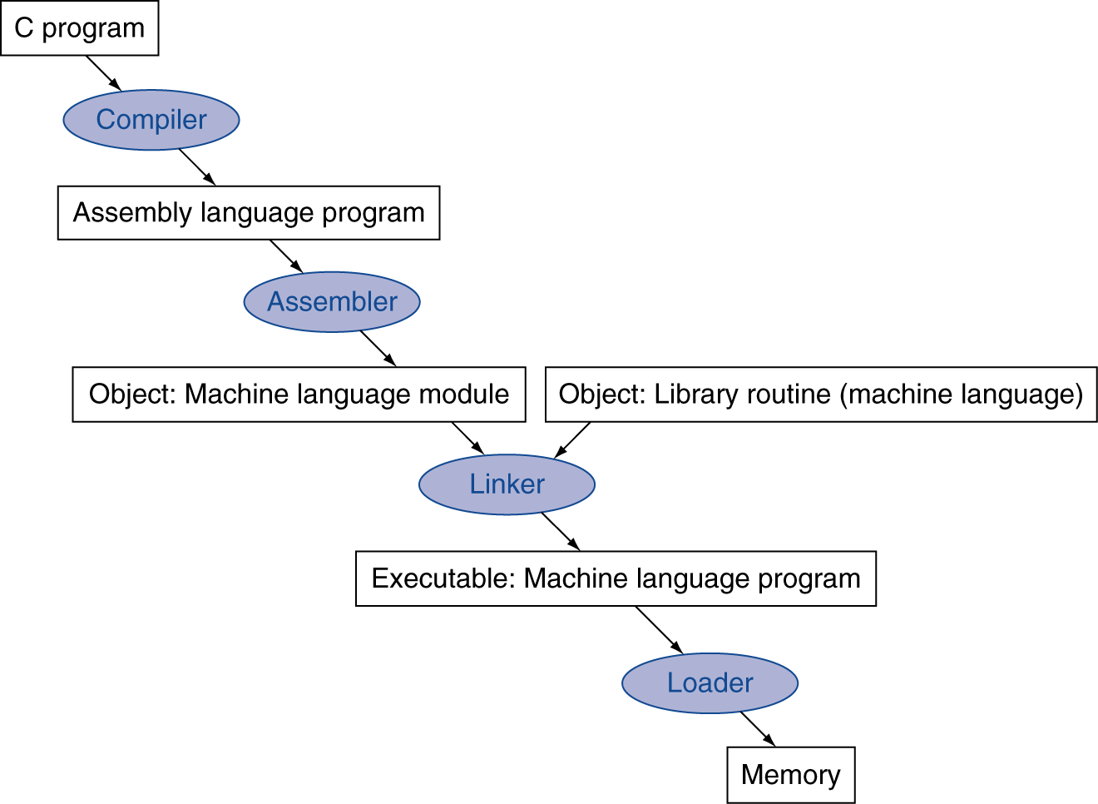
Translation and Startup
Many compilers produce object modules directly
§2.12 Translating and Starting a Program
Static linking
Notes:
When we have said compiler previously, really we mean this whole process, which often happens automatically for us.
This is an overview of the process, now let’s go into detail…

Slide 3
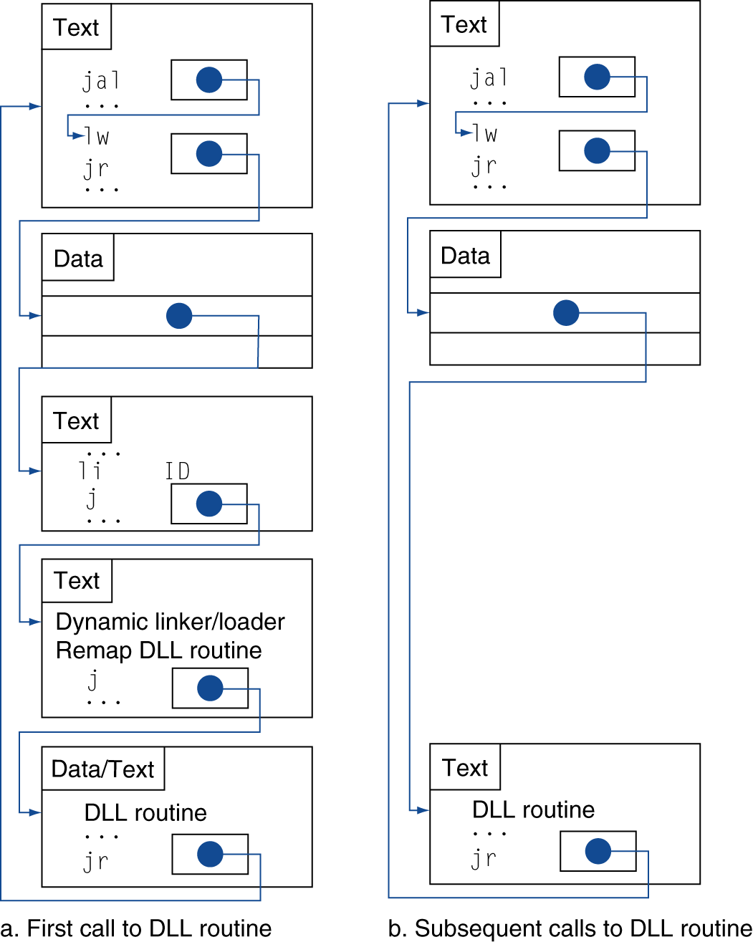
Lazy Linkage
Indirection table
Stub: Loads routine ID, Jump to linker/loader
Linker/loader code
Dynamically mapped code
Notes:
All problems in computer science can be solved by indirection.

Slide 4
Arrays vs. Pointers
Array indexing involves
Multiplying index by element size
Adding to array base address
Pointers correspond directly to memory addresses
Can avoid indexing complexity
§2.14 Arrays versus Pointers
Notes:
How would we “clear” an array?
clear1(int array[], int size) {
int i;
for (i = 0; i < size; i += 1)
array[i] = 0;
}
clear2(int *array, int size) {
int *p;
for (p = &array[0]; p < &array[size];
p = p + 1)
*p = 0;
}

Slide 5
Example: Clearing and Array
clear1(int array[], int size) { int i; for (i = 0; i < size; i += 1) array[i] = 0; } | clear2(int *array, int size) { int *p; for (p = &array[0]; p < &array[size]; p = p + 1) *p = 0; }
move $t0,$zero # i = 0 loop1: slt $t3,$t0,$a1 # $t3 = # (i < size) beq $t3,$zero,exit # if (…) # goto loop1 sll $t1,$t0,2 # $t1 = i * 4 add $t2,$a0,$t1 # $t2 = # &array[i] sw $zero, 0($t2) # array[i] = 0 addi $t0,$t0,1 # i = i + 1 | move $t0,$a0 # p = & array[0] sll $t1,$a1,2 # $t1 = size * 4 add $t2,$a0,$t1 # $t2 = # &array[size] loop2: slt $t3,$t0,$t2 # $t3 = #(p<&array[size]) beq $t3,$zero,exit # if (…) # goto loop2 sw $zero,0($t0) # Memory[p] = 0 addi $t0,$t0,4 # p = p + 4

Slide 6
Comparison of Array vs. Ptr
Multiply “strength reduced” to shift
Array version requires shift to be inside loop
Part of index calculation for incremented i
c.f. incrementing pointer
Compiler can achieve same effect as manual use of pointers
Induction variable elimination
Better to make program clearer and safer

Slide 7
ARM & MIPS Similarities
ARM: the most popular embedded core
Similar basic set of instructions to MIPS
§2.16 Real Stuff: ARM Instructions
 | ARM | MIPS
Date announced | 1985 | 1985
Instruction size | 32 bits | 32 bits
Address space | 32-bit flat | 32-bit flat
Data alignment | Aligned | Aligned
Data addressing modes | 9 | 3
Registers | 15 × 32-bit | 31 × 32-bit
Input/output | Memory mapped | Memory mapped

Slide 8
Compare and Branch in ARM
Uses condition codes for result of an arithmetic/logical instruction
Negative, zero, carry, overflow
Compare instructions to set condition codes without keeping the result
Each instruction can be conditional
Top 4 bits of instruction word: condition value
Can avoid branches over single instructions

Slide 9
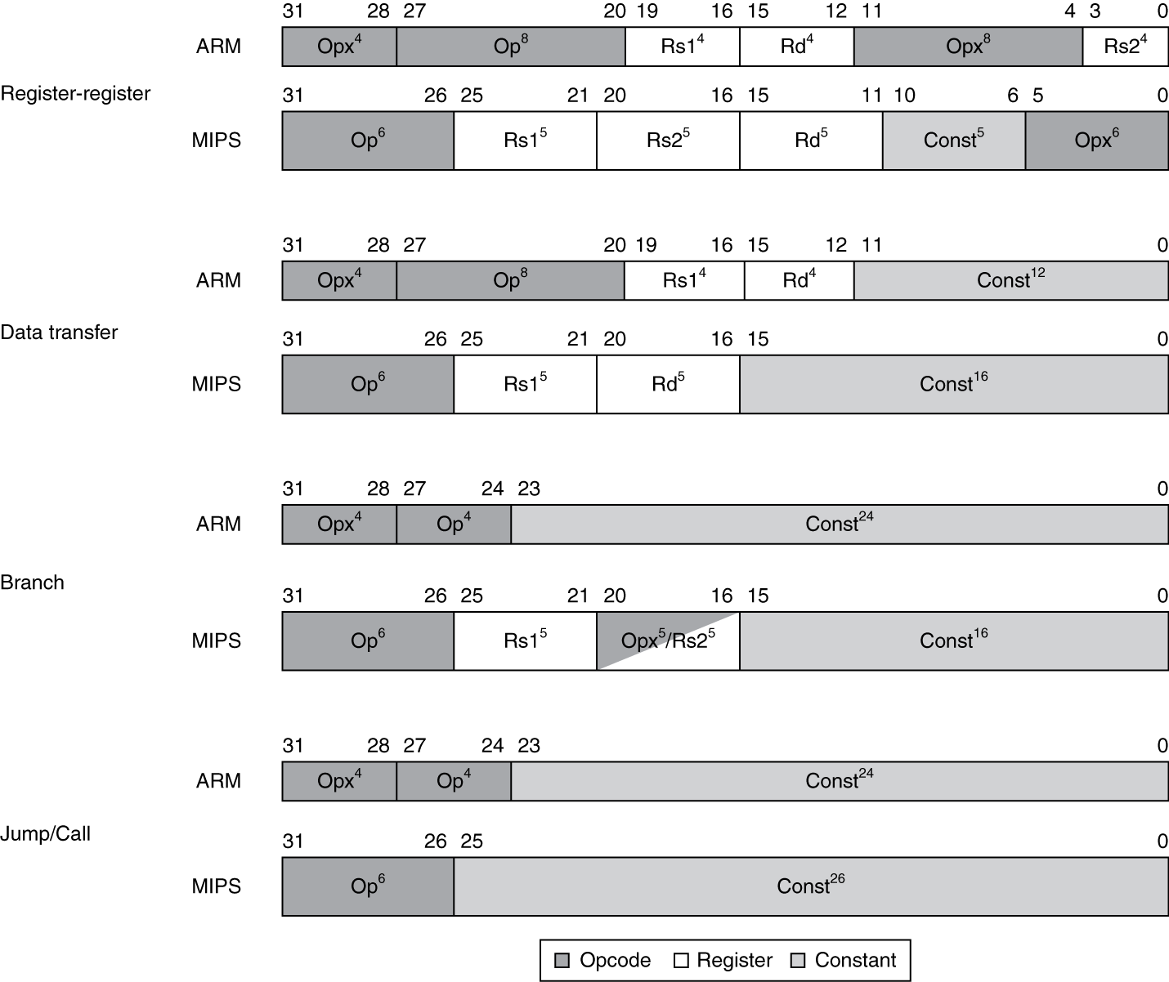
Instruction Encoding

Slide 10
The Intel x86 ISA
Evolution with backward compatibility
8080 (1974): 8-bit microprocessor
Accumulator, plus 3 index-register pairs
8086 (1978): 16-bit extension to 8080
Complex instruction set (CISC)
8087 (1980): floating-point coprocessor
Adds FP instructions and register stack
80286 (1982): 24-bit addresses, MMU
Segmented memory mapping and protection
80386 (1985): 32-bit extension (now IA-32)
Additional addressing modes and operations
Paged memory mapping as well as segments
§2.17 Real Stuff: x86 Instructions

Slide 11
The Intel x86 ISA
Further evolution…
i486 (1989): pipelined, on-chip caches and FPU
Compatible competitors: AMD, Cyrix, …
Pentium (1993): superscalar, 64-bit datapath
Later versions added MMX (Multi-Media eXtension) instructions
The infamous FDIV bug
Pentium Pro (1995), Pentium II (1997)
New microarchitecture (see Colwell, The Pentium Chronicles)
Pentium III (1999)
Added SSE (Streaming SIMD Extensions) and associated registers
Pentium 4 (2001)
New microarchitecture
Added SSE2 instructions

Slide 12
The Intel x86 ISA
And further…
AMD64 (2003): extended architecture to 64 bits
EM64T – Extended Memory 64 Technology (2004)
AMD64 adopted by Intel (with refinements)
Added SSE3 instructions
Intel Core (2006)
Added SSE4 instructions, virtual machine support
AMD64 (announced 2007): SSE5 instructions
Intel declined to follow, instead…
Advanced Vector Extension (announced 2008)
Longer SSE registers, more instructions
If Intel didn’t extend with compatibility, its competitors would!
Technical elegance ≠ market success

Slide 13
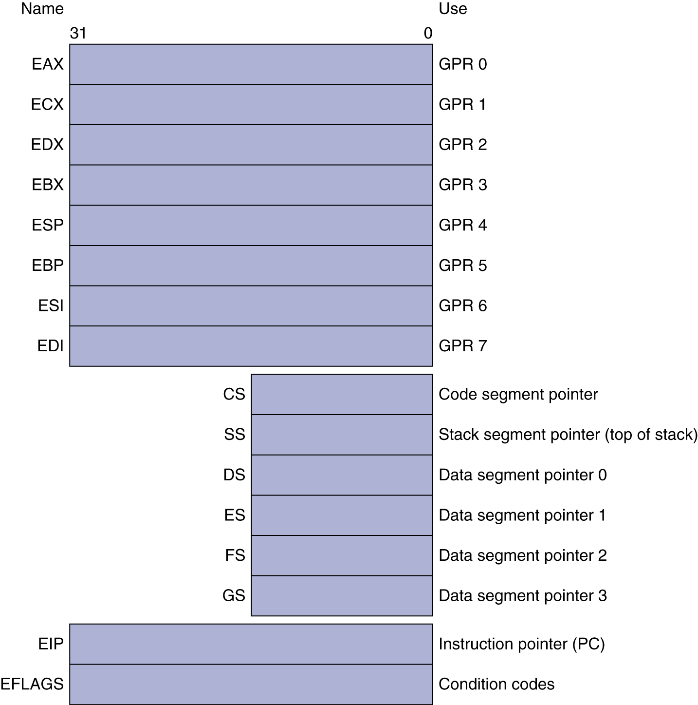
Basic x86 Registers

Slide 14
Basic x86 Addressing Modes
Two operands per instruction
Source/dest operand | Second source operand
Register | Register
Register | Immediate
Register | Memory
Memory | Register
Memory | Immediate
Memory addressing modes
Address in register
Address = R_{base} + displacement
Address = R_{base} + 2^{scale} × R_{index} (scale = 0, 1, 2, or 3)
Address = R_{base} + 2^{scale} × R_{index} + displacement

Slide 15
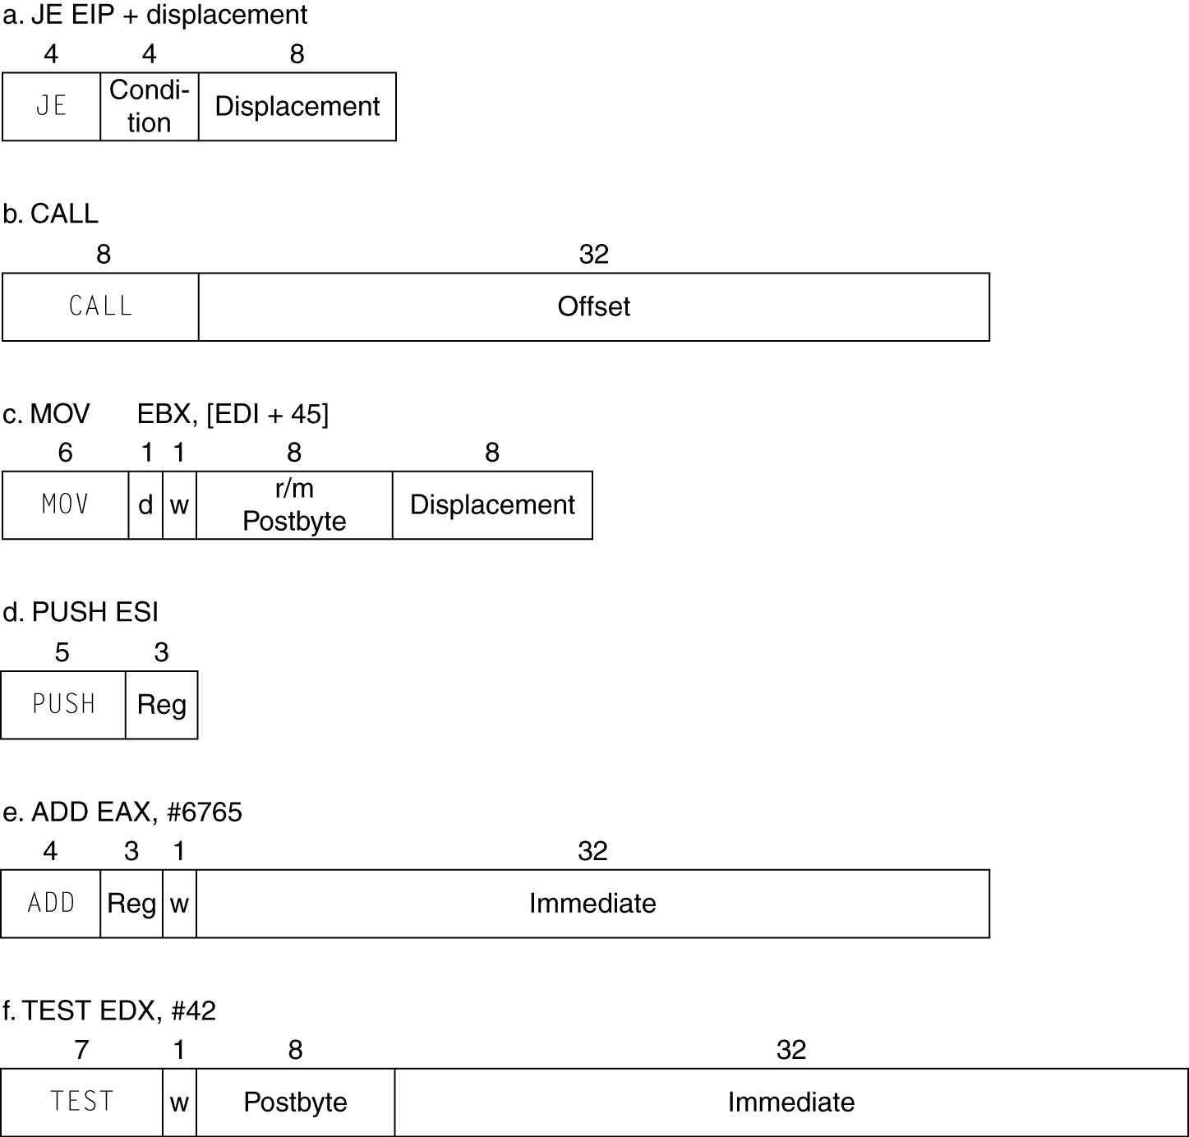
x86 Instruction Encoding
Variable length encoding
Postfix bytes specify addressing mode
Prefix bytes modify operation
Operand length, repetition, locking, …

Slide 16
Implementing IA-32
Complex instruction set makes implementation difficult
Hardware translates instructions to simpler microoperations
Simple instructions: 1–1
Complex instructions: 1–many
Microengine similar to RISC
Market share makes this economically viable
Comparable performance to RISC
Compilers avoid complex instructions

Slide 17
ARM v8 Instructions
In moving to 64-bit, ARM did a complete overhaul
ARM v8 resembles MIPS
Changes from v7:
No conditional execution field
Immediate field is 12-bit constant
Dropped load/store multiple
PC is no longer a GPR
GPR set expanded to 32
Addressing modes work for all word sizes
Divide instruction
Branch if equal/branch if not equal instructions
§2.18 Real Stuff: ARM v8 (64-bit) Instructions

Slide 18
Fallacies
Powerful instruction ⇒ higher performance
Fewer instructions required
But complex instructions are hard to implement
May slow down all instructions, including simple ones
Compilers are good at making fast code from simple instructions
Use assembly code for high performance
But modern compilers are better at dealing with modern processors
More lines of code ⇒ more errors and less productivity
§2.19 Fallacies and Pitfalls

Slide 19
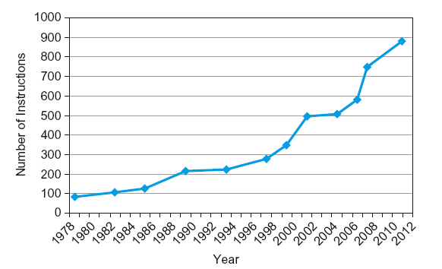
Fallacies
Backward compatibility ⇒ instruction set doesn’t change
But they do accrete more instructions
x86 instruction set

Slide 20
Pitfalls
Sequential words are not at sequential addresses
Increment by 4, not by 1!
Keeping a pointer to an automatic variable after procedure returns
e.g., passing pointer back via an argument
Pointer becomes invalid when stack popped

Slide 21
Concluding Remarks
Design principles
1. Simplicity favors regularity
2. Smaller is faster
3. Make the common case fast
4. Good design demands good compromises
Layers of software/hardware
Compiler, assembler, hardware
MIPS: typical of RISC ISAs
c.f. x86
§2.20 Concluding Remarks

Slide 22
Concluding Remarks
Measure MIPS instruction executions in benchmark programs
Consider making the common case fast
Consider compromises
Instruction class | MIPS examples | SPEC2006 Int | SPEC2006 FP
Arithmetic | add, sub, addi | 16% | 48%
Data transfer | lw, sw, lb, lbu, lh, lhu, sb, lui | 35% | 36%
Logical | and, or, nor, andi, ori, sll, srl | 12% | 4%
Cond. Branch | beq, bne, slt, slti, sltiu | 34% | 8%
Jump | j, jr, jal | 2% | 0%

