Slide 1
The Memory Hierarchy
Chapter 5
Notes:
On a write hit, one thing we could do it always write the result back to memory. What is this called (write-through)
What’s the alternative? (write-back, which only writes back to memory when a block is kicked out of memory)
It’s a waste to write back to memory if we haven’t changed the block since it came into cache. How do we handle this? (dirty bit)

Slide 2
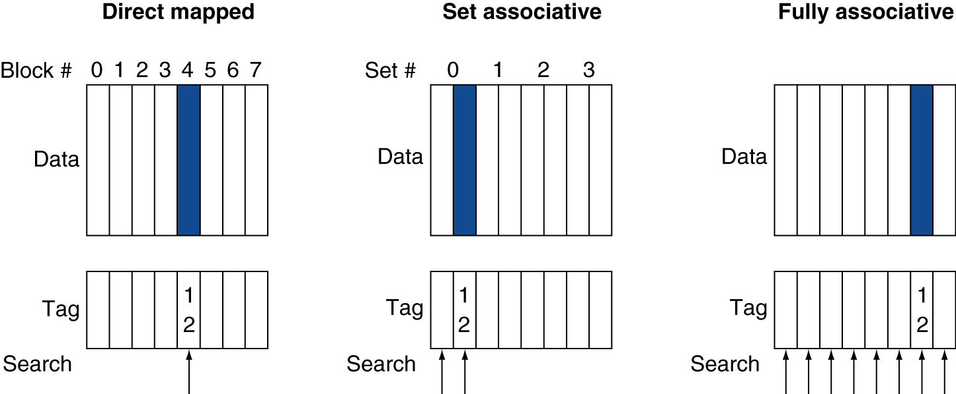
Associative Cache Example

Slide 3
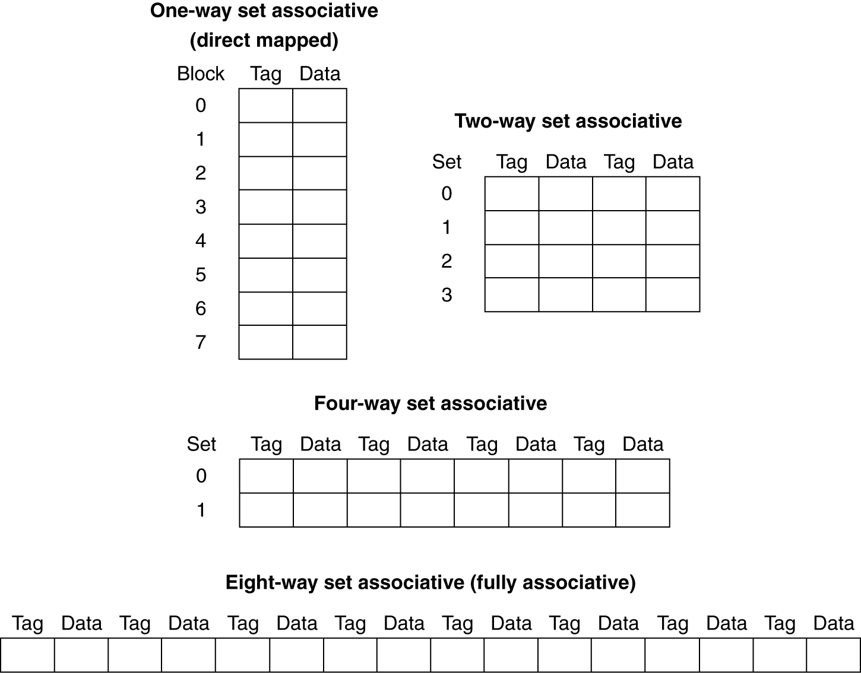
Spectrum of Associativity
For a cache with 8 entries

Slide 4
Associativity Example
2-way set associative
Block address | Cache index | Hit/miss | Cache content after access
 |  |  | Set 0 |  | Set 1
0 | 0 | miss | Mem[0]
8 | 0 | miss | Mem[0] | Mem[8]
0 | 0 | hit | Mem[0] | Mem[8]
6 | 0 | miss | Mem[0] | Mem[6]
8 | 0 | miss | Mem[8] | Mem[6]
Fully associative
Block address |  | Hit/miss | Cache content after access
0 |  | miss | Mem[0]
8 |  | miss | Mem[0] | Mem[8]
0 |  | hit | Mem[0] | Mem[8]
6 |  | miss | Mem[0] | Mem[8] | Mem[6]
8 |  | hit | Mem[0] | Mem[8] | Mem[6]

Slide 5
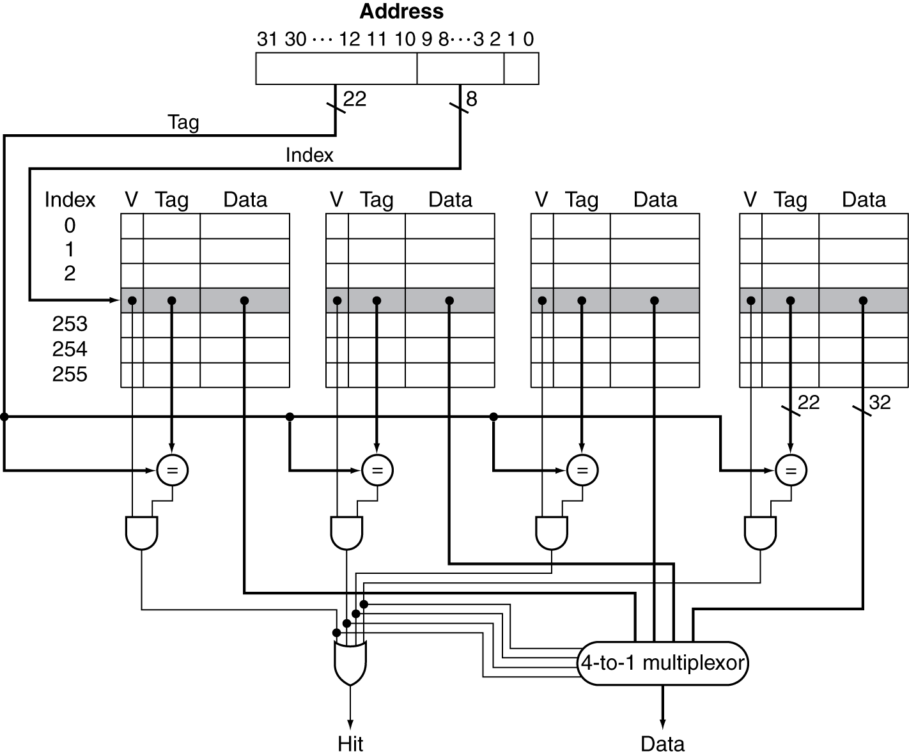
Set Associative Cache Organization
Notes:
But as soon as we allow multiple ways, we have a new choice to make.
When we need to kick something out of cache, which way do we choose?

Slide 6
Replacement Policy
Direct mapped: no choice
Set associative
Prefer non-valid entry, if there is one
Otherwise, choose among entries in the set
Least-recently used (LRU)
Choose the one unused for the longest time
Simple for 2-way, manageable for 4-way, too hard beyond that
Random
Gives approximately the same performance as LRU for high associativity

Slide 7
Multilevel Caches
Primary cache attached to CPU
Small, but fast
Level-2 cache services misses from primary cache
Larger, slower, but still faster than main memory
Main memory services L2 cache misses
Some high-end systems include L3 cache

Slide 8
Multilevel Cache Example
Given
CPU base CPI = 1, clock rate = 4GHz
Miss rate/instruction = 2%
Main memory access time = 100ns
With just primary cache, effective CPI?
Notes:
Calculate the effective CPI with just a primary cache…
Miss penalty = 100ns/0.25ns = 400 cycles
Effective CPI = 1 + 0.02 × 400 = 9

Slide 9
Multilevel Cache Example
Given
CPU base CPI = 1, clock rate = 4GHz
Miss rate/instruction = 2%
Main memory access time = 100ns
With just primary cache
Miss penalty = 100ns/0.25ns = 400 cycles
Effective CPI = 1 + 0.02 × 400 = 9

Slide 10
Example (cont.)
Now add L2 cache
Access time = 5ns
Global miss rate to main memory = 0.5%
Primary miss with L2 hit
Penalty = ???
Notes:
Penalty (in cycles?)
5ns/0.25ns = 20 cycles

Slide 11
Example (cont.)
Now add L2 cache
Access time = 5ns
Global miss rate to main memory = 0.5%
Primary miss with L2 hit
Penalty = 5ns/0.25ns = 20 cycles
Primary miss with L2 miss
Extra penalty = ???
Notes:
Extra penalty in cycles?
100ns/0.25ns = 400 cycles

Slide 12
Example (cont.)
Now add L2 cache
Access time = 5ns
Global miss rate to main memory = 0.5%
Primary miss with L2 hit
Penalty = 5ns/0.25ns = 20 cycles
Primary miss with L2 miss
Extra penalty = 100ns/0.25ns = 400 cycles
CPI = ???
Notes:
1 + 0.02 × 20 + 0.005 × 400 = 3.4

Slide 13
Example (cont.)
Now add L2 cache
Access time = 5ns
Global miss rate to main memory = 0.5%
Primary miss with L2 hit
Penalty = 5ns/0.25ns = 20 cycles
Primary miss with L2 miss
Extra penalty = 100ns/0.25ns = 400 cycles
CPI = 1 + 0.02 × 20 + 0.005 × 400 = 3.4
Performance ratio = 9/3.4 = 2.6
Notes:
Notice you could have calculated this a different way, too….

Slide 14
Multilevel Cache Considerations
Primary cache
Focus on minimal hit time
L2 cache
Focus on low miss rate to avoid main memory access
Hit time has less overall impact
Results
L1 cache usually smaller than a single cache
L1 block size smaller than L2 block size
Notes:
The l2 (or l3) is kind of like your last-ditch/resort effort

Slide 15
Interactions with Advanced CPUs
Out-of-order CPUs can execute instructions during cache miss
Pending store stays in load/store unit
Dependent instructions wait in reservation stations
Independent instructions continue
Effect of miss depends on program data flow
Much harder to analyse
Use system simulation

Slide 16
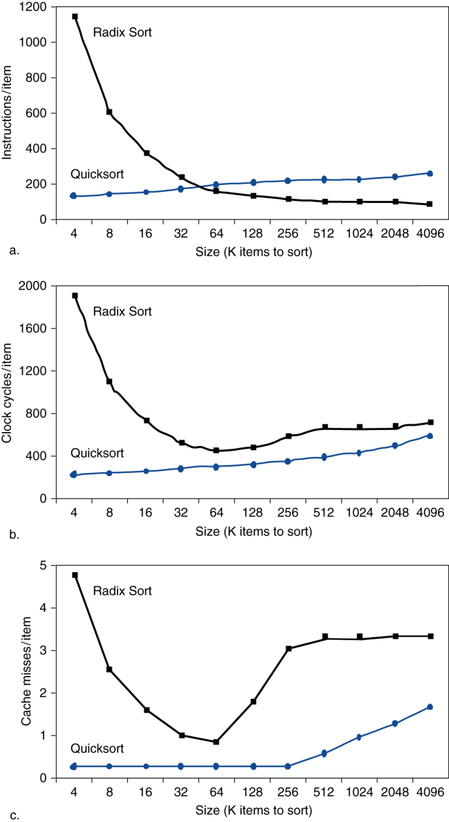
Interactions with Software
Misses depend on memory access patterns
Algorithm behavior
Compiler optimization for memory access
Hardware prefetch

Slide 17
Software Optimization via Blocking
Goal: maximize accesses to data before it is replaced
Consider inner loops of DGEMM:
for (int j = 0; j < n; ++j)
{
double cij = C[i+j*n];
for( int k = 0; k < n; k++ )
cij += A[i+k*n] * B[k+j*n];
C[i+j*n] = cij;
}

Slide 18
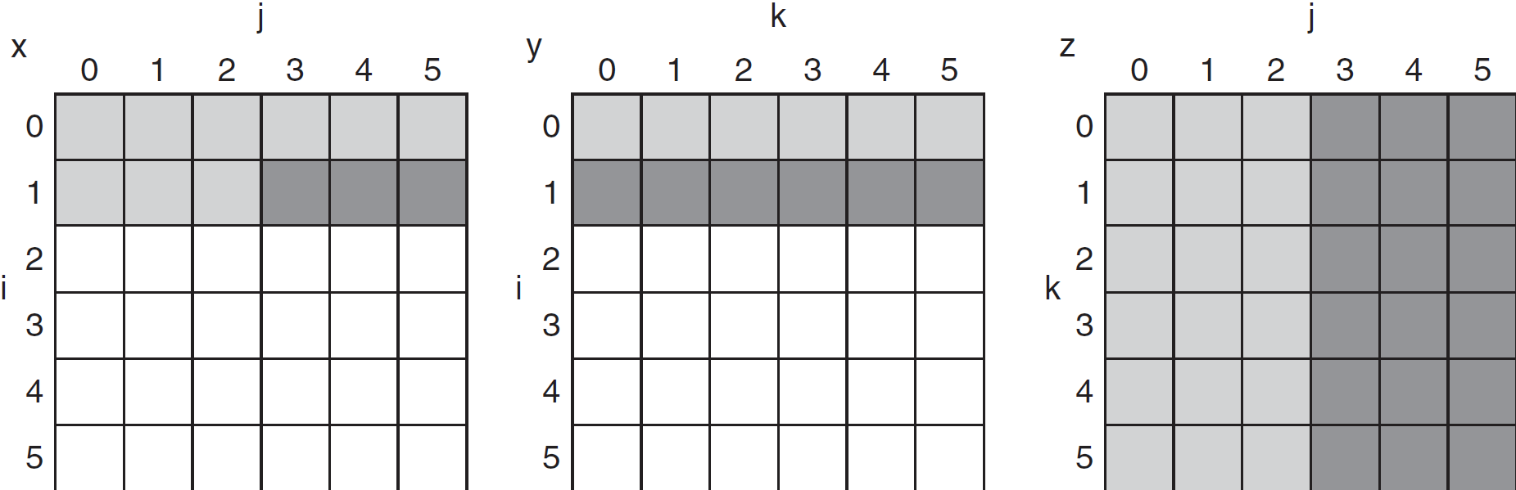
DGEMM Access Pattern
C, A, and B arrays
older accesses
new accesses

Slide 19
Cache Blocked DGEMM
1 #define BLOCKSIZE 32
2 void do_block (int n, int si, int sj, int sk, double *A, double
3 *B, double *C)
4 {
5 for (int i = si; i < si+BLOCKSIZE; ++i)
6 for (int j = sj; j < sj+BLOCKSIZE; ++j)
7 {
8 double cij = C[i+j*n];/* cij = C[i][j] */
9 for( int k = sk; k < sk+BLOCKSIZE; k++ )
10 cij += A[i+k*n] * B[k+j*n];/* cij+=A[i][k]*B[k][j] */
11 C[i+j*n] = cij;/* C[i][j] = cij */
12 }
13 }
14 void dgemm (int n, double* A, double* B, double* C)
15 {
16 for ( int sj = 0; sj < n; sj += BLOCKSIZE )
17 for ( int si = 0; si < n; si += BLOCKSIZE )
18 for ( int sk = 0; sk < n; sk += BLOCKSIZE )
19 do_block(n, si, sj, sk, A, B, C);
20 }

Slide 20
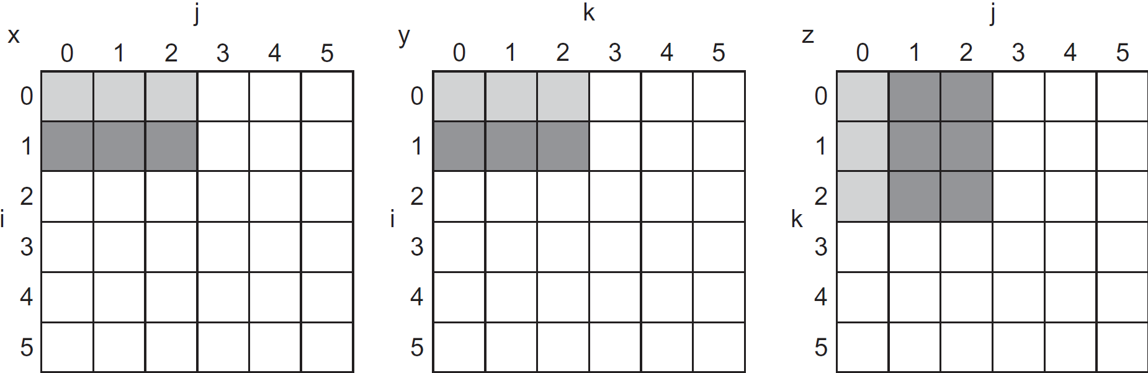
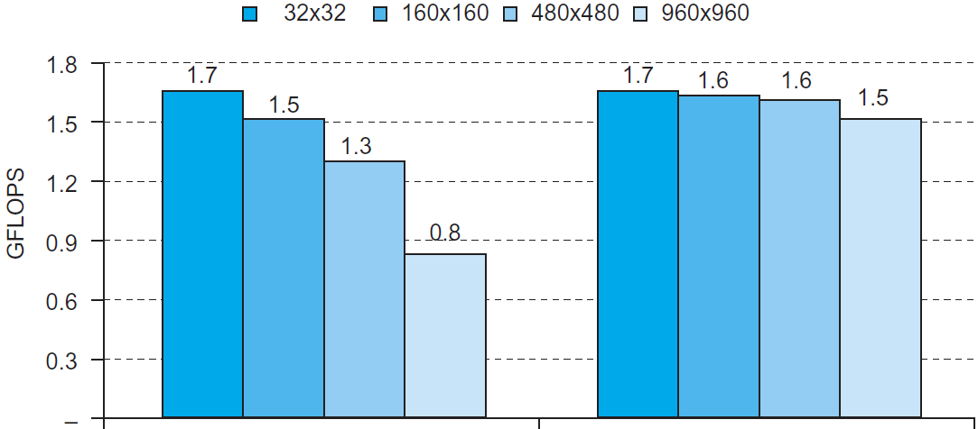
Blocked DGEMM Access Pattern
Unoptimized
Blocked

Slide 21
Dependability
Service accomplishment
Service delivered as specified
§5.5 Dependable Memory Hierarchy
Fault: failure of a component
May or may not lead to system failure
Restoration
Failure
Service interruption
Deviation from specified service

Slide 22
Dependability Measures
Reliability: mean time to failure (MTTF)
Service interruption: mean time to repair (MTTR)
Mean time between failures
MTBF = MTTF + MTTR
Availability = MTTF / (MTTF + MTTR)
Improving Availability
Increase MTTF: fault avoidance, fault tolerance, fault forecasting
Reduce MTTR: improved tools and processes for diagnosis and repair
Notes:
These terms are often thrown around vaguely, but we have actual definitions for them.

Slide 23
The Hamming SEC Code
Hamming distance
Number of bits that are different between two bit patterns
Minimum distance = 2 provides single bit error detection
E.g. parity code
Minimum distance = 3 provides single error correction, 2 bit error detection

Slide 24
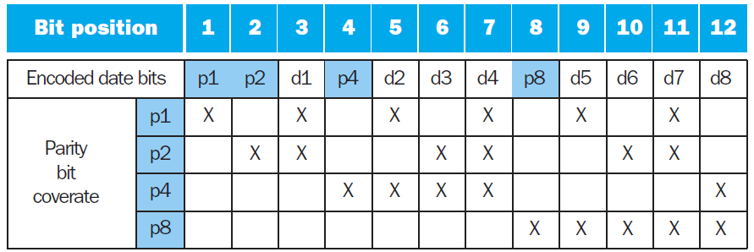
Encoding ECC
To calculate Hamming code:
Number bits from 1 on the left
All bit positions that are a power 2 are parity bits
Each parity bit checks certain data bits:

Slide 25
Decoding SEC
Value of parity bits indicates which bits are in error
Use numbering from encoding procedure
E.g.
Parity bits = 0000 indicates no error
Parity bits = 1010 indicates bit 10 was flipped

Slide 26
SEC/DEC Code
Add an additional parity bit for the whole word (p_{n})
Make Hamming distance = 4
Decoding:
Let H = SEC parity bits
H even, p_{n} even, no error
H odd, p_{n} odd, correctable single bit error
H even, p_{n} odd, error in p_{n} bit
H odd, p_{n} even, double error occurred
Note: ECC DRAM uses SEC/DEC with 8 bits protecting each 64 bits

