Slide 1
The Memory Hierarchy
Chapter 5

Slide 2
The Problem
Pick 1
Fast memory
Cheap (=> large) memory
Registers are fast, but we only have a few
SRAM larger, but slower
DRAM is dense but very slow
Disks are extremely dense but even slower

Slide 3
The Fix: Hierarchy of Memory
Registers
Cache (SRAM)
Main Memory (DRAM)
Disks (HDD and/or SDD)
Notes:
Relies on speculation to work correctly. We can’t always speculate correctly, but luckily we often can because of locality…

Slide 4
Principle of Locality
§5.1 Introduction
Programs access a small proportion of their address space at any time
Temporal locality
Items accessed recently are likely to be accessed again soon
e.g., instructions in a loop, induction variables
Spatial locality
Items near those accessed recently are likely to be accessed soon
E.g., sequential instruction access, array data

Slide 5
Taking Advantage of Locality
Memory hierarchy
Store everything on disk
Copy recently accessed (and nearby) items from disk to smaller DRAM memory
Main memory
Copy more recently accessed (and nearby) items from DRAM to smaller SRAM memory
Cache memory attached to CPU
Notes:
SRAM used to be on separate chips on the motherboard, but now they are built onto the same chip as the CPU

Slide 6
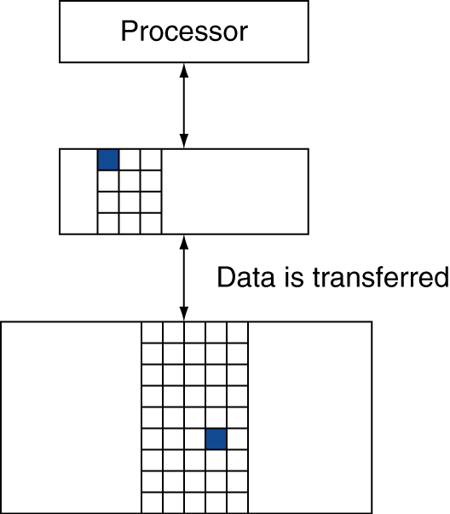
Memory Hierarchy Levels
Block (aka line): unit of copying
May be multiple words
If accessed data is present in upper level
Hit: access satisfied by upper level
Hit ratio: hits/accesses
If accessed data is absent
Miss: block copied from lower level
Time taken: miss penalty
Miss ratio: misses/accesses = 1 – hit ratio
Then accessed data supplied from upper level
Notes:
We will always be talking about inclusive memory hierarchy…

Slide 7
Memory Technology
Static RAM (SRAM)
0.5ns – 2.5ns, $500 – $1000 per GB
Dynamic RAM (DRAM)
50ns – 70ns, $10 – $20 per GB
Flash (USB stick, SSD)
5000-50000ns, $0.75-$1.00 per GB
Magnetic disk
5ms – 20ms, $0.05 – $0.10 per GB
Ideal memory
Access time of SRAM
Capacity and cost/GB of disk
§5.2 Memory Technologies
Notes:
These are 2012 prices

Slide 8
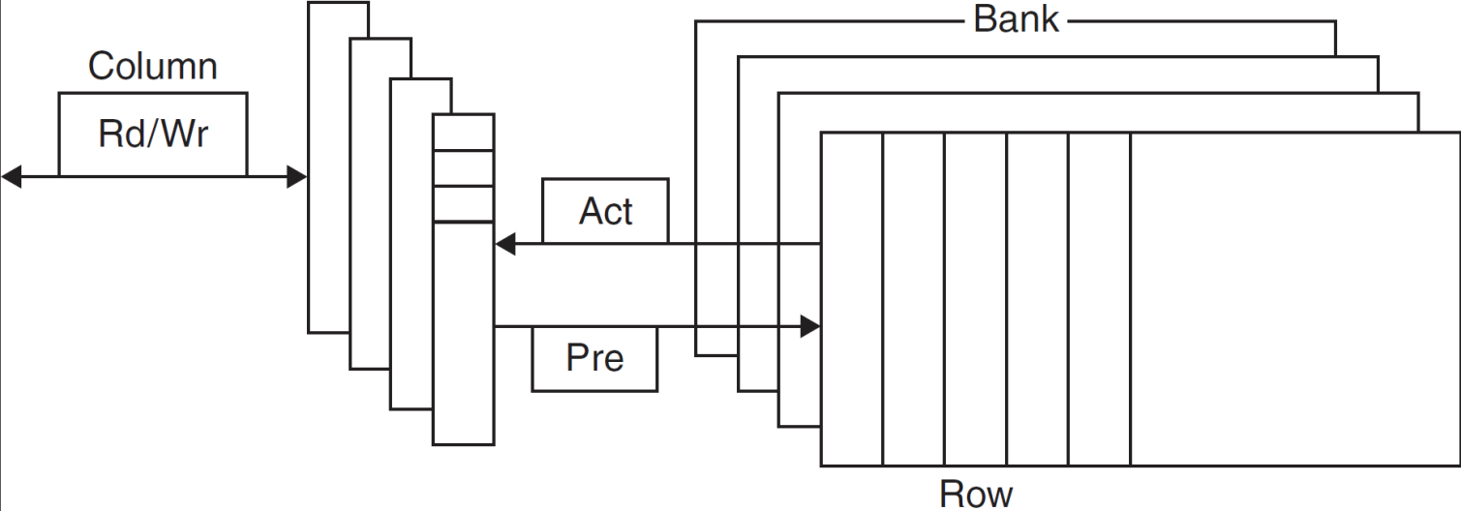
DRAM Technology
Data stored as a charge in a capacitor
Single transistor used to access the charge
Must periodically be refreshed
Read contents and write back
Performed on a DRAM “row”

Slide 9
Advanced DRAM Organization
Bits in a DRAM are organized as a rectangular array
DRAM accesses an entire row
Burst mode: supply successive words from a row with reduced latency
Double data rate (DDR) DRAM
Transfer on rising and falling clock edges
Quad data rate (QDR) DRAM
Separate DDR inputs and outputs

Slide 10
DRAM Generations
Year | Capacity | $/GB
1980 | 64Kbit | $1500000
1983 | 256Kbit | $500000
1985 | 1Mbit | $200000
1989 | 4Mbit | $50000
1992 | 16Mbit | $15000
1996 | 64Mbit | $10000
1998 | 128Mbit | $4000
2000 | 256Mbit | $1000
2004 | 512Mbit | $250
2007 | 1Gbit | $50

Slide 11
DRAM Performance Factors
Row buffer
Allows several words to be read and refreshed in parallel
Synchronous DRAM (SDRAM)
Allows for consecutive accesses in bursts without needing to send each address
Improves bandwidth
DRAM banking
Allows simultaneous access to multiple DRAMs
Improves bandwidth

Slide 12
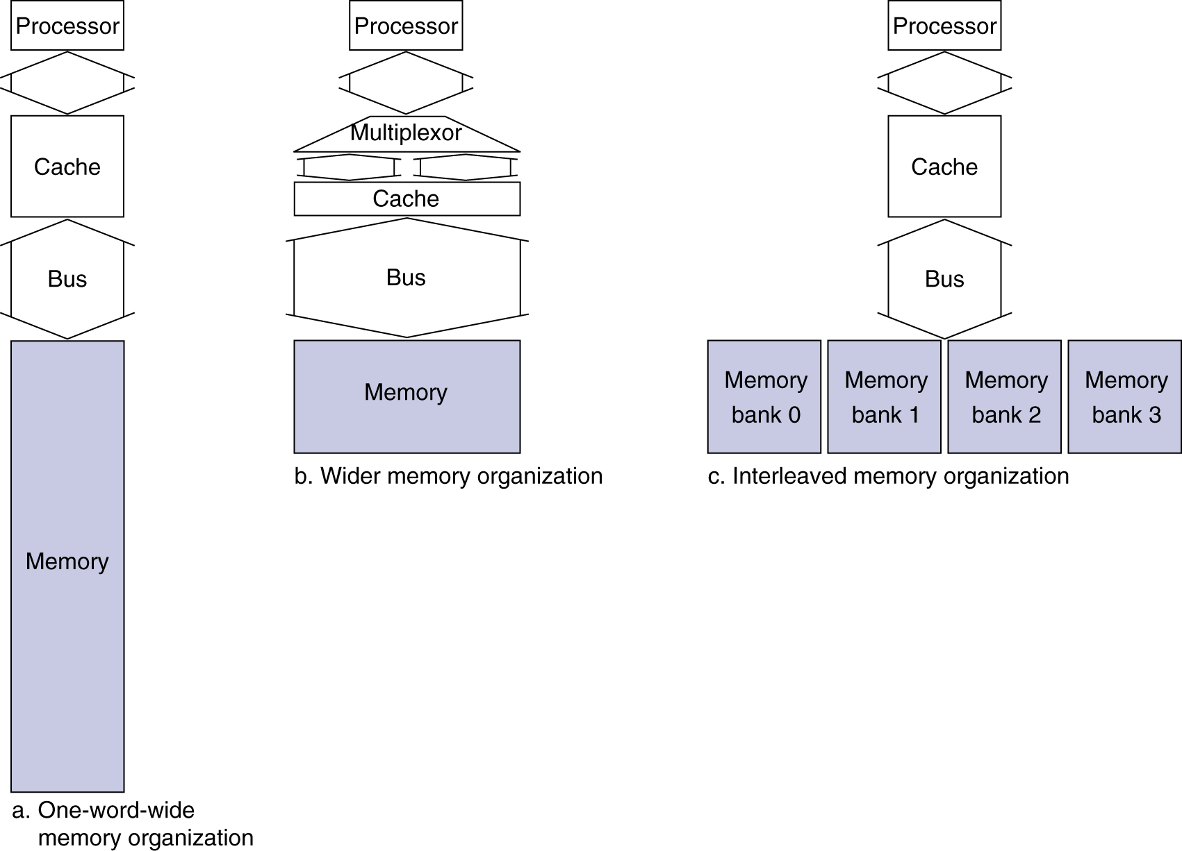
Increasing Memory Bandwidth
4-word wide memory
Miss penalty = 1 + 15 + 1 = 17 bus cycles
Bandwidth = 16 bytes / 17 cycles = 0.94 B/cycle
4-bank interleaved memory
Miss penalty = 1 + 15 + 4×1 = 20 bus cycles
Bandwidth = 16 bytes / 20 cycles = 0.8 B/cycle
Notes:
1 cycle to notice the miss, 15 cycles to transfer the words, 1 more to get from cache

Slide 13
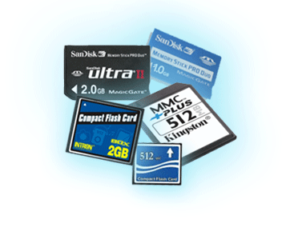
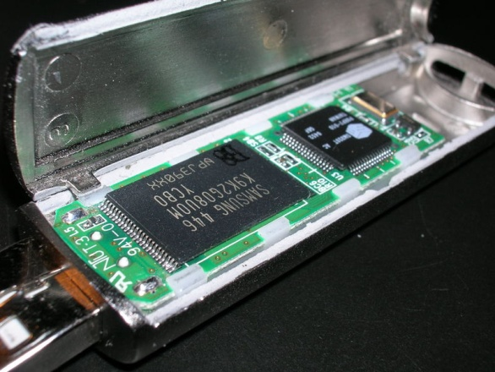
Flash Storage
§6.4 Flash Storage
Nonvolatile semiconductor storage
100× – 1000× faster than disk
Smaller, lower power, more robust
But more $/GB (between disk and DRAM)
Notes:
Big area of change/research currently! Lots of new technologies!
Some may already have an SSD on their laptops…

Slide 14
Flash Types
NOR flash: bit cell like a NOR gate
Random read/write access
Used for instruction memory in embedded systems
NAND flash: bit cell like a NAND gate
Denser (bits/area), but block-at-a-time access
Cheaper per GB
Used for USB keys, media storage, …
Flash bits wears out after 1000’s of accesses
Not suitable for direct RAM or disk replacement
Wear leveling: remap data to less used blocks
Notes:
Flash is typically EEPROM, which we briefly talked about in Appendix B.
I don’t actually know that much about the specifics of the types of memory; it quickly gets into electrical engineering territory.

Slide 15
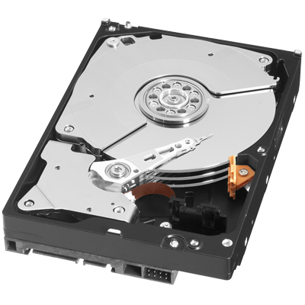
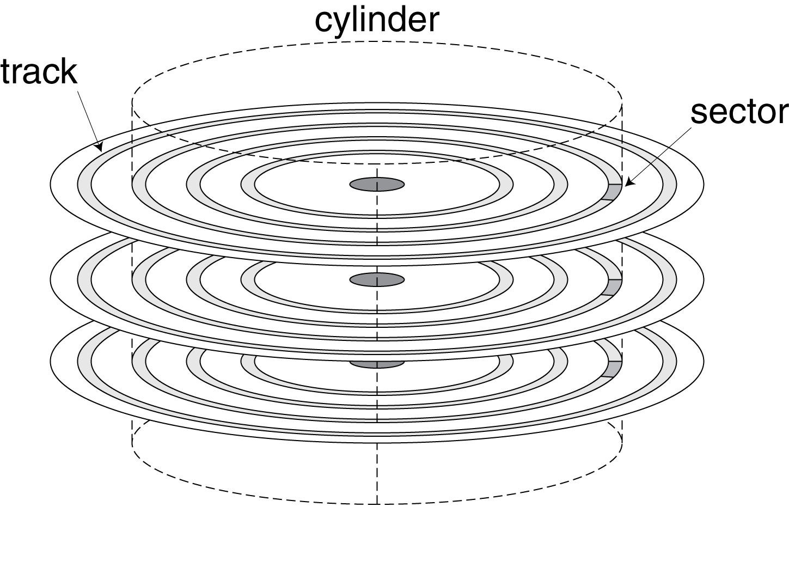
Disk Storage
§6.3 Disk Storage
Nonvolatile, rotating magnetic storage

Slide 16
Disk Sectors and Access
Each sector records
Sector ID
Data (512 bytes, 4096 bytes proposed)
Error correcting code (ECC)
Used to hide defects and recording errors
Synchronization fields and gaps
Access to a sector involves
Queuing delay if other accesses are pending
Seek: move the heads
Rotational latency
Data transfer
Controller overhead

Slide 17
Disk Access Example
Given
512B sector, 15,000rpm, 4ms average seek time, 100MB/s transfer rate, 0.2ms controller overhead, idle disk
Average read time
4ms seek time + ½ / (15,000/60) = 2ms rotational latency + 512 / 100MB/s = 0.005ms transfer time + 0.2ms controller delay = 6.2ms
If actual average seek time is 1ms
Average read time = 3.2ms
Notes:
This *seems* fast, but is super slow compared to other memory…

Slide 18
Disk Performance Issues
Manufacturers quote average seek time
Based on all possible seeks
Locality and OS scheduling lead to smaller actual average seek times
Smart disk controller allocate physical sectors on disk
Present logical sector interface to host
SCSI, ATA, SATA
Disk drives include caches
Prefetch sectors in anticipation of access
Avoid seek and rotational delay
Notes:
There are lots of other memory technologies. Magnetic tape, for example, is EXTREMELY slow but very dense.
Lots of companies used to use tape for backups, and a few still do. I bet there’s warehouses worth of old tape backups sittings somewhere.

Slide 19
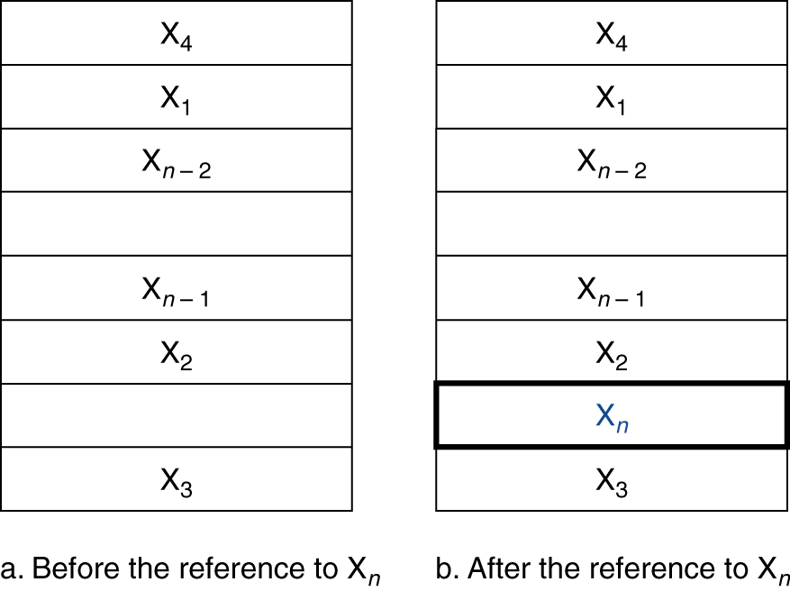
Cache Memory
Cache memory
The level of the memory hierarchy closest to the CPU
Given accesses X₁, …, X_{n–1}, X_{n}
§5.3 The Basics of Caches
How do we know if the data is present?
Where do we look?
Notes:
The cache is smaller than the rest of memory, so we can only store some things in here.
Brainstorm some ideas on how to do this?

Slide 20
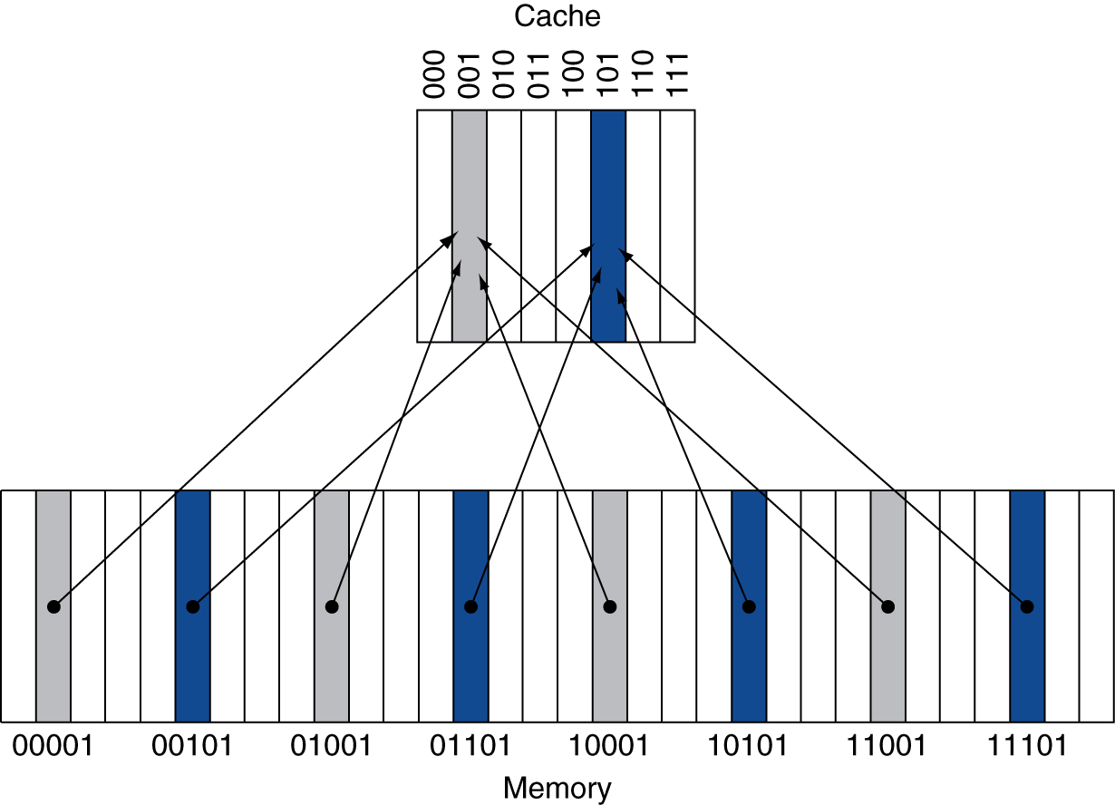
Direct Mapped Cache
Location determined by address
Direct mapped: only one choice
(Block address) modulo (#Blocks in cache)
#Blocks is a power of 2
Use low-order address bits
Notes:
BTW, what’s the problem with this approach?
We may have two slots and also use two memory locations. Theoretically they should both fit in cache, but if they both map to the same slot they don’t!

Slide 21
Tags and Valid Bits
How do we know which particular block is stored in a cache location?
Store block address as well as the data
Actually, only need the high-order bits
Called the tag
What if there is no data in a location?
Valid bit: 1 = present, 0 = not present
Initially 0

Slide 22
Cache Example
8-blocks, 1 word/block, direct mapped
Initial state
Index | V | Tag | Data
000 | N
001 | N
010 | N
011 | N
100 | N
101 | N
110 | N
111 | N
Notes:
Accesses:
22, 10 110
26, 11 010
22, 10 110
26, 11 010
16, 10 000
3, 00 011
16, 10 000
18, 10 010
16, 10 000

