Slide 1
The Memory Hierarchy
Chapter 5

Slide 2
for(int i = 0; i<10,000,000;i++)
sum+=A[i];
Assume each element of A is 4 bytes and sum is kept in a register. Assume a baseline direct-mapped 32KB L1 cache with 32 byte blocks. Which changes would help the hit rate of the above code?
Selection | Change
A | Increase to 2-way set associativity
B | Increase block size to 64 bytes
C | Increase cache size to 64 KB
D | A and C combined
E | A, B, and C combined
Notes:
Correct Answer – B
Primary Purpose: Having students understand the impact of block size, cache size, and associativity
Concept: Aid students in understanding the interaction of caches and real code.
Expected mistakes: Not realizing set-associativity (A) and cache size (C) are irrelevant for streaming behavior
Post Discussion: Discuss how each improvement would change the cache behavior

Slide 3
Sources of Misses
Compulsory misses (aka cold start misses)
First access to a block
Capacity misses
Due to finite cache size
A replaced block is later accessed again
Conflict misses (aka collision misses)
In a non-fully associative cache
Due to competition for entries in a set
Would not occur in a fully associative cache of the same total size

Slide 4
Cache Design Trade-offs
Design change | Effect on miss rate | Negative performance effect
Increase cache size | Decrease capacity misses | May increase access time
Increase associativity | Decrease conflict misses | May increase access time
Increase block size | Decrease compulsory misses | Increases miss penalty. For very large block size, may increase miss rate due to pollution.

Slide 5
Miss Types
Suppose you experience a cache miss on a block (let's call it block A). You have accessed block A in the past. There have been precisely 1027 different blocks accessed between your last access to block A and your current miss. Your block size is 32-bytes and you have a 64KB cache. What kind of miss was this?
Selection | Cache Miss
A | Compulsory
B | Capacity
C | Conflict
D | Both Capacity and Conflict
E | None of the above
Notes:
C
Explain the way to know if it
Is a capacity vs. conflict – would
a fully associative cache of the
Same size get a miss

Slide 6
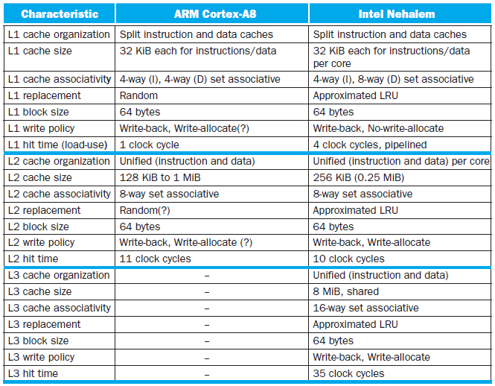
Multilevel On-Chip Caches
§5.13 The ARM Cortex-A8 and Intel Core i7 Memory Hierarchies

Slide 7
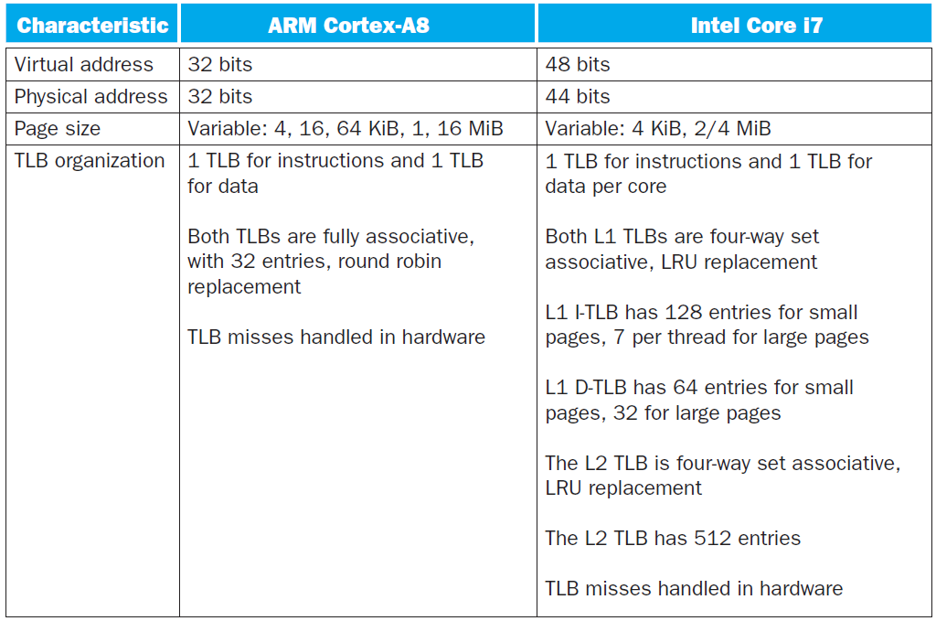
2-Level TLB Organization

Slide 8
Caches in Current Processors
A few years ago, DM at highest level (closest to CPU), associative further away.
Now: less associative near the processor (4-8), more farther away (8-16).
split I and D close to the processor (for throughput rather than miss rate), unified further away.
write-through and write-back both common, but never write-through all the way to memory.
64-byte cache lines common (but getting larger)

Slide 9
Supporting Multiple Issue
Both have multi-banked caches that allow multiple accesses per cycle assuming no bank conflicts
Core i7 cache optimizations
Return requested word first
Non-blocking cache
Hit under miss
Miss under miss
Data prefetching
Notes:
Non-blocking
processor doesn’t stall on a miss, but only on the use of a miss (if even then)
this means the cache must be able to keep track of multiple outstanding accesses.

Slide 10
Prefetching
“Watch the trends in movie watching and attempt to guess movies that will be rented soon – put those in the front office.”
Hardware Prefetching
suppose you are walking through a single element in an array of large objects
hardware determines the “stride” and starts grabbing values early
Software Prefetching
Load instruction a fair number of instructions before it is needed

Slide 11
Writing Cache-Aware Code
Focus on your working set
If your “working set” fits in L1 it will be vastly better than a “working set” that fits only on disk.
If you have a large data set – do processing on it in chunks.
Think about regularity in data structures (can a prefetcher guess where you are going – or are you pointer chasing)
Instrumentation tools (PIN, Atom, PEBIL) can often help you analyze your working set
Profiling can give you idea of which section of code is dominant which can tell you where to focus

Slide 12
Pitfalls
Byte vs. word addressing
Example: 32-byte direct-mapped cache, 4-byte blocks
Byte 36 maps to block 1
Word 36 maps to block 4
Ignoring memory system effects when writing or generating code
Example: iterating over rows vs. columns of arrays
Large strides result in poor locality
§5.15 Fallacies and Pitfalls

Slide 13
Pitfalls
In multiprocessor with shared L2 or L3 cache
Less associativity than cores results in conflict misses
More cores ⇒ need to increase associativity
Using AMAT to evaluate performance of out-of-order processors
Ignores effect of non-blocked accesses
Instead, evaluate performance by simulation
Notes:
With shared cache, need more associativity b/c more cores = more conflict

Slide 14
Pitfalls
Extending address range using segments
E.g., Intel 80286
But a segment is not always big enough
Makes address arithmetic complicated
Implementing a VMM on an ISA not designed for virtualization
E.g., non-privileged instructions accessing hardware resources
Either extend ISA, or require guest OS not to use problematic instructions
Notes:
Someone summarize this chapter for me.

Slide 15
Concluding Remarks
Fast memories are small, large memories are slow
We really want fast, large memories ☹
Caching gives this illusion ☺
Principle of locality
Programs use a small part of their memory space frequently
Memory hierarchy
L1 cache ↔ L2 cache ↔ … ↔ DRAM memory ↔ disk
Memory system design is critical for multiprocessors
§5.16 Concluding Remarks

Slide 16
Parallelism
Chapter 6
Notes:
Why Parallelism?
Heat (power) & energy
Difference between power and energy?

Slide 17
Introduction
§6.1 Introduction
Goal: connecting multiple computers to get higher performance
Multiprocessors
Scalability, availability, power efficiency
Task-level (process-level) parallelism
High throughput for independent jobs
Parallel processing program
Single program run on multiple processors
Multicore microprocessors
Chips with multiple processors (cores)

Slide 18
Hardware and Software
Hardware
Serial: e.g., Pentium 4
Parallel: e.g., quad-core Xeon e5345
Software
Sequential: e.g., matrix multiplication
Concurrent: e.g., operating system
Sequential/concurrent software can run on serial/parallel hardware
Challenge: making effective use of parallel hardware
Notes:
Book’s terminology is bad. Can’t just automatically parallelize sequential matrix multiplication. It’s a research area but can only do some parallelization.
It’s better to separate software that is explicitly written to utilize multiple cores and that which isn’t.

Slide 19
Parallelism in the Book
§2.11: Parallelism and Instructions
Synchronization
§3.6: Parallelism and Computer Arithmetic
Subword Parallelism
§4.10: Parallelism and Advanced Instruction-Level Parallelism
§5.10: Parallelism and Memory Hierarchies
Cache Coherence

Slide 20
Parallel Programming
Parallel software is the problem
Need to get significant performance improvement
Otherwise, just use a faster uniprocessor, since it’s easier!
Difficulties
Partitioning
Coordination
Communications overhead
§6.2 The Difficulty of Creating Parallel Processing Programs
Notes:
Reporting analogy – equal sized pieces, communication overhead, balancing the load, time to synchronize
The more processors (reporters), the harder this coordination becomes…

Slide 21
Amdahl’s Law
Notes:
Who remembers Amdahl’s law? If not the details, then what is means at a high level…
100 processors, 90× speedup?
How much of the problem must be (perfectly) parallelizable?

Slide 22
Amdahl’s Law
Sequential part can limit speedup
Example: 100 processors, 90× speedup?
T_{new} = T_{parallelizable}/100 + T_{sequential}
Solving: F_{parallelizable} = 0.999
Need sequential part to be 0.1% of original time
Notes:
Speedup = T_old / T_new = T_old / (T_par/100 + T_seq)
= 1/( (T_par/100/T_old) + (T_seq/T_old) = 1 / ((F_par/100) + F_seq)
Note that parts of a problem may be parallelizable but not perfectly…

