Slide 1
Parallelism
Chapter 6
Notes:
Why Parallelism?
Heat (power) & energy
Difference between power and energy?

Slide 2
Parallel Programming
Parallel software is the problem
Need to get significant performance improvement
Otherwise, just use a faster uniprocessor, since it’s easier!
Difficulties
Partitioning
Coordination
Communications overhead
§6.2 The Difficulty of Creating Parallel Processing Programs
Notes:
Reporting analogy – equal sized pieces, communication overhead, balancing the load, time to synchronize
The more processors (reporters), the harder this coordination becomes…

Slide 3
Amdahl’s Law
Sequential part can limit speedup
Example: 100 processors, 90× speedup?
T_{new} = T_{parallelizable}/100 + T_{sequential}
Solving: F_{parallelizable} = 0.999
Need sequential part to be 0.1% of original time
Notes:
Speedup = T_old / T_new = T_old / (T_par/100 + T_seq)
= 1/( (T_par/100/T_old) + (T_seq/T_old) = 1 / ((F_par/100) + F_seq)
Note that parts of a problem may be parallelizable but not perfectly…

Slide 4
Scaling Example
Workload: sum of 10 scalars, and 10 × 10 matrix sum
Speed up from 10 to 100 processors
Single processor: Time = (10 + 100) × t_{add}
10 processors
Time = 10 × t_{add} + 100/10 × t_{add} = 20 × t_{add}
Speedup = 110/20 = 5.5 (55% of potential)
100 processors
Time = 10 × t_{add} + 100/100 × t_{add} = 11 × t_{add}
Speedup = 110/11 = 10 (10% of potential)
Assumes load can be balanced across processors
Notes:
Now I want you do repeat these calculations with a 100x100 matrix.

Slide 5
Scaling Example (cont)
What if matrix size is 100 × 100?
Single processor: Time = (10 + 10000) × t_{add}
10 processors
Time = 10 × t_{add} + 10000/10 × t_{add} = 1010 × t_{add}
Speedup = 10010/1010 = 9.9 (99% of potential)
100 processors
Time = 10 × t_{add} + 10000/100 × t_{add} = 110 × t_{add}
Speedup = 10010/110 = 91 (91% of potential)
Assuming load balanced

Slide 6
Strong vs Weak Scaling
Strong scaling: problem size fixed
As in example
Weak scaling: problem size proportional to number of processors
10 processors, 10 × 10 matrix
Time = 20 × t_{add}
100 processors, 32 × 32 matrix
Time = 10 × t_{add} + 1000/100 × t_{add} = 20 × t_{add}
Constant performance in this example
Notes:
Exception: memory hierarchy!

Slide 7
Instruction and Data Streams
An alternate classification
 |  | Data Streams
 |  | Single | Multiple
Instruction Streams | Single | SISD: Intel Pentium 4 | SIMD: SSE instructions of x86
 | Multiple | MISD: No examples today | MIMD: Intel Xeon e5345
§6.3 SISD, MIMD, SIMD, SPMD, and Vector
SPMD: Single Program Multiple Data
A parallel program on a MIMD computer
Conditional code for different processors

Slide 8
Example: DAXPY (Y = a × X + Y)
Conventional MIPS code
l.d $f0,a($sp) ;load scalar a addiu r4,$s0,#512 ;upper bound of what to load loop: l.d $f2,0($s0) ;load x(i) mul.d $f2,$f2,$f0 ;a × x(i) l.d $f4,0($s1) ;load y(i) add.d $f4,$f4,$f2 ;a × x(i) + y(i) s.d $f4,0($s1) ;store into y(i) addiu $s0,$s0,#8 ;increment index to x addiu $s1,$s1,#8 ;increment index to y subu $t0,r4,$s0 ;compute bound bne $t0,$zero,loop ;check if done
Vector MIPS code
l.d $f0,a($sp) ;load scalar a lv $v1,0($s0) ;load vector x mulvs.d $v2,$v1,$f0 ;vector-scalar multiply lv $v3,0($s1) ;load vector y addv.d $v4,$v2,$v3 ;add y to product sv $v4,0($s1) ;store the result
Notes:
Note dependencies in conventional mode.
Code size is a bit misleading: if you needed to DAXPY more elements than fit in a vector, still need the loop operations…

Slide 9
Vector Processors
Highly pipelined function units
Stream data from/to vector registers to units
Data collected from memory into registers
Results stored from registers to memory
Example: Vector extension to MIPS
32 × 64-element registers (64-bit elements)
Vector instructions
lv, sv: load/store vector
addv.d: add vectors of double
addvs.d: add scalar to each element of vector of double
Significantly reduces instruction-fetch bandwidth
Notes:
Instead of fixed width SIMD

Slide 10
Vector vs. Scalar
Vector architectures and compilers
Simplify data-parallel programming
Explicit statement of absence of loop-carried dependences
Reduced checking in hardware
Regular access patterns benefit from interleaved and burst memory
Avoid control hazards by avoiding loops
More general than ad-hoc media extensions (such as MMX, SSE)
Better match with compiler technology

Slide 11
SIMD
Operate elementwise on vectors of data
E.g., MMX and SSE instructions in x86
Multiple data elements in 128-bit wide registers
All processors execute the same instruction at the same time
Each with different data address, etc.
Simplifies synchronization
Reduced instruction control hardware
Works best for highly data-parallel applications
Notes:
SIMD in general just means single instruction, multiple data, but most people use it when talking about media extensions: SSE, AVX, etc.

Slide 12
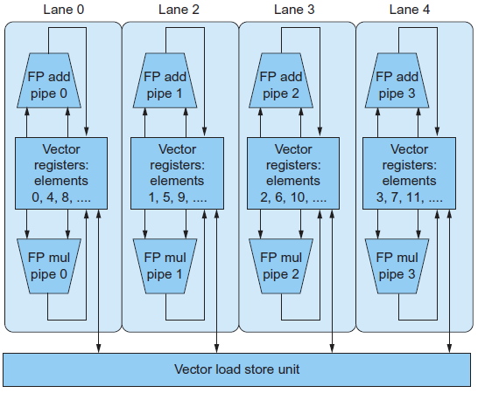
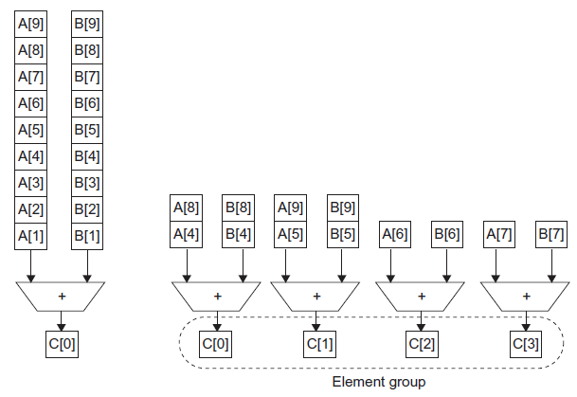
Vector vs. Multimedia Extensions
Vector instructions have a variable vector width, multimedia extensions have a fixed width
Vector instructions support strided access, multimedia extensions do not
Vector units can be combination of pipelined and arrayed functional units:
Notes:
Didn’t show, but you can specify how much of a vector register you want to use for an operation.
More specifically, # of operations for vector is not in the opcode (like AVX,SSE) but in a register.
Though I’m pretty sure later Intel media extensions do support strided access and gather/scatter… (maybe manual only?)

Slide 13
Multithreading
Performing multiple threads of execution in parallel
Replicate registers, PC, etc.
Fast switching between threads
Fine-grain multithreading
Switch threads after each cycle
Interleave instruction execution
If one thread stalls, others are executed
Coarse-grain multithreading
Only switch on long stall (e.g., L2-cache miss)
Simplifies hardware, but doesn’t hide short stalls (eg, data hazards)
§6.4 Hardware Multithreading

Slide 14
Simultaneous Multithreading
In multiple-issue dynamically scheduled processor
Schedule instructions from multiple threads
Instructions from independent threads execute when function units are available
Within threads, dependencies handled by scheduling and register renaming
Example: Intel Pentium-4 HT
Two threads: duplicated registers, shared function units and caches
Notes:
Think about a dual-issue chip, and how we talked about low utilization

Slide 15
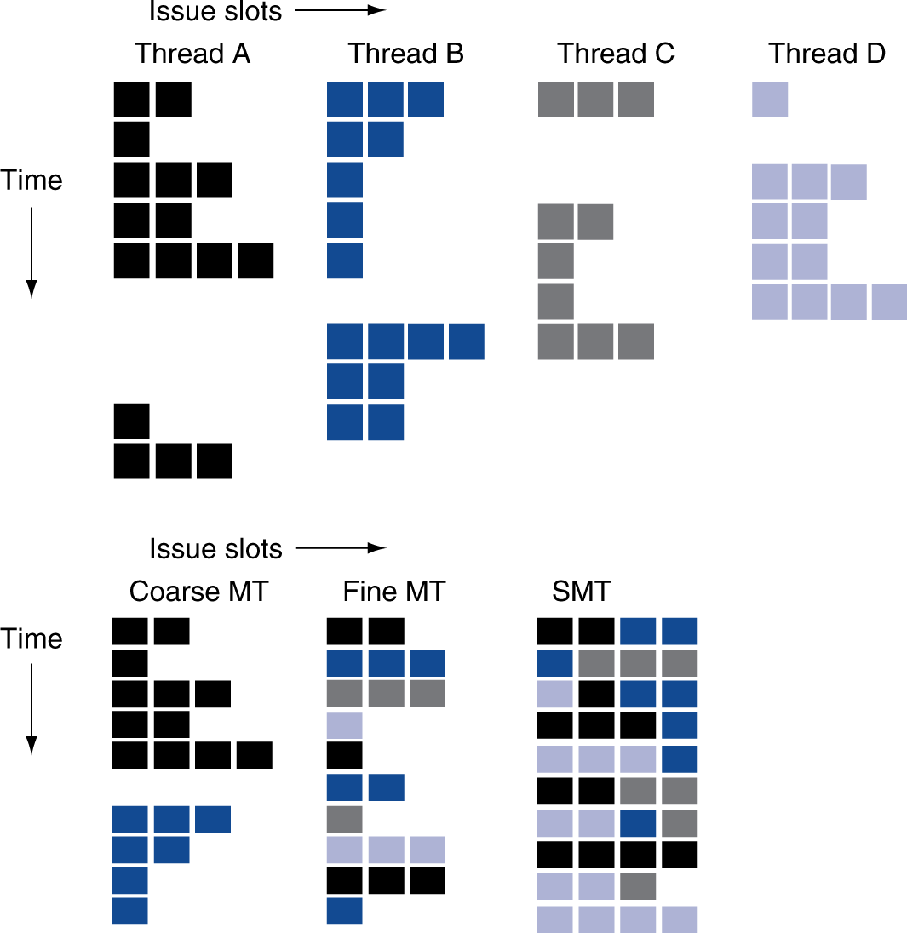
Multithreading Example
Notes:
Coarse MT must take time to load up pipeline. Fine MT requires very fast thread-switching time and still not full utilization.

Slide 16
Future of Multithreading
Will it survive? In what form?
Power considerations ⇒ simplified microarchitectures
Simpler forms of multithreading
Tolerating cache-miss latency
Thread switch may be most effective
Multiple simple cores might share resources more effectively

Slide 17
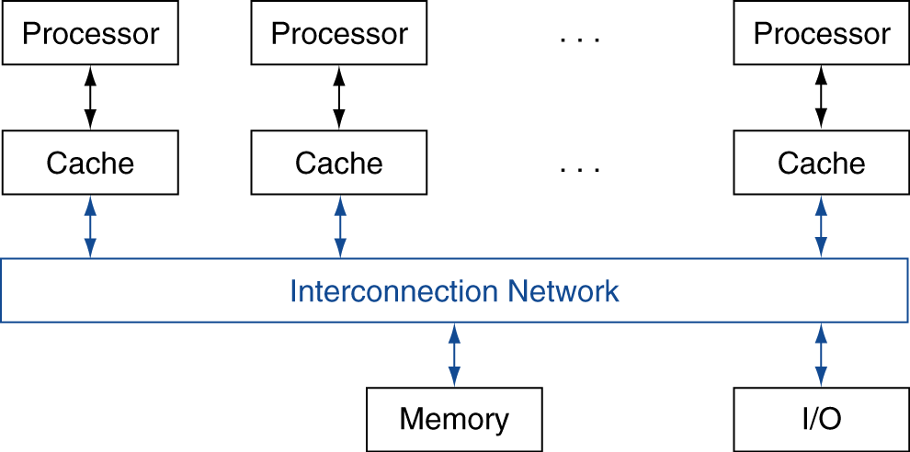
Shared Memory
SMP: shared memory multiprocessor
Hardware provides single physical address space for all processors
Synchronize shared variables using locks
Memory access time
UMA (uniform) vs. NUMA (nonuniform)
§6.5 Multicore and Other Shared Memory Multiprocessors
Notes:
Sometimes people use SMP for Symmetric Multiprocessor, though this conflates with UMA.

Slide 18
Example: Sum Reduction
Sum 100,000 numbers on 100 processor UMA

Slide 19
Example: Sum Reduction
Sum 100,000 numbers on 100 processor UMA
Each processor has ID: 0 ≤ Pn ≤ 99
Partition 1000 numbers per processor
Initial summation on each processor
sum[Pn] = 0; for (i = 1000*Pn; i < 1000*(Pn+1); i = i + 1) sum[Pn] = sum[Pn] + A[i];
Now need to add these partial sums
Reduction: divide and conquer
Half the processors add pairs, then quarter, …
Need to synchronize between reduction steps

Slide 20
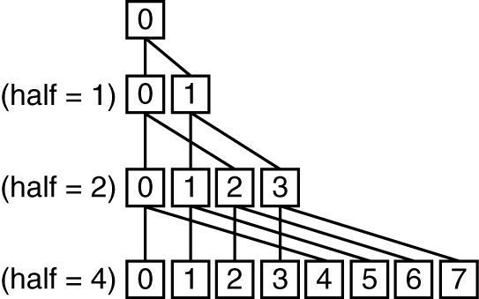
Example: Sum Reduction
half = 100;
repeat
synch();
if (half%2 != 0 && Pn == 0)
sum[0] = sum[0] + sum[half-1];
/* Conditional sum needed when half is odd;
Processor0 gets missing element */
half = half/2; /* dividing line on who sums */
if (Pn < half) sum[Pn] = sum[Pn] + sum[Pn+half];
until (half == 1);

Slide 21
History of GPUs
Early video cards
Frame buffer memory with address generation for video output
3D graphics processing
Originally high-end computers (e.g., SGI)
Moore’s Law ⇒ lower cost, higher density
3D graphics cards for PCs and game consoles
Graphics Processing Units
Processors oriented to 3D graphics tasks
Vertex/pixel processing, shading, texture mapping, rasterization
§6.6 Introduction to Graphics Processing Units

Slide 22
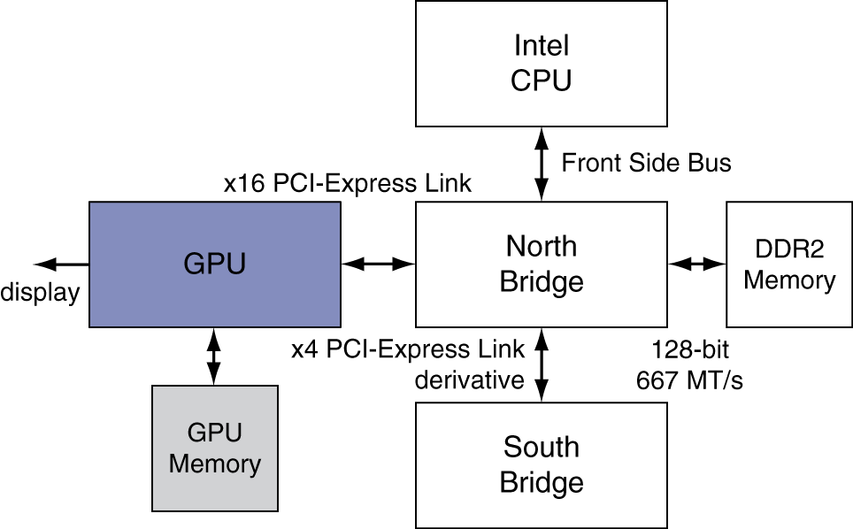
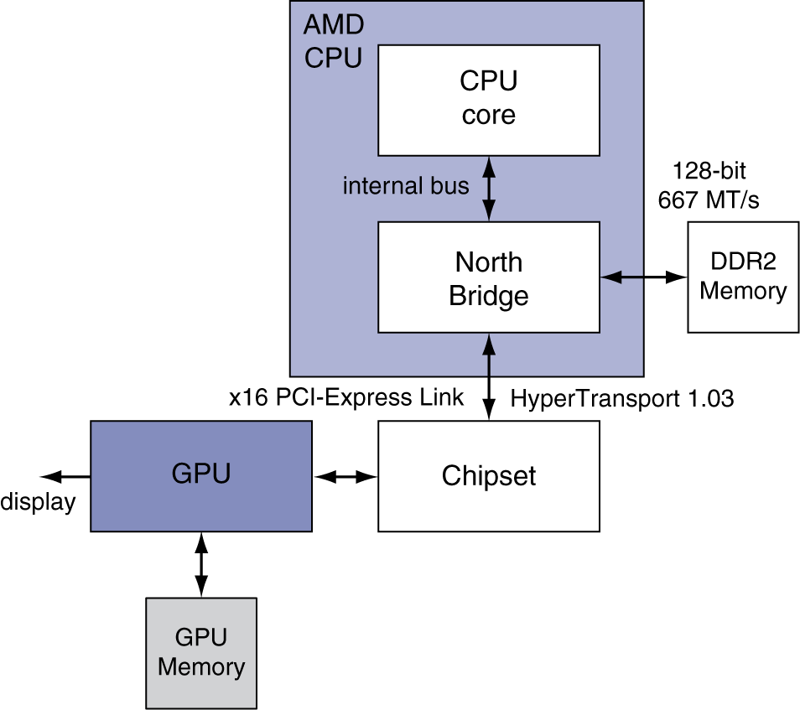
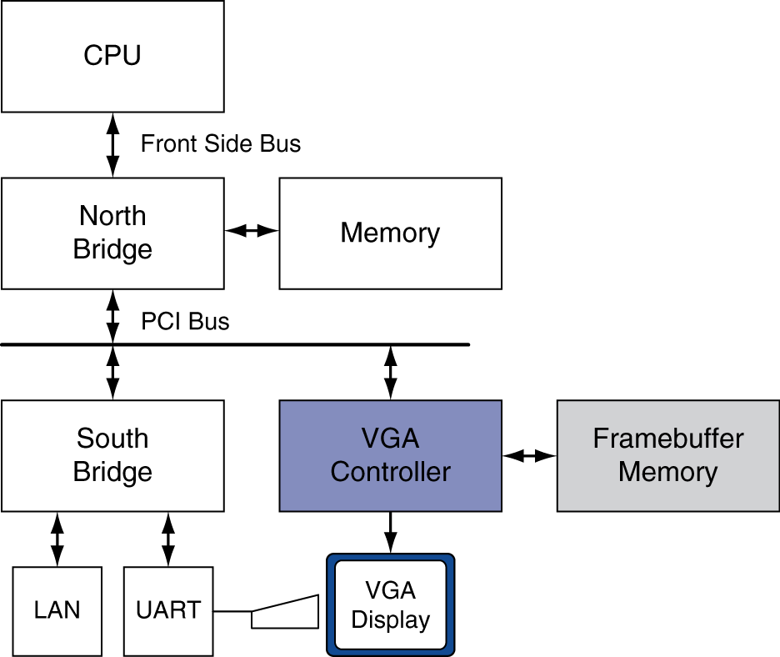
Graphics in the System

Slide 23
GPU Architectures
Processing is highly data-parallel
GPUs are highly multithreaded
Use thread switching to hide memory latency
Less reliance on multi-level caches
Graphics memory is wide and high-bandwidth
Trend toward general purpose GPUs
Heterogeneous CPU/GPU systems
CPU for sequential code, GPU for parallel code
Programming languages/APIs
DirectX, OpenGL
C for Graphics (Cg), High Level Shader Language (HLSL)
Compute Unified Device Architecture (CUDA)
Notes:
Now OpenCL, like CUDA but for many GPU makers

Slide 24
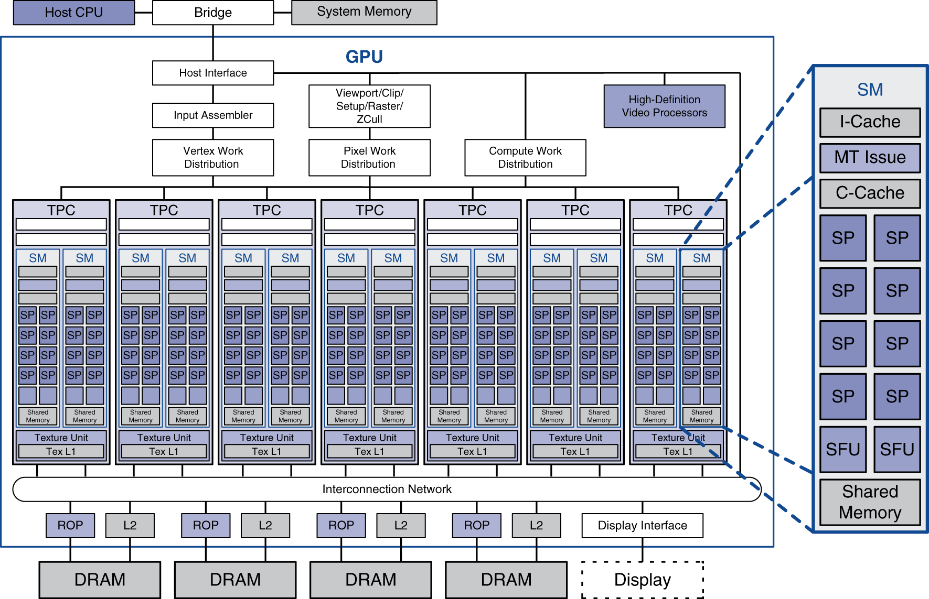
Example: NVIDIA Tesla
Streaming multiprocessor
8 × Streaming processors
Notes:
Each GPU is split up into many (8-16) multithreaded SIMD processors (streaming multiprocessor).
Each of these is split up into many SIMD lanes (streaming processors), and use multithreading to support up to 32 separate instruction streams.

Slide 25
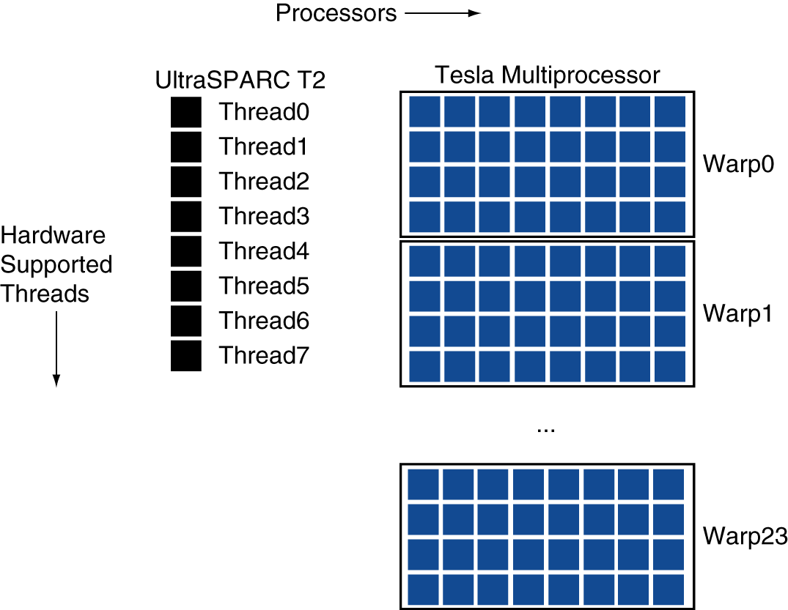
Example: NVIDIA Tesla
Streaming Processors
Single-precision FP and integer units
Each SMP is fine-grained multithreaded
Warp: group of 32 threads
Executed in parallel, SIMD style
8 SPs × 4 clock cycles
Hardware contexts for 24 warps
Registers, PCs, …

Slide 26
Classifying GPUs
Don’t fit nicely into SIMD/MIMD model
Conditional execution in a thread allows an illusion of MIMD
But with performance degredation
Need to write general purpose code with care
 | Static: Discovered at Compile Time | Dynamic: Discovered at Runtime
Instruction-Level Parallelism | VLIW | Superscalar
Data-Level Parallelism | SIMD or Vector | Tesla Multiprocessor

Slide 27
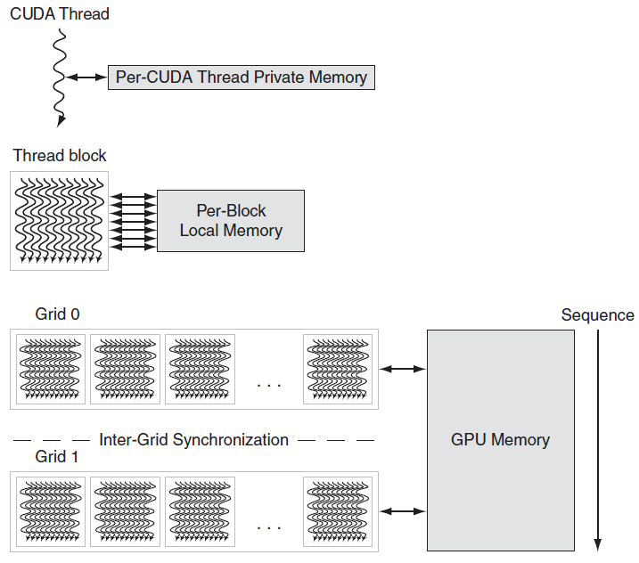
GPU Memory Structures
Notes:
CUDA thread -> one iteration of a loop (with SIMD instructions
Thread block -> one vectorized loop
Grid -> vectorized loop made up of several thread blocks

Slide 28
Putting GPUs into Perspective
Feature | Multicore with SIMD | GPU
SIMD processors | 4 to 8 | 8 to 16
SIMD lanes/processor | 2 to 4 | 8 to 16
Multithreading hardware support for SIMD threads | 2 to 4 | 16 to 32
Typical ratio of single precision to double-precision performance | 2:1 | 2:1
Largest cache size | 8 MB | 0.75 MB
Size of memory address | 64-bit | 64-bit
Size of main memory | 8 GB to 256 GB | 4 GB to 6 GB
Memory protection at level of page | Yes | Yes
Demand paging | Yes | No
Integrated scalar processor/SIMD processor | Yes | No
Cache coherent | Yes | No
Notes:
Extreme data locality => only small caches are necessary.

Slide 29
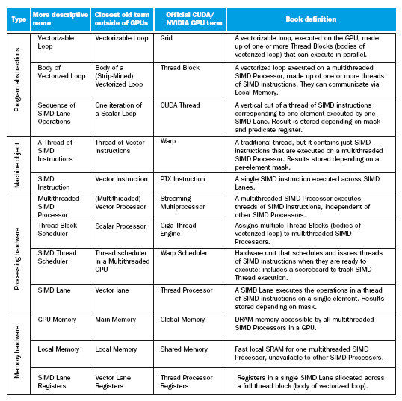
Guide to GPU Terms

Slide 30
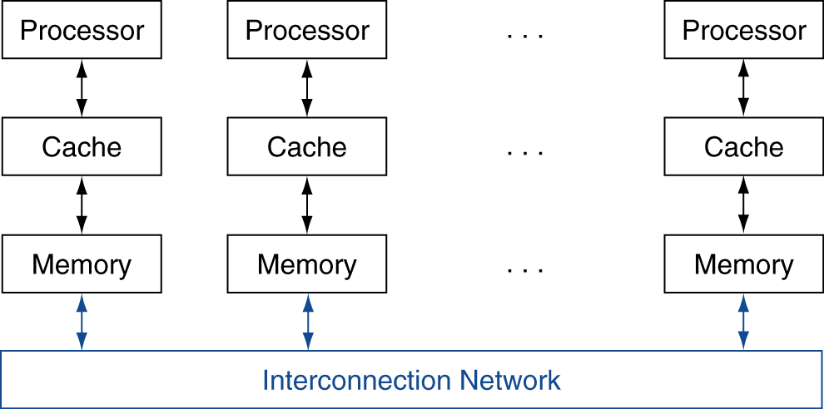
Message Passing
Each processor has private physical address space
Hardware sends/receives messages between processors
§6.7 Clusters, WSC, and Other Message-Passing MPs

Slide 31
Loosely Coupled Clusters
Network of independent computers
Each has private memory and OS
Connected using I/O system
E.g., Ethernet/switch, Internet
Suitable for applications with independent tasks
Web servers, databases, simulations, …
High availability, scalable, affordable
Problems
Administration cost (prefer virtual machines)
Low interconnect bandwidth
c.f. processor/memory bandwidth on an SMP
Notes:
A lot of supercomputers use message passing, but as one large system, vs. clusters…

Slide 32
Sum Reduction (Again)
Sum 100,000 on 100 processors
First distribute 100 numbers to each
The do partial sums
sum = 0; for (i = 0; i<1000; i = i + 1) sum = sum + AN[i];
Reduction
Half the processors send, other half receive and add
The quarter send, quarter receive and add, …

Slide 33
Sum Reduction (Again)
Given send() and receive() operations
limit = 100; half = 100;/* 100 processors */ repeat half = (half+1)/2; /* send vs. receive dividing line */ if (Pn >= half && Pn < limit) send(Pn - half, sum); if (Pn < (limit/2)) sum = sum + receive(); limit = half; /* upper limit of senders */ until (half == 1); /* exit with final sum */
Send/receive also provide synchronization
Assumes send/receive take similar time to addition
Notes:
There’s lots of details to how send() and receive() work
In real life you’d probably be using MPI

Slide 34
Grid Computing
Separate computers interconnected by long-haul networks
E.g., Internet connections
Work units farmed out, results sent back
Can make use of idle time on PCs
E.g., SETI@home, World Community Grid

Slide 35


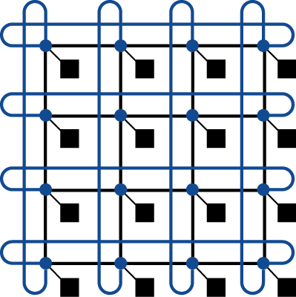

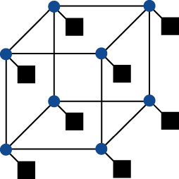
Interconnection Networks
Network topologies
Arrangements of processors, switches, and links
§6.8 Introduction to Multiprocessor Network Topologies
Bus
Ring
N-cube (N = 3)
2D Mesh
Fully connected

Slide 36
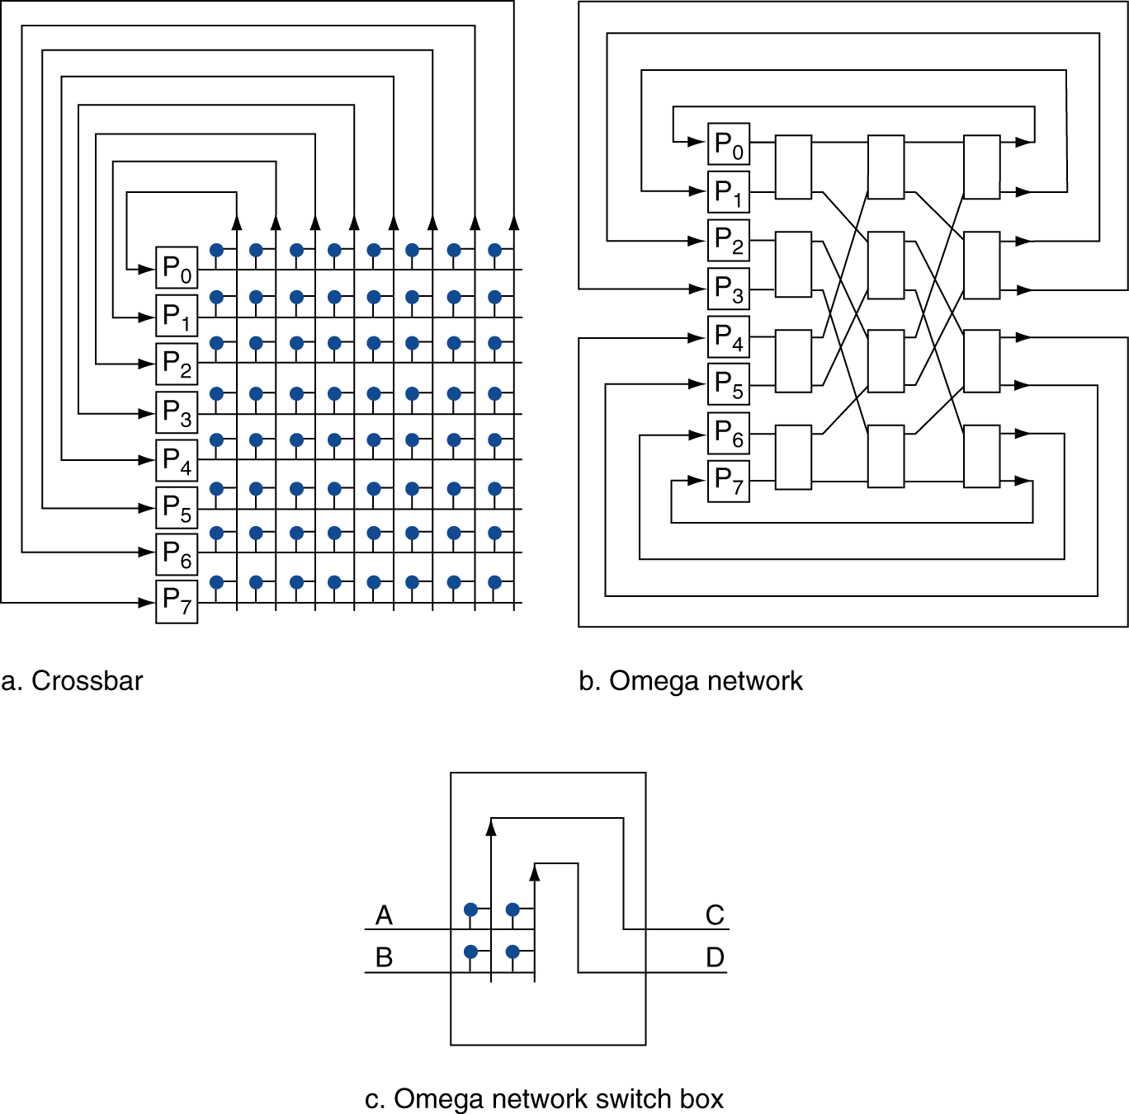
Multistage Networks

Slide 37
Network Characteristics
Performance
Latency per message (unloaded network)
Throughput
Link bandwidth
Total network bandwidth
Bisection bandwidth
Congestion delays (depending on traffic)
Cost
Power
Routability in silicon
Notes:
Fully connected total bandwidth: P(P-1)/2 (sum of (P-1)+(P-2)+(P-3)…+1+0)
Full connected bisection bandwith: (P/2)^2

Slide 38
Parallel Benchmarks
Linpack: matrix linear algebra
SPECrate: parallel run of SPEC CPU programs
Job-level parallelism
SPLASH: Stanford Parallel Applications for Shared Memory
Mix of kernels and applications, strong scaling
NAS (NASA Advanced Supercomputing) suite
computational fluid dynamics kernels
PARSEC (Princeton Application Repository for Shared Memory Computers) suite
Multithreaded applications using Pthreads and OpenMP
§6.10 Multiprocessor Benchmarks and Performance Models

Slide 39
Code or Applications?
Traditional benchmarks
Fixed code and data sets
Parallel programming is evolving
Should algorithms, programming languages, and tools be part of the system?
Compare systems, provided they implement a given application
E.g., Linpack, Berkeley Design Patterns
Would foster innovation in approaches to parallelism

Slide 40
Modeling Performance
Assume performance metric of interest is achievable GFLOPs/sec
Measured using computational kernels from Berkeley Design Patterns
Arithmetic intensity of a kernel
FLOPs per byte of memory accessed
For a given computer, determine
Peak GFLOPS (from data sheet)
Peak memory bytes/sec (using Stream benchmark)

Slide 41
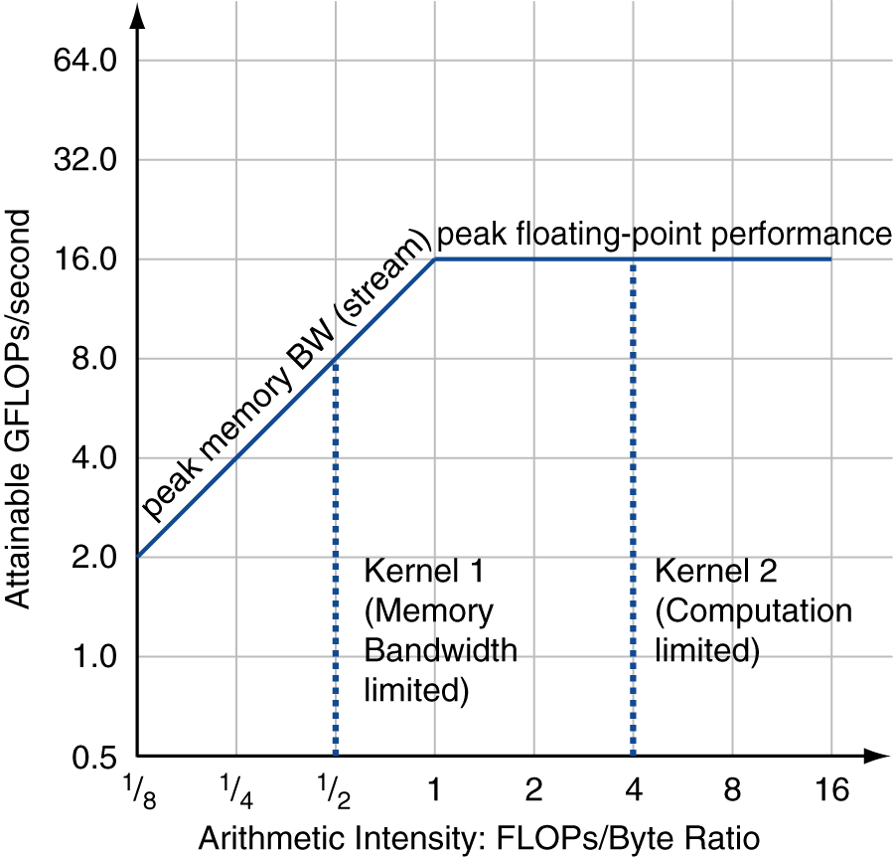
Roofline Diagram
Attainable GPLOPs/sec
= Max ( Peak Memory BW × Arithmetic Intensity, Peak FP Performance )

Slide 42
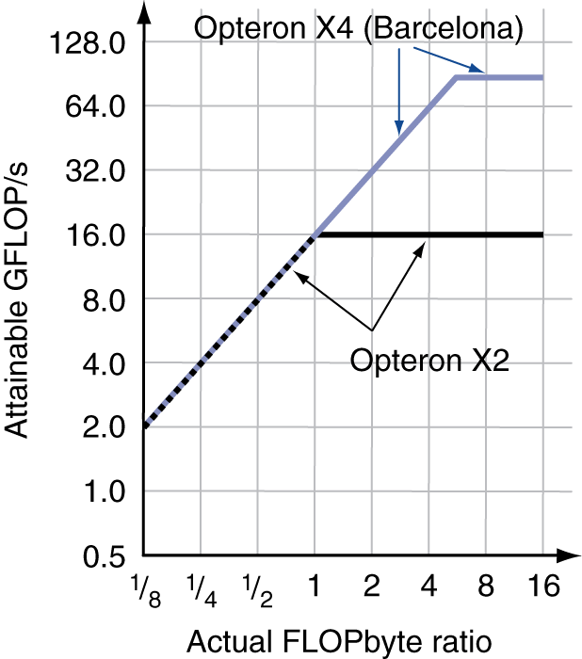
Comparing Systems
Example: Opteron X2 vs. Opteron X4
2-core vs. 4-core, 2× FP performance/core, 2.2GHz vs. 2.3GHz
Same memory system
To get higher performance on X4 than X2
Need high arithmetic intensity
Or working set must fit in X4’s 2MB L-3 cache

Slide 43
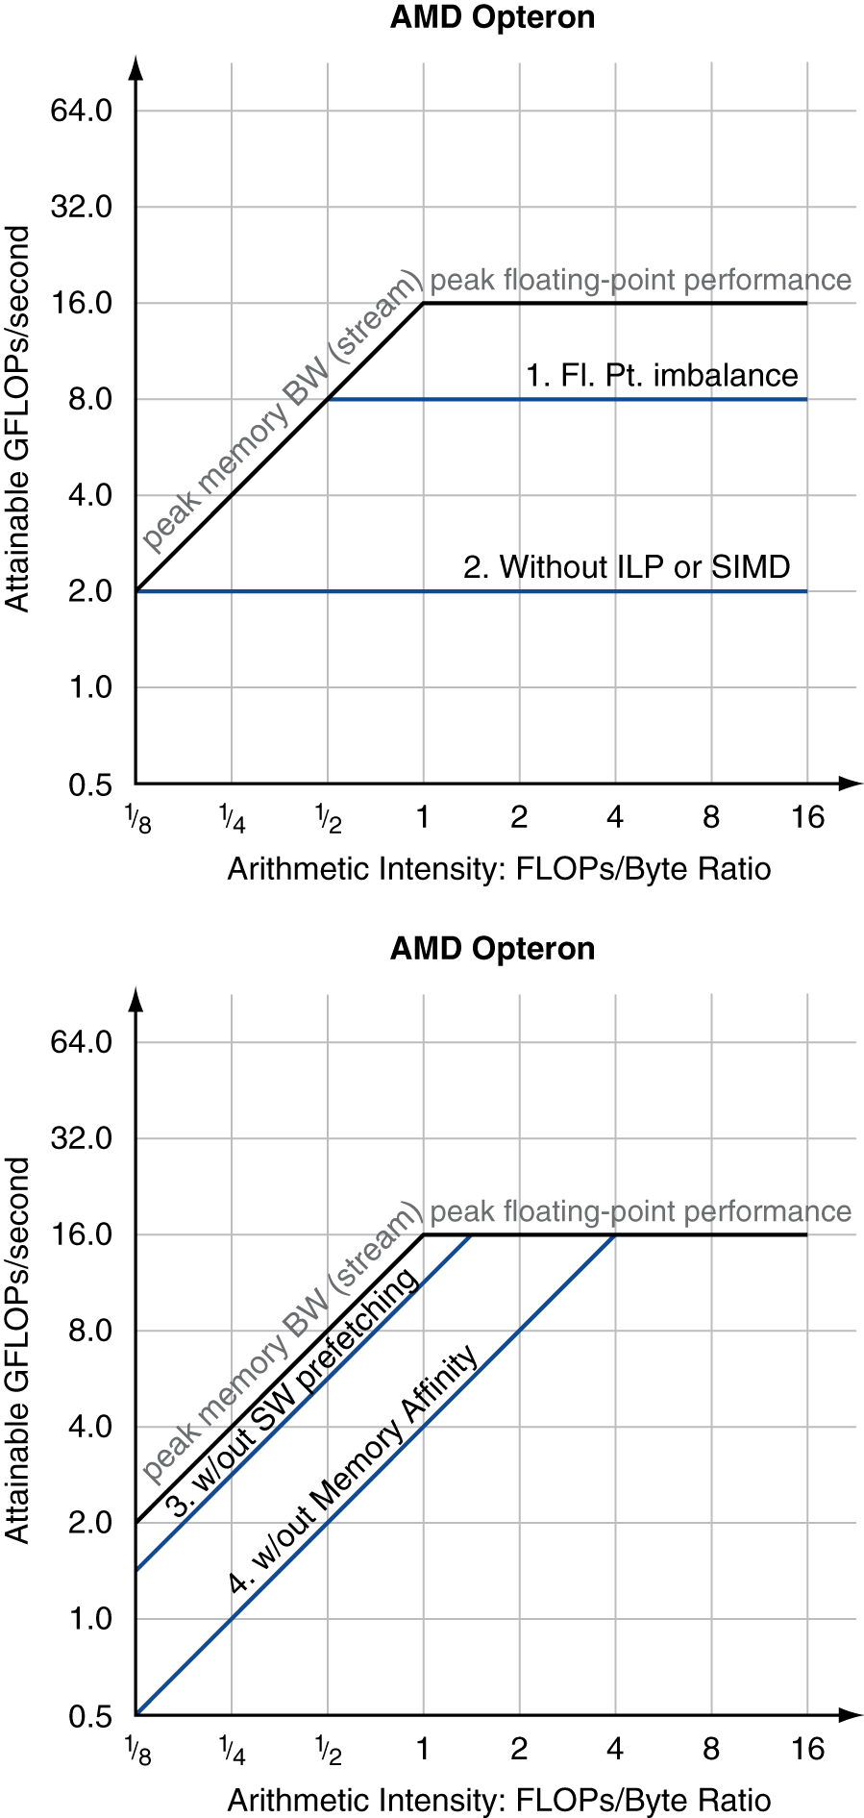
Optimizing Performance
Optimize FP performance
Balance adds & multiplies
Improve superscalar ILP and use of SIMD instructions
Optimize memory usage
Software prefetch
Avoid load stalls
Memory affinity
Avoid non-local data accesses

Slide 44
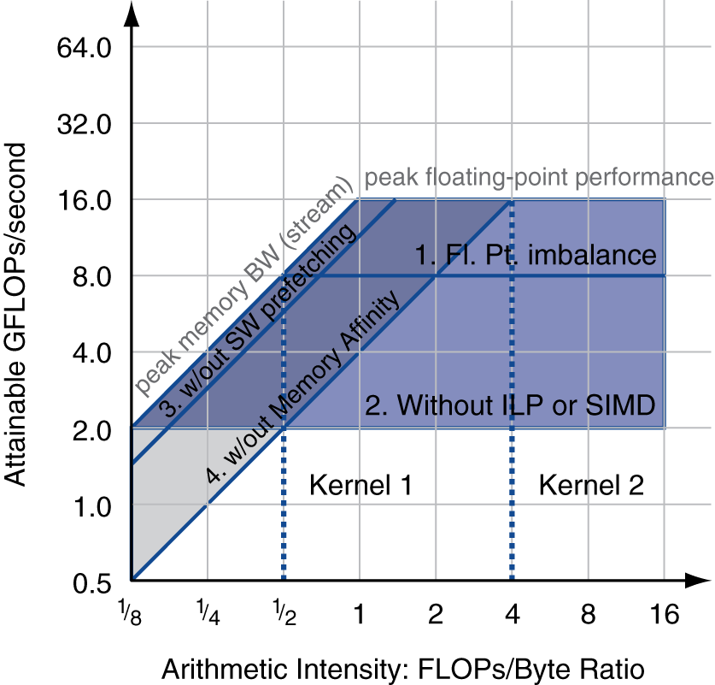
Optimizing Performance
Choice of optimization depends on arithmetic intensity of code
Arithmetic intensity is not always fixed
May scale with problem size
Caching reduces memory accesses
Increases arithmetic intensity

Slide 45
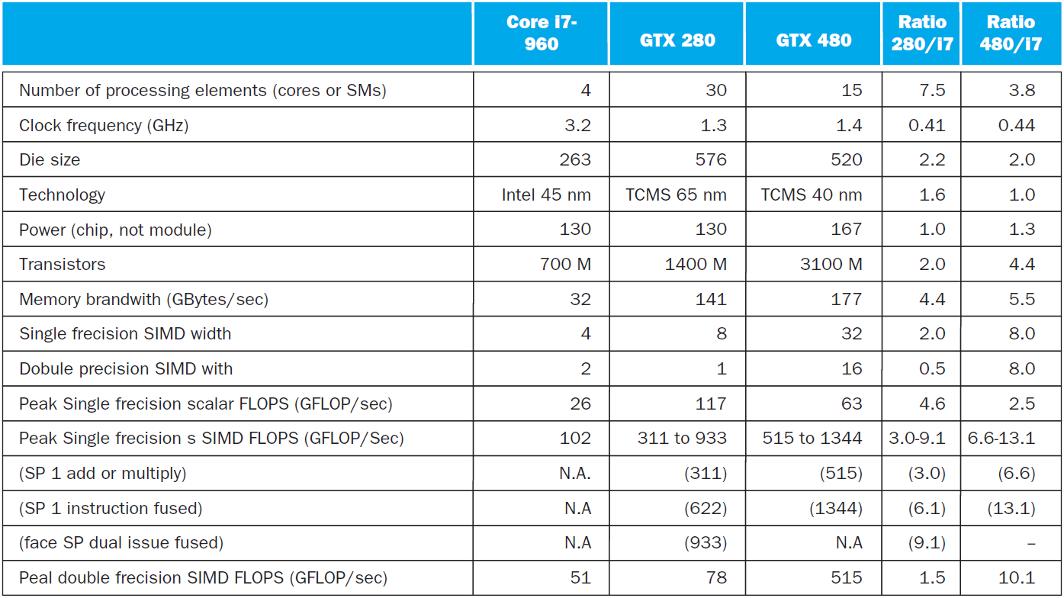
i7-960 vs. NVIDIA Tesla 280/480
§6.11 Real Stuff: Benchmarking and Rooflines i7 vs. Tesla

Slide 46
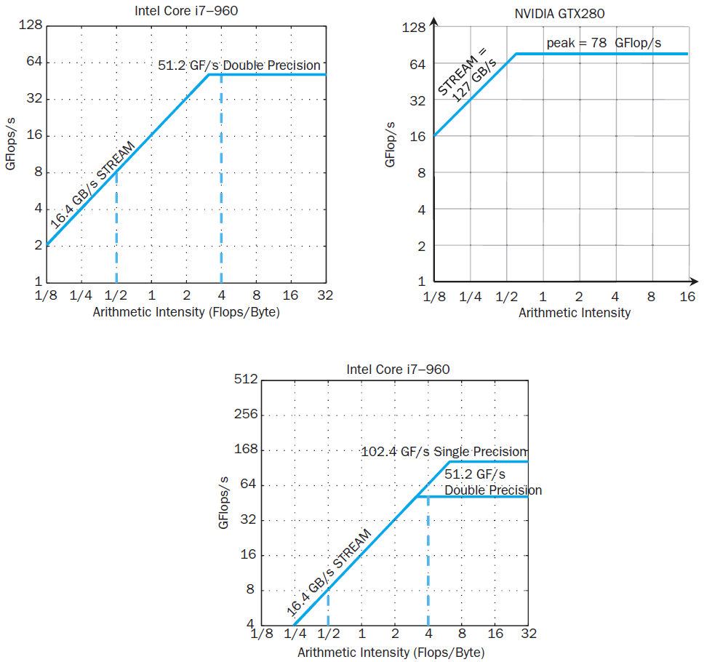
Rooflines

Slide 47
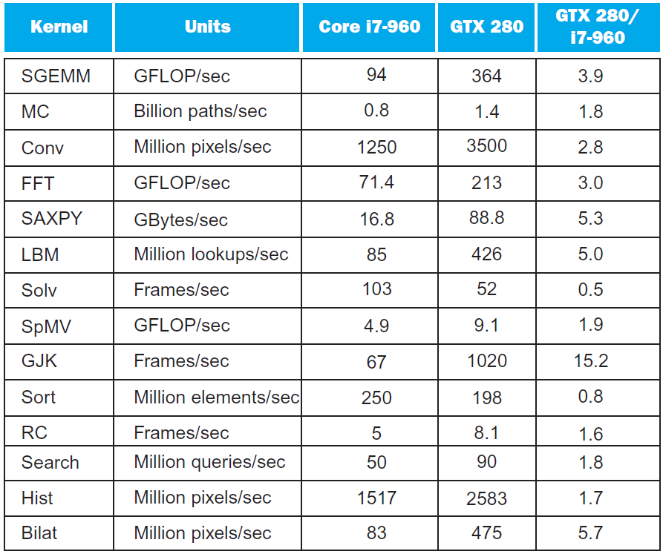
Benchmarks

Slide 48
Performance Summary
GPU (480) has 4.4 X the memory bandwidth
Benefits memory bound kernels
GPU has 13.1 X the single precision throughout, 2.5 X the double precision throughput
Benefits FP compute bound kernels
CPU cache prevents some kernels from becoming memory bound when they otherwise would on GPU
GPUs offer scatter-gather, which assists with kernels with strided data
Lack of synchronization and memory consistency support on GPU limits performance for some kernels

Slide 49
Multi-threading DGEMM
Use OpenMP:
void dgemm (int n, double* A, double* B, double* C)
{
#pragma omp parallel for
for ( int sj = 0; sj < n; sj += BLOCKSIZE )
for ( int si = 0; si < n; si += BLOCKSIZE )
for ( int sk = 0; sk < n; sk += BLOCKSIZE )
do_block(n, si, sj, sk, A, B, C);
}
§6.12 Going Faster: Multiple Processors and Matrix Multiply

Slide 50
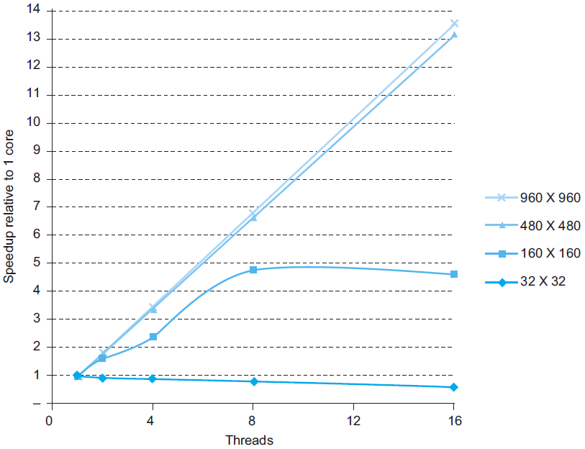
Multithreaded DGEMM

Slide 51
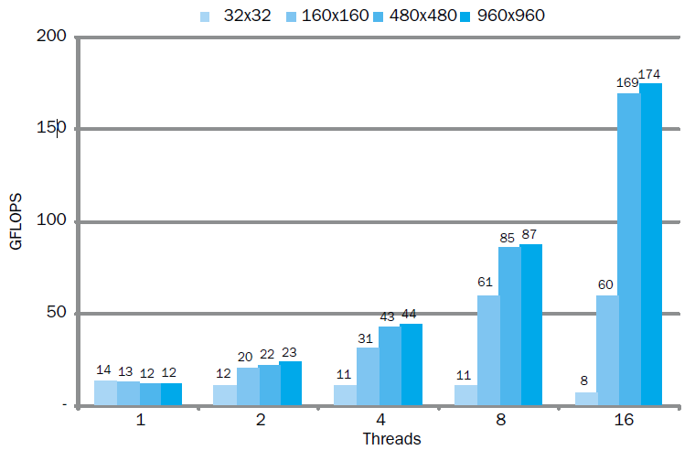
Multithreaded DGEMM

Slide 52
Fallacies
Amdahl’s Law doesn’t apply to parallel computers
Since we can achieve linear speedup
But only on applications with weak scaling
Peak performance tracks observed performance
Marketers like this approach!
But compare Xeon with others in example
Need to be aware of bottlenecks
§6.13 Fallacies and Pitfalls

Slide 53
Pitfalls
Not developing the software to take account of a multiprocessor architecture
Example: using a single lock for a shared composite resource
Serializes accesses, even if they could be done in parallel
Use finer-granularity locking

Slide 54
Concluding Remarks
Goal: higher performance by using multiple processors
Difficulties
Developing parallel software
Devising appropriate architectures
SaaS importance is growing and clusters are a good match
Performance per dollar and performance per Joule drive both mobile and WSC
§6.14 Concluding Remarks

Slide 55
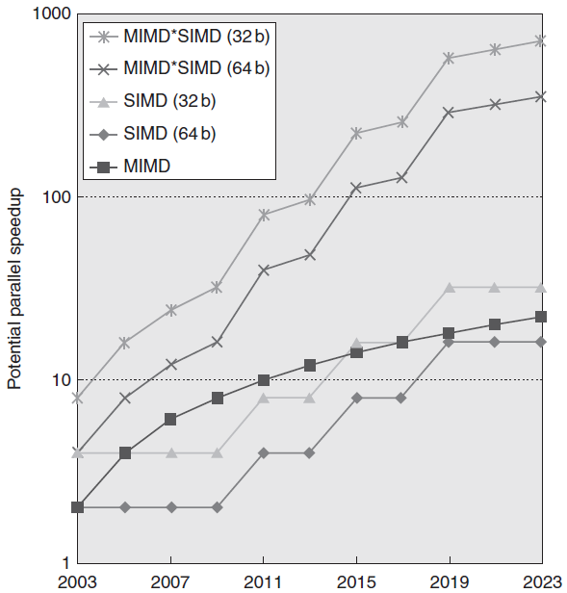
Concluding Remarks (con’t)
SIMD and vector operations match multimedia applications and are easy to program

