Slide 1
SubWord Parallelism
Instructor: Robert Utterback
Lecture 30
Notes:
Before: put matrix mult. C code on board so we can refer to it while tracing MIPS code.

Slide 2
IEEE Floating-Point Format
single: 8 bits double: 11 bits
single: 23 bits double: 52 bits
S
Exponent
Fraction
S: sign bit (0 ⇒ non-negative, 1 ⇒ negative)
Normalize significand: 1.0 ≤ |significand| < 2.0
Always has a leading pre-binary-point 1 bit, so no need to represent it explicitly (hidden bit)
Significand is Fraction with the “1.” restored
Exponent: excess representation: actual exponent + Bias
Ensures exponent is unsigned
Single: Bias = 127; Double: Bias = 1203
Notes:
Q: How do we represent: infinity? NaN?

Slide 3
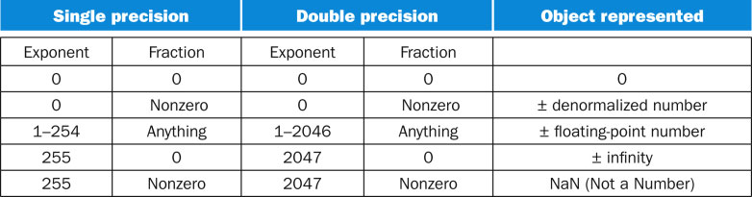
FP Encoding

Slide 4
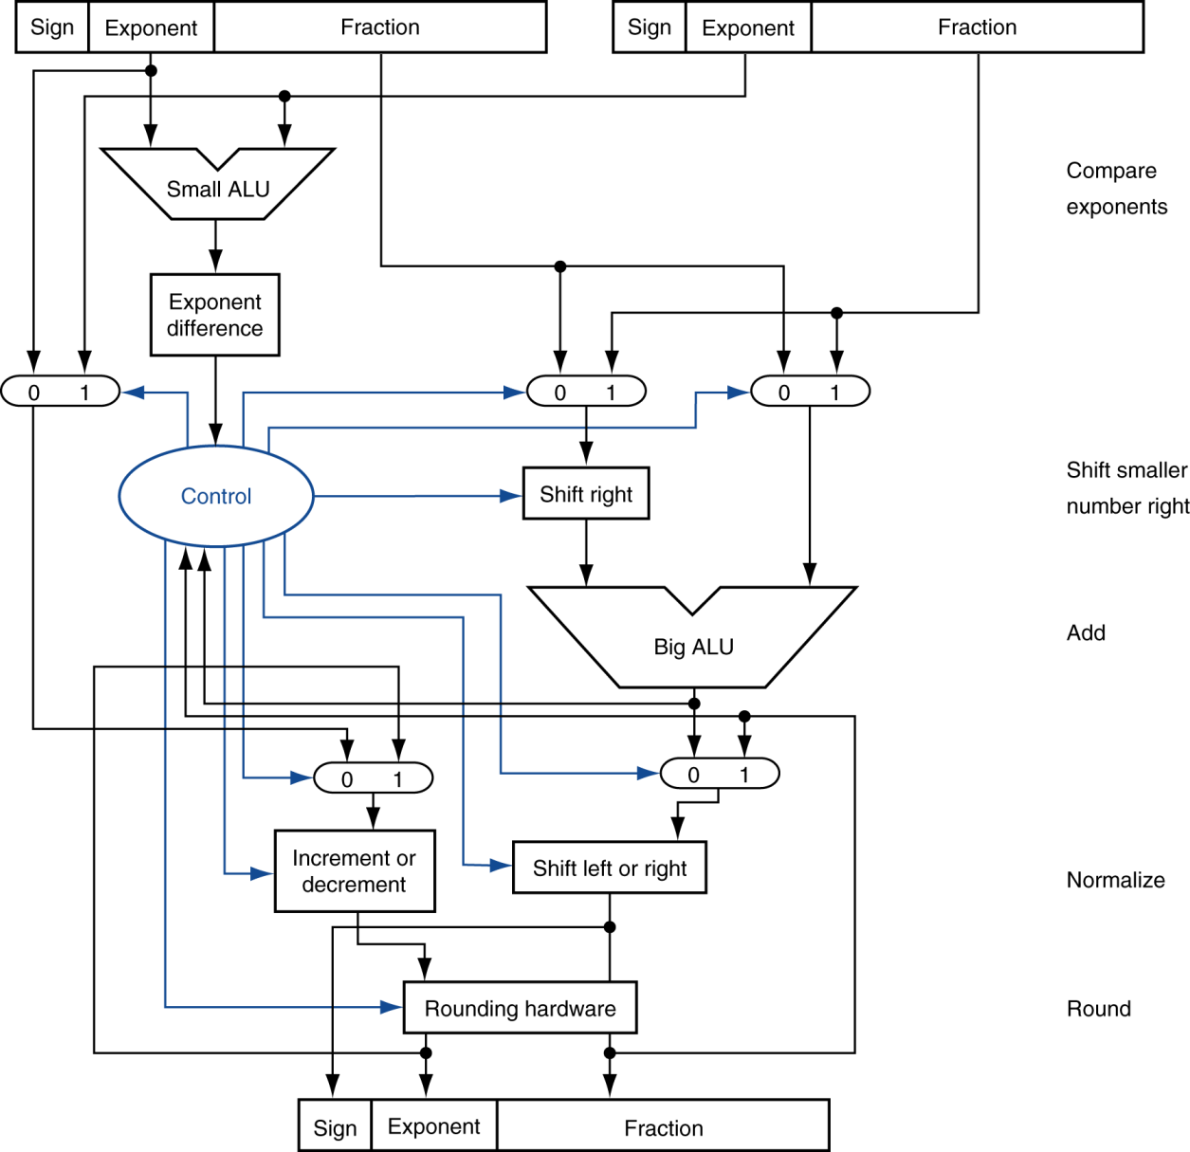
FP Adder Hardware
Step 1
Step 2
Step 3
Step 4
Notes:
What registers do you use for float? Double? $f0, $f0/$f1

Slide 5
FP Instructions in MIPS
FP hardware is coprocessor 1
Adjunct processor that extends the ISA
Separate FP registers
32 single-precision: $f0, $f1, … $f31
Paired for double-precision: $f0/$f1, $f2/$f3, …
Release 2 of MIPs ISA supports 32 × 64-bit FP reg’s
FP instructions operate only on FP registers
Programs generally don’t do integer ops on FP data, or vice versa
More registers with minimal code-size impact
Notes:
Q: Review: How to load into float register? A: lwc1

Slide 6
FP Instructions in MIPS
FP load and store instructions
lwc1, ldc1, swc1, sdc1
e.g., ldc1 $f8, 32($sp)
Floating point argument registers
NOT $a1, $a2, etc.
$f12, $f13, $f14, $f15
Floating point return value
NOT $v0
$f0

Slide 7
FP Instructions in MIPS
Single-precision arithmetic
add.s, sub.s, mul.s, div.s
e.g., add.s $f0, $f1, $f6
Double-precision arithmetic
add.d, sub.d, mul.d, div.d
e.g., mul.d $f4, $f4, $f6
Single- and double-precision comparison
c.xx.s, c.xx.d (xx is eq, lt, le, …)
Sets or clears FP condition-code bit
e.g. c.lt.s $f3, $f4
Branch on FP condition code true or false
bc1t, bc1f
e.g., bc1t TargetLabel

Slide 8
FP Example: °F to °C
C code:
float f2c (float fahr) { return ((5.0/9.0)*(fahr - 32.0)); }
fahr in $f12, result in $f0, literals in global memory space
Compiled MIPS code:
f2c: lwc1 $f16, const5($gp) lwc1 $f18, const9($gp) div.s $f16, $f16, $f18 lwc1 $f18, const32($gp) sub.s $f18, $f12, $f18 mul.s $f0, $f16, $f18 jr $ra
Notes:
Q: Write the code!
Also li.s and li.d

Slide 9
Accurate Arithmetic
IEEE Std 754 specifies additional rounding control
Extra bits of precision (guard, round, sticky)
Choice of rounding modes (round to nearest even)
Allows programmer to fine-tune numerical behavior of a computation
Not all FP units implement all options
Most programming languages and FP libraries just use defaults
Trade-off between hardware complexity, performance, and market requirements
Notes:
Guard = first extra bit, round = second extra bit
3 significant bits (counting the digit before decimal point), just a base 10 example for simplicity
Ex: 2.56 x 10^0 + 2.34 x 10^2, with and without guard and round (p. 219) (do without FIRST)
Now explain rounding modes, THEN sticky bit
Another Ex: 5.01 x 10^-1, 2.34 x 10^2
Yields 0.0050 + 2.34 = 2.3450, need to set the sticky bit
Use sticky bit to round, since we often round to the nearest even
What if we had 5.01 x 10^-42? Then that .01 part would be shifted VERY far over. But we don’t need to store all those bits, just the sticky “flag”

Slide 10
FP Example: Array Multiplication
X = X + Y × Z
All 32 × 32 matrices, 64-bit double-precision elements
C code:
void mm (double x[32][32], double y[32][32], double z[32][32]) { for (int i = 0; i != 32; i++) for (int j = 0; j != 32; j++) for (int k = 0; k != 32; k++) x[i][j] = x[i][j] + y[i][k] * z[k][j]; }
Addresses of x, y, z in $a0, $a1, $a2, and i, j, k in $s0, $s1, $s2
Notes:
Explain basic idea behind a matrix; they will see it a lot in Linear Algebra. Used in all kinds of places, e.g., computer graphics, scientific calculations, machine learning, etc.
Declaring double x[32][32] is really just declaring a 32*32 size array, but let’s you use the double brackets to index.
Actual index calculation for, e.g., x[i][j] is tricky
Need the ith row and jth column.
First need to figure out which “slot” we’re in: i * size of row = i * 32, then add column number (j)
Then: how big is each slot? 8 bytes, so take that value * 8, then add to start of array. Whew!
That’s the actual byte address we need to load.
Q: (Exercise): calculate the byte address of x[i][j]

Slide 11
Example: Matrix Multiplication
MIPS code:
li $t1, 32 # $t1 = 32 (row size/loop end) li $s0, 0 # i = 0; initialize 1st for loop L1: li $s1, 0 # j = 0; restart 2nd for loop L2: li $s2, 0 # k = 0; restart 3rd for loop sll $t2, $s0, 5 # $t2 = i * 32 (size of row of x) addu $t2, $t2, $s1 # $t2 = i * size(row) + j sll $t2, $t2, 3 # $t2 = byte offset of [i][j] addu $t2, $a0, $t2 # $t2 = byte address of x[i][j] l.d $f4, 0($t2) # $f4 = 8 bytes of x[i][j] L3: sll $t0, $s2, 5 # $t0 = k * 32 (size of row of z) addu $t0, $t0, $s1 # $t0 = k * size(row) + j sll $t0, $t0, 3 # $t0 = byte offset of [k][j] addu $t0, $a2, $t0 # $t0 = byte address of z[k][j] l.d $f16, 0($t0) # $f16 = 8 bytes of z[k][j] …
Notes:
Note the complicated index calculation. First we calculate which element of the matrix we need by looking at row and column. Kind of like “flattening” the 2D matrix into one dimensional memory. THEN we use the size of each element (sll by 3) to calculate actual byte offset, then add to base to get byte address.

Slide 12
Example: Matrix Multiplication
… sll $t0, $s0, 5 # $t0 = i*32 (size of row of y) addu $t0, $t0, $s2 # $t0 = i*size(row) + k sll $t0, $t0, 3 # $t0 = byte offset of [i][k] addu $t0, $a1, $t0 # $t0 = byte address of y[i][k] l.d $f18, 0($t0) # $f18 = 8 bytes of y[i][k] mul.d $f16, $f18, $f16 # $f16 = y[i][k] * z[k][j] add.d $f4, $f4, $f16 # f4=x[i][j] + y[i][k]*z[k][j] addiu $s2, $s2, 1 # $k k + 1 bne $s2, $t1, L3 # if (k != 32) go to L3 s.d $f4, 0($t2) # x[i][j] = $f4 addiu $s1, $s1, 1 # $j = j + 1 bne $s1, $t1, L2 # if (j != 32) go to L2 addiu $s0, $s0, 1 # $i = i + 1 bne $s0, $t1, L1 # if (i != 32) go to L1
Notes:
The book for some reason loves to put their termination condition checks at the end, though to me it’s more intuitive to do it at the beginning…
Q: What’s the problem with putting it at the end?
A: If you’re not 100% sure the termination condition will be satisfied the first iteration, this code executes 1 iteration when it should execute 0!
But this is an optimization (skips one check), if you know for sure that your loop will run one iteration.

Slide 13
Subword Parallellism
Graphics and audio applications can take advantage of performing simultaneous operations on short vectors
Example: 128-bit adder:
Sixteen 8-bit adds
Eight 16-bit adds
Four 32-bit adds
Also called data-level parallelism, vector parallelism, or Single Instruction, Multiple Data (SIMD)
§3.6 Parallelism and Computer Arithmetic: Subword Parallelism
Notes:
Newer MIPS extensions actually have some SIMD instructions, but we’ll just look at the x86 versions.

