Slide 1
Static Multiple-Issue (4.10)
Lecture 41
Notes:
What did we look at on Friday?
What is the point of pipelining?

Slide 2
Instruction-Level Parallelism (ILP)
Pipelining: executing multiple instructions in parallel
To increase ILP
Deeper pipeline
Less work per stage ⇒ shorter clock cycle
Multiple issue
Replicate pipeline stages ⇒ multiple pipelines
Start multiple instructions per clock cycle
CPI < 1, so use Instructions Per Cycle (IPC)
E.g., 4GHz 4-way multiple-issue
16 BIPS, peak CPI = 0.25, peak IPC = 4
But dependencies reduce this in practice
§4.10 Parallelism via Instructions
Notes:
We’re going to go over the high level ideas first, so the details will be missing. Then we’ll at least dig a little deeper with some more details.
What does 4 GHz mean? How many IPS for 1Ghz 1-way multiple-issue?

Slide 3
Multiple Issue
Static multiple issue
Compiler groups instructions to be issued together
Packages them into “issue slots”
Compiler detects and avoids hazards
Dynamic multiple issue
CPU examines instruction stream and chooses instructions to issue each cycle
Compiler can help by reordering instructions
CPU resolves hazards using advanced techniques at runtime
Notes:
Sometimes the compiler can’t package them perfectly into slots b/c of dependencies…use what’s called a “nop”

Slide 4
Speculation
“Guess” what to do with an instruction
Start operation as soon as possible
Check whether guess was right
If so, complete the operation
If not, roll-back and do the right thing
Common to static and dynamic multiple issue
Examples
Speculate on branch outcome
Roll back if path taken is different
Speculate on load
Roll back if location is updated
Notes:
We’ve already seen one example, what is it?
Speculate on loads: we often access arrays of elements…just guess the next element

Slide 5
Compiler/Hardware Speculation
Compiler can reorder instructions
e.g., move load before branch
Can include “fix-up” instructions to recover from incorrect guess
Hardware can look ahead for instructions to execute
Buffer results until it determines they are actually needed
Flush buffers on incorrect speculation

Slide 6
Speculation and Exceptions
What if exception occurs on a speculatively executed instruction?
e.g., speculative load before null-pointer check
Static speculation
Can add ISA support for deferring exceptions
Dynamic speculation
Can buffer exceptions until instruction completion (which may not occur)
Notes:
Q: What does ISA stand for?
Okay, that’s the high level for OOO execution, now let’s look in more detail at static dual issue

Slide 7
Static Multiple Issue
Compiler groups instructions into “issue packets”
Group of instructions that can be issued on a single cycle
Determined by pipeline resources required
Think of an issue packet as a very long instruction
Specifies multiple concurrent operations
⇒ Very Long Instruction Word (VLIW)

Slide 8
Scheduling Static Multiple Issue
Compiler must remove some/all hazards
Reorder instructions into issue packets
No dependencies with a packet
Possibly some dependencies between packets
Varies between ISAs; compiler must know!
Pad with nop if necessary
Notes:
MIPS was designed carefully, but with a different ISA we might have a different pipeline. For example, the memory access might actually come BEFORE the alu operation! Different hazards will result from that,…

Slide 9
MIPS with Static Dual Issue
Two-issue packets
One ALU/branch instruction
One load/store instruction
64-bit aligned
ALU/branch, then load/store
Pad an unused instruction with nop
Address | Instruction type | Pipeline Stages
n | ALU/branch | IF | ID | EX | MEM | WB
n + 4 | Load/store | IF | ID | EX | MEM | WB
n + 8 | ALU/branch |  | IF | ID | EX | MEM | WB
n + 12 | Load/store |  | IF | ID | EX | MEM | WB
n + 16 | ALU/branch |  |  | IF | ID | EX | MEM | WB
n + 20 | Load/store |  |  | IF | ID | EX | MEM | WB
Notes:
Notice we have to replicate the ALU, but not the memory, since an ALU/branch doesn’t access the memory

Slide 10
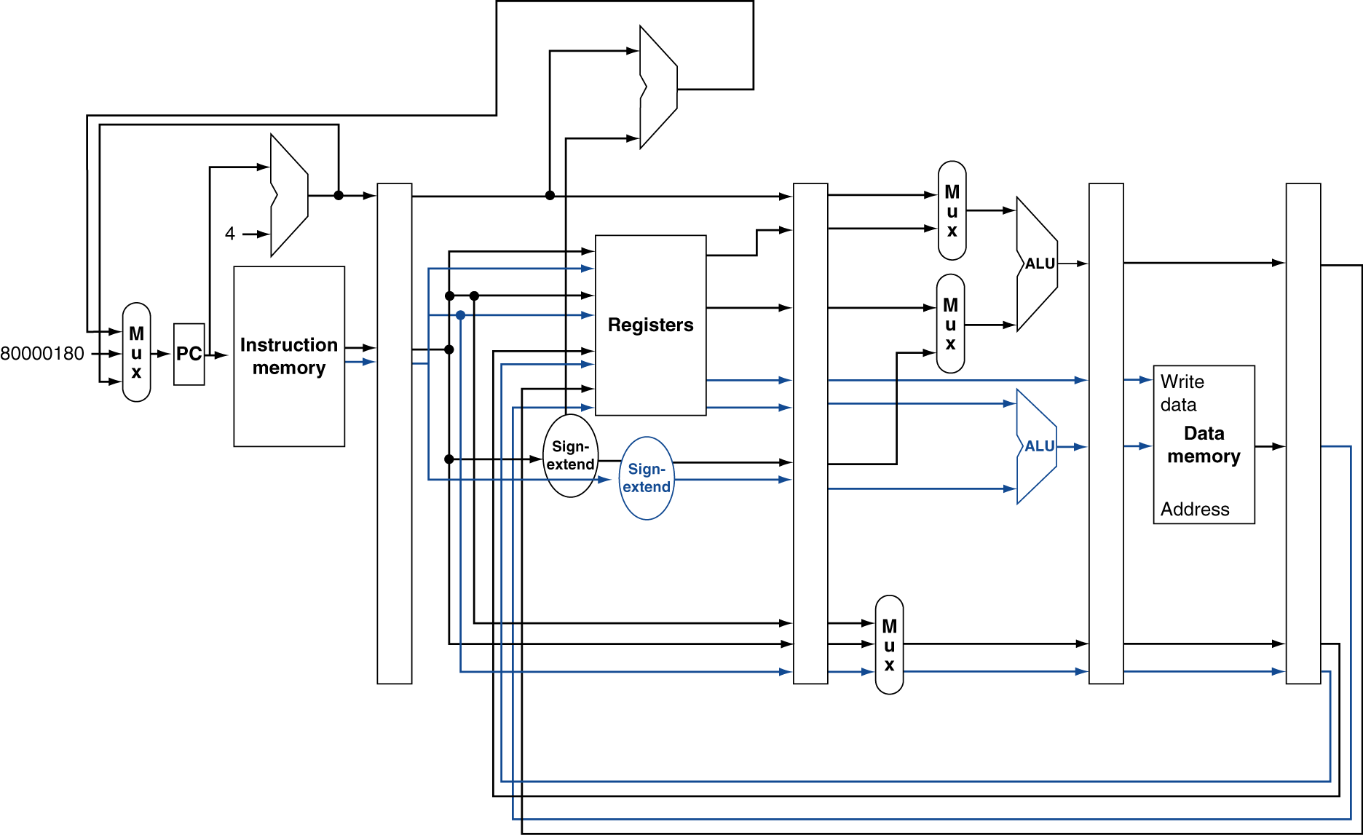
MIPS with Static Dual Issue
Notes:
There’s a bug in this figure…what is it? (Need to add 8 to PC…)
Also, notice just one ALU above registers…(first, what is this for?) why don’t new need to replicate this?
Why doesn’t the bottom ALU need muxes?

Slide 11
Hazards in the Dual-Issue MIPS
More instructions executing in parallel
EX data hazard
Forwarding avoided stalls with single-issue
Now can’t use ALU result in load/store in same packet
add $t0, $s0, $s1 lw $s2, 0($t0)
Split into two packets, effectively a stall
Load-use hazard
Still one cycle use latency, but now two instructions
More aggressive scheduling required

Slide 12
Scheduling Example
Schedule this for dual-issue MIPS
Loop: lw $t0, 0($s1) # $t0=array element addu $t0, $t0, $s2 # add scalar in $s2 sw $t0, 0($s1) # store result addi $s1, $s1,–4 # decrement pointer bne $s1, $zero, Loop # branch $s1!=0
Notes:
First, let’s think about what C code this came from… (just for practice?

