Slide 1
Static Multiple-Issue (4.10)
Lecture 42
Notes:
What did we look at on Friday?
What is the point of pipelining?

Slide 2
MIPS with Static Dual Issue
Two-issue packets
One ALU/branch instruction
One load/store instruction
64-bit aligned
ALU/branch, then load/store
Pad an unused instruction with nop
Address | Instruction type | Pipeline Stages
n | ALU/branch | IF | ID | EX | MEM | WB
n + 4 | Load/store | IF | ID | EX | MEM | WB
n + 8 | ALU/branch |  | IF | ID | EX | MEM | WB
n + 12 | Load/store |  | IF | ID | EX | MEM | WB
n + 16 | ALU/branch |  |  | IF | ID | EX | MEM | WB
n + 20 | Load/store |  |  | IF | ID | EX | MEM | WB
Notes:
Notice we have to replicate the ALU, but not the memory, since an ALU/branch doesn’t access the memory

Slide 3
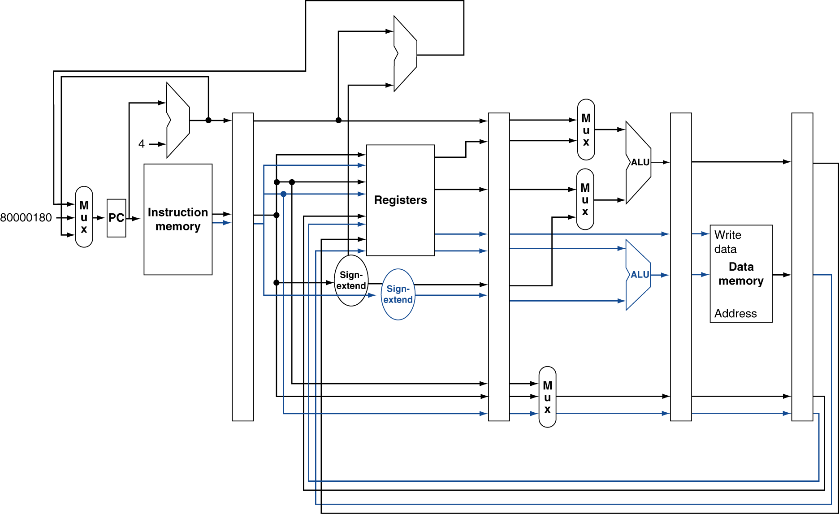
MIPS with Static Dual Issue
Notes:
There’s a bug in this figure…what is it? (Need to add 8 to PC…)
Also, notice just one ALU above registers…(first, what is this for?) why don’t new need to replicate this?
Why doesn’t the bottom ALU need muxes?

Slide 4
Scheduling Example
Schedule this for dual-issue MIPS
Loop: lw $t0, 0($s1) # $t0=array element addu $t0, $t0, $s2 # add scalar in $s2 sw $t0, 0($s1) # store result addi $s1, $s1,–4 # decrement pointer bne $s1, $zero, Loop # branch $s1!=0
Notes:
Int x = 42; // in $s2
Int *p = …;
Do {
*p = *p + x;
p--;
} while (p != nullptr);

Slide 5
Scheduling Example
Schedule this for dual-issue MIPS
Loop: lw $t0, 0($s1) # $t0=array element addu $t0, $t0, $s2 # add scalar in $s2 sw $t0, 0($s1) # store result addi $s1, $s1,–4 # decrement pointer bne $s1, $zero, Loop # branch $s1!=0
 | ALU/branch | Load/store | cycle
Loop: | nop | lw $t0, 0($s1) | 1
 | addi $s1, $s1,–4 | nop | 2
 | addu $t0, $t0, $s2 | nop | 3
 | bne $s1, $zero, Loop | sw $t0, 4($s1) | 4
What’s the IPC?
Notes:
Keep in mind you can change the instructions, e.g. the offset of a lw or sw
Simple:
Nop, lw
Addu, sw (currently can’t do this, but you could envision some kind of bypassing that would make this work…though it takes more hardware)
Addi, nop (but actually, the above doesn’t work, after the load the result is not ready for the add, even if we waited to start the add!)
Bne
Any problem with:
addi $s1, $s1, -4 | lw $t0, 0($s1) // use “old” value of $s1
Addu (again, use after load problem…)
Don’t count nop as an executed instruction

Slide 6
Scheduling Example
Schedule this for dual-issue MIPS
Loop: lw $t0, 0($s1) # $t0=array element addu $t0, $t0, $s2 # add scalar in $s2 sw $t0, 0($s1) # store result addi $s1, $s1,–4 # decrement pointer bne $s1, $zero, Loop # branch $s1!=0
 | ALU/branch | Load/store | cycle
Loop: | nop | lw $t0, 0($s1) | 1
 | addi $s1, $s1,–4 | nop | 2
 | addu $t0, $t0, $s2 | nop | 3
 | bne $s1, $zero, Loop | sw $t0, 4($s1) | 4
IPC = 5/4 = 1.25 (c.f. peak IPC = 2)

Slide 7
Loop Unrolling
Replicate loop body to expose more parallelism
Reduces loop-control overhead
Use different registers per replication
Called “register renaming”
Avoid loop-carried “anti-dependencies”
Store followed by a load of the same register
Aka “name dependence”
Reuse of a register name
Notes:
Go back to previous example, first unroll the code naively, then try to do dual-issue

Slide 8
Loop Unrolling Example
 | ALU/branch | Load/store | cycle
Loop: | addi $s1, $s1,–16 | lw $t0, 0($s1) | 1
 | nop | lw $t1, 12($s1) | 2
 | addu $t0, $t0, $s2 | lw $t2, 8($s1) | 3
 | addu $t1, $t1, $s2 | lw $t3, 4($s1) | 4
 | addu $t2, $t2, $s2 | sw $t0, 16($s1) | 5
 | addu $t3, $t4, $s2 | sw $t1, 12($s1) | 6
 | nop | sw $t2, 8($s1) | 7
 | bne $s1, $zero, Loop | sw $t3, 4($s1) | 8
IPC = 14/8 = 1.75
Closer to 2, but at cost of registers and code size
Notes:
What’s the IPC here?
Great, but what are the downsides?
Increased code size and more registers used…

