Slide 1
3.5: Floating Point Arithmetic
Lecture 33

Slide 2
IEEE Floating-Point Format
single: 8 bits double: 11 bits
single: 23 bits double: 52 bits
S
Exponent
Fraction
S: sign bit (0 ⇒ non-negative, 1 ⇒ negative)
Normalize significand: 1.0 ≤ |significand| < 2.0
Always has a leading pre-binary-point 1 bit, so no need to represent it explicitly (hidden bit)
Significand is Fraction with the “1.” restored
Exponent: excess representation: actual exponent + Bias
Ensures exponent is unsigned
Single: Bias = 127; Double: Bias = 1203
Notes:
Consider a 4-digit decimal example
9.999 × 10¹ + 1.610 × 10^{–1}
How to do it?

Slide 3
Floating-Point Addition
Consider a 4-digit decimal example
9.999 × 10¹ + 1.610 × 10^{–1}
1. Align decimal points
Shift number with smaller exponent
9.999 × 10¹ + 0.016 × 10¹
2. Add significands
9.999 × 10¹ + 0.016 × 10¹ = 10.015 × 10¹
3. Normalize result & check for over/underflow
1.0015 × 10²
4. Round and renormalize if necessary
1.002 × 10²
Notes:
Notice that rounding (say, 1.99999) may cause the number to become denormalized, so do step 3 again!

Slide 4
Floating-Point Addition
Now consider a 4-digit binary example
1.000₂ × 2^{–1} + –1.110₂ × 2^{–2}
Notes:
First, what are these numbers in base 10?
(0.5 + –0.4375)

Slide 5
Floating-Point Addition
Now consider a 4-digit binary example
1.000₂ × 2^{–1} + –1.110₂ × 2^{–2}
1. Align binary points
Shift number with smaller exponent
1.000₂ × 2^{–1} + –0.111₂ × 2^{–1}

Slide 6
Floating-Point Addition
Now consider a 4-digit binary example
1.000₂ × 2^{–1} + –1.110₂ × 2^{–2}
1. Align binary points
Shift number with smaller exponent
1.000₂ × 2^{–1} + –0.111₂ × 2^{–1}
2. Add significands
1.000₂ × 2^{–1} + –0.111₂ × 2–1 = 0.001₂ × 2^{–1}
Notes:
First, what are these numbers in base 10?
(0.5 + –0.4375)

Slide 7
Floating-Point Addition
Now consider a 4-digit binary example
1.000₂ × 2^{–1} + –1.110₂ × 2^{–2}
1. Align binary points
Shift number with smaller exponent
1.000₂ × 2^{–1} + –0.111₂ × 2^{–1}
2. Add significands
1.000₂ × 2^{–1} + –0.111₂ × 2–1 = 0.001₂ × 2^{–1}
3. Normalize result & check for over/underflow
1.000₂ × 2^{–4}, with no over/underflow
Notes:
First, what are these numbers in base 10?
(0.5 + –0.4375)

Slide 8
Floating-Point Addition
Now consider a 4-digit binary example
1.000₂ × 2^{–1} + –1.110₂ × 2^{–2}
1. Align binary points
Shift number with smaller exponent
1.000₂ × 2^{–1} + –0.111₂ × 2^{–1}
2. Add significands
1.000₂ × 2^{–1} + –0.111₂ × 2–1 = 0.001₂ × 2^{–1}
3. Normalize result & check for over/underflow
1.000₂ × 2^{–4}, with no over/underflow
4. Round and renormalize if necessary
1.000₂ × 2^{–4} (no change) = 0.0625
Notes:
First, what are these numbers in base 10?
(0.5 + –0.4375)

Slide 9
FP Adder Hardware
Much more complex than integer adder
Doing it in one clock cycle would take too long
Much longer than integer operations
Slower clock would penalize all instructions
FP adder usually takes several cycles
Can be pipelined

Slide 10
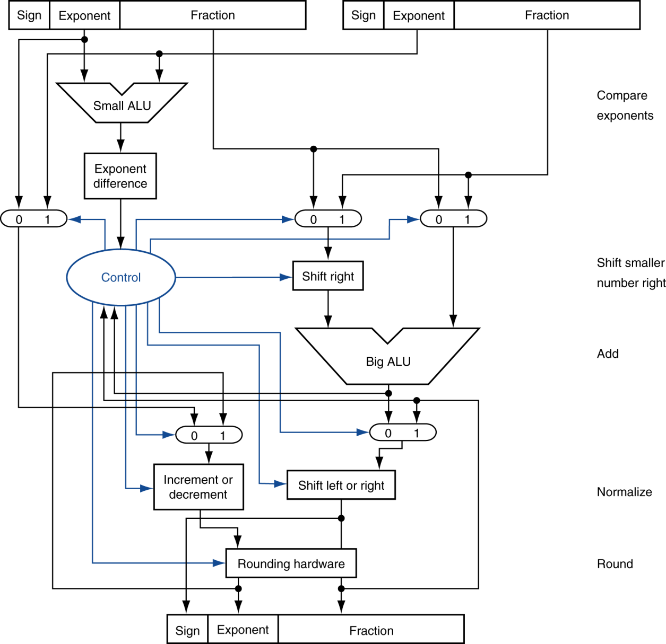
FP Adder Hardware
Step 1
Step 2
Step 3
Step 4

Slide 11
FP Arithmetic Hardware
FP multiplier is of similar complexity to FP adder
But uses a multiplier for significands instead of an adder
FP arithmetic hardware usually does
Addition, subtraction, multiplication, division, reciprocal, square-root
FP ↔ integer conversion
Operations usually takes several cycles
Can be pipelined

Slide 12
FP Instructions in MIPS
FP hardware is coprocessor 1
Adjunct processor that extends the ISA
Separate FP registers
32 single-precision: $f0, $f1, … $f31
Paired for double-precision: $f0/$f1, $f2/$f3, …
Release 2 of MIPs ISA supports 32 × 64-bit FP reg’s
FP instructions operate only on FP registers
Programs generally don’t do integer ops on FP data, or vice versa
More registers with minimal code-size impact

Slide 13
FP Instructions in MIPS
FP load and store instructions
lwc1, ldc1, swc1, sdc1
e.g., ldc1 $f8, 32($sp)
Floating point argument registers
NOT $a1, $a2, etc.
$f12, $f13, $f14, $f15
Floating point return value
NOT $v0
$f0

Slide 14
FP Instructions in MIPS
Single-precision arithmetic
add.s, sub.s, mul.s, div.s
e.g., add.s $f0, $f1, $f6
Double-precision arithmetic
add.d, sub.d, mul.d, div.d
e.g., mul.d $f4, $f4, $f6
Single- and double-precision comparison
c.xx.s, c.xx.d (xx is eq, lt, le, …)
Sets or clears FP condition-code bit
e.g. c.lt.s $f3, $f4
Branch on FP condition code true or false
bc1t, bc1f
e.g., bc1t TargetLabel

Slide 15
FP Example: °F to °C
C code:
float f2c (float fahr) { return ((5.0/9.0)*(fahr - 32.0)); }
fahr in $f12, result in $f0, literals in global memory space
Compiled MIPS code:
f2c: lwc1 $f16, const5($gp) lwc1 $f18, const9($gp) div.s $f16, $f16, $f18 lwc1 $f18, const32($gp) sub.s $f18, $f12, $f18 mul.s $f0, $f16, $f18 jr $ra
Notes:
Also li.s and li.d

Slide 16
Accurate Arithmetic
IEEE Std 754 specifies additional rounding control
Extra bits of precision (guard, round, sticky)
Choice of rounding modes (round to nearest even)
Allows programmer to fine-tune numerical behavior of a computation
Not all FP units implement all options
Most programming languages and FP libraries just use defaults
Trade-off between hardware complexity, performance, and market requirements
Notes:
Guard = first extra bit, round = second extra bit
3 significant bits, just a base 10 example for simplicity
Ex: 2.56 x 10^0 + 2.34 x 10^2, with and without guard and round
Another Ex: 5.01 x 10^-1, 2.34 x 10^2
Yields 0.0050 + 2.34 = 2.3450, need to set the sticky bit
Use sticky bit to round, since we often round to the nearest even

