Slide 1

Review
What are generate/propagate?

Slide 2
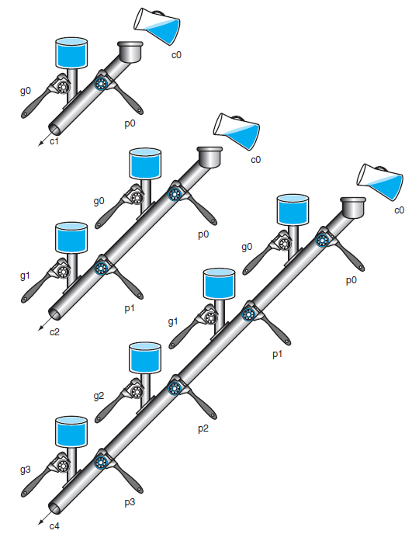
A Plumbing Analog
Wrenches open and close valves
ci+1 will be full
if the nearest generate value gi is on
or pi is on there is water further upstream
c0 can result in a carry out without the help of any generates but the help of all propagates

Slide 3
Review
What are generate/propagate?
Complicated for a large adder…how to fix?
Notes:
Negating B and setting carryIn to 1.

Slide 4
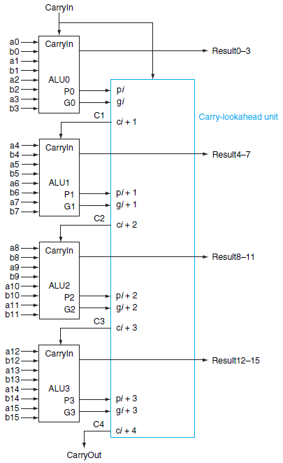
Four 4-bit ALUs with Carry Lookahead to form a 16-bit adder
Notes:
Each of the boxes on the left is a 4-bit Carry lookahead adder (actually ALU).
Each computes their p and g, then their P and G and pass this to carry-lookahead unit.
Consider adding 16-bit
0001 1010 0011 0011
1110 0101 1110 1011

Slide 5
Fast Carry Lookahead
How many “steps”?
step 1: produce generate and propagate
step 2: produce super generate and super propagate
step 3: produce carryout
much faster than adder without fast carry lookahead
Notes:
Lots of other adders that work efficiently: carry-select, carry save

Slide 6
Clocks
B.7

Slide 7
Clock Cycle
Clock cycle time (clock period)
Two portions
Clock is high
Clock is low
Edge-triggered clocking
All state changes occur on a clock edge
Notes:
Alternative is called level-triggered
State meaning we can read some input wire or write onto one, i.e., memory

Slide 8
Combinational Logic and Sequential Logic
Combinational Logic
A logic system whose blocks do not contain memory and hence compute the same output given the same input
NOTE: So far EVERYTHING has been combinational logic.
Sequential Logic
A group of logic elements that contain memory and hence whose value depends on the inputs as well as the current contents of the memory
Made up of combinational logic and some memory

Slide 9
State Element and Valid State
State Element
A memory element
Signals written into state elements must be valid when the active clock edge occurs
Valid means stable (not changing)
Will not change again until the inputs change
Synchronous System
A memory system that employs clocks and where data signals are read only when the clock indicates that the signal values are stable
Notes:
Alternative is asynchronous systems, which can be very confusing.

Slide 10
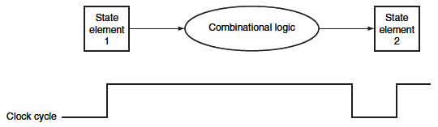
Inputs to a combinational logic block from a state element, and the outputs are written into a state element
Clock edge determines when the state elements are updated
Notes:
Before first edge state element 1 could be in the process of changing. On first clock edge it is valid and can be read by combinational logic, which does some stuff during the clock cycle.
Then on the second edge this is valid and written to state element 2

Slide 11
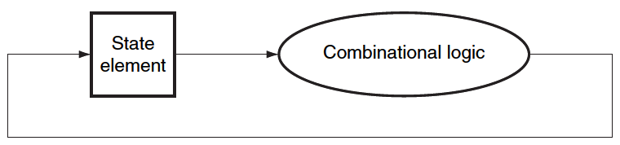
Read and Write in one cycle
Edge-triggered methodology allows a state element to be read and written in the same clock cycle
Read the value of a state element
Send it through some combinational logic
Value does not change during the clock cycle
Write it back to the same state element
All in one cycle

Slide 12
Memory Elements
Memory Elements
Store States
Output depends on
The inputs, and
The value stored in the memory element
Elements
Flip-Flops
Latches
Registers
Register Files
SRAMS
DRAMS
Notes:
To store values for later, we need some type of feedback…This is pretty cool.

Slide 13
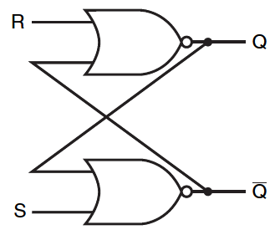
Feedback
Notes:
Q: Let’s say Q=0, S=1, R=0. What happens to Q?
Q: Q=1, S=0, R=1?

Slide 14
Set-Reset Latch (S-R Latch)
A pair of cross-coupled NOR gates
Unclocked
Do not have a clock input
Can store an internal value
Q represent the current state

Slide 15
S-R Latch (Cont.)
S=0 and R=0
Previous State is stored
S=1 and R=0
Q=1 and ~Q=0
S=0 and R=1
Q=0 and ~Q=1
S=1 and R=1
Q=0 and ~Q=0
???

Slide 16
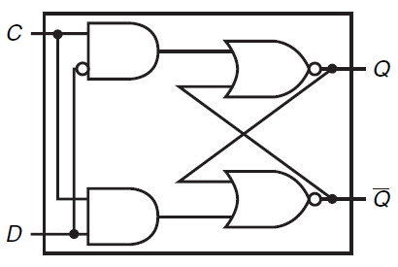
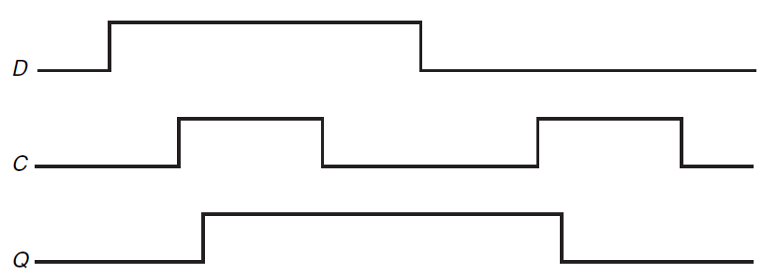
D-Latch
D-Latch
Clock input C
Data input D

Slide 17
Difference btw. Latch and Flip-flop
Latch
Asynchronous
Output changes soon after input changes
Flip-flop
Synchronous
Output changes at the clock edge
Notes:
A latch can be clocked or unclocked. The first S-R latch was unclocked and just changed whenever the input changed.
If clcocked, it changes when the clock is asserted/high.

Slide 18
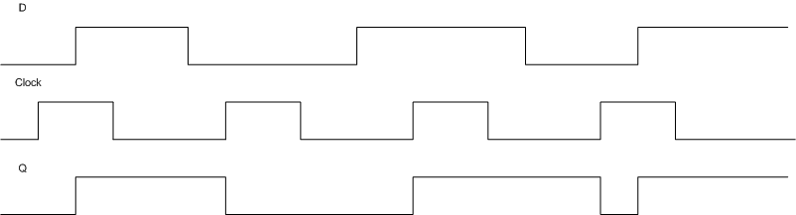
More on D-Latch
Q changes as D changes when clock is up
Not really edge-triggered
Notes:
Basically, when the clock is high it immediately reacts to changes from D, then input.
Want edge-triggered to make sure everything is synchronized

Slide 19
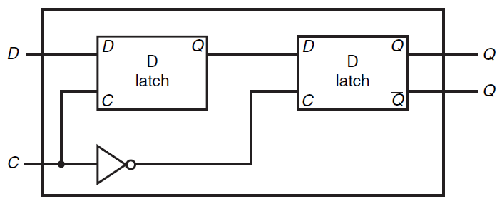
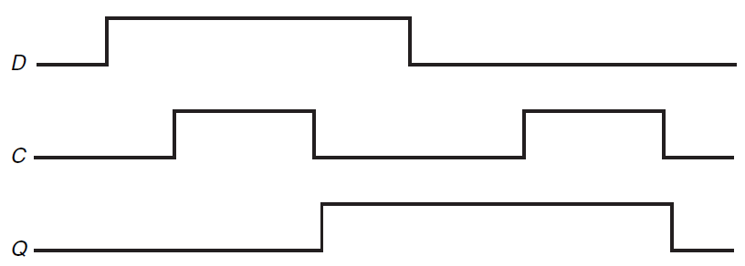
D Flip Flop
D Flip Flop with a Falling-Edge Trigger

Slide 20
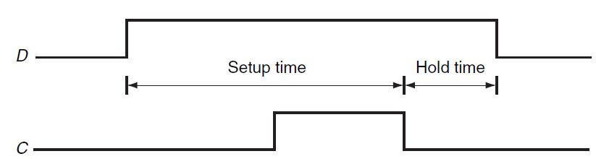
Setup Time and Hold Time
The input must be stable for a period of time before and after the clock edge
Setup Time
The minimum time the signal must be stable before clock edge
Hold Time
The minimum time the signal must be stable after clock edge
Usually very small
Notes:
We’re not going to talk much about these b/c we’re not really going to do much actual circuit design.

Slide 21
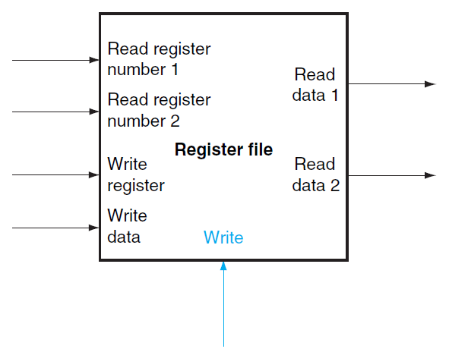
Register Files
A register file consists of a set of registers that can be read and written by supplying a register number
Built from an array of D Flip-Flops
A decoder is used to select a register in the register file

Slide 22
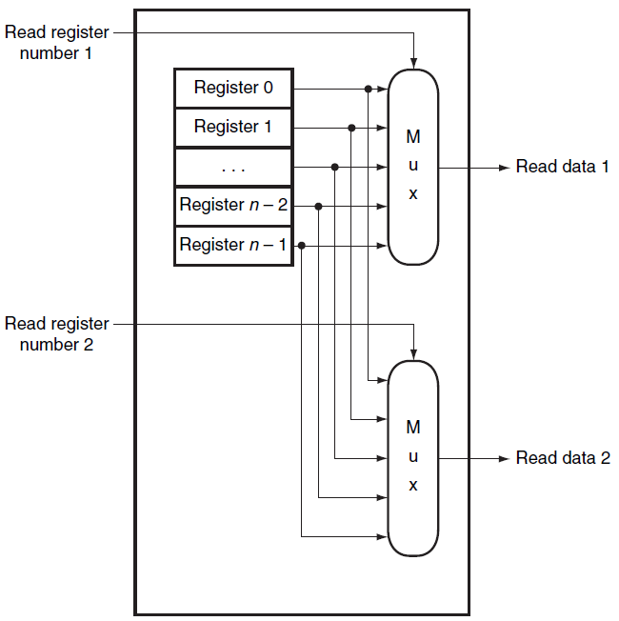
Reading Registers
Multiplexor
Select data from the specific register

Slide 23
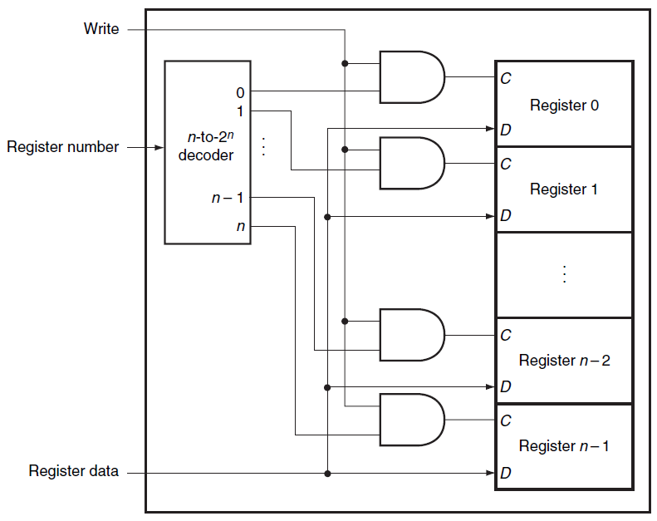
Writing to a register
Write Signal
Specify a write operation to the register
Decoder
Specify which register to write
Register Data
Data to write to the register

Slide 24
Register Files
Register Files
Can be used to build small memory
Too costly to build large amount of memory
Large Scale Memory
Static random access memories (SRAM)
Dynamic random access memories (DRAM)

Slide 25
SRAMs
SRAM
Integrated circuits of memory arrays
A single access port
Either read or write
Fixed access time to any datum
Height
Number of addressable locations
Width
Number of output bits per unit
Example: 8Mx8 SRAM
8M = 2²³, 23 address lines
8 output bits
Notes:
Q: If I have 32 addressable locations, how many address lines do I need? A: 5 b/c 2^5 = 32.
Q: Now what if I have 8 MB? 1MB = 2^20 locations if each location is 1 byte. A: 23.

Slide 26
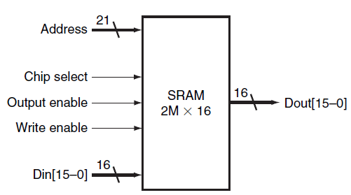
2Mx16 SRAM
21-bit address line
16-bit data input/output

Slide 27
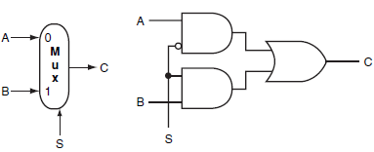
Implementation of Large SRAM
Register File
Use Multiplexor
32x1 Multiplexor
Large SRAM
Impractical to use a large multiplexor like 64kx1
Try to remember the implementation of a two input multiplexor
Solution
A more efficient implementation of Multiplexor
Shared output line (bit line)
Allow multiple sources to drive a single output line

Slide 28
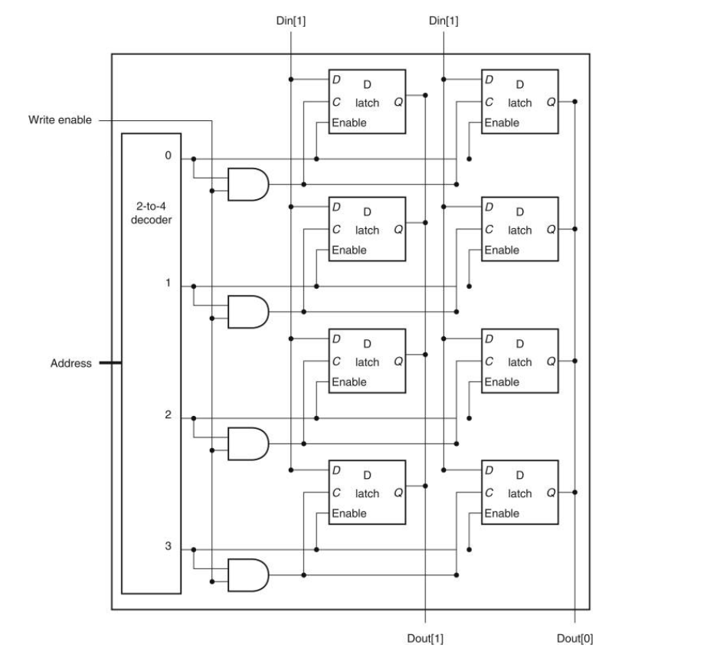
Small SRAM (4 x 2)

Slide 29
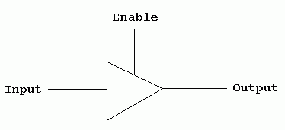
Three State Buffer
Two inputs
A data signal
An output enable (output select)
A single output
Three states
Output enable = 1
Asserted (1) state
Deasserted (0) state
Output enable = 0
High Impedance state
Allow the another three-state buffer with output enable =1 to determine the output

Slide 30
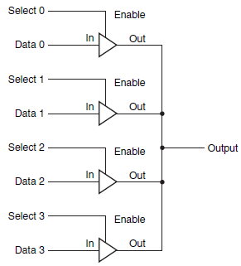
Multiplexor using Three-State Buffers
Three-State Buffer
Two inputs
A data signal
An output enable (output select)
A single output
Three states
Output enable = 1
Asserted (1) state
Deasserted (0) state
Output enable = 0
High Impedance state
Allow the another three-state buffer with output enable =1 to determine the output

Slide 31
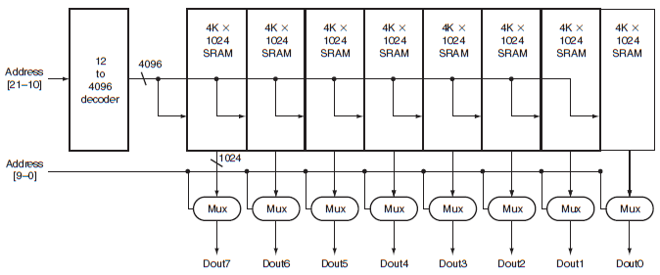
Organization of a 4M SRAM
Array of 8 Modules – Each for a bit
Addr 21-10
Use a 12 to 4096 decoder
Select an array of1024 bits out of 4K 1024 bits
Addr 9-0
Select 1 bit from the 1024 bits as an output bit
Notes:
So tristate buffers get rid of the problem of large multiplexors, but you’d still need large decoder and a whole lot of word lines. Instead we can use arrays of modules and a two step decode process.

Slide 32
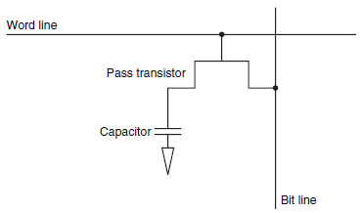
DRAM
SRAM
Requires 4-6 transistors per bit
Fast
But costly
DRAM
Requires 1 transistor per bit
Charge stored in a capacitor
Needs to be refreshed periodically
Slower than SRAM
But less expensive
Notes:
Since it must be refreshed, it loses the values without power!

Slide 33
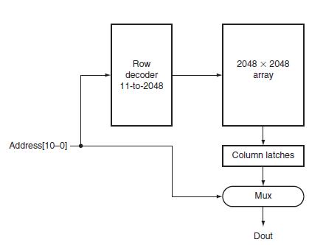
Organization of a 4M DRAM
Addr 11-21
Select 1 row from 2048 rows
Addr 10-0
Select 1 bit from the 2048 bits as an output bit
Column Latches
Store the selected output from 2048x2048 array temporally
Notes:
RAS (Row Access Strobe) and CAS(Column Access Strobe) to reduce lines needed.
Column latches also serve to help refresh, to latches and back.
Can also keep the values in the column latches and keep using new CAS values.
SDRAM is synchronous, i.e. clocked. That’s why you’ll see a speed, e.g. 3 GHz. (though they often will say 3000 or something)
DDR = double data rate, both rising and fall edge transfers

Slide 34
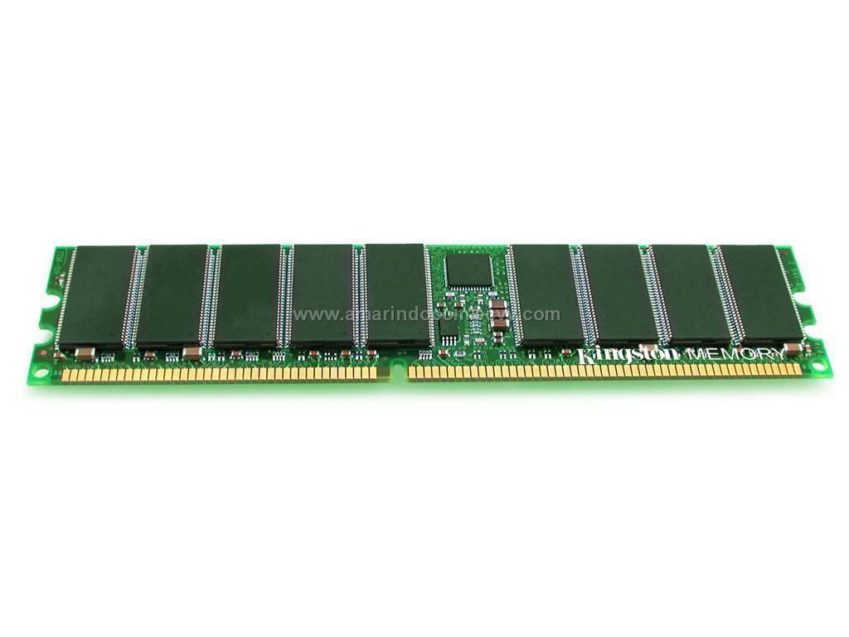
DRAM

Slide 35
SRAM and DRAM
SRAM
Fast but costly
Small amount
Used for Computer Cache
DRAM
Slow but less costly
Large amount
Used for Computer Main Memory

Slide 36
What I want you to do
Read Appendix B.6-7

