Slide 1
Division
Instructor: Robert Utterback
Lecture 27
Notes:
What instructions to we have for multiplication?
Mult, multu, mfhi, mflo, mul (pseudo)

Slide 2
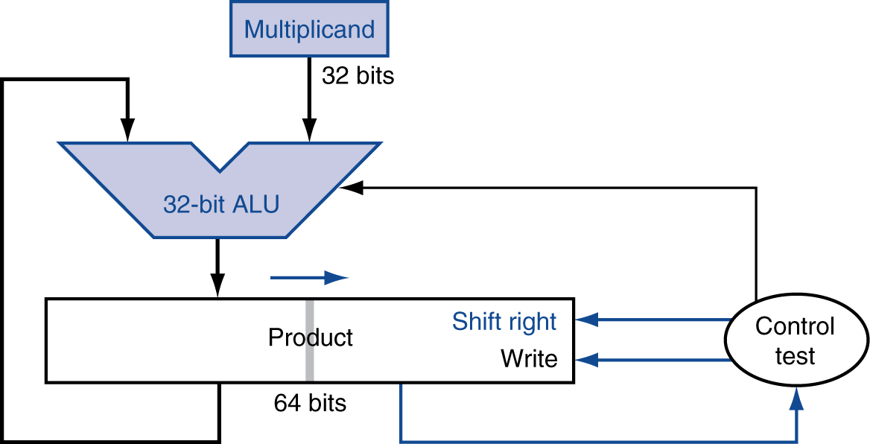
Optimized Multiplier
Perform steps in parallel: add/shift
One cycle per partial-product addition
That’s ok, if frequency of multiplications is low
Notes:
“One cycle” assuming a single cycle for add…

Slide 3
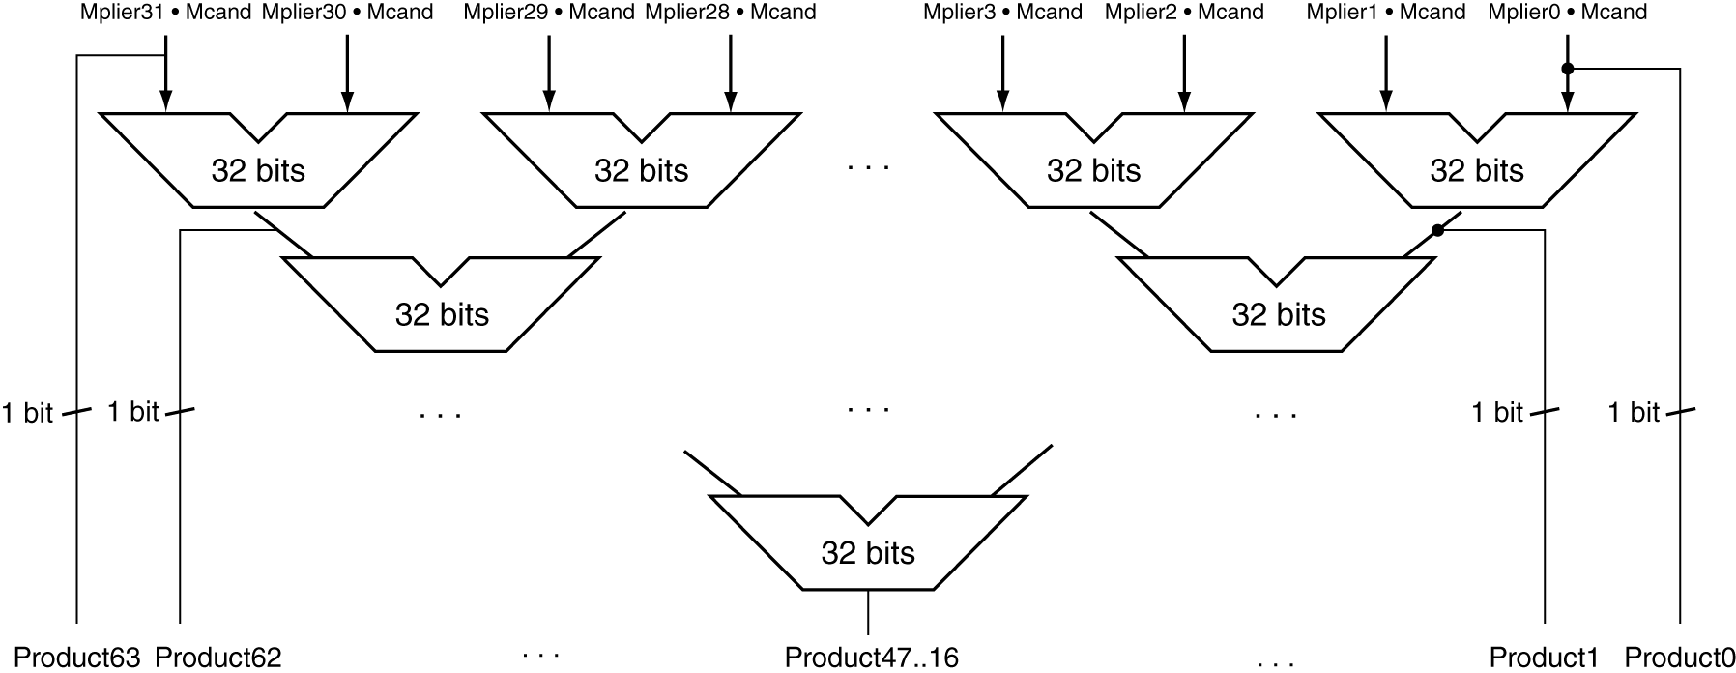
Faster Multiplier
Uses multiple adders
Cost/performance tradeoff
Can be pipelined
Several multiplication performed in parallel
Notes:
Not correct! First Explain what this is trying so say.
Q: Do you see what’s wrong?
A: The left product bits cannot possibly be right…we must wait for the carry-in bits!
But there are more complicated schemes that can do better, see Booth’s algorithm and Wallace trees.
Can do in O(log n) time, but in practice still much slower than addition.

Slide 4
Division
§3.4 Division
Check for 0 divisor
Long division approach
If divisor ≤ dividend bits
1 bit in quotient, subtract
Otherwise
0 bit in quotient, bring down next dividend bit
Restoring division
Do the subtract, and if remainder goes < 0, add divisor back
Signed division
Divide using absolute values
Adjust sign of quotient and remainder as required
quotient
dividend
1001
1000 1001010
-1000
10
101
1010
-1000
10
divisor
remainder
n-bit operands yield n-bit quotient and remainder
Notes:
See if the divisor “fits” into the part of the dividend we’re looking at.
Except how does a computer know if it fits? If just checks if it’s less than, which it does by subtracting and checking < 0.

Slide 5
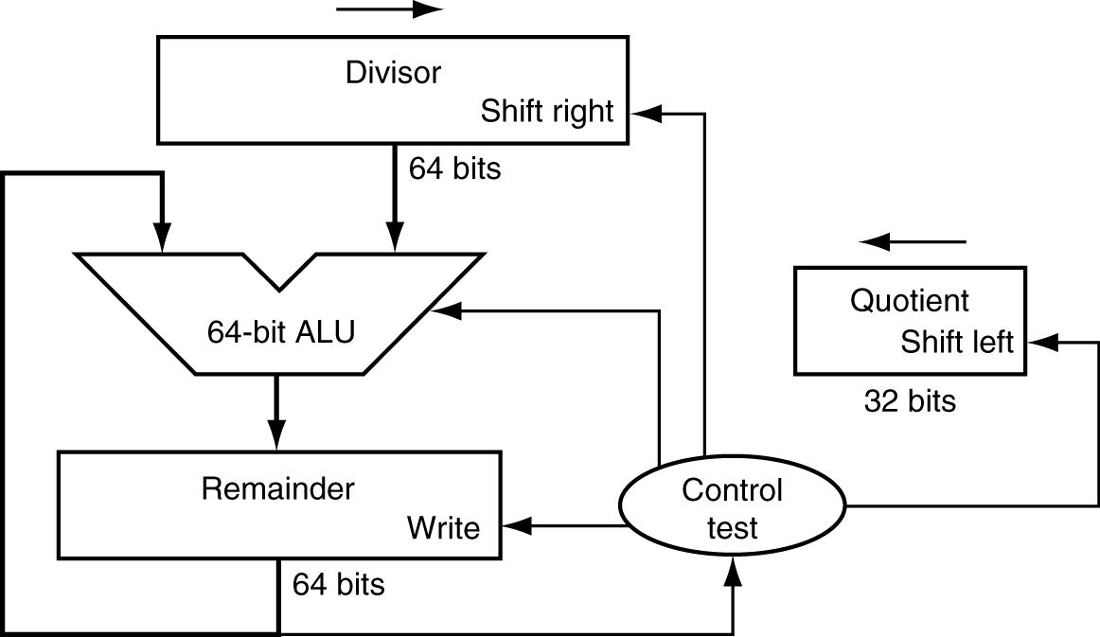
Division Hardware
First version of Division Hardware
32-bit quotient
64-bit ALU
64-bit remainder
Initially divisor in left half
Initially dividend
Notes:
Note the similarity to multiplication HW:
Multiplicand * multiplier = product
Dividend = quotient * divisor + remainder -> Divisor * quotient = dividend - remainder
Divisor starts in left half of divisor register, remainder initialized to dividend

Slide 6
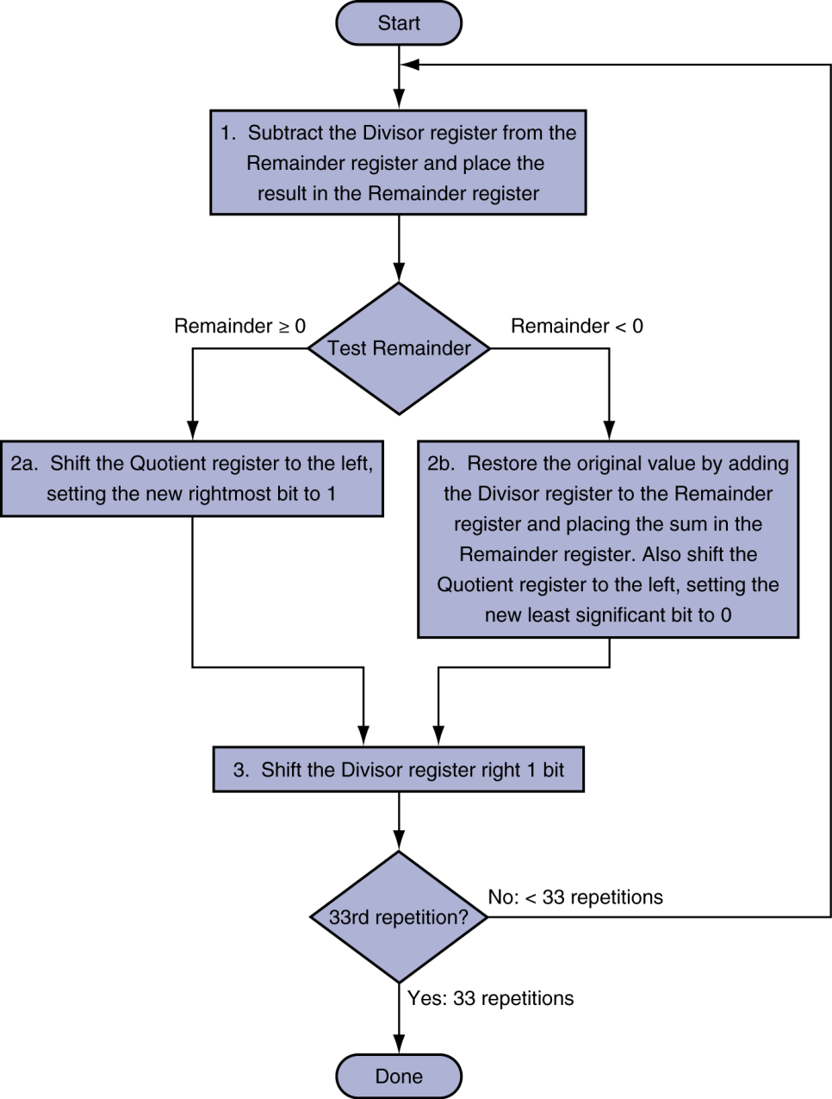
First Version Division Hardware
Initially divisor in left half
Initially dividend
Notes:
Shifting divisor to the right is basically considering another digit of dividend.
Example: Fill out a table for 7/2
Table:
Iteration, Step (1,2b,3), Quotient, Divisor, Remainder

Slide 7
Iter | Step | Quotient | Divisor | Remainder
0 | Initial | 0000 | 0010 0000 | 0000 0111
1 | Rem = Rem - Div
 | Rem < 0?
 | Shift Div right
2 | Rem = Rem - Div
 | Rem < 0?
 | Shift Div right
3 | Rem = Rem - Div
 | Rem < 0?
 | Shift Div right
4 | Rem = Rem - Div
 | Rem < 0?
 | Shift Div right
5 | Rem = Rem - Div
 | Rem < 0?
 | Shift Div right
Notes:
7/2 Example.
Need n+1 iterations!

Slide 8
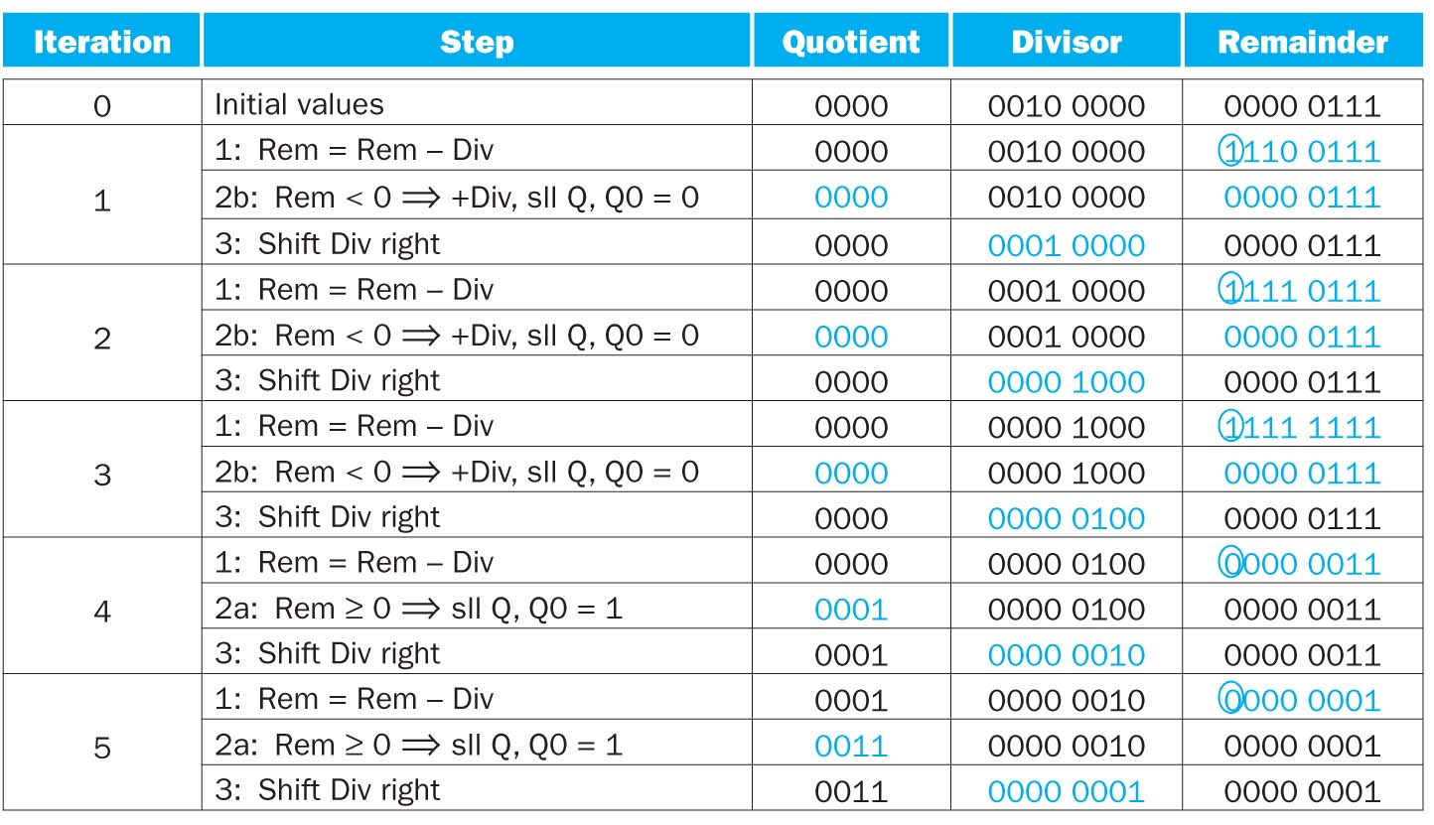
Example
7/2
Notes:
Need n+1 iterations.

Slide 9
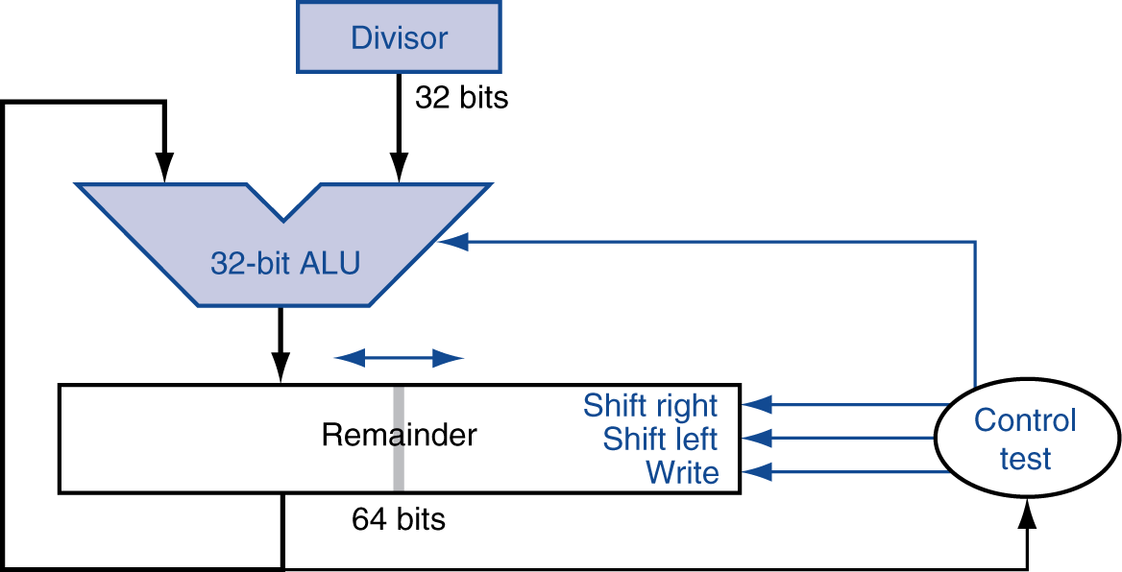
Optimized Divider
One cycle per partial-remainder subtraction
Looks a lot like a multiplier!
Same hardware can be used for both
Notes:
Start: Dividend in right half, zeros in left half of “Remainder”
Remainder in left half, quotient in right half
The “one cycle” part is only if you adder only takes 1 cycle…may not be the case
Work out 7/2 example

Slide 10
Iter | Step | Rem | Quotient
0 | Initial
1 | Shift
 | Sub?
 | Q0=?
2 | Shift
 | Sub?
 | Q0=?
3 | Shift
 | Sub?
 | Q0=?
4 | Shift
 | Sub?
 | Q0=?
Notes:
7/2 Example.

Slide 11
Faster Division
Can’t use parallel hardware as in multiplier
Subtraction is conditional on sign of remainder
Faster dividers (e.g. SRT division) generate multiple quotient bits per step
Still require multiple steps
Notes:
Fastest I know of is O(log^2 n). In practice, 2-4x slower than mult?

Slide 12
MIPS Division
Use HI/LO registers for result
HI: 32-bit remainder
LO: 32-bit quotient
Instructions
div rs, rt / divu rs, rt
No overflow or divide-by-0 checking
Software must perform checks if required
Use mfhi, mflo to access result
Notes:
Also div and divu with 3 registers: pseudoinstructions that give you the quotient
Also rem, and remu pseudoinstructions.

Slide 13
Example Revisit
A better way to do 7/2?
7>>2
SRL
Most compiler will replace divide by power of 2 using right shift operations

Slide 14
Summary
Multiplication
First version of multiplication
Optimized multiplication
Division

Slide 15
3.5: Floating Point
Notes:
With integers, we could store all the values in a particular range. For real numbers, this is impossible. Why? Think about [0,1].
Instead, we’ve got to pick a representation that allows us to store some values spaced out in some range, hopefully to high enough precision that we can do scientific calculations.

Slide 16
Floating Point
§3.5 Floating Point
Representation for non-integral numbers
Including very small and very large numbers
Like scientific notation
–2.34 × 10⁵⁶
+0.002 × 10^{–4}
+987.02 × 10⁹
In binary
±1.xxxxxxx₂ × 2^{yyyy}
Types float and double in C
normalized
not normalized
Notes:
Normalized: >= 1 < 10 (single digit before decimal point)

Slide 17
Floating Point Standard
Defined by IEEE Std 754-1985
Developed in response to divergence of representations
Portability issues for scientific code
Now almost universally adopted
Two representations
Single precision (32-bit)
Double precision (64-bit)

Slide 18
IEEE Floating-Point Format
single: 8 bits double: 11 bits
single: 23 bits double: 52 bits
S
Exponent
Fraction
$$x={(−1)}^{S}×(1+\text{Fraction}\text{)}×2^{\text{Exponent}}$$
S: sign bit (0 ⇒ non-negative, 1 ⇒ negative)
Normalize significand: 1.0 ≤ |significand| < 2.0
Always has a leading pre-binary-point 1 bit, so no need to represent it explicitly (hidden bit)
Significand is Fraction with the “1.” restored
Not really, though
Exponent is slightly more complicated
Notes:
Try an example on
Sign: 1
Exponent: 0 0 0 0 0 0 0 1
Fraction: 0 1 0 (0…)
Which is -1.25 * 2^1 = -2.5, except not really

Slide 19
IEEE Floating-Point Format
single: 8 bits double: 11 bits
single: 23 bits double: 52 bits
S
Exponent
Fraction
S: sign bit (0 ⇒ non-negative, 1 ⇒ negative)
Normalize significand: 1.0 ≤ |significand| < 2.0
Always has a leading pre-binary-point 1 bit, so no need to represent it explicitly (hidden bit)
Significand is Fraction with the “1.” restored
Exponent: excess representation: actual exponent + Bias
Ensures exponent is unsigned
Single: Bias = 127; Double: Bias = 1203
Notes:
Book’s terminology of fraction/mantissa vs. significand…not everyone uses them that way.
See p.200 for the reason behind biasing --- basically, it makes comparison a lot easier, hence sorting can be done efficiently.
The bias makes the most negative exponent (which makes a small number) 0…0 and the most positive exponent 1..1
Now example on p.201 (next slide)

Slide 20
Floating-Point Example
Represent –0.75
–0.75 = (–1)¹ × 1.1₂ × 2^{–1}
S = 1
Fraction = 1000…00₂
Exponent = –1 + Bias
Single: –1 + 127 = 126 = 01111110₂
Double: –1 + 1023 = 1022 = 01111111110₂
Single: 1011111101000…00
Double: 1011111111101000…00

Slide 21
Floating-Point Example
What number is represented by the single-precision float
11000000101000…00
S = 1
Fraction = 01000…00₂
Fxponent = 10000001₂ = 129
x = (–1)¹ × (1 + 01₂) × 2^{(129 – 127)}
= (–1) × 1.25 × 2²
= –5.0

