Slide 1
Floating Point
Instructor: Robert Utterback
Lecture 28

Slide 2
Floating Point
§3.5 Floating Point
Representation for non-integral numbers
Including very small and very large numbers
Like scientific notation
–2.34 × 10⁵⁶
+0.002 × 10^{–4}
+987.02 × 10⁹
In binary
±1.xxxxxxx₂ × 2^{yyyy}
Types float and double in C
normalized
not normalized
Notes:
Normalized: >= 1 < 10 (single digit before decimal point)

Slide 3
IEEE Floating-Point Format
single: 8 bits double: 11 bits
single: 23 bits double: 52 bits
S
Exponent
Fraction
S: sign bit (0 ⇒ non-negative, 1 ⇒ negative)
Normalize significand: 1.0 ≤ |significand| < 2.0
Always has a leading pre-binary-point 1 bit, so no need to represent it explicitly (hidden bit)
Significand is Fraction with the “1.” restored
Exponent: excess representation: actual exponent + Bias
Ensures exponent is unsigned
Single: Bias = 127; Double: Bias = 1203
Notes:
Book’s terminology of fraction/mantissa vs. significand…not everyone uses them that way.
See p.200 for the reason behind biasing --- basically, it makes comparison a lot easier, hence sorting can be done efficiently.
The bias makes the most negative exponent (which makes a small number) 0…0 and the most positive exponent 1..1
Now example on p.201 (next slide)

Slide 4
Floating-Point Example
Represent –0.75
–0.75 = (–1)¹ × 1.1₂ × 2^{–1}
S = 1
Fraction = 1000…00₂
Exponent = –1 + Bias
Single: –1 + 127 = 126 = 01111110₂
Double: –1 + 1023 = 1022 = 01111111110₂
Single: 1011111101000…00
Double: 1011111111101000…00

Slide 5
Floating-Point Example
What number is represented by the single-precision float
11000000101000…00
S = 1
Fraction = 01000…00₂
Fxponent = 10000001₂ = 129
x = (–1)¹ × (1 + 01₂) × 2^{(129 – 127)}
= (–1) × 1.25 × 2²
= –5.0

Slide 6
Floating-Point Numbers
Representation of floating point numbers in IEEE 754 standard:
single precision
1
8
23
sign
S
E
F
exponent:
excess 127
binary integer
Fraction (mantissa):
Hidden integer bit: 1.F
(actual exponent is e = E - 127)
Convert the following:
1 1000 0010 0100 0000 0000 0000 0000 000
Selection | Choices
A | - 1.010 * 2^130
B | 10
C | +10
D | 1.010 * 2^130
E | None of the above
Notes:
Single precision example
Correct answer – B
Another example: convert 5.0 to floating point:
5.0 = 101 = 1.01 x 2^2
S=0,
Exp = 2 + 127 = 129 = 1000 0001
M = 01 0…
Result = 0 1000 0001 01 000000000000000000000

Slide 7
Single-Precision Range
Exponents 00000000 and 11111111 reserved
“Smallest” value
Exponent: 00000001 ⇒ actual exponent = 1 – 127 = –126
Fraction: 000…00 ⇒ significand = 1.0
±1.0 × 2^{–126} ≈ ±1.2 × 10^{–38}
Largest value
exponent: 11111110 ⇒ actual exponent = 254 – 127 = +127
Fraction: 111…11 ⇒ significand ≈ 2.0
±2.0 × 2⁺¹²⁷ ≈ ±3.4 × 10⁺³⁸

Slide 8
Double-Precision Range
Exponents 0000…00 and 1111…11 reserved
Smallest value
Exponent: 00000000001 ⇒ actual exponent = 1 – 1023 = –1022
Fraction: 000…00 ⇒ significand = 1.0
±1.0 × 2^{–1022} ≈ ±2.2 × 10^{–308}
Largest value
Exponent: 11111111110 ⇒ actual exponent = 2046 – 1023 = +1023
Fraction: 111…11 ⇒ significand ≈ 2.0
±2.0 × 2⁺¹⁰²³ ≈ ±1.8 × 10⁺³⁰⁸

Slide 9
Floating-Point Precision
Relative precision
all fraction bits are significant
Single: approx 2^{–23}
Notes:
Let’s solve for this…How many decimal digits of precision?
2^23 = 10^x
log_10 2^23 = x
23 * log_10 2

Slide 10
Floating-Point Precision
Relative precision
all fraction bits are significant
Single: approx 2^{–23}
Equivalent to 23 × log₁₀2 ≈ 23 × 0.3 ≈ 6 decimal digits of precision

Slide 11
Floating-Point Precision
Relative precision
all fraction bits are significant
Single: approx 2^{–23}
Equivalent to 23 × log₁₀2 ≈ 23 × 0.3 ≈ 6 decimal digits of precision
Double: approx 2^{–52}

Slide 12
Floating-Point Precision
Relative precision
all fraction bits are significant
Single: approx 2^{–23}
Equivalent to 23 × log₁₀2 ≈ 23 × 0.3 ≈ 6 decimal digits of precision
Double: approx 2^{–52}
Equivalent to 52 × log₁₀2 ≈ 52 × 0.3 ≈ 16 decimal digits of precision

Slide 13
Denormal Numbers
Exponent = 000...0 ⇒ hidden bit is 0
Smaller than normal numbers
allow for gradual underflow, with diminishing precision
Denormal with fraction = 000...0
Two representations of 0.0!
Notes:
How to represent 0?
See figure 3.13 on p.199 (next slide)
We have seen overflow, underflow is when the fraction part you are calculating became so small it can no longer be represented.
All 1 exponent and 0 fraction: Infinity! (positive or negative)
Use infinity for the result when dividing by 0.
All 1 exponent and nonzero fraction: NaN, for 0/0

Slide 14
Infinities and NaNs
Exponent = 111...1, Fraction = 000...0
±Infinity
Can be used in subsequent calculations, avoiding need for overflow check
Exponent = 111...1, Fraction ≠ 000...0
Not-a-Number (NaN)
Indicates illegal or undefined result
e.g., 0.0 / 0.0
Can be used in subsequent calculations

Slide 15
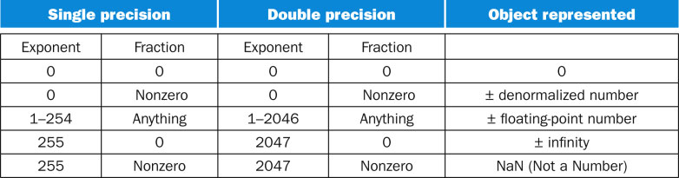
FP Encoding

Slide 16
3.5: Floating Point Arithmetic
Notes:
In the book (and these slides), we’re basically just going to sketch the algorithms. There are actually a lot of details that go into actual floating point arithmetic that are tedious to deal with, but we just want to convey the main ideas.

Slide 17
IEEE Floating-Point Format
single: 8 bits double: 11 bits
single: 23 bits double: 52 bits
S
Exponent
Fraction
S: sign bit (0 ⇒ non-negative, 1 ⇒ negative)
Normalize significand: 1.0 ≤ |significand| < 2.0
Always has a leading pre-binary-point 1 bit, so no need to represent it explicitly (hidden bit)
Significand is Fraction with the “1.” restored
Exponent: excess representation: actual exponent + Bias
Ensures exponent is unsigned
Single: Bias = 127; Double: Bias = 1203
Notes:
Consider a 4-digit decimal example
9.999 × 10¹ + 1.610 × 10^{–1}
Q: How would you do it?

Slide 18
Floating-Point Addition
Consider a 4-digit decimal example
9.999 × 10¹ + 1.610 × 10^{–1}
1. Align decimal points
Shift number with smaller exponent
9.999 × 10¹ + 0.016 × 10¹
2. Add significands
9.999 × 10¹ + 0.016 × 10¹ = 10.015 × 10¹
3. Normalize result & check for over/underflow
1.0015 × 10²
4. Round and renormalize if necessary
1.002 × 10²
Notes:
Notice that rounding (say, 1.99999) may cause the number to become denormalized, so do step 3 again!

Slide 19
Floating-Point Addition
Now consider a 4-digit binary example
1.000₂ × 2^{–1} + –1.110₂ × 2^{–2}
Notes:
Now let’s do a binary example (class exercise).
First, what are these numbers in base 10?
(0.5 + –0.4375)
So now we know what the answer *should* be…

Slide 20
Floating-Point Addition
Now consider a 4-digit binary example
1.000₂ × 2^{–1} + –1.110₂ × 2^{–2}
1. Align binary points
Shift number with smaller exponent
1.000₂ × 2^{–1} + –0.111₂ × 2^{–1}

Slide 21
Floating-Point Addition
Now consider a 4-digit binary example
1.000₂ × 2^{–1} + –1.110₂ × 2^{–2}
1. Align binary points
Shift number with smaller exponent
1.000₂ × 2^{–1} + –0.111₂ × 2^{–1}
2. Add significands
1.000₂ × 2^{–1} + –0.111₂ × 2–1 = 0.001₂ × 2^{–1}
Notes:
First, what are these numbers in base 10?
(0.5 + –0.4375)

Slide 22
Floating-Point Addition
Now consider a 4-digit binary example
1.000₂ × 2^{–1} + –1.110₂ × 2^{–2}
1. Align binary points
Shift number with smaller exponent
1.000₂ × 2^{–1} + –0.111₂ × 2^{–1}
2. Add significands
1.000₂ × 2^{–1} + –0.111₂ × 2–1 = 0.001₂ × 2^{–1}
3. Normalize result & check for over/underflow
1.000₂ × 2^{–4}, with no over/underflow
Notes:
First, what are these numbers in base 10?
(0.5 + –0.4375)

Slide 23
Floating-Point Addition
Now consider a 4-digit binary example
1.000₂ × 2^{–1} + –1.110₂ × 2^{–2}
1. Align binary points
Shift number with smaller exponent
1.000₂ × 2^{–1} + –0.111₂ × 2^{–1}
2. Add significands
1.000₂ × 2^{–1} + –0.111₂ × 2–1 = 0.001₂ × 2^{–1}
3. Normalize result & check for over/underflow
1.000₂ × 2^{–4}, with no over/underflow
4. Round and renormalize if necessary
1.000₂ × 2^{–4} (no change) = 0.0625
Notes:
First, what are these numbers in base 10?
(0.5 + –0.4375)

Slide 24
FP Adder Hardware
Much more complex than integer adder
Doing it in one clock cycle would take too long
Much longer than integer operations
Slower clock would penalize all instructions
FP adder usually takes several cycles
Can be pipelined (multiple adds in progress at same time)

Slide 25
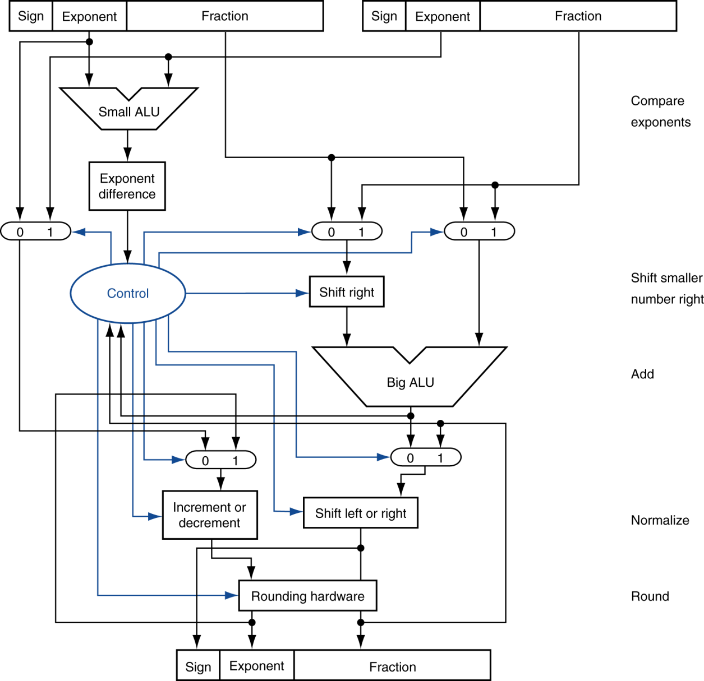
FP Adder Hardware
Step 1
Step 2
Step 3
Step 4

