Slide 1
The Processor
Chapter 4
Notes:
Note about collaboration…

Slide 2
The Big Picture
The Five Classic Components of a Computer
Today’s Topic: Datapath Design, then Control Design
Processor
Input
Control
Memory
Datapath
Output
Notes:
Before we go any further, let’s step back for a second and take a look at the big picture.
All computer consist of five components: (1) Input and (2) output devices. (3) The Memory System. And the (4) Control and (5) Datapath of the Processor.
Today’s lecture covers the datapath and control design.

Slide 3
The Performance Perspective
Processor design (datapath and control) will determine:
Clock cycle time
Clock cycles per instruction
Starting today:
Single cycle processor:
Advantage: One clock cycle per instruction
Disadvantage: long cycle time
ET = Insts * CPI * Cycle Time
Execute an
entire instruction
Notes:
This slide shows how the next two lectures fit into the overall performance picture.
Have seen instruction count, now let’s dig into CPI (and also cycle time somewhat)
Instruction count is controlled by the Instruction Set Architecture and the compiler design so the computer engineer has very little control over it (Instruction Count).
What you as a computer engineer can control, while you are designing a processor, are the Clock Cycle Time and Instruction Count per cycle.
More specifically, in the next two lectures, you will be designing a single cycle processor which by definition takes one clock cycle to execute every instruction.
The disadvantage of this single cycle processor design is that it has a long cycle time.

Slide 4
Simplified Processor
We're ready to look at an implementation of the MIPS simplified to contain only:
memory-reference instructions: lw, sw
arithmetic-logical instructions: add, sub, and, or, slt
control flow instructions: beq, (and j later)
Generic Implementation:
use program counter (PC) to supply instruction address
get the instruction from memory
read registers
use the instruction to decide exactly what to do
Notes:
Later we’ll look at a more realistic processor design.

Slide 5
Instruction Execution
PC → instruction memory, fetch instruction
Register numbers → register file, read registers
Depending on instruction class
Use ALU to calculate
Arithmetic result
Memory address for load/store
Branch target address
Access data memory for load/store
PC ← target address or PC + 4
Notes:
These instructions actually have a lot in common. In particular, many need to read a register and use an ALU to calculate something.
Arithmetic need their result, load/store need to calculate memory address, beq must calculate instruction address…

Slide 6
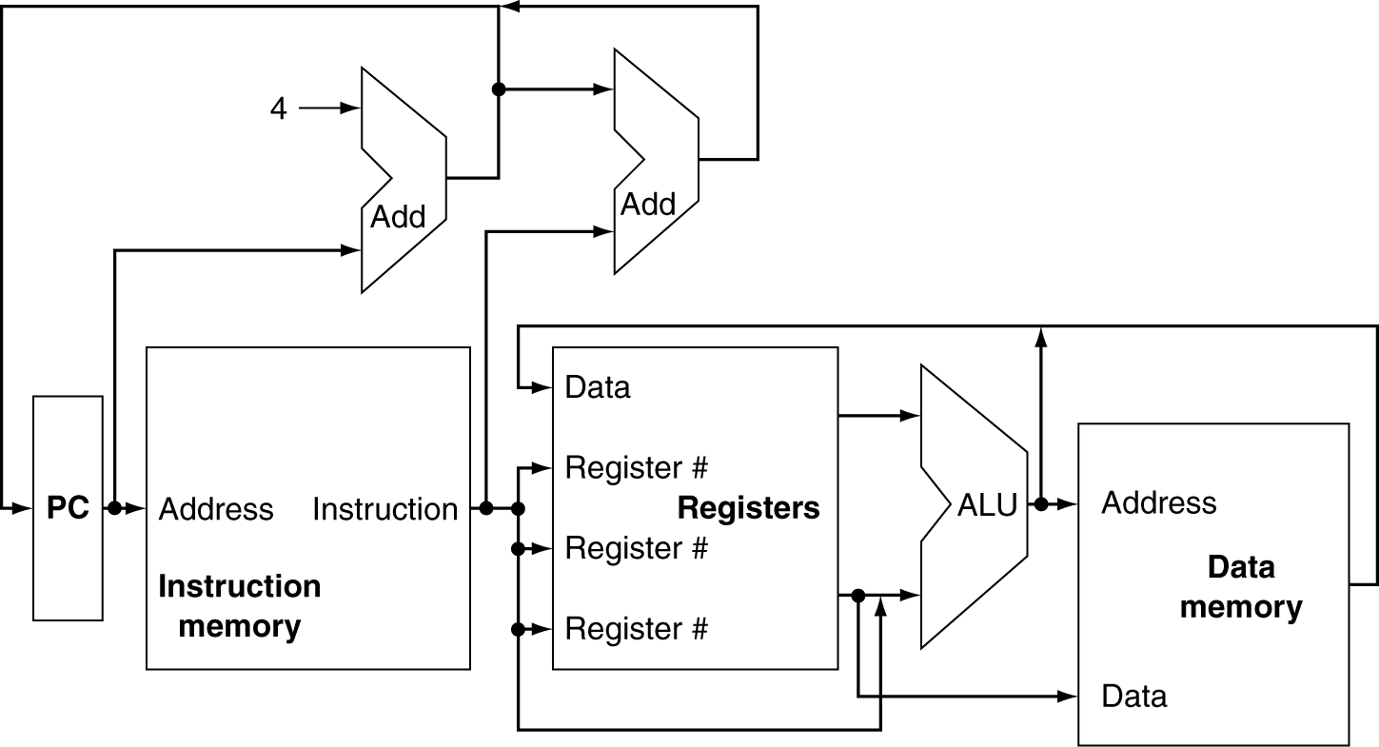
CPU Overview
Notes:
Very basic diagram.
Q: What is top left add for? (get next instruction address)
Q: top right (branch calculation)
Assumes duplicated instruction and data memory, at least for now.

Slide 7
Notes:
Can’t just have multiple lines running into each other!
SQ: What logic component can we use to choose between multiple inputs?

Slide 8
Multiplexers
Can’t just join wires together
Use multiplexers
Notes:
In addition to the muxers, we need to show how we decide which components to use, and how to use them.
e.g. do we take the PC+4 as next instruction, or the result of branch calculation?

Slide 9
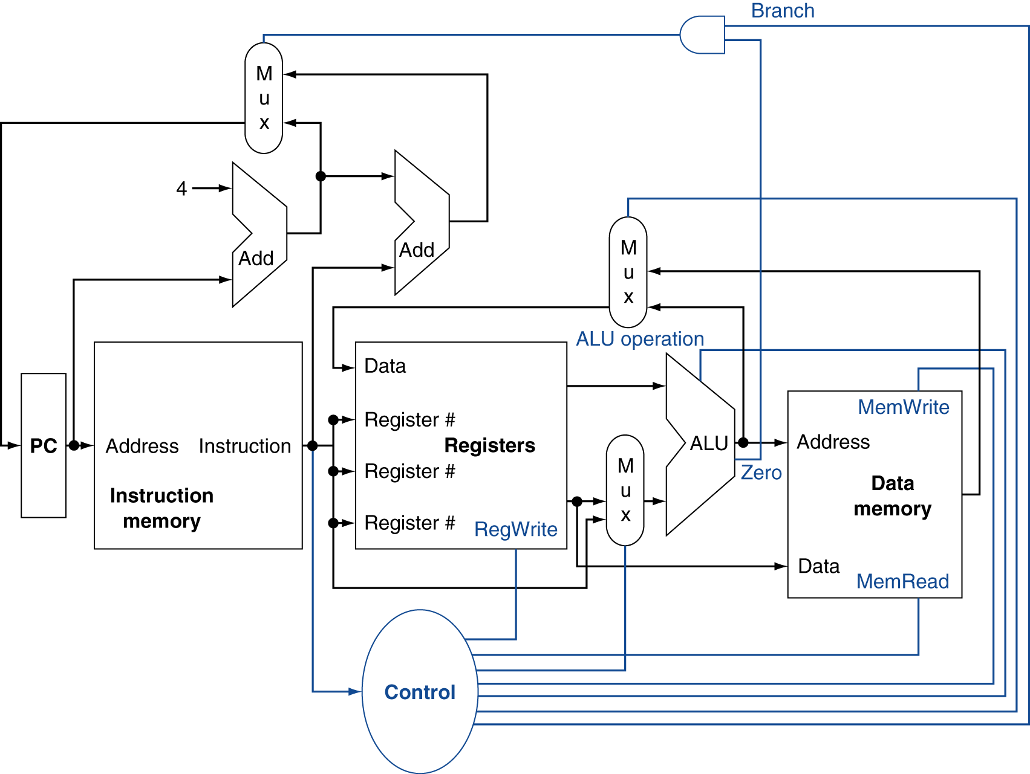
Control
Notes:
We’ll show these “control” lines in blue.
Typically we won’t show all these control wires b/c they make the picture messy. Instead we’ll just show a blue line segment going in to the appropriate place at each block.
Q: What’s the AND gate at the top for? A: Must be branch instruction and result must have been true.

Slide 10
Logic Design Basics
Information encoded in binary
Low voltage = 0, High voltage = 1
One wire per bit
Multi-bit data encoded on multi-wire buses
Combinational element
Operate on data
Output is a function of input
State (sequential) elements
Store information
§4.2 Logic Design Conventions
Notes:
Q: What is diff. between combinational and sequential logic?

Slide 11
Combinational Elements
AND-gate
Y = A & B
Adder
Y = A + B
A
+
Y
B
A
Y
B
Arithmetic/Logic Unit
Y = F(A, B)
Multiplexer
Y = S ? I1 : I0
A
I0
M u x
Y
Y
ALU
I1
B
S
F

Slide 12
Sequential Elements
Register: stores data in a circuit
Uses a clock signal to determine when to update the stored value
Edge-triggered: update when Clk changes from 0 to 1
Clk
D
Q
D
Clk
Q

Slide 13
Sequential Elements
Register with write control
Only updates on clock edge when write control input is 1
Used when stored value is required later
Clk
D
Q
Write
Write
D
Clk
Q

Slide 14
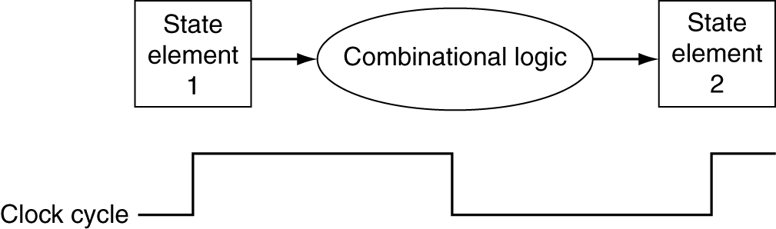
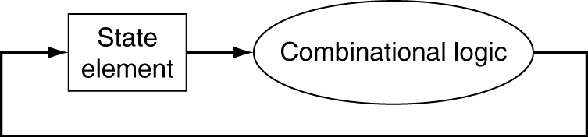
Clocking Methodology
Combinational logic transforms data during clock cycles
Between clock edges
Input from state elements, output to state element
Longest delay determines clock period
Notes:
We have already seen this.
Right half is important b/c we want to be able to read and then write back to a register (e.g., add) in the same clock cycle.
Since this is a single-cycle CPU design, Q: What’s going to limit the cycle time of our clock? How fast can we make it?
A: Equal to the longest delay path through our logic.
Actually there are other factors: setup/hold time, clock skew, but we don’t worry too much about those.

Slide 15
Building a Datapath
Datapath
Elements that process data and addresses in the CPU
Registers, ALUs, mux’s, memories, …
We will build a MIPS datapath incrementally
Refining the overview design
§4.3 Building a Datapath

Slide 16
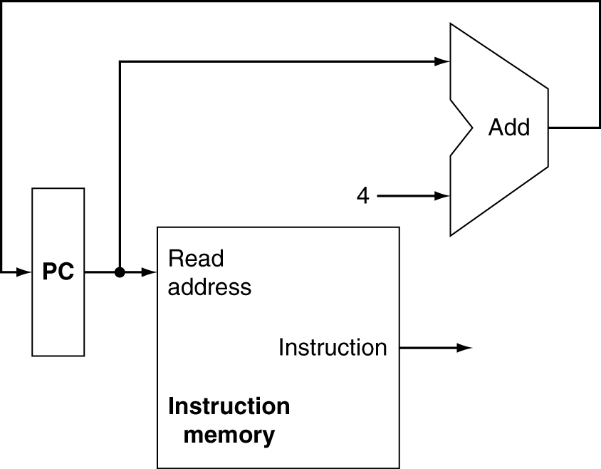
Instruction Fetch
Increment by 4 for next instruction
32-bit register
Notes:
Q: Why do we need to increment by 4? So how big is the PC?

Slide 17
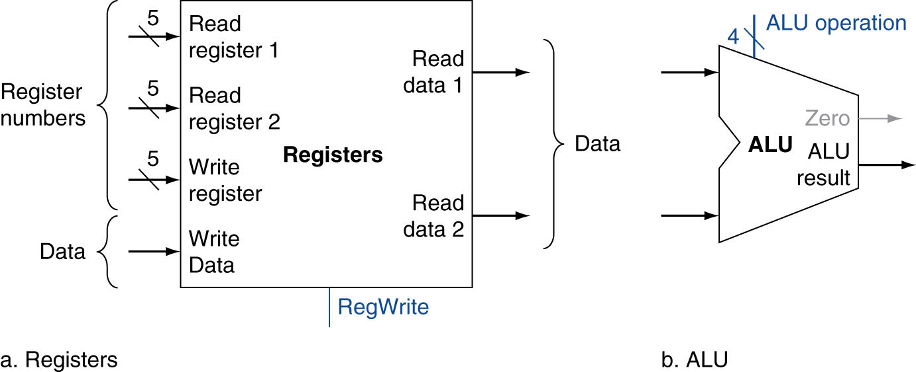
R-Format Instructions
Read two register operands
Perform arithmetic/logical operation
Write register result
Notes:
Q: Why 5 bits?

Slide 18
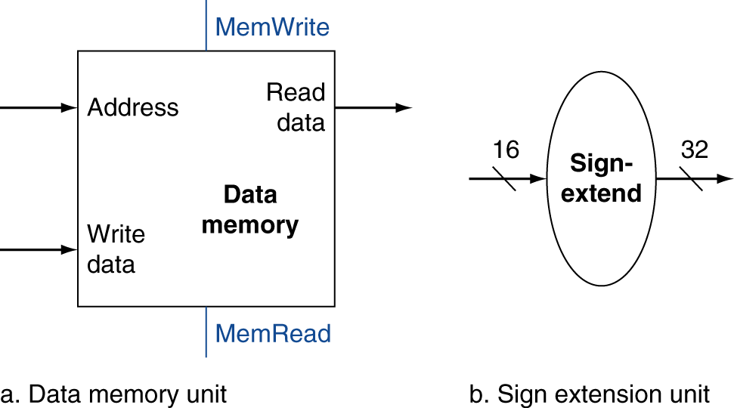
Load/Store Instructions
Read register operands
Calculate address using 16-bit offset
Use ALU, but sign-extend offset
Load: Read memory and update register
Store: Write register value to memory

Slide 19
Branch Instructions
Read register operands
Compare operands
Use ALU, subtract and check Zero output
Calculate target address
Sign-extend displacement
Shift left 2 places (word displacement)
Add to PC + 4
Already calculated by instruction fetch
Notes:
What addressing mode do branch instructions use?

Slide 20
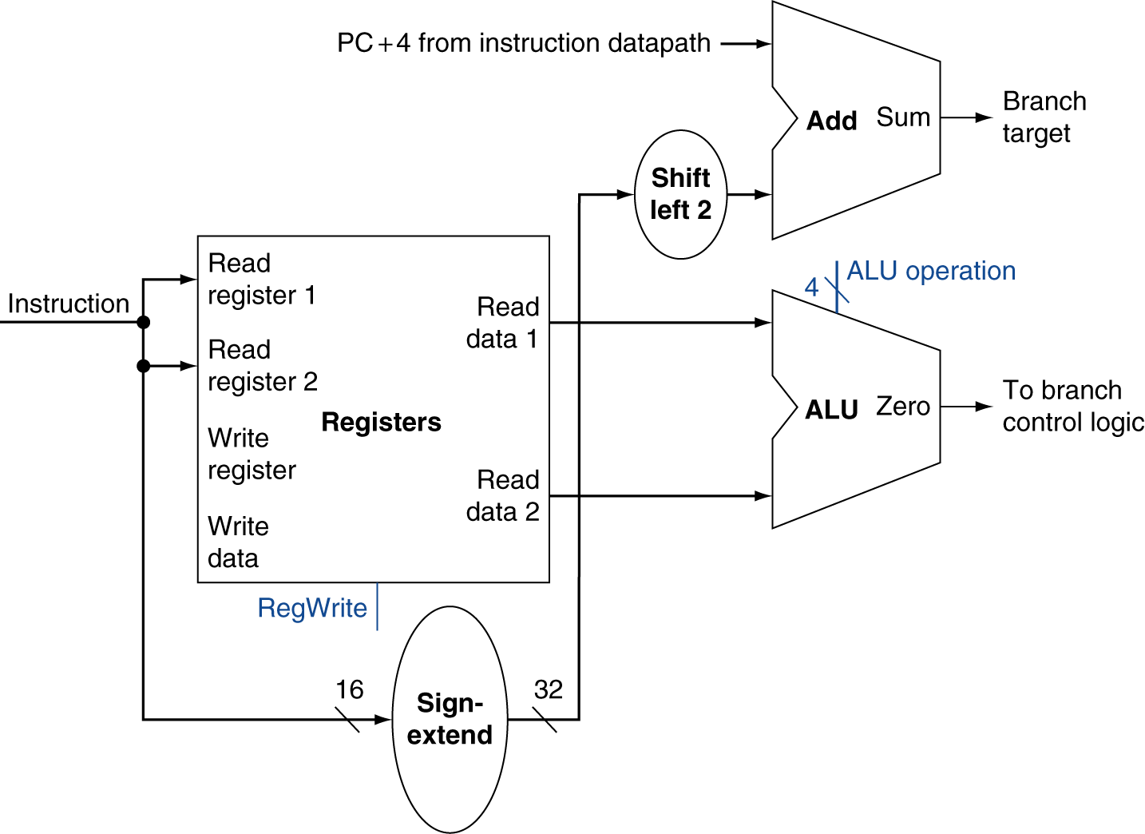
Branch Instructions
Just re-routes wires
Sign-bit wire replicated

Slide 21
Composing the Elements
First-cut data path does an instruction in one clock cycle
Each datapath element can only do one function at a time
Hence, we need separate instruction and data memories
Use multiplexers where alternate data sources are used for different instructions
Notes:
Must first read the instruction before we know which addresses we need to read/write!

Slide 22
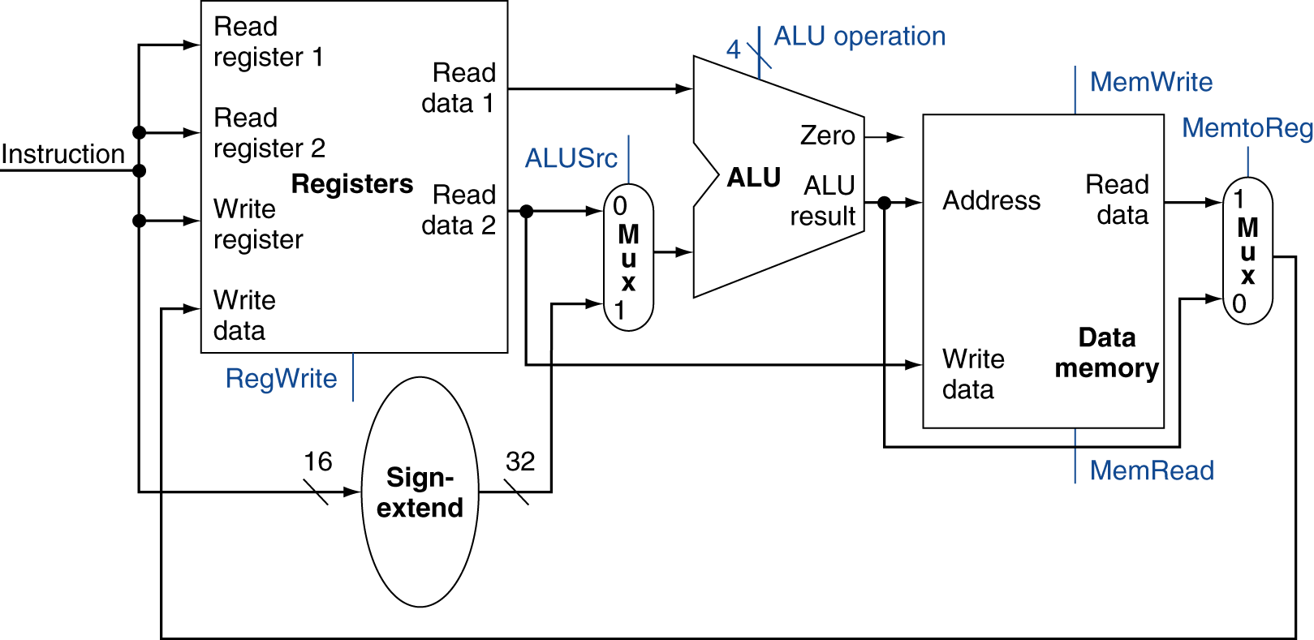
R-Type/Load/Store Datapath

Slide 23
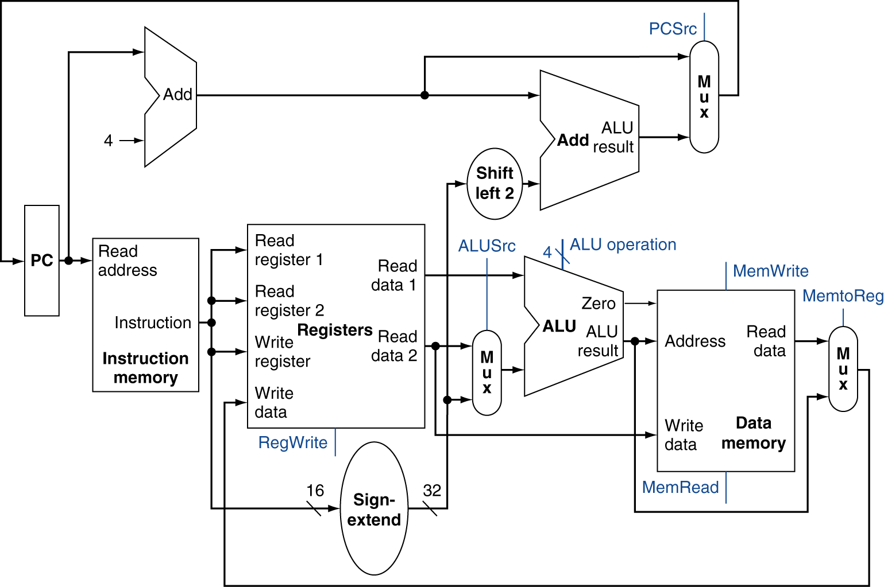
Full Datapath

Slide 24
Active Single-Cycle Datapath
Ignoring control - which instruction does this active datapath represent
R-type
lw
sw
Beq
None of the above
Notes:
B

Slide 25
ALU Control
ALU used for
Load/Store: add
Branch: subtract
R-type: depends on funct field
§4.4 A Simple Implementation Scheme
ALU control | Function
0000 | AND
0001 | OR
0010 | add
0110 | subtract
0111 | set-on-less-than
1100 | NOR
Notes:
Why that relationship between add and subtract? Remember the picture of our ALU?
Need to generate these 4 ALU control bits based on the instruction we are currently executing..

Slide 26
ALU Control
Assume 2-bit ALUOp derived from opcode
Combinational logic derives ALU control
opcode | ALUOp | Operation | funct | ALU function | ALU control
lw | 00 | load word | XXXXXX | add | 0010
sw | 00 | store word | XXXXXX | add | 0010
beq | 01 | branch equal | XXXXXX | subtract | 0110
R-type | 10 | add | 100000 | add | 0010
 |  | subtract | 100010 | subtract | 0110
 |  | AND | 100100 | AND | 0000
 |  | OR | 100101 | OR | 0001
 |  | set-on-less-than | 101010 | set-on-less-than | 0111
Notes:
Split into 3 groups:
Mem access op: 00
Branch: 01
Any R-type: 10

Slide 27
Generating ALU signals
X: (Op1)(!Op0)(F0+F3)
Y: !Op1+!F2
Z: Op0+Op1F1
Select | ALUctr2 | ALUctr1 | ALUctr0
A | X | Y | Z
B | X | Z | Y
C | Y | Z | X
D | Z | Y | X
E | None of the above
func
op
Main
Control
6
ALU
Control
ALUctr
6
ALUop
3
2
Notes:
This, then, is the logic. Notice that two function bits were dropped for being completely redundant (because of our small set of instructions).
Op0 is far-right bit, etc.
Answer: D

Slide 28
The Main Control Unit
Control signals derived from instruction
R-type
0
rs
rt
rd
shamt
funct
31:26
25:21
20:16
15:11
10:6
5:0
Load/ Store
35 or 43
rs
rt
address
31:26
25:21
20:16
15:0
Branch
4
rs
rt
address
31:26
25:21
20:16
15:0
opcode
always read
read, except for load
write for R-type and load
sign-extend and add

Slide 29
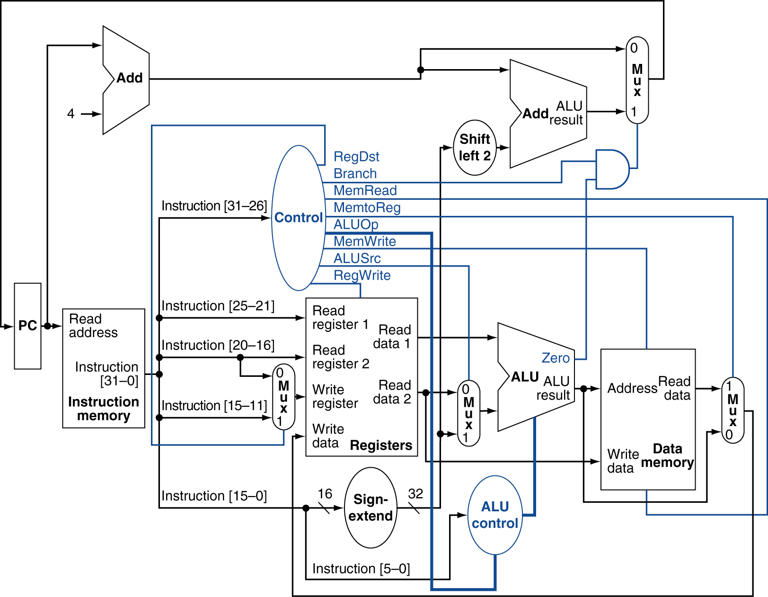
Datapath With Control
Notes:
E: Trace through an add, someone.

Slide 30
Datapath With Control
Select | RegDst | MemToReg | ALUOp
A | 0 | X | 00
B | 1 | 0 | 00
C | 0 | X | 10
D | 1 | 0 | 10
E | None of the above
Notes:
SQ: What are the control signals? A: D

