Slide 1
The Processor
Chapter 4
Notes:
Note about collaboration…

Slide 2
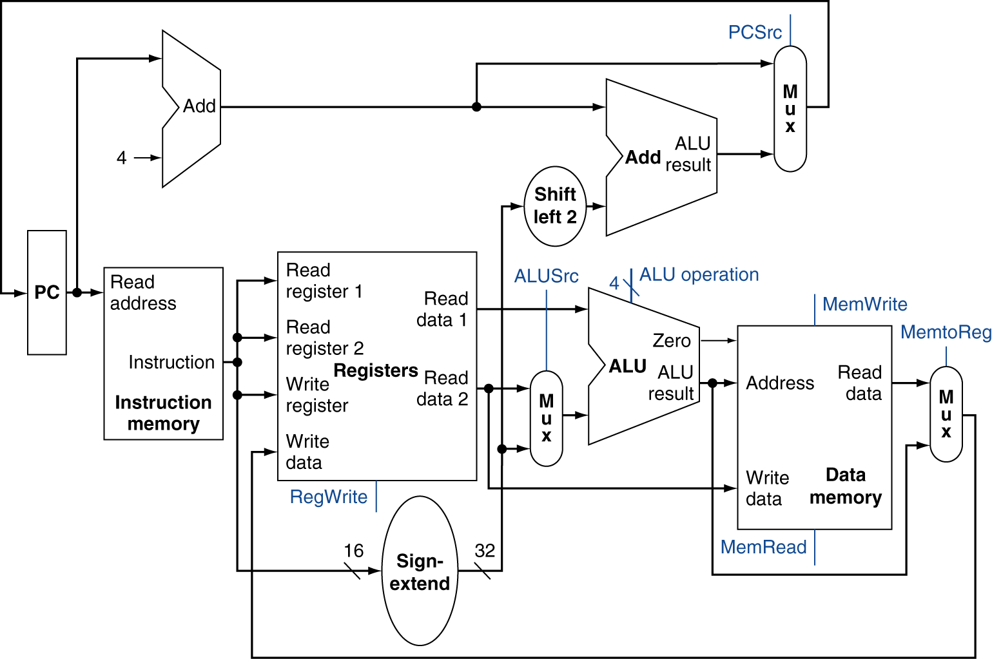
Full Datapath

Slide 3
Active Single-Cycle Datapath
Ignoring control - which instruction does this active datapath represent
R-type
lw
sw
Beq
None of the above
Notes:
B

Slide 4
ALU Control
Assume 2-bit ALUOp derived from opcode
Combinational logic derives ALU control
opcode | ALUOp | Operation | funct | ALU function | ALU control
lw | 00 | load word | XXXXXX | add | 0010
sw | 00 | store word | XXXXXX | add | 0010
beq | 01 | branch equal | XXXXXX | subtract | 0110
R-type | 10 | add | 100000 | add | 0010
 |  | subtract | 100010 | subtract | 0110
 |  | AND | 100100 | AND | 0000
 |  | OR | 100101 | OR | 0001
 |  | set-on-less-than | 101010 | set-on-less-than | 0111
Notes:
Split into 3 groups:
Mem access op: 00
Branch: 01
Any R-type: 10

Slide 5
The Main Control Unit
Control signals derived from instruction
R-type
0
rs
rt
rd
shamt
funct
31:26
25:21
20:16
15:11
10:6
5:0
Load/ Store
35 or 43
rs
rt
address
31:26
25:21
20:16
15:0
Branch
4
rs
rt
address
31:26
25:21
20:16
15:0
opcode
always read
read, except for load
write for R-type and load
sign-extend and add

Slide 6
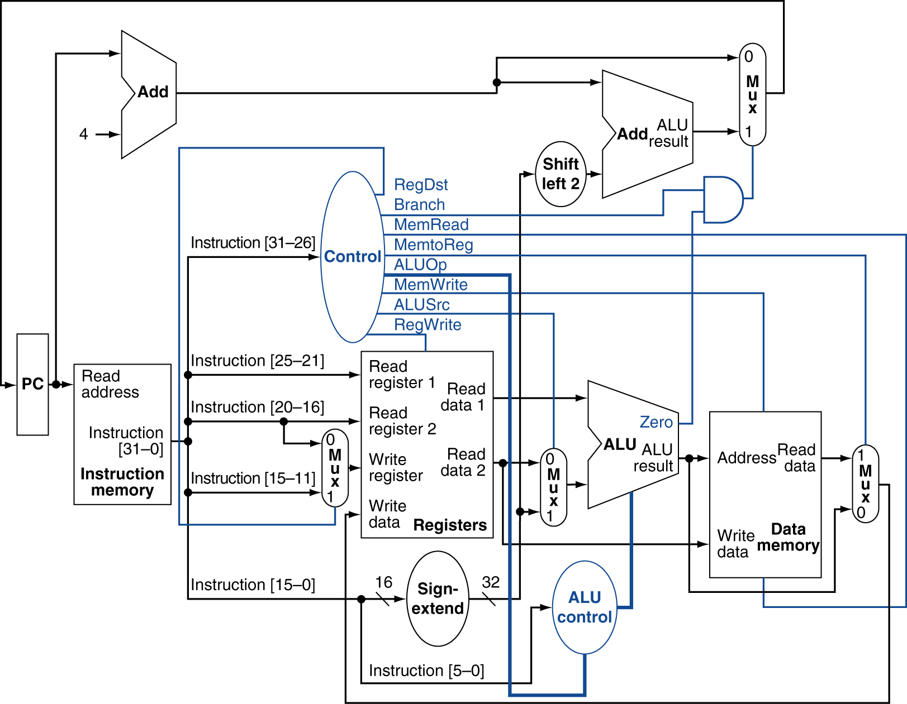
Datapath With Control
Notes:
E: Trace through an add, someone.
Highlight the active lines/buses.

Slide 7
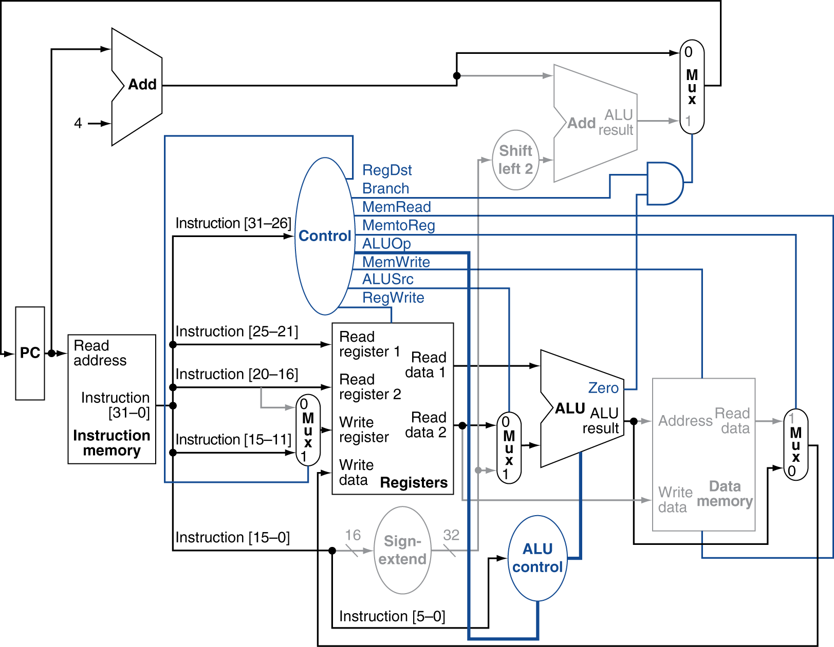
R-Type Instruction
Notes:
Q: How would an addi work?

Slide 8
Store Instruction
Notes:
E: Now trace through a sw.

Slide 9
BEQ
Notes:
E: Now trace through a beq.

Slide 10
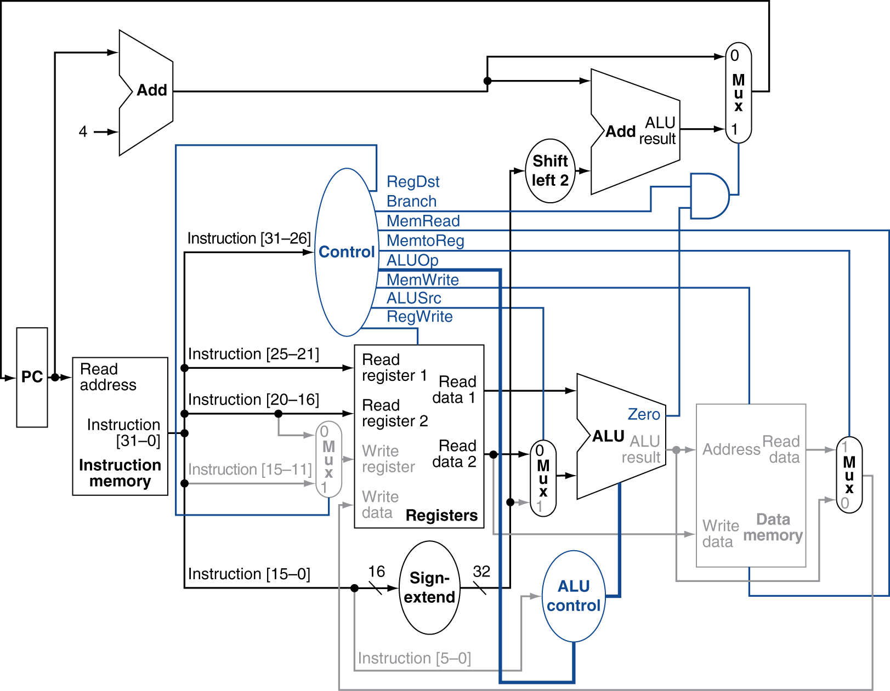
Branch-on-Equal Instruction
Notes:
Now, this is almost complete.
Q: How might we implement the jump instruction? What do we need to DO (what is the specification of jump)? What components do we need to add?

Slide 11
Implementing Jumps
Jump
2
address
31:26
25:0
Jump uses word address
Update PC with concatenation of
Top 4 bits of old PC
26-bit jump address
00
Need an extra control signal decoded from opcode
Notes:
Why the 00?
Let’s see if we can add this to our diagram

Slide 12
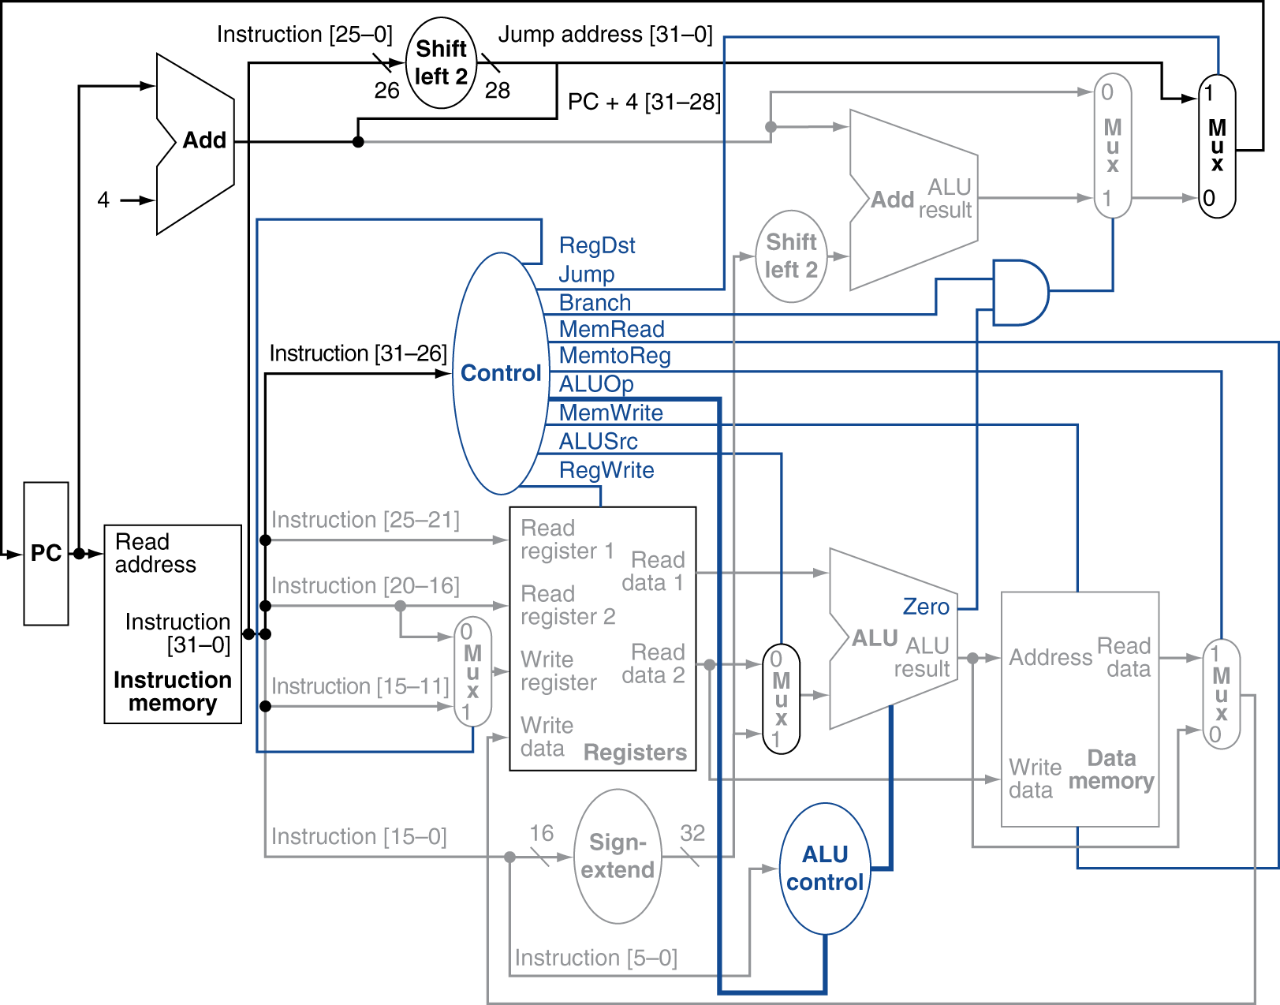
Datapath With Jumps Added
Notes:
Notice how EVERYTHING is happening in parallel, at the same time. For example, the 0-25 instruction bits get shifted and concatenated as if they were a jump address even when they were not. It’s the multiplexors that choose whether or not that value is actually used.

Slide 13
Performance Issues
Longest delay determines clock period
Critical path: load instruction
Instruction memory → register file → ALU → data memory → register file
Not feasible to vary period for different instructions
Violates design principle
Making the common case fast
We will improve performance by pipelining
Notes:
Notice CPI is 1 here, but clock period is long…
Before we go on, exercise:

Slide 14
Control Truth Table
Notes:
So then we have another truth table. Again, since we can derive a truth table, we must be able to design the logic for it (e.g., use PLA,etc.)
Note ALU control is separate, this just generates the ALUOp bits, which are then used together with funct.
Go over, say, sw. Since RegWrite=0, we don’t care about RegDst (flip back to diagram).

Slide 15
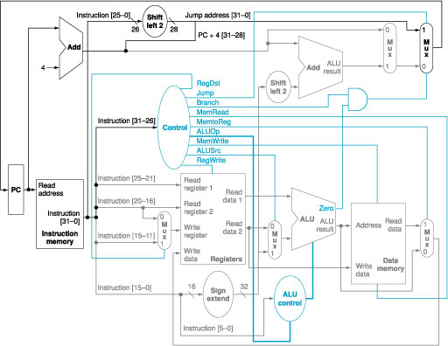
D
B
A
C
Which wire – if always ZERO – would break add?
Notes:
Equal (HW) – heads Correct Answer - D

Slide 16
D
B
A
C
Which wire – if always ZERO – would break lw?
Notes:
Correct Answer – B AND C.
Primary Purpose: Helping students understand the single-cycle processor
Concept: Understanding how control lines dictate the behavior of the processor
Expected mistakes: If they don’t understand how lw functions – they may not understand the control signals.
Post Discussion: Draw the active datapath of both instructions and mark control signals.

Slide 17
Add new instructions
Potentially requires modifying the datapath
Potentially requires adding more control wires – which would impact our previous truth table.

Slide 18
Do we need to modify our single-cycle design to do jr
Select | Best Answer
A | Yes – we need both new control and datapath.
B | Yes – we need just datapath.
C | No – but we should for better performance.
D | No – just changing control signals is fine.
E | Single cycle can’t do jump register.
Notes:
A

Slide 19
Exercise
New instruction: lwi rt, rd(rs)
Meaning:
Reg[rt] = Mem[Reg[rd] + Reg[rs]]
How to implement this?
What datapath blocks are used?
What new blocks?
What new control signals?

Slide 20
LWI
Notes:
Datapath: This instruction uses instruction memory, both register read ports, the ALU
to add Rd and Rs together, data memory, and write port in Registers.
New blocks? None. is instruction can be implemented using existing blocks.
New control? None. is instruction can be implemented without adding new control signals. It only requires changes in the Control logic.
Q: What would the ALU operation be? Various mux selects?

