Slide 1
Instructions: Language of the Computer (Ch 2)
Instructor: Robert Utterback
Lecture 11

Slide 2
Instruction Set
§2.1 Introduction
The repertoire of instructions of a computer
Different computers have different instruction sets
But with many aspects in common
Early computers had very simple instruction sets
Simplified implementation
Many modern computers also have simple instruction sets
Notes:
Instructions: commands that a computer can understand

Slide 3
CISC and RISC
CISC (complex instruction set computer)
VAX, Intel X86, IBM 360/370, etc.
RISC (reduced instruction set computer)
MIPS, DEC Alpha, SUN Sparc, IBM RS6000
Boundaries have blurred
Modern CPUs utilize features of both
Notes:
Basically two camps…
RISC are simple instructions, that are easier to implement and also to understand
CISC is complex instructions, harder to understand and implement, but each instruction can do more complicated and fancy things.

Slide 4
The MIPS Instruction Set
Used as the example throughout the book
Stanford MIPS commercialized by MIPS Technologies (www.mips.com)
Large share of embedded core market
Applications in consumer electronics, network/storage equipment, cameras, printers, …
Typical of many modern ISAs
See MIPS Reference Data tear-out card, and Appendixes B and E
Notes:
Microprocessor without Interlocked Pipeline Stages

Slide 5
Arithmetic Operations
Add and subtract, three operands
Two sources and one destination
add a, b, c # a gets b + c
All arithmetic operations have this form
How about a = b + c + d?
§2.2 Operations of the Computer Hardware
Notes:
add a, b, c
add a, a, d
But actually these are not variables, they are registers!

Slide 6
ISA Design
Design Principle 1: Simplicity favors regularity
Regularity makes implementation simpler
Simplicity enables higher performance at lower cost
§2.2 Operations of the Computer Hardware
Notes:
A, b, and c are just abstract locations here…

Slide 7
Arithmetic Example
C code:
f = (g + h) - (i + j);
Compiled MIPS code:
add t0, g, h # temp t0 = g + h add t1, i, j # temp t1 = i + j sub f, t0, t1 # f = t0 - t1
Notes:
All our arithmetic operations take exactly three operands: 2 to read, 1 to write. So if you have more you’ll need multiple instructions.
Take a minute to write the MIPS code for this.

Slide 8
More Arithmetic Example
C code:
f = g + h + i + j + k;
Compiled MIPS code:
add t0, g, h # temp t0 = g + h add t1, t0, i # temp t1 = t0 + i add t2, t1, j # temp t2 = t1 + j add f, t2, k # f = t2 + k
Do we really need three registers?
Notes:
Can just continually add to f

Slide 9
Register Operands
Arithmetic instructions use register operands
MIPS has a 32 × 32-bit register file
Use for frequently accessed data
Numbered 0 to 31
32-bit data called a “word”
Assembler names
$t0, $t1, …, $t9 for temporary values
$s0, $s1, …, $s7 for saved variables
Why only 32?
§2.3 Operands of the Computer Hardware
Notes:
It’d be annoying to just use numbers for registers, so we have a few mnemonics that the assembler helps us with.
For now, just s and t. We’ll get to why these names, and use the rest of the registers, in 2.8.

Slide 10
ISA Design
Design Principle 2: Smaller is faster
c.f. main memory: millions of locations

Slide 11
Register Operand Example
C code:
f = (g + h) - (i + j);
f, …, j in $s0, …, $s4
Compiled MIPS code:
add $t0, $s1, $s2 add $t1, $s3, $s4 sub $s0, $t0, $t1

Slide 12
Memory Operands
Main memory used for composite data
Arrays, structures, dynamic data
To apply arithmetic operations
Load values from memory into registers
Store result from register to memory
Memory is byte addressed
Each address identifies an 8-bit byte
Words are aligned in memory
Address must be a multiple of 4
Notes:
Very important to understand memory and visualize it in your head!

Slide 13
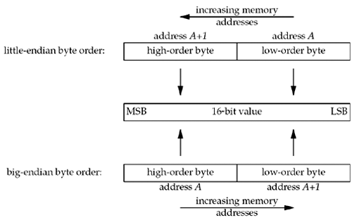
Byte Ordering
Little-endian byte order
With the low-order byte at the starting address
Example: Intel, DEC
Big-endian byte order
With the high-order byte at the starting address
Example: HP, IBM, Motorola 68000
Internet standard byte ordering
Format 256₁₀ in little-endian and big-endian using 16 bits
Format
Value
Little-Endian
00000000 00000001
Big-Endian
00000001 00000000
Notes:
MIPS is Big Endian
Most-significant byte at least address of a word
c.f. Little Endian: least-significant byte at least address

