Slide 1
The Memory Hierarchy
Chapter 5

Slide 2
From the book we know SRAM is very fast, expensive ($/GB), and small. We also know Disks are slow, inexpensive ($/GB), and large. Which statement best describes the role of cache when it works.
Selection | Role of caching
A | Locality allows us to keep frequently touched data in SRAM.
B | Locality allows us the illusion of memory as fast as SRAM but as large as a disk.
C | SRAM is too expensive to have large – so it must be small and caching helps use it well.
D | Disks are too slow – we have to have something faster for our processor to access.
E | None of these accurately describes the roll of cache.

Slide 3
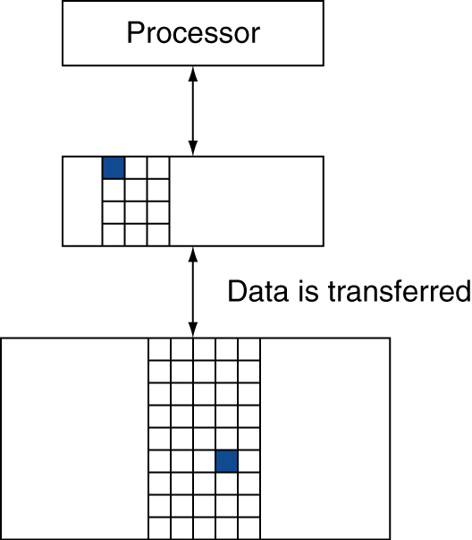
Cache Memory
Memory access
How to tell if hit or miss?
Cache miss
Where to put data?
What to throw out?
How to remember what data this is?
§5.3 The Basics of Caches

Slide 4
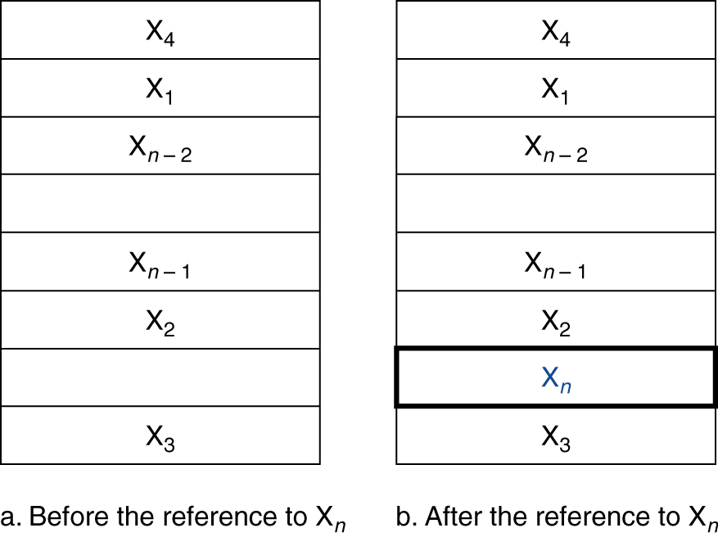
Cache Memory
Cache memory
The level of the memory hierarchy closest to the CPU
Given accesses X₁, …, X_{n–1}, X_{n}
§5.3 The Basics of Caches
How do we know if the data is present?
Where do we look?
Notes:
Focus on these questions first.
Brainstorm some ideas on how to do this?

Slide 5
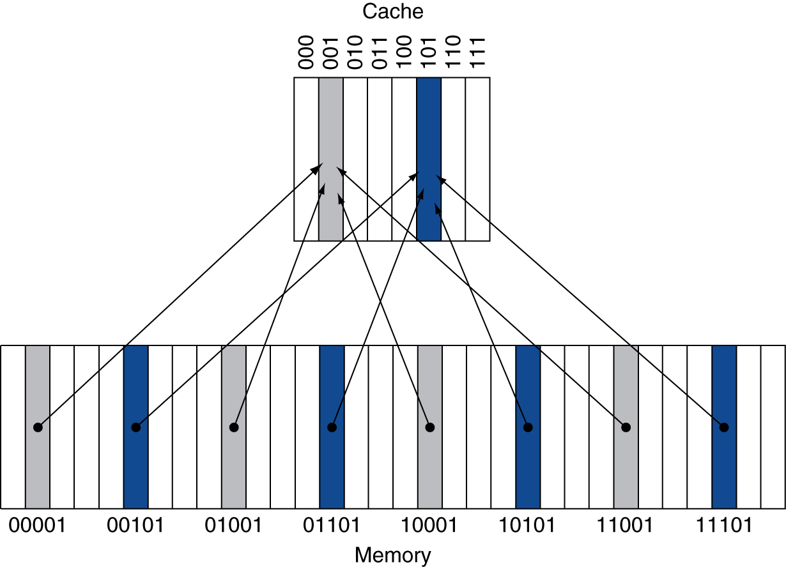
Direct Mapped Cache
Location determined by address
Direct mapped: only one choice
(Block address) modulo (#Blocks in cache)
#Blocks is a power of 2
Use low-order address bits
Notes:
BTW, what’s the problem with this approach?
We may have two slots and also use two memory locations. Theoretically they should both fit in cache, but if they both map to the same slot they don’t!

Slide 6
Tags and Valid Bits
How do we know which particular block is stored in a cache location?
Store block address as well as the data
Actually, only need the high-order bits
Called the tag
What if there is no data in a location?
Valid bit: 1 = present, 0 = not present
Initially 0
Notes:
Q

Slide 7
Cache Example
8-blocks, 1 word/block, direct mapped
Initial state
Index | V | Tag | Data
000 | N
001 | N
010 | N
011 | N
100 | N
101 | N
110 | N
111 | N
Notes:
First we are just going to think about reads.
Accesses:
22, 10 110
26, 11 010
22, 10 110
26, 11 010
16, 10 000
3, 00 011
16, 10 000
18, 10 010
16, 10 000

Slide 8
Cache Example
Word addr | Binary addr | Hit/miss | Cache block
22 | 10 110 | Miss | 110
Index | V | Tag | Data
000 | N
001 | N
010 | N
011 | N
100 | N
101 | N
110 | N
111 | N

Slide 9
Cache Example
Word addr | Binary addr | Hit/miss | Cache block
22 | 10 110 | Miss | 110
Index | V | Tag | Data
000 | N
001 | N
010 | N
011 | N
100 | N
101 | N
110 | Y | 10 | Mem[10110]
111 | N

Slide 10
Cache Example
Word addr | Binary addr | Hit/miss | Cache block
26 | 11 010 | Miss | 010
Index | V | Tag | Data
000 | N
001 | N
010 | N
011 | N
100 | N
101 | N
110 | Y | 10 | Mem[10110]
111 | N

Slide 11
Cache Example
Word addr | Binary addr | Hit/miss | Cache block
26 | 11 010 | Miss | 010
Index | V | Tag | Data
000 | N
001 | N
010 | Y | 11 | Mem[11010]
011 | N
100 | N
101 | N
110 | Y | 10 | Mem[10110]
111 | N

Slide 12
Cache Example
Word addr | Binary addr | Hit/miss | Cache block
22 | 10 110 | Hit | 110
26 | 11 010 | Hit | 010
Index | V | Tag | Data
000 | N
001 | N
010 | Y | 11 | Mem[11010]
011 | N
100 | N
101 | N
110 | Y | 10 | Mem[10110]
111 | N

Slide 13
Cache Example
Word addr | Binary addr | Hit/miss | Cache block
16 | 10 000 | Miss | 000
3 | 00 011 | Miss | 011
16 | 10 000 | Hit | 000
Index | V | Tag | Data
000 | N
001 | N
010 | Y | 11 | Mem[11010]
011 | N
100 | N
101 | N
110 | Y | 10 | Mem[10110]
111 | N

Slide 14
Cache Example
Word addr | Binary addr | Hit/miss | Cache block
16 | 10 000 | Miss | 000
3 | 00 011 | Miss | 011
16 | 10 000 | Hit | 000
Index | V | Tag | Data
000 | Y | 10 | Mem[10000]
001 | N
010 | Y | 11 | Mem[11010]
011 | Y | 00 | Mem[00011]
100 | N
101 | N
110 | Y | 10 | Mem[10110]
111 | N

Slide 15
Cache Example
Word addr | Binary addr | Hit/miss | Cache block
18 | 10 010 | Miss | 010
Index | V | Tag | Data
000 | Y | 10 | Mem[10000]
001 | N
010 | Y | 11 | Mem[11010]
011 | Y | 00 | Mem[00011]
100 | N
101 | N
110 | Y | 10 | Mem[10110]
111 | N

Slide 16
Cache Example
Word addr | Binary addr | Hit/miss | Cache block
18 | 10 010 | Miss | 010
Index | V | Tag | Data
000 | Y | 10 | Mem[10000]
001 | N
010 | Y | 10 | Mem[10010]
011 | Y | 00 | Mem[00011]
100 | N
101 | N
110 | Y | 10 | Mem[10110]
111 | N

Slide 17
Direct Mapped Cache
4
8
12
4
8
20
4
8
20
24
12
8
4
addresses
00 00 01 00
00 00 10 00
00 00 11 00
00 00 01 00
00 00 10 00
00 01 01 00
00 00 01 00
00 00 10 00
00 01 01 00
00 01 10 00
00 00 11 00
00 00 10 00
00 00 01 00
A
M
M
M
H
H
M
M
H
H
M
H
H
H
B
M
M
M
H
H
M
M
H
M
M
H
M
M
C
M
M
M
H
H
M
H
H
H
M M
H
M
D
M
H
M
H
H
M
H
H
H
M
H
H
M
E
None are correct
tag
data
00
01
10
11
4 blocks, each block holds one word, each word
in memory maps to exactly one cache location.
Notes:
B

Slide 18
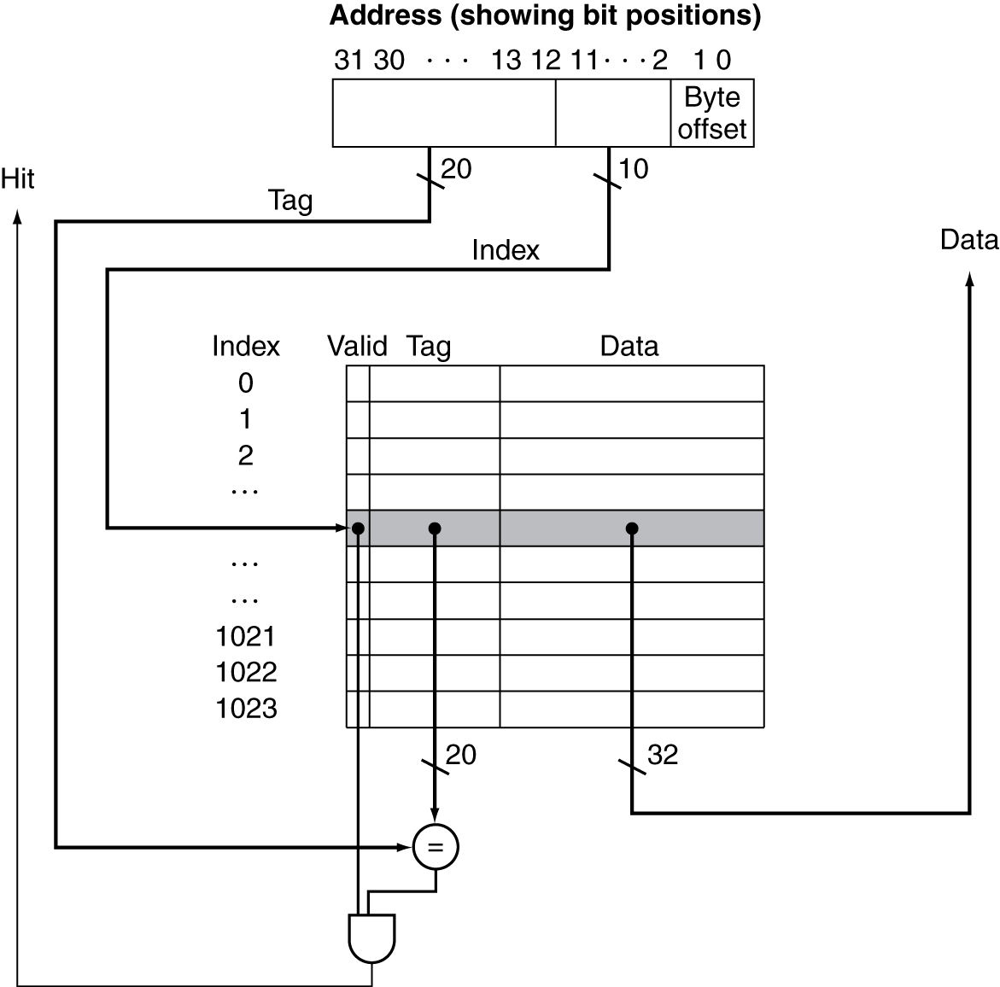
Address Subdivision
Notes:
Data can be grabbed in || with tag compare

Slide 19
Example: Larger Block Size
64 blocks, 16 bytes/block
To what block number does address 1200 map?
Block address = ⎣1200/16⎦ = 75
Block number = 75 modulo 64 = 11
31
10
9
4
3
0
Tag
Index
Offset
22 bits
6 bits
4 bits
Notes:
What block address? What block number?
In general, block addr = address / num blocks
Then mod by # blocks to get block number
Question: If you increase block size, how does that affect cache miss rate? More misses or fewer misses?
(at least, from small block sizes to larger)
A: fewer misses b/c of locality (but not too large, because then it causes conflicts)

Slide 20
Block Size Considerations
Larger blocks should reduce miss rate
Due to spatial locality
But in a fixed-sized cache
Larger blocks ⇒ fewer of them
More competition ⇒ increased miss rate
Larger blocks ⇒ pollution
Larger miss penalty
Can override benefit of reduced miss rate
Early restart and critical-word-first can help

Slide 21
Cache Misses
On cache hit, CPU proceeds normally
On cache miss
Stall the CPU pipeline
Fetch block from next level of hierarchy
Instruction cache miss
Restart instruction fetch
Data cache miss
Complete data access
Notes:
OOO pipelines (superscalar) can actually get around this by executing other, non-dependent instructions…
If you’re reading, you basically might as well put it in the cache; you’re likely to need it again. The same is not necessarily true for writes…
Now: how to handle writes?

Slide 22
Dealing with Writes
Stores must be handled differently than loads, because...
they don’t necessarily require the CPU to stall.
they change the content of cache/memory (creating memory consistency issues)
may require a _______ and a store to complete
Notes:
There have been a number of issues glossed over – we’ll cover those now
May require a load if you want to bring into cache!

Slide 23
Write-Through
On data-write hit, could just update the block in cache
But then cache and memory would be inconsistent
Write through: also update memory
But makes writes take longer
e.g., if base CPI = 1, 10% of instructions are stores, write to memory takes 100 cycles
Effective CPI = 1 + 0.1×100 = 11
Solution: write buffer
Holds data waiting to be written to memory
CPU continues immediately
Only stalls on write if write buffer is already full

Slide 24
Write-Back
Alternative: On data-write hit, just update the block in cache
Keep track of whether each block is “dirty”
When a dirty block is replaced
Write it back to memory
Can use a write buffer to allow replacing block to be read first

