Slide 1
The Memory Hierarchy
Chapter 5

Slide 2
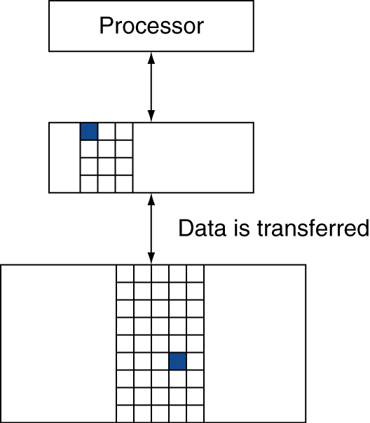
Cache Memory
Memory access
How to tell if hit or miss?
Cache miss
Where to put data?
What to throw out?
How to remember what data this is?
§5.3 The Basics of Caches

Slide 3
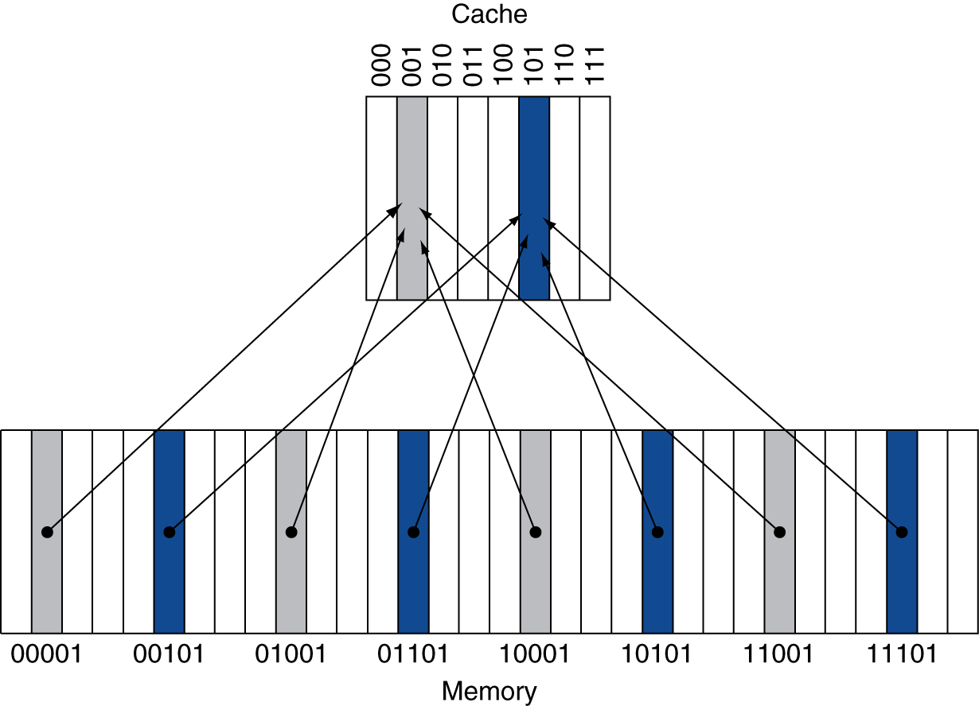
Direct Mapped Cache
Location determined by address
Direct mapped: only one choice
(Block address) modulo (#Blocks in cache)
#Blocks is a power of 2
Use low-order address bits
Notes:
BTW, what’s the problem with this approach?
We may have two slots and also use two memory locations. Theoretically they should both fit in cache, but if they both map to the same slot they don’t!

Slide 4
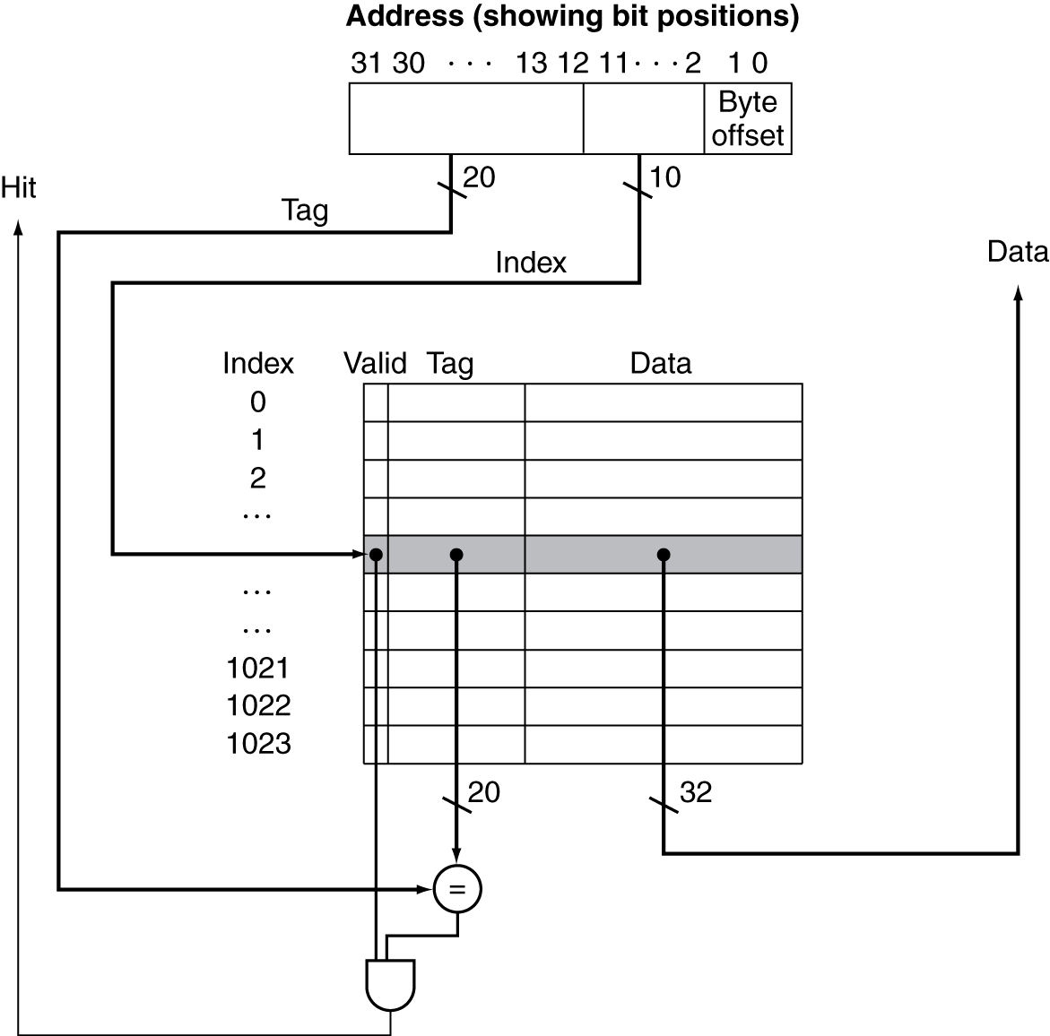
Address Subdivision
Notes:
Data can be grabbed in || with tag compare

Slide 5
Cache Misses
On cache hit, CPU proceeds normally
On cache miss
Stall the CPU pipeline
Fetch block from next level of hierarchy
Instruction cache miss
Restart instruction fetch
Data cache miss
Complete data access
Notes:
OOO pipelines (superscalar) can actually get around this by executing other, non-dependent instructions…
If you’re reading, you basically might as well put it in the cache; you’re likely to need it again. The same is not necessarily true for writes…
Now: how to handle writes?

Slide 6
Write-Through
On data-write hit, could just update the block in cache
But then cache and memory would be inconsistent
Write through: also update memory
But makes writes take longer
e.g., if base CPI = 1, 10% of instructions are stores, write to memory takes 100 cycles
Effective CPI = 1 + 0.1×100 = 11
Solution: write buffer
Holds data waiting to be written to memory
CPU continues immediately
Only stalls on write if write buffer is already full

Slide 7
Write-Back
Alternative: On data-write hit, just update the block in cache
Keep track of whether each block is “dirty”
When a dirty block is replaced
Write it back to memory
Can use a write buffer to allow replacing block to be read first

Slide 8
Write Allocation
What should happen on a write miss?
Alternatives for write-through
Allocate on miss: fetch the block
Write around: don’t fetch the block
Since programs often write a whole block before reading it (e.g., initialization)
For write-back
Usually fetch the block
Notes:
Some chips will even let the operating system decide and switch back and forth.

Slide 9
Store Policies
Given either high store locality or low store locality, which policies might you expect to find?
Selection | High Locality |  | Low Locality
 | Miss Policy | Hit Policy | Miss Policy | Hit Policy
A | Write-allocate | Write-through | Write-around | Write-back
B | Write-around | Write-through | Write-allocate | Write-back
C | Write-allocate | Write-back | Write-around | Write-through
D | Write-around | Write-back | Write-allocate | Write-through
E | None of the above
Notes:
C

Slide 10
Example: Intrinsity FastMATH
Embedded MIPS processor
12-stage pipeline
Instruction and data access on each cycle
Split cache: separate I-cache and D-cache
Each 16KB: 256 blocks × 16 words/block
D-cache: write-through or write-back
SPEC2000 miss rates
I-cache: 0.4%
D-cache: 11.4%
Weighted average: 3.2%
Notes:
This is an embedded processor. Actually let’s the programmer (operating system, really) decide whether to use write-through or write-back.
Q: How many bits will we need to specify the word we want? (4) (also 2 wasted b/c we always address by word)
Q: How many to specify the block (8, b/c 256)
Q: How many tag bits? (32 – 8 – 6 = 18)

Slide 11
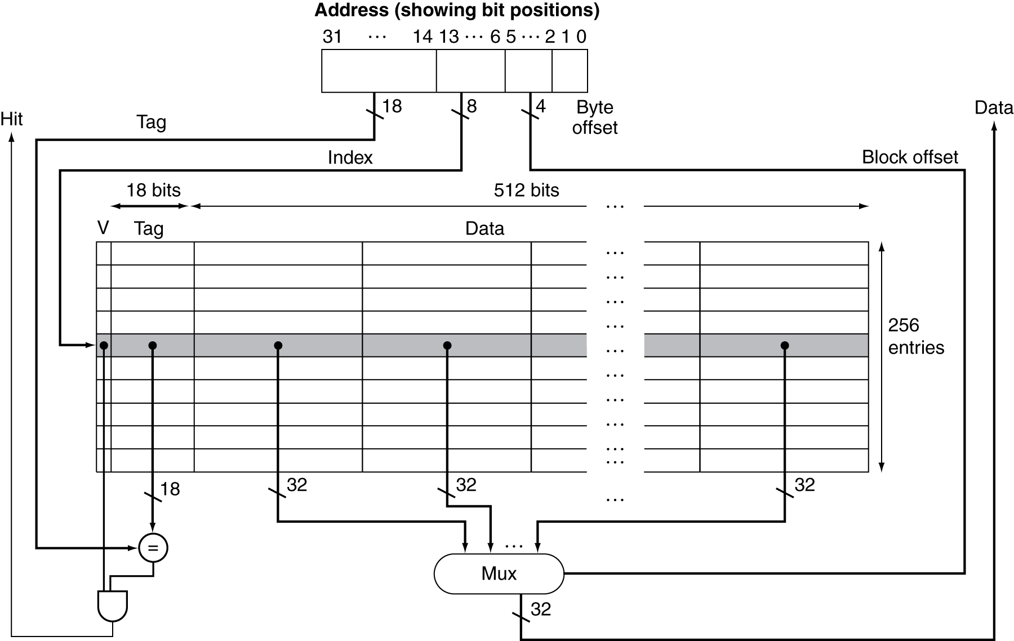
Example: Intrinsity FastMATH

Slide 12
Main Memory Supporting Caches
Use DRAMs for main memory
Fixed width (e.g., 1 word)
Connected by fixed-width clocked bus
Bus clock is typically slower than CPU clock
Example cache block read
1 bus cycle for address transfer
15 bus cycles per DRAM access
1 bus cycle per data transfer
For 4-word block, 1-word-wide DRAM
Miss penalty = 1 + 4×15 + 4×1 = 65 bus cycles
Bandwidth = 16 bytes / 65 cycles = 0.25 B/cycle
Notes:
If we make our bus and DRAM 4 words wide we can get rid of both of these 4s.
If we make DRAM 4 words wide (or make it 4 banks), we can keep the bus small while removing the first 4.
*This is a dumb slide b/c we talked about this earlier and this adds nothing*

Slide 13
Measuring Cache Performance
Components of CPU time
Program execution cycles
Includes cache hit time
Memory stall cycles
Mainly from cache misses
With simplifying assumptions:
§5.4 Measuring and Improving Cache Performance
Notes:
Now let’s dig a little deeper into cache performance.
In particular, we assume that our write buffer never gets too full, or if it does it’s too infrequent to matter.

Slide 14
Cache Performance Example
Given
I-cache miss rate = 2%
D-cache miss rate = 4%
Miss penalty = 100 cycles
Base CPI (ideal cache) = 2
Load & stores are 36% of instructions
Notes:
Q: Calculate CPI
Step 1: I-cache miss cycles
Step 2: D-Cache miss cycles
Step 3: Add these to normal cycles (2 / instruction), divide by # instructions

Slide 15
Cache Performance Example
Given
I-cache miss rate = 2%
D-cache miss rate = 4%
Miss penalty = 100 cycles
Base CPI (ideal cache) = 2
Load & stores are 36% of instructions
Miss cycles per instruction
I-cache: 0.02 × 100 = 2
D-cache: 0.36 × 0.04 × 100 = 1.44
Actual CPI = 2 + 2 + 1.44 = 5.44
Ideal CPU is 5.44/2 =2.72 times faster

Slide 16
Average Access Time
Hit time is also important for performance
Average memory access time (AMAT)
AMAT = Hit time + Miss rate × Miss penalty
Example
CPU with 1ns clock, hit time = 1 cycle, miss penalty = 20 cycles, I-cache miss rate = 5%
AMAT = 1 + 0.05 × 20 = 2ns
2 cycles per instruction

Slide 17
Performance Summary
When CPU performance increased
Miss penalty becomes more significant
Decreasing base CPI
Greater proportion of time spent on memory stalls
Increasing clock rate
Memory stalls account for more CPU cycles
Can’t neglect cache behavior when evaluating system performance
Notes:
This relates to Amdahl’s law…who remembers what this is?
Improved performance = fraction of time in improved component / improvement factor + fraction of time in other components

