Slide 1
The Memory Hierarchy
Chapter 5
Notes:
Write-through vs. Write-back? (write hit policy)
Write-allocate vs. write-around? (write miss policy)

Slide 2
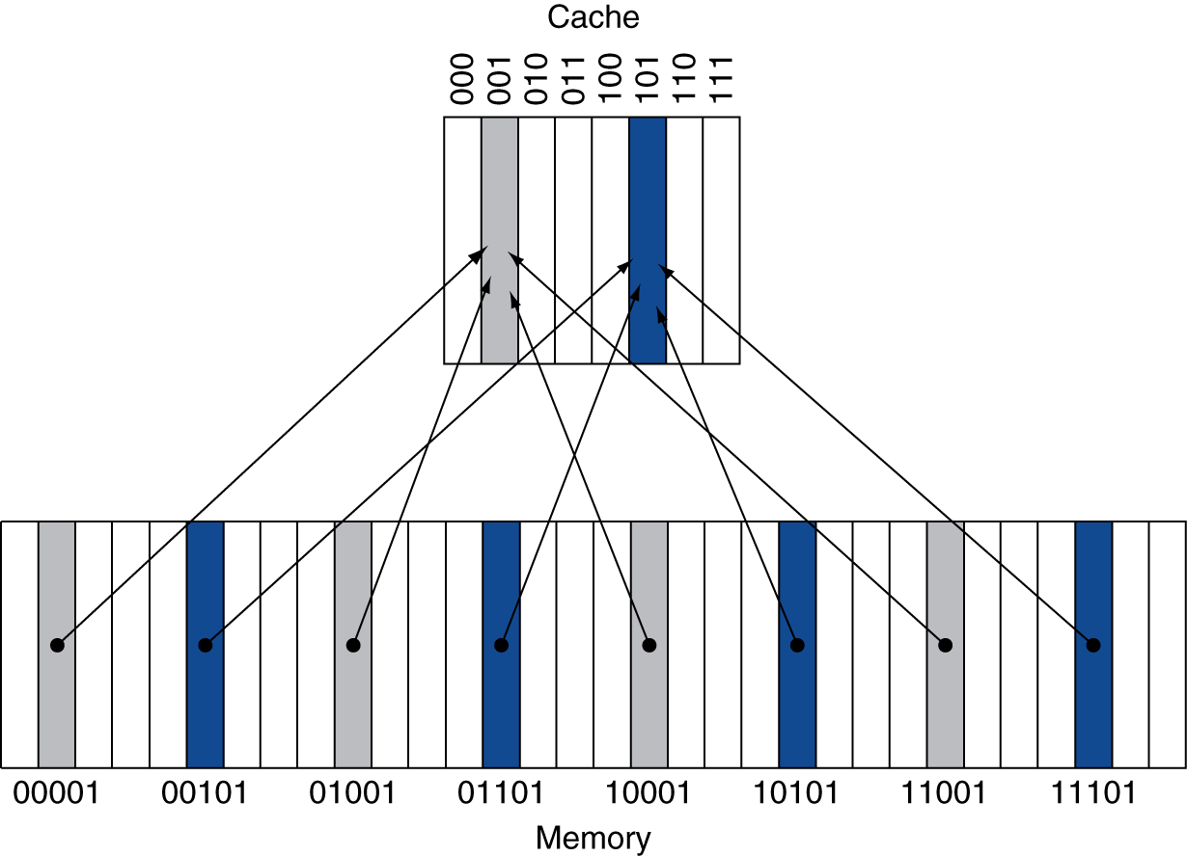
Direct Mapped Cache
Location determined by address
Direct mapped: only one choice
(Block address) modulo (#Blocks in cache)
#Blocks is a power of 2
Use low-order address bits
Notes:
BTW, what’s the problem with this approach?
We may have two slots and also use two memory locations. Theoretically they should both fit in cache, but if they both map to the same slot they don’t!

Slide 3
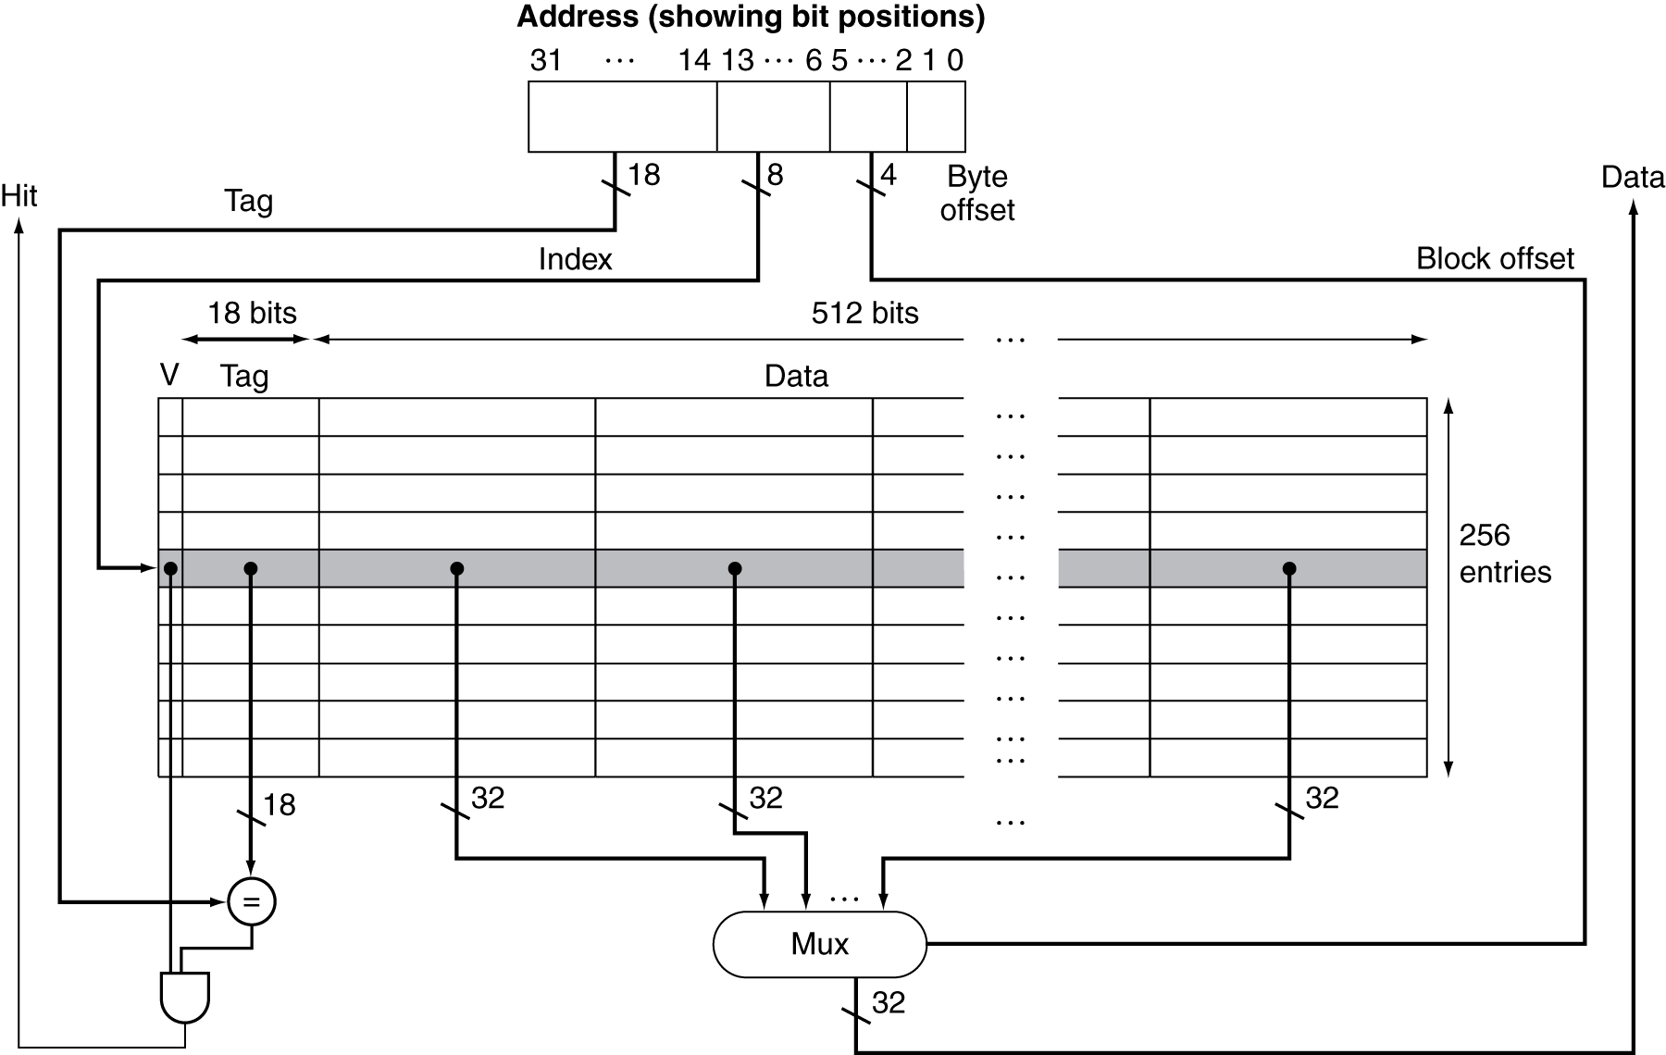
Example: Intrinsity FastMATH

Slide 4
Measuring Cache Performance
Components of CPU time
Program execution cycles
Includes cache hit time
Memory stall cycles
Mainly from cache misses
With simplifying assumptions:
§5.4 Measuring and Improving Cache Performance
Notes:
Now let’s dig a little deeper into cache performance.
In particular, we assume that our write buffer never gets too full, or if it does it’s too infrequent to matter.

Slide 5
Average Access Time
Hit time is also important for performance
Average memory access time (AMAT)
AMAT = Hit time + Miss rate × Miss penalty
Example
CPU with 1ns clock, hit time = 1 cycle, miss penalty = 20 cycles, I-cache miss rate = 5%
AMAT = 1 + 0.05 × 20 = 2ns
2 cycles per instruction

Slide 6
Performance Summary
When CPU performance increased
Miss penalty becomes more significant
Decreasing base CPI
Greater proportion of time spent on memory stalls
Increasing clock rate
Memory stalls account for more CPU cycles
Can’t neglect cache behavior when evaluating system performance
Notes:
This relates to Amdahl’s law…who remembers what this is?
Improved performance = fraction of time in improved component / improvement factor + fraction of time in other components

Slide 7
Associative Caches
Fully associative
Allow a given block to go in any cache entry
Requires all entries to be searched at once
Comparator per entry (expensive)
n-way set associative
Each set contains n entries
Block number determines which set
(Block number) modulo (#Sets in cache)
Search all entries in a given set at once
n comparators (less expensive)
Notes:
Fully associative is actually the scheme David suggested, though it’s faster than I implied, since we can do all the searches in parallel.

Slide 8
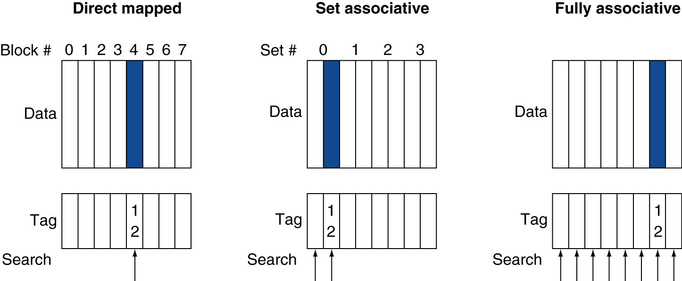
Associative Cache Example
Notes:
Two-way set associative (middle)

Slide 9
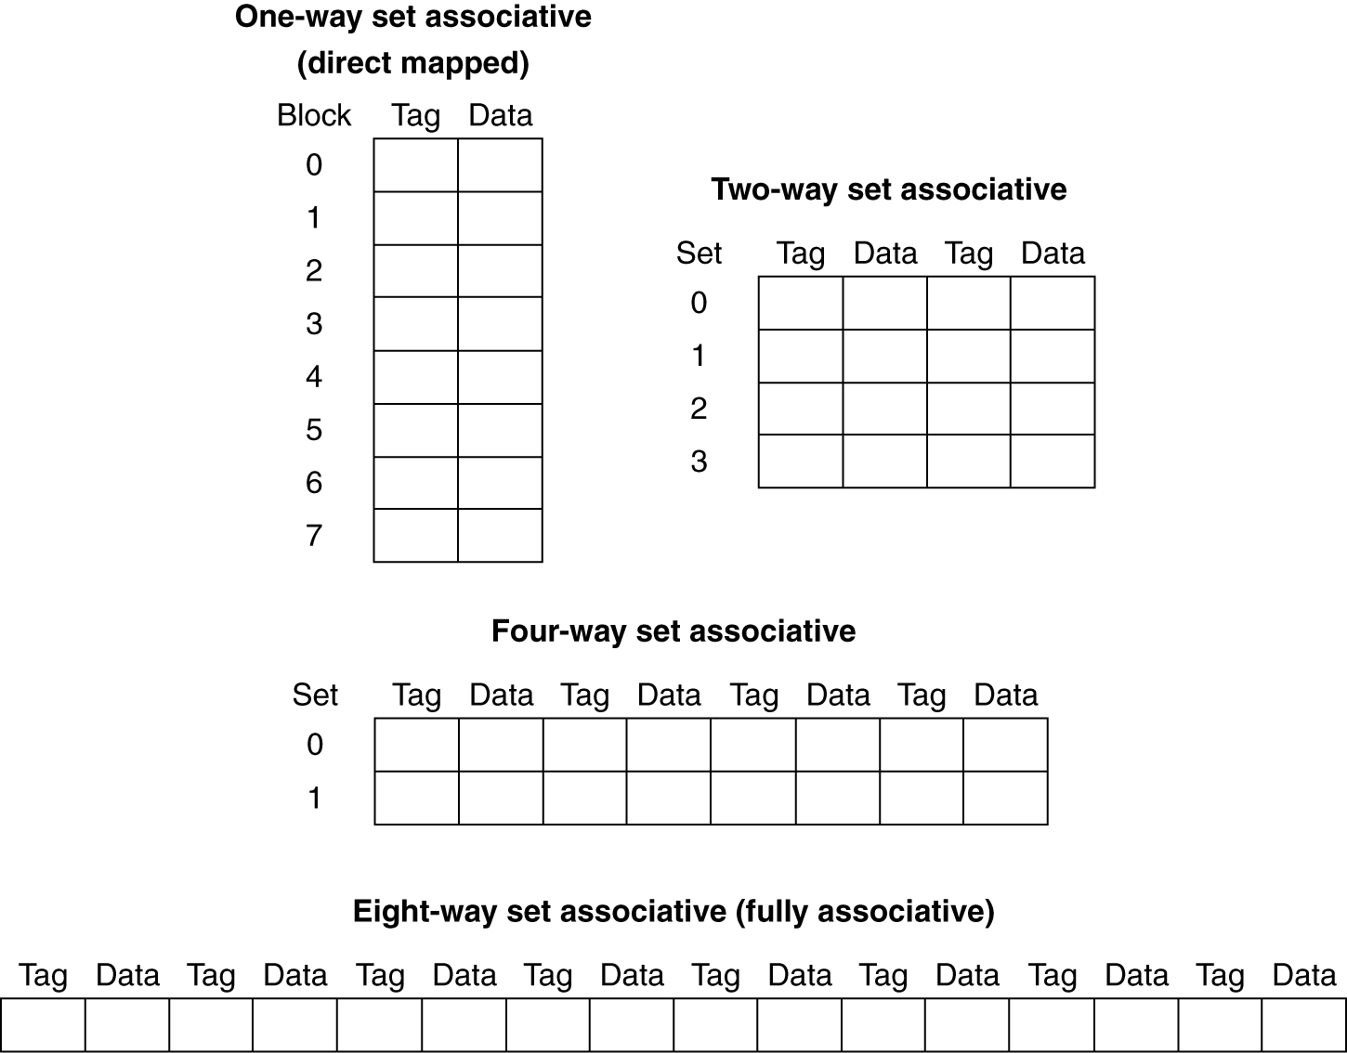
Spectrum of Associativity
For a cache with 8 entries

Slide 10
Associativity Example
Compare 4-block caches
Direct mapped, 2-way set associative, fully associative
Block access sequence: 0, 8, 0, 6, 8
Direct mapped
Block address | Cache index | Hit/miss | Cache content after access
 |  |  | 0 | 1 | 2 | 3
0
8
0
6
8
Notes:
What does it look like (contents, misses)
| Block address | Cache index | Hit/miss | 0 | 1 | 2 | 3 |
|---------------+-------------+----------+--------+---+--------+---|
| 0 | 0 | miss | Mem[0] | | | |
| 8 | 0 | miss | Mem[8] | | | |
| 0 | 0 | miss | Mem[0] | | | |
| 6 | 2 | miss | Mem[0] | | Mem[6] | |
| 8 | 0 | miss | Mem[8] | | Mem[6] | |

Slide 11
Associativity Example
Compare 4-block caches
Direct mapped, 2-way set associative, fully associative
Block access sequence: 0, 8, 0, 6, 8
Direct mapped
Block address | Cache index | Hit/miss | Cache content after access
 |  |  | 0 | 1 | 2 | 3
0 | 0 | miss | Mem[0]
8 | 0 | miss | Mem[8]
0 | 0 | miss | Mem[0]
6 | 2 | miss | Mem[0] |  | Mem[6]
8 | 0 | miss | Mem[8] |  | Mem[6]

Slide 12
Associativity Example
2-way set associative
Block address | Cache index | Hit/miss | Cache content after access
 |  |  | Set 0 |  | Set 1
0
8
0
6
8
Fully associative
Block address | Cache index | Hit/miss | Cache content after access
0
8
0
6
8
Notes:
Now what do these look like? In particular, how many misses?
| Block address | Cache index | Hit/miss | 0 | 1 | 2 | 3 |
|---------------+-------------+----------+--------+--------+---+---|
| 0 | 0 | miss | Mem[0] | | | |
| 8 | 0 | miss | Mem[0] | Mem[8] | | |
| 0 | 0 | hit | Mem[0] | Mem[8] | | |
| 6 | 0 | miss | Mem[0] | Mem[6] | | |
| 8 | 0 | miss | Mem[8] | Mem[6] | | |
| Block address | Cache index | Hit/miss | 0 | 1 | 2 | 3 |
|---------------+-------------+----------+--------+--------+--------+---|
| 0 | | miss | Mem[0] | | | |
| 8 | | miss | Mem[0] | Mem[8] | | |
| 0 | | hit | Mem[0] | Mem[8] | | |
| 6 | | miss | Mem[0] | Mem[8] | Mem[6] | |
| 8 | | hit | Mem[0] | Mem[8] | Mem[6] | |

Slide 13
Associativity Example
2-way set associative
Block address | Cache index | Hit/miss | Cache content after access
 |  |  | Set 0 |  | Set 1
0 | 0 | miss | Mem[0]
8 | 0 | miss | Mem[0] | Mem[8]
0 | 0 | hit | Mem[0] | Mem[8]
6 | 0 | miss | Mem[0] | Mem[6]
8 | 0 | miss | Mem[8] | Mem[6]
Fully associative
Block address |  | Hit/miss | Cache content after access
0 |  | miss | Mem[0]
8 |  | miss | Mem[0] | Mem[8]
0 |  | hit | Mem[0] | Mem[8]
6 |  | miss | Mem[0] | Mem[8] | Mem[6]
8 |  | hit | Mem[0] | Mem[8] | Mem[6]
Notes:
Q: How does increasing associativity affect miss rate? A: lower, to a point

Slide 14
How Much Associativity
Increased associativity decreases miss rate
But with diminishing returns
Simulation of a system with 64KB D-cache, 16-word blocks, SPEC2000
1-way: 10.3%
2-way: 8.6%
4-way: 8.3%
8-way: 8.1%

Slide 15
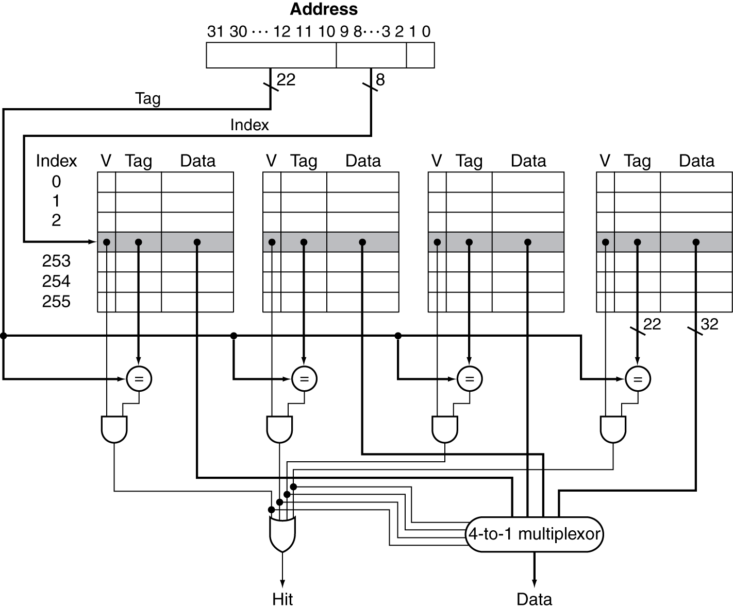
Set Associative Cache Organization
Notes:
But as soon as we allow multiple ways, we have a new choice to make.
When we need to kick something out of cache, which way do we choose?

Slide 16
Replacement Policy
Direct mapped: no choice
Set associative
Prefer non-valid entry, if there is one
Otherwise, choose among entries in the set
Least-recently used (LRU)
Choose the one unused for the longest time
Simple for 2-way, manageable for 4-way, too hard beyond that
Random
Gives approximately the same performance as LRU for high associativity
Notes:
But the random result is rather theoretical. LRU is actually best in practice.
The problem is actually calculating full LRU is difficult b/c you have to remember the entire history, which is why it’s hard beyond 4-way.
Instead most real hardware approximates LRU if it’s more than 4-way (in fact often even if it’s 4-way)

Slide 17
Multilevel Caches
Primary cache attached to CPU
Small, but fast
Level-2 cache services misses from primary cache
Larger, slower, but still faster than main memory
Main memory services L2 cache misses
Many systems include L3 cache
Notes:
Your tablet/phone may not have an L3, but it’s very likely your desktop/laptop does.

Slide 18
Multilevel Cache Example
Given
CPU base CPI = 1, clock rate = 4GHz
Miss rate/instruction = 2%
Main memory access time = 100ns
With just primary cache, effective CPI?
Notes:
Calculate the effective CPI with just a primary cache…
100e-9/ 1/(4e9)
Miss penalty = 100ns/0.25ns = 400 cycles
Effective CPI = 1 + 0.02 × 400 = 9

Slide 19
Multilevel Cache Example
Given
CPU base CPI = 1, clock rate = 4GHz
Miss rate/instruction = 2%
Main memory access time = 100ns
With just primary cache
Miss penalty = 100ns/0.25ns = 400 cycles
Effective CPI = 1 + 0.02 × 400 = 9

Slide 20
Example (cont.)
Now add L2 cache
Access time = 5ns
Global miss rate to main memory = 0.5%
Primary miss with L2 hit
Penalty = ???
Notes:
Penalty (in cycles?)
5ns/0.25ns = 20 cycles

Slide 21
Example (cont.)
Now add L2 cache
Access time = 5ns
Global miss rate to main memory = 0.5%
Main memory access time = 100ns (still)
Primary miss with L2 hit
Penalty = 5ns/0.25ns = 20 cycles
Primary miss with L2 miss
Extra penalty = ???
Notes:
Extra penalty in cycles?
100ns/0.25ns = 400 cycles

Slide 22
Example (cont.)
Now add L2 cache
Access time = 5ns
Global miss rate to main memory = 0.5%
Main memory access time = 100ns (still)
Primary miss with L2 hit
Penalty = 5ns/0.25ns = 20 cycles
Primary miss with L2 miss
Extra penalty = 100ns/0.25ns = 400 cycles
CPI = ???
Notes:
Note still pay L2 hit cost with an L2 miss!
Our caches are inclusive, which Is why you can use the global miss rate here.
If it’s not in L2, it’s also not in L1, so we pay the full price.
1 + 0.02 × 20 + 0.005 × 400 = 3.4

Slide 23
Example (cont.)
Now add L2 cache
Access time = 5ns
Global miss rate to main memory = 0.5%
Primary miss with L2 hit
Penalty = 5ns/0.25ns = 20 cycles
Primary miss with L2 miss
Extra penalty = 100ns/0.25ns = 400 cycles
CPI = 1 + 0.02 × 20 + 0.005 × 400 = 3.4
Performance ratio = 9/3.4 = 2.6
Notes:
Notice you could have calculated this a different way, too….

