Slide 1
Logical and Conditional Instructions
Instructor: Robert Utterback
Lecture 15

Slide 2
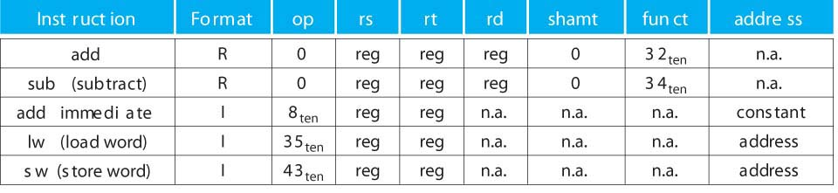
Mini Green Sheet
MIPS instructions
R:
I:
Register numbers
$t0 – $t7 : 8 – 15, $t8 – $t9 : 24 – 25
$s0 – $s7 : 16 – 23, $zero : 0
op
rs
rt
rd
shamt
funct
6 bits
5 bits
5 bits
5 bits
5 bits
6 bits
op
rs
rt
constant or address
6 bits
5 bits
5 bits
16 bits
Notes:
With a single exception, when op=0 it’s in R format

Slide 3
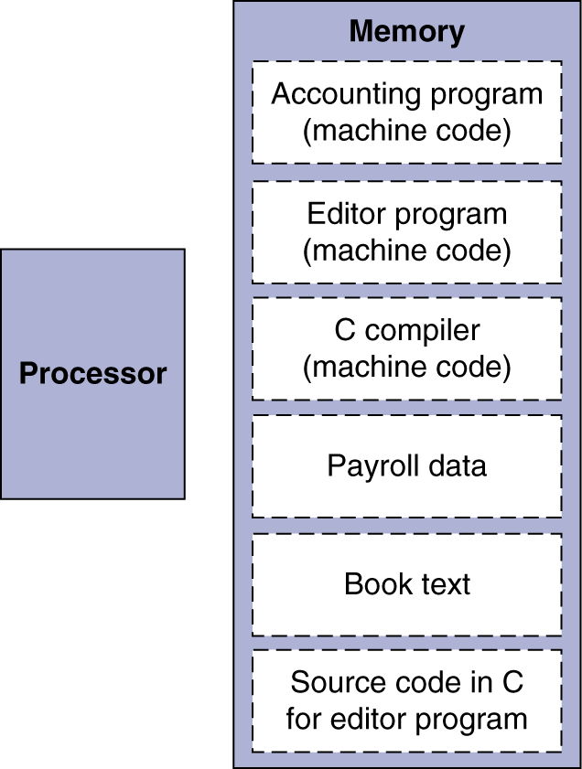
Stored Program Computers
The BIG Picture
Instructions represented in binary, just like data
Instructions and data stored in memory
Programs can operate on programs
e.g., compilers, linkers, …
Binary compatibility allows compiled programs to work on different computers
Standardized ISAs

Slide 4
Logical Operations (2.6)
Instructions for bitwise manipulation
§2.6 Logical Operations
Operation | C | Java | MIPS
Shift left | << | << | sll
Shift right | >> | >>> | srl
Bitwise AND | & | & | and, andi
Bitwise OR | | | | | or, ori
Bitwise NOT | ~ | ~ | nor
Useful for extracting and inserting groups of bits in a word

Slide 5
Shift Operations
op
rs
rt
rd
shamt
funct
6 bits
5 bits
5 bits
5 bits
5 bits
6 bits
shamt: how many positions to shift
Shift left logical
Shift left and fill with 0 bits
sll by i bits multiplies by 2^{i}
Shift right logical
Shift right and fill with 0 bits
srl by i bits divides by 2^{i} (unsigned only)
Notes:
We sometimes use this to get different bytes from a word.
Compare to base 10, multiplying by 10

Slide 6
AND Operations
Useful to mask bits in a word
Select some bits, clear others to 0
and $t0, $t1, $t2
$t2
0000 0000 0000 0000 0000 1101 1100 0000
$t1
0000 0000 0000 0000 0011 1100 0000 0000
$t0
0000 0000 0000 0000 0000 1100 0000 0000

Slide 7
OR Operations
Useful to include bits in a word
Set some bits to 1, leave others unchanged
or $t0, $t1, $t2
$t2
0000 0000 0000 0000 0000 1101 1100 0000
$t1
0000 0000 0000 0000 0011 1100 0000 0000
$t0
0000 0000 0000 0000 0011 1101 1100 0000

Slide 8
NOT Operations
Useful to invert bits in a word
Change 0 to 1, and 1 to 0
MIPS has NOR 3-operand instruction
a NOR b == NOT ( a OR b )
nor $t0, $t1, $zero
Register 0: always read as zero
$t1
0000 0000 0000 0000 0011 1100 0000 0000
$t0
1111 1111 1111 1111 1100 0011 1111 1111

Slide 9
Making Decisions (2.7)

Slide 10
Conditional Operations
Branch to a labeled instruction if a condition is true
Otherwise, continue sequentially
beq rs, rt, L1
if (rs == rt) branch to instruction labeled L1;
bne rs, rt, L1
if (rs != rt) branch to instruction labeled L1;
j L1
unconditional jump to instruction labeled L1
§2.7 Instructions for Making Decisions

Slide 11
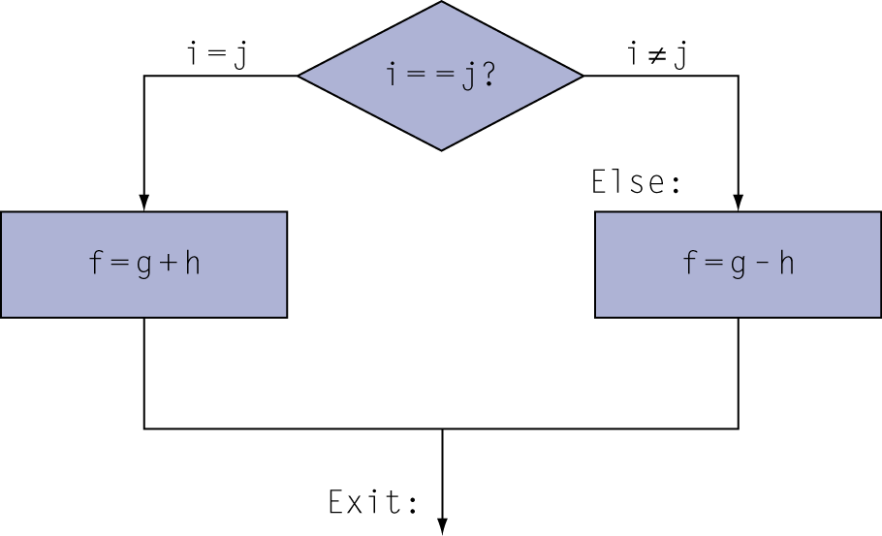
Compiling If Statements
C code:
if (i==j) f = g+h; else f = g-h;
f, g, … in $s0, $s1, …
Compiled MIPS code:
bne $s3, $s4, Else add $s0, $s1, $s2 j Exit Else: sub $s0, $s1, $s2 Exit: …
Assembler calculates addresses

Slide 12
Compiling Loop Statements
C code:
while (save[i] == k) i += 1;
i in $s3, k in $s5, address of save in $s6
Compiled MIPS code:
Loop: sll $t1, $s3, 2 add $t1, $t1, $s6 lw $t0, 0($t1) bne $t0, $s5, Exit addi $s3, $s3, 1 j Loop Exit: …

Slide 13
Basic Blocks
A basic block is a sequence of instructions with
No embedded branches (except at end)
No branch targets (except at beginning)
A compiler identifies basic blocks for optimization
An advanced processor can accelerate execution of basic blocks

Slide 14
More Conditional Operations
Set result to 1 if a condition is true
Otherwise, set to 0
slt rd, rs, rt
if (rs < rt) rd = 1; else rd = 0;
slti rt, rs, constant
if (rs < constant) rt = 1; else rt = 0;
Use in combination with beq, bne
slt $t0, $s1, $s2 # if ($s1 < $s2) bne $t0, $zero, L # branch to L

Slide 15
Branch Instruction Design
Why not blt, bge, etc?
Hardware for <, ≥, … slower than =, ≠
Combining with branch involves more work per instruction, requiring a slower clock
All instructions penalized!
beq and bne are the common case
This is a good design compromise
Notes:
How to do >? What about <=?

Slide 16
Signed vs. Unsigned
Signed comparison: slt, slti
Unsigned comparison: sltu, sltui
Example
$s0 = 1111 1111 1111 1111 1111 1111 1111 1111
$s1 = 0000 0000 0000 0000 0000 0000 0000 0001
slt $t0, $s0, $s1 # signed
–1 < +1 ⇒ $t0 = 1
sltu $t0, $s0, $s1 # unsigned
+4,294,967,295 > +1 ⇒ $t0 = 0

