Slide 1
Trends in Weather
Marcus Lorenzana
Robert vasquez

Slide 2
Data Analysis (Weka)
For our project we did a data analysis of weather data.
We used Weka as our data mining tool.
More specifically, we used the development version of Weka in order to get the package manager and download the correct tools.
For preprocessing, we used Java to process the files
Initial files were in csv format, for easier processing in Java
After processing is done, the final files are arff with the correct headers

Slide 3
The Data
We were able to get all our data from NOAA or NCDC (National Climatic Data Center)
Good options for downloading data
Can specify timeframe
Attributes
Weather stations
We used a large that contained all climate data from all stations across the United States.
Each station represents a geographical location. There can be many stations per city or state.
The data contains ~ 1 million records
Each record contains: STATION, DATE, MNTM, TPCP
MNTM: Monthly temperature means
TPCP : Total precipitation (monthly)
CSV format

Slide 4
Problems With Data
Our project required a lot of preprocessing.
Values with -9999 for both MNTM and TPCP
Thousands of stations, each with their own State
Each station has its own list of data for MNTM and TPCP
Duplicate DATE values for each Month and Year across all stations

Slide 5
Preprocessing 1
While processing initial large file, ignore -9999 values
-9999 values usually indicated a lot of problems with the station itself.
Removing them entirely seemed the way to go.
Create 50 smaller files for each state in the U.S.
Check with an array to see if the line contains the state abbreviation
Output that line its corresponding state file.

Slide 6
Preprocessing 2
Select a state file that you want to operate on
Read in that state file and sort all of the lines by month and date
There will be duplicate dates because of multiple stations
e.g.:
Station 1 TX, 2002-01
Station 2 TX, 2002-01
Station 3 TX, 2002-01
Take this file and pass it to another class that will store lists of lists, each list containing all the records for that date
Find the mean of all these value for both MNTM and TPCP and output to a new file that will represent the final .arff file.

Slide 7
Time Series Analysis
The process of using statistical techniques to model and explain a time-dependent series of data points.
Time series: A sequence of data points, typically consisting of successive measurements made over a time interval
Exactly what is needed for finding trends and predicting future patterns in temperature and precipitation
Equally spaced out data points
Continuous, real values dependent on time

Slide 8
Applying Time Series
For our project, we first generated all the appropriate .arff files ready to be analyzed with the Weka forecast tool
We first looked at temperatures
Very natural and consistent pattern
Follows seasonal patterns as one would expect
Not a significant increase if any in temperature over time
Glacial data probably would be a better indicator for warming
Though did give insight on the differences in temperature across different regions of the United States

Slide 9
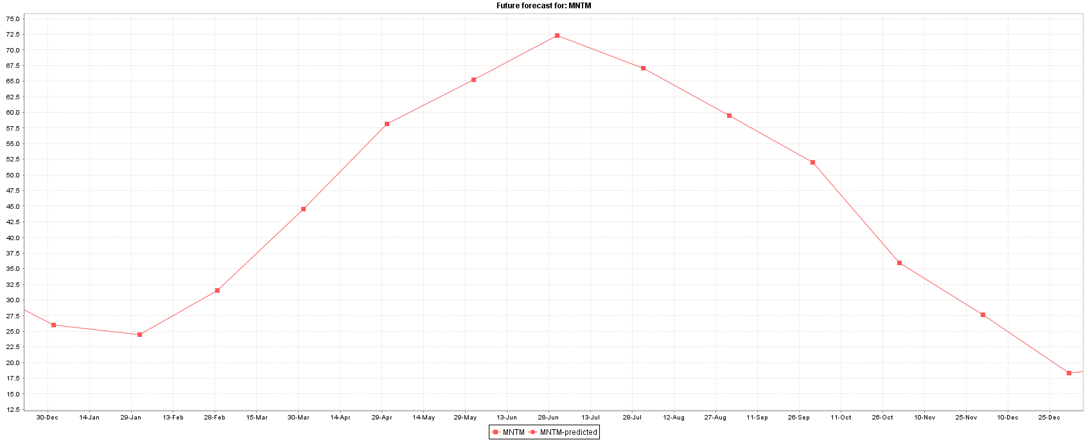
NY 2013, Maximum AVG Temp: ~73 Minimum AVG Temp: ~17.5

Slide 10
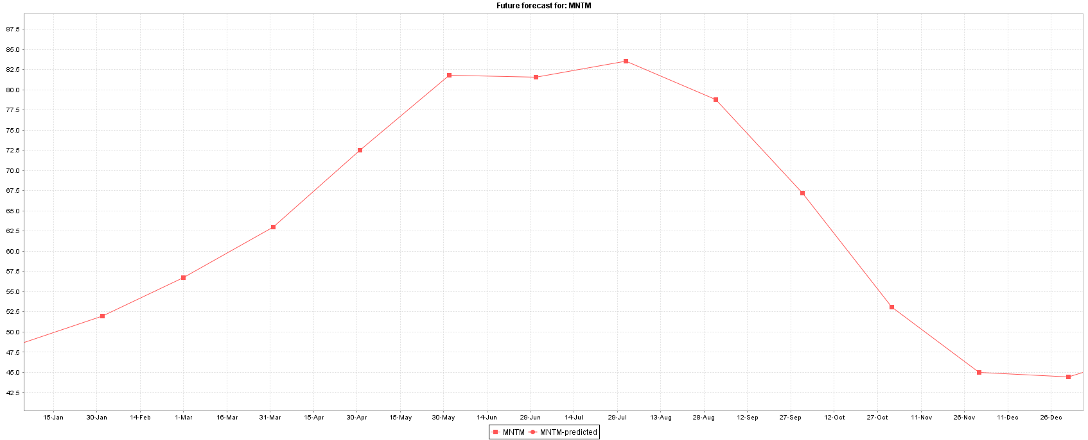
TX 2013 Maximum AVG Temp: ~83 Minimum AVG Temp: ~45

Slide 11
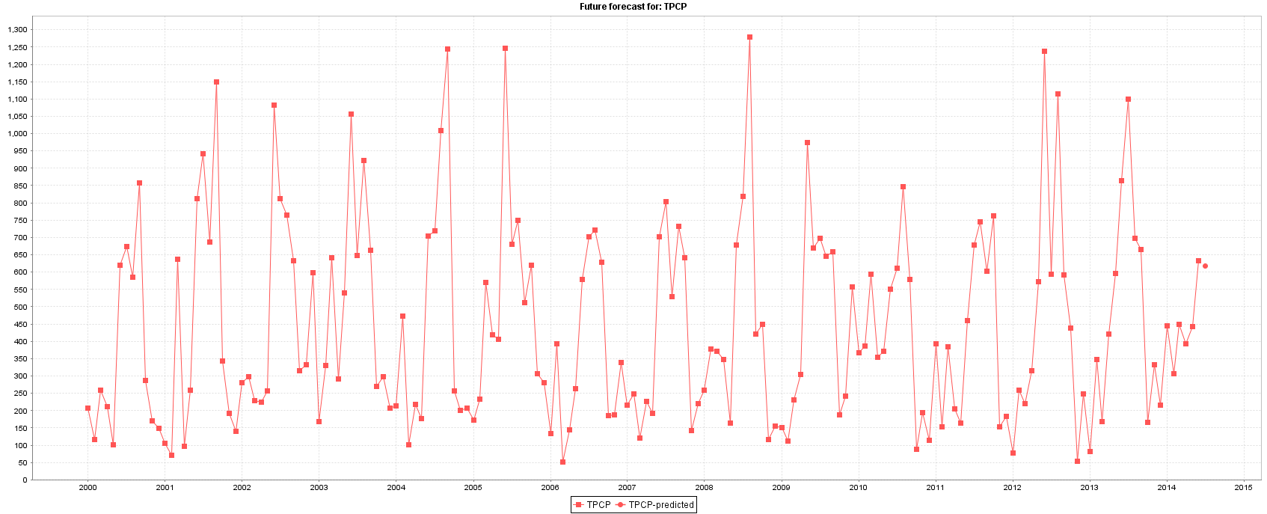
Precipitation
Precipitation was an interesting indicator because the precipitation spikes usually linked to a Hurricane, Tsunami, or other major thunderstorm
Below is a graph of the precipitation of Florida, which is very susceptible to thunderstorms

Slide 12
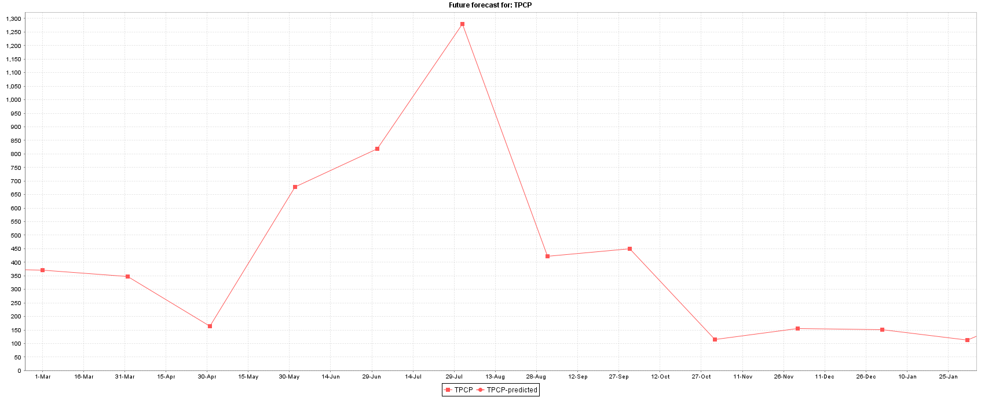
Florida August 2008
Tropical Storm Fay (2008)

Slide 13
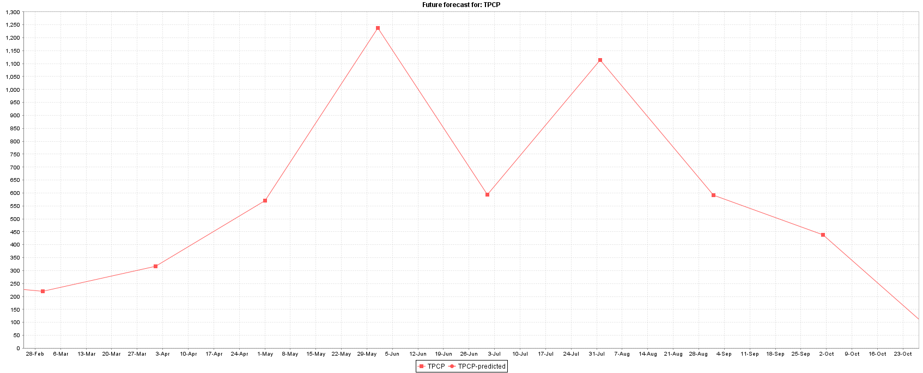
Florida (2012)
Tropical Storm Beryl (May 2012), Hurricane Isaac (August 2012)

