Slide 1
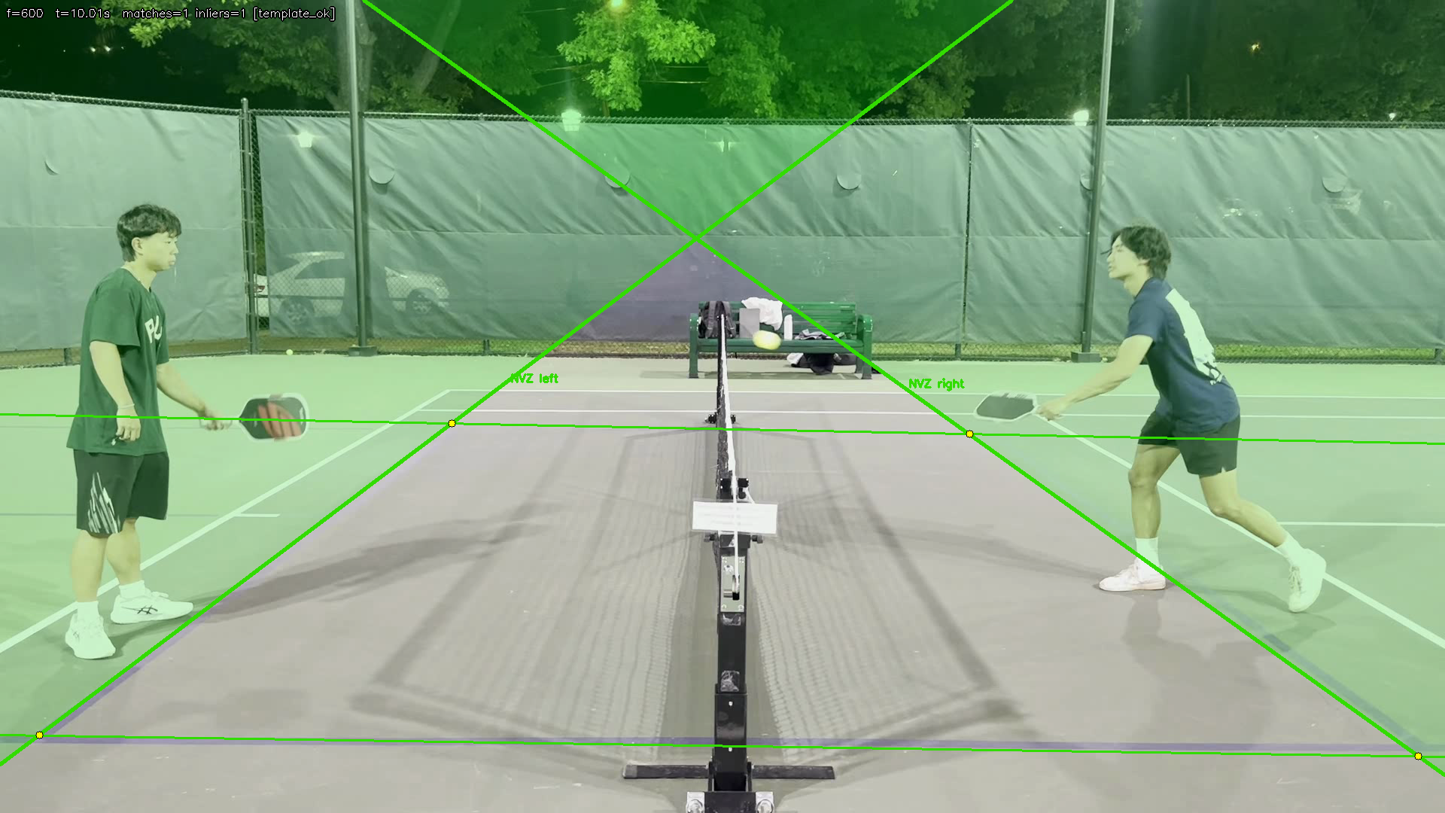
KITCHENMASTER
Pickleball kitchen foot-fault detection from a single side-view camera
A research prototype that registers court geometry, infers likely volley events, localizes the relevant foot, and labels the result as legal, fault, or uncertain.
2055 / 2055
1 fault
1 camera
registered frames
demo snapshot
capture setup
best current technical result
plus 2 uncertain events
single fixed side view
Main claim: geometry is the foundation, and uncertainty is better than a wrong fault call.
Notes:
Open with the problem framing, then immediately anchor the audience on the strongest result: reliable court registration across the full clip.
[Sources]
- photos_for_slides/TECHNICAL_SUMMARY.md
- photos_for_slides/court_reg_v3_summary_report.json
- photos_for_slides/demo_foot_fault_summary.json

Slide 2
PROBLEM
02 / 10
Why this problem is hard from a single camera
A foot location alone is not enough. The system has to know where the kitchen line is in the same frame, which player is active, and whether the evidence is clear enough to support a confident call.
Research questions
• Can a side-view camera detect whether a foot stayed behind the kitchen line or crossed it?
• How sensitive is the decision to blur, occlusion, angle, and line ambiguity?
• Is it better to output uncertain than force a wrong legal or fault label?
What the project must estimate
• Court geometry in each frame
• Likely volley timing from the ball trajectory
• Relevant foot point and signed distance to the NVZ boundary
Key takeaway
Geometry is the foundation. Without a stable kitchen-line estimate, every later label becomes hard to trust.
Notes:
Use this slide to establish the problem before getting into methods. The line estimate, active side, and foot point all have to agree in the same frame.
[Sources]
- photos_for_slides/TECHNICAL_SUMMARY.md

Slide 3
PIPELINE
03 / 10
Pipeline overview: from video to decision
The current system is a configurable pipeline: register the court, track the ball, infer events, localize the relevant foot, then apply a signed-distance rule with an uncertainty margin.
1
Court registration
2
Ball tracking
3
Event inference
Estimate where the kitchen boundaries are in each frame using anchor points and ORB-based stabilization.
Track the ball trajectory and export candidate positions plus debug overlays.
Convert the trajectory into bounce or volley timing hypotheses for likely review frames.
4
Foot localization
5
Signed-distance label
6
Review
Estimate the relevant contact point using the event_hybrid foot localizer and ROI constraints.
Measure the foot against the selected NVZ boundary and output legal, fault, or uncertain.
Stop for human correction on hard cases.
Interpretability
The final label is not a black box. It can be traced back to court geometry, player side, foot point, and a measurable signed distance.
Notes:
This slide is the method summary. Keep it high level and save implementation details for questions.
[Sources]
- photos_for_slides/TECHNICAL_SUMMARY.md

Slide 4
REGISTRATION FOUNDATION
04 / 10
Court registration is the strongest result in the repo
The anchor-point court model plus ORB post-translation tracked the court across the full 34.28 second clip with no fallbacks.
2055 / 2055
0
25.03 px
successful frames
fallback frames
mean translation
0.0% fallback rate
reference clip at 1920x1080
sampled validation frames
Why this matters
Everything downstream depends on knowing where the kitchen line actually is in each frame. The demo is only interpretable because the boundary is registered before any fault decision is made.
The overlay image makes the project easier to explain: once the court is aligned, later foot-fault measurements become a geometric question instead of a guess.
Notes:
Emphasize that registration is the most defensible result. If asked for the single strongest number, cite 2055 out of 2055 frames with zero fallbacks.
[Sources]
- photos_for_slides/court_reg_v3_summary_report.json
- photos_for_slides/TECHNICAL_SUMMARY.md

Slide 5
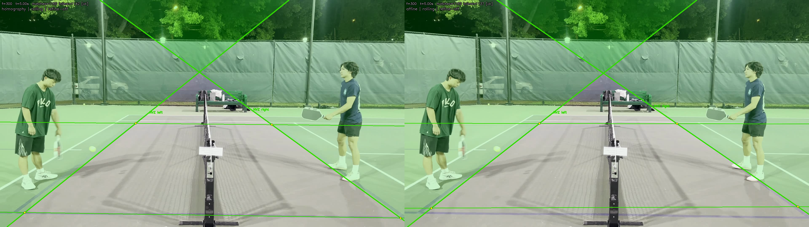
COMPARISON
05 / 10
The current registration method is more stable than the affine comparison
On the same clip, the fixed affine configuration dropped from 2055 successful frames to 2036 and needed 19 fallbacks.
2055
2036
19
post-translation
affine fixed
affine fallbacks
successful frames
successful frames
same clip and settings family
Interpretation
The registration stage is already giving a meaningful technical result: the current transform choice matters, and the more stable option is visible both qualitatively and in the fallback count.
Left: post-translation. Right: affine. Even without going deep into the math, the qualitative comparison supports the same story as the frame-count metrics.
Notes:
Use this slide to justify why the current registration configuration is not arbitrary. The comparison result is a strong way to show engineering progress.
[Sources]
- photos_for_slides/court_reg_v3_summary_report.json
- photos_for_slides/TECHNICAL_SUMMARY.md

Slide 6
DEMO SNAPSHOT
06 / 10
Current end-to-end demo status
The demo pipeline is wired and producing reviewable outputs, but it should still be presented as a human-in-the-loop research workflow rather than a finished automatic referee.
3
1
2
35.7%
final events
fault
uncertain
ball detection rate
demo snapshot
foot_fault_volley
hard cases stay reviewable
weakest current stage
What is already working
What is still fragile
• Registration outputs are stable and explainable.
• The pipeline produces event-level artifacts and summaries.
• At least one clean event is labeled as a foot fault end-to-end.
• Ball detection and event timing are the weakest automatic stages.
• Some hard cases still require manual review and overrides.
• This is a demo workflow, not yet a production-grade referee.
Notes:
This is the status slide. It is intentionally honest and should lower the risk of overclaiming the current system.
[Sources]
- photos_for_slides/demo_foot_fault_summary.json
- photos_for_slides/TECHNICAL_SUMMARY.md

Slide 7
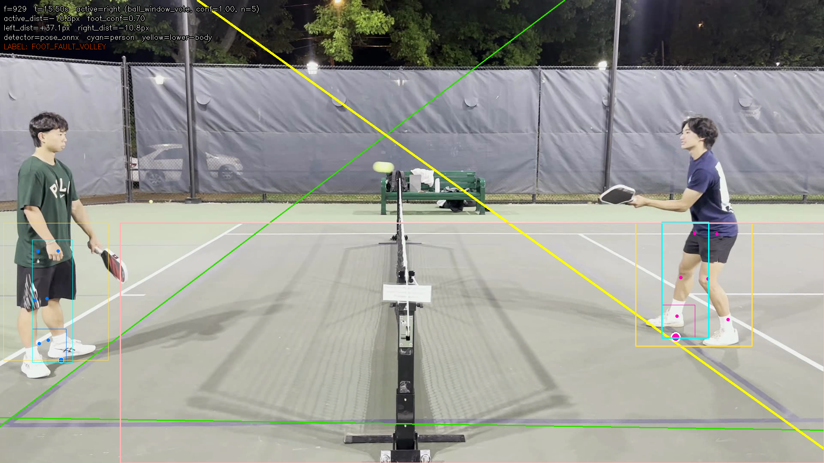
DETECTED FAULT
07 / 10
The end-to-end demo can surface a clear foot-fault example
This event is labeled `foot_fault_volley` because the selected foot lands inside the non-volley zone after registration and active-side selection.
3
1
events in demo
fault event
presentation snapshot
two more marked uncertain
-10.78 px
5 px
signed distance
fault threshold
fault side of threshold
margin before uncertainty
Interpretability
The label is explainable: court line, active player side, localized foot point, and signed distance all remain visible in the frame.
Notes:
Use this slide to show that the prototype is more than a registration demo. The full chain can produce an interpretable fault call on at least one clean event.
[Sources]
- photos_for_slides/demo_foot_fault_summary.json
- photos_for_slides/demo_foot_fault_events.csv
- photos_for_slides/TECHNICAL_SUMMARY.md

Slide 8
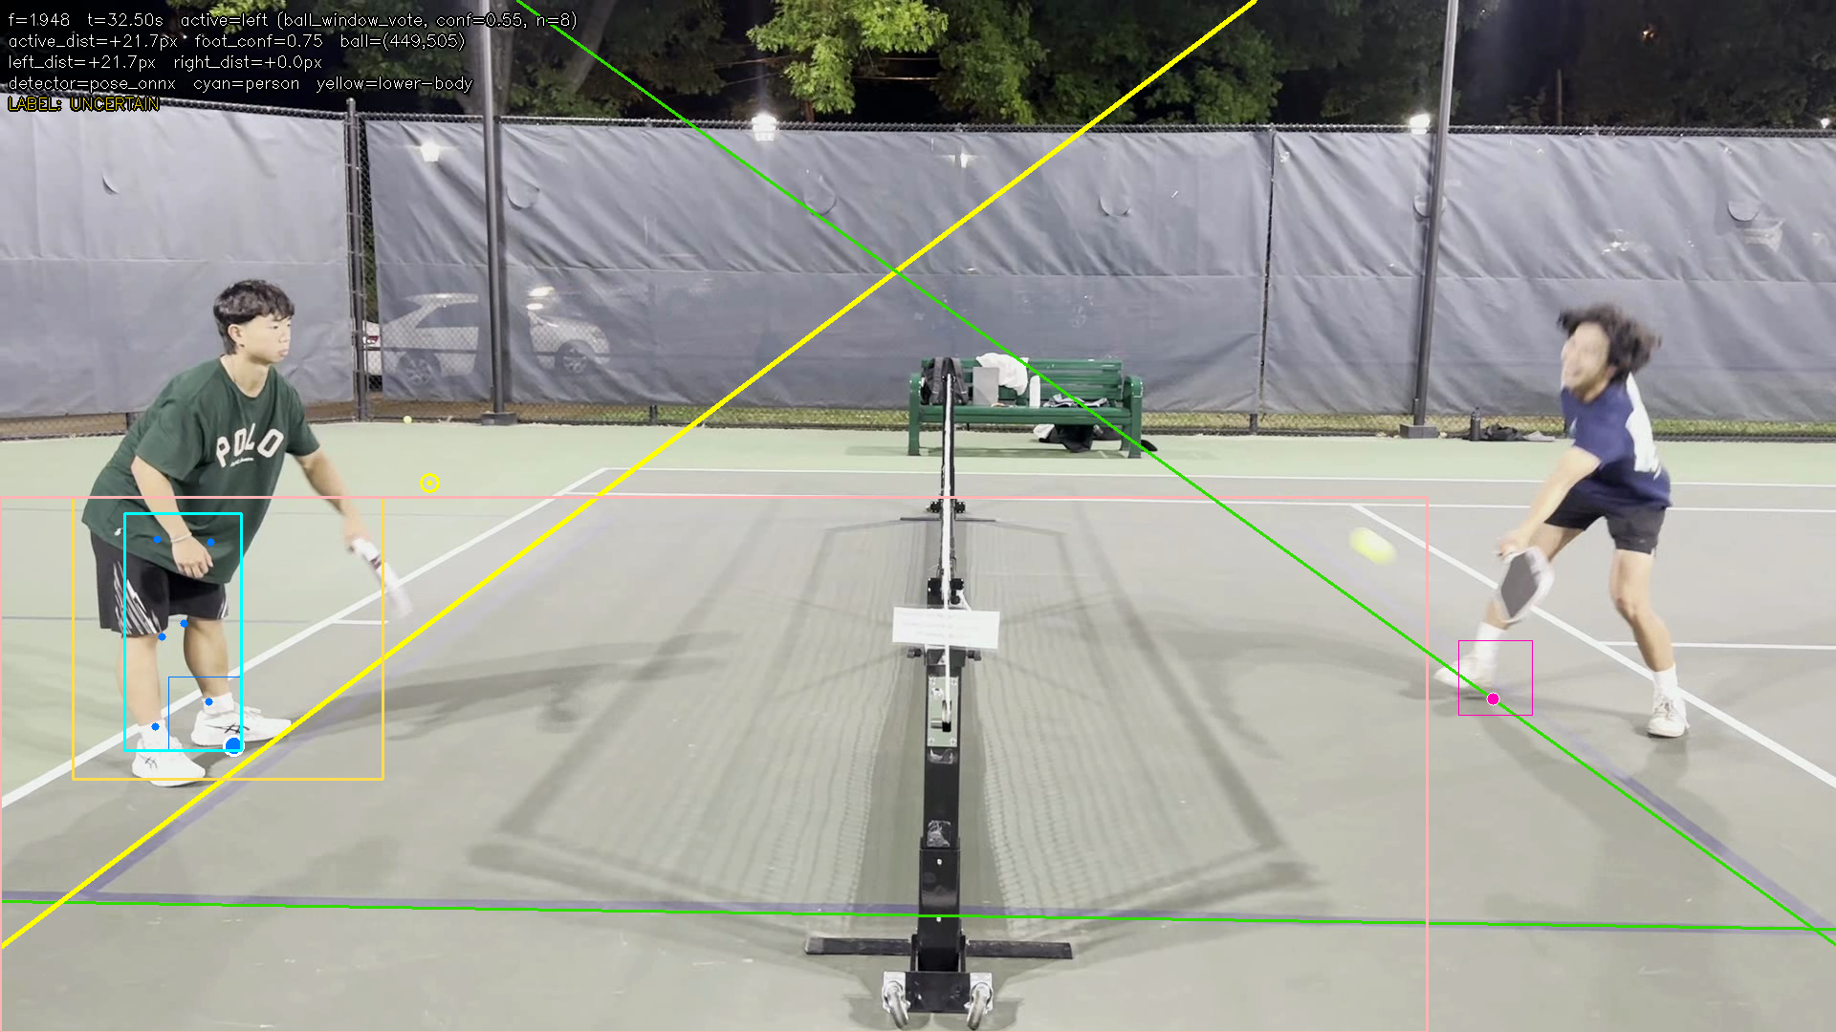
UNCERTAINTY
08 / 10
Uncertain is a deliberate outcome, not a failure state
When the foot is near the line, the ball timing is noisy, or the active side is less certain, abstaining is safer than forcing a wrong call.
2
15 px
0.551
uncertain events
uncertain margin
active-side confidence
out of 3 demo events
configured guard band
example uncertain case
Presentation framing
The honest story is that registration is strong, while the ball and event stage remains fragile. The system already knows when it should defer to human review instead of pretending to be fully automatic.
This example stays close enough to the line that the safer label is `uncertain`, especially given the active-side confidence and ball ambiguity in the same frame.
Notes:
If asked why uncertainty is useful, answer that a wrong fault call is worse than abstaining. This slide is the evidence for that design choice.
[Sources]
- photos_for_slides/demo_foot_fault_summary.json
- photos_for_slides/demo_foot_fault_events.csv
- photos_for_slides/TECHNICAL_SUMMARY.md

Slide 9
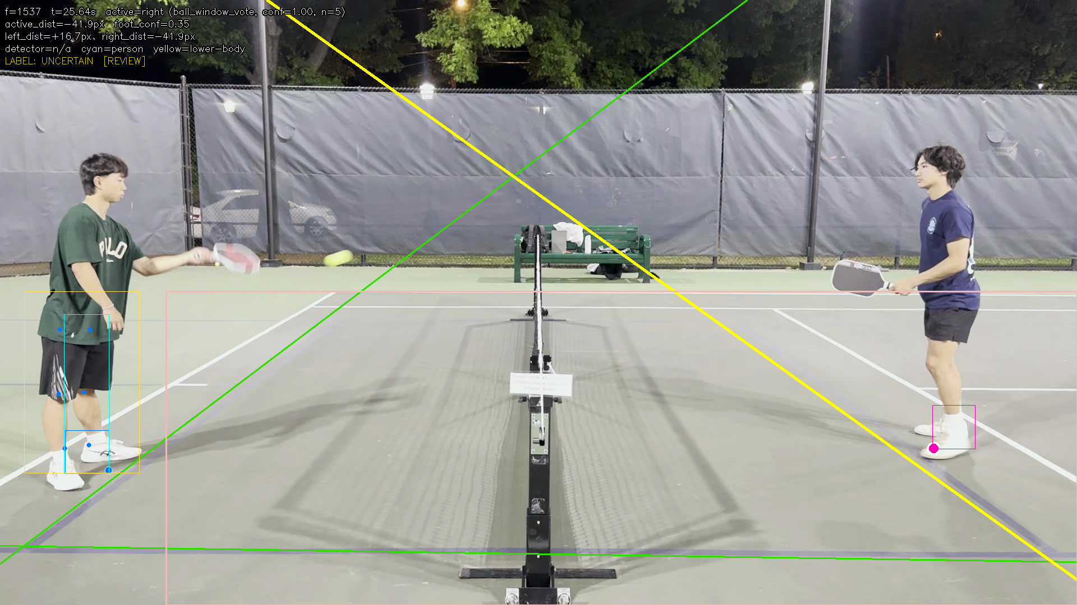
HUMAN REVIEW
09 / 10
The demo is intentionally human-in-the-loop
In auto_review mode, the pipeline exports artifacts and stops so the reviewer can correct ambiguous frames before final outputs are generated.
Reviewer can override
• Line geometry
• Ball points and bounce labels
• Foot points and active side
• Final event label
Why this is acceptable in a research prototype
The review step makes the workflow honest and auditable. Hard cases are surfaced explicitly instead of being hidden behind a false sense of automation.
This architecture is a strength for presentation: it shows the system knows when to ask for help.
Notes:
This is the slide to use when the professor asks whether the system is fully automatic. The correct answer is no, and the review workflow is an intentional part of the current design.
[Sources]
- photos_for_slides/TECHNICAL_SUMMARY.md

Slide 10
TAKEAWAYS
10 / 10
Present this as a research prototype with human review
That framing highlights what already works, stays honest about what does not, and gives a credible roadmap for future improvement.
Strongest result
Court registration stayed stable across 2055 / 2055 frames with 0 fallbacks on the real clip.
Current limitation
Ball tracking and event timing still limit the automatic pipeline, which is why the demo uses a review-and-override workflow.
Best next step
Improve the ball detector and collect more labeled real clips so the uncertainty and override rates can be measured rigorously.
Recommended closing line: KitchenMaster already produces interpretable court-aligned event evidence, but it should be presented today as a human-in-the-loop referee assistant rather than a finished autonomous judge.
Notes:
Finish with the strongest result, the honest limitation, and the next step. This keeps the presentation credible and focused.
[Sources]
- photos_for_slides/TECHNICAL_SUMMARY.md
- photos_for_slides/court_reg_v3_summary_report.json
- photos_for_slides/demo_foot_fault_summary.json

