Slide 1

Canvas data portal canvas api
Birdville independent school district

Slide 2
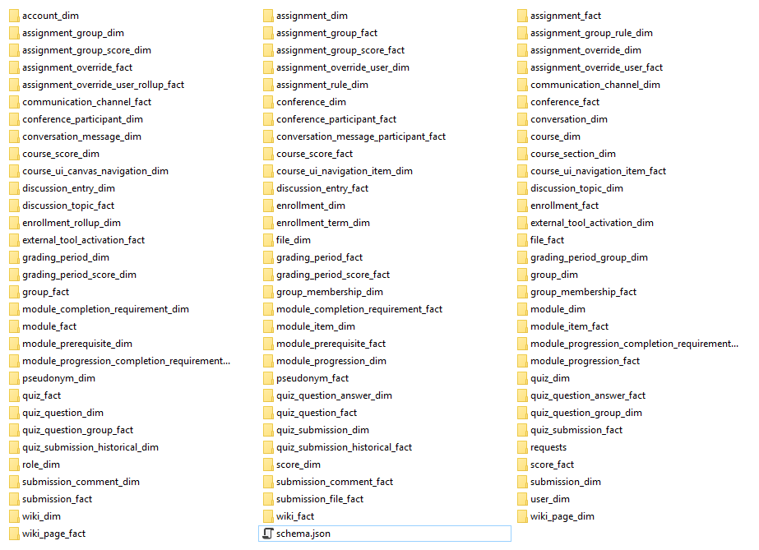
All the data
There is no question that Canvas provides users with an overwhelming amount of data. It’s not whether or not this information is useful, but how we use it.
These are three ways we do:
Imported into Excel
Loaded into objects in PowerShell
Loaded into SQL Server

Slide 3
Dimensions and facts
DIM – Short for dimensions. This is where your “readable” data is held. You can see usernames, course titles, assignment details, quiz questions, and more.
Upside: User, account, course specifics; easier to read
Downside: Slow process when running numbers on a large scale
Facts – These files are great for pulling raw data. The data is not bogged down with fields that are easy to interpret by human eyes. Most of these values are purely IDs and not text.
Upside: Reporting; usage percentages; large picture
Downside: Can be hard to read and interpret; small picture details

Slide 4
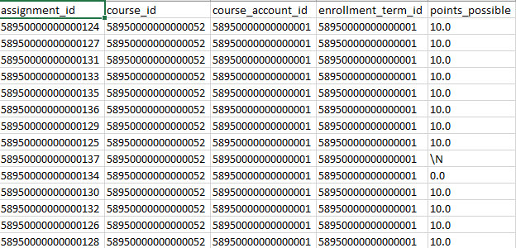
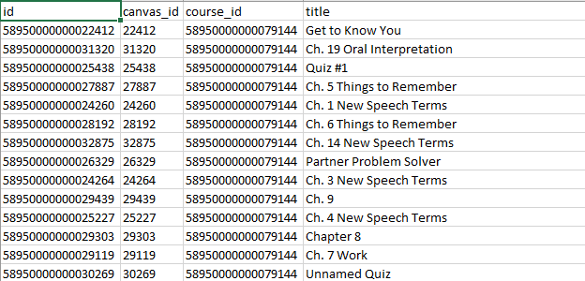
Facts vs dimensions
Assignment Fact
Assignment dimension

Slide 5
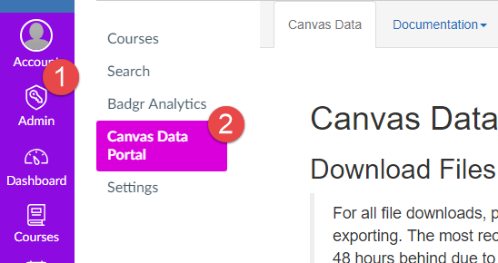
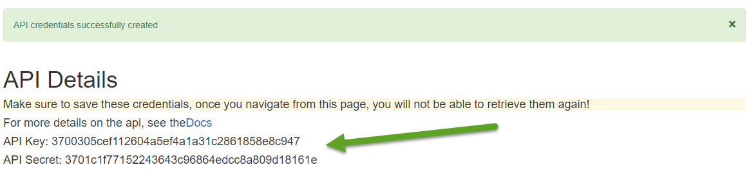
Data Portal
Make sure to never share these codes to outside sources
This code will give someone access to ALL data for the entire environment, regardless of user type
Be very careful with this access
Administrators Only

Slide 6
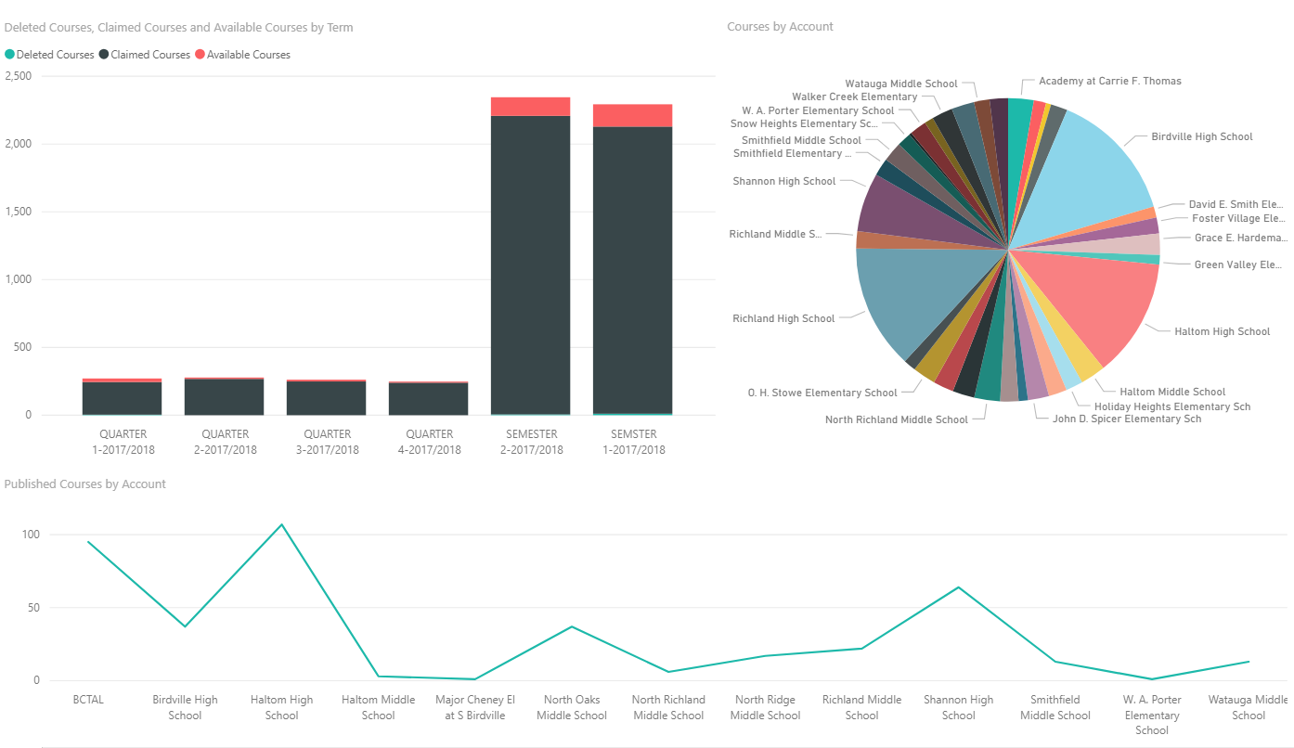
Adapting canvas data into excel and Power BI
Published versus created courses across the entire district

Slide 7
Using canvas api calls

Slide 8
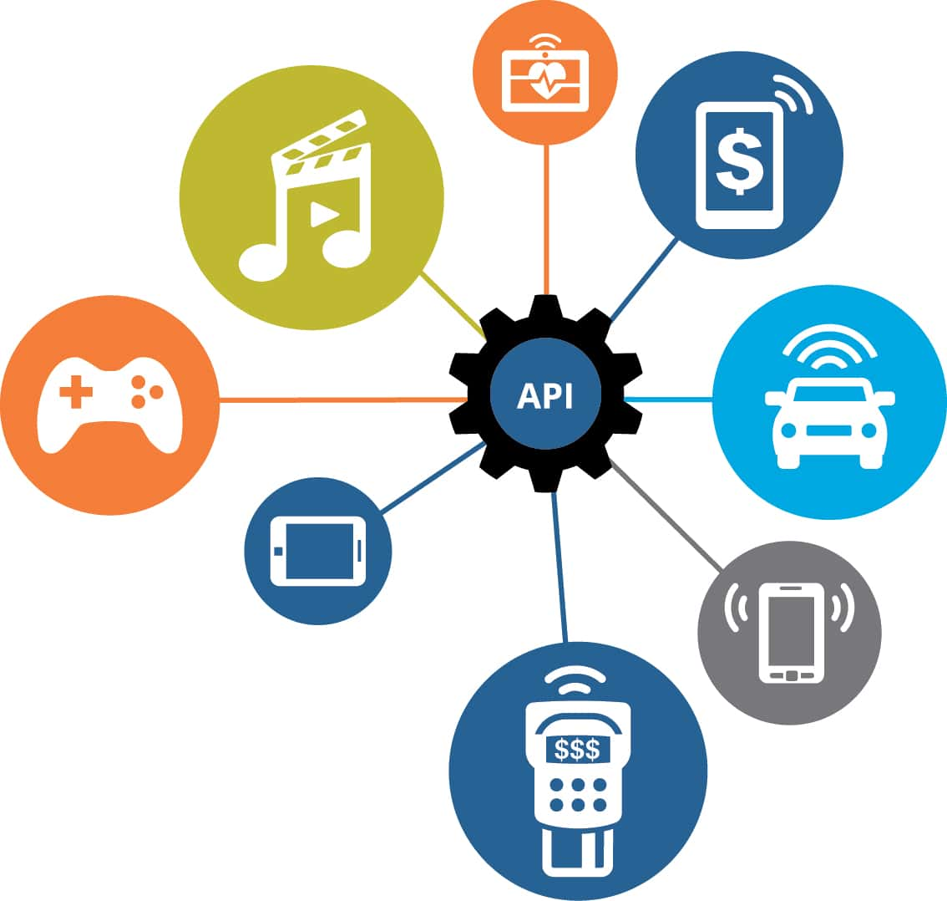
What the heck is an API??
Application Programming Interface
An API takes all the data you see in your every day use, and simplifies it into a string of text entries known as JSON (JavaScript Notation).
GET: Get calls are the simplest way to call an API and can be used inside the browser itself. Essentially, these calls GET information from Canvas.
POST: Post calls send data that you create into Canvas. This gives users another way to add their custom content into Canvas. For instance, you can add a new user, enroll a user, create a course, etc.
PUT: Puts let you modify information that is already in Canvas. For instance, you can update a student’s grade, change the due date of an assignment, and more.
DELETE: As you might expect, this lets you delete information from Canvas. You can remove users from a course or delete an assignment.

Slide 9
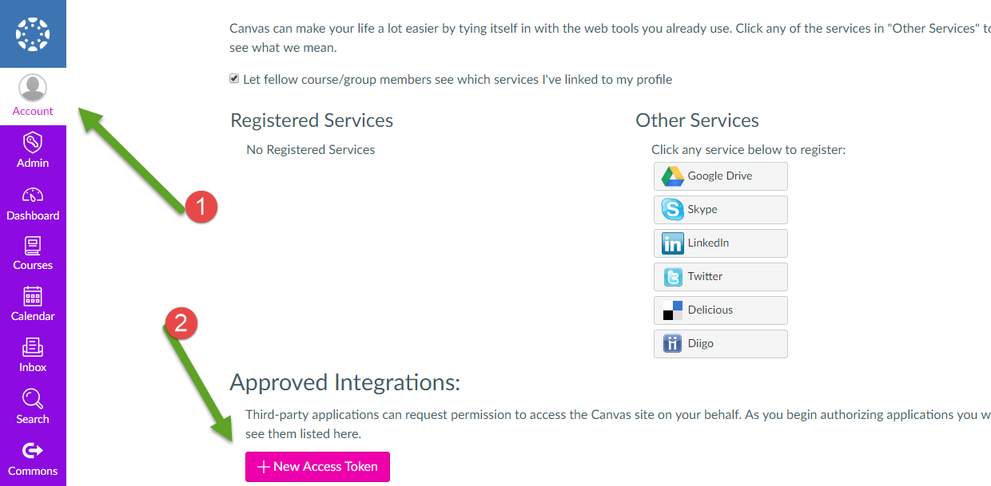
Set Up the api
From your account settings, you will have to request a new access token.
For purpose, it doesn’t really matter what you choose. “Personal” is fine.
While it isn’t necessary, it is a good idea to set up a new access token every so often in case your code ever gets shared. If you ever lose the token, it is easy to ask the system to send you another one.

Slide 10
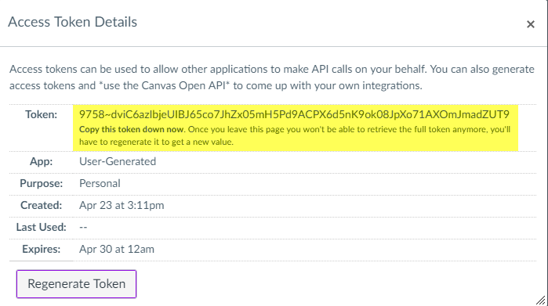
Using Your new access token
This token will be used with every API call as a means to authenticate that it is really you getting the data
While pulling API GET calls from the browser, you may not be asked for authorization if you’re currently logged into Canvas
Saving your token as a Windows environment variable is a good way to protect your token

Slide 11
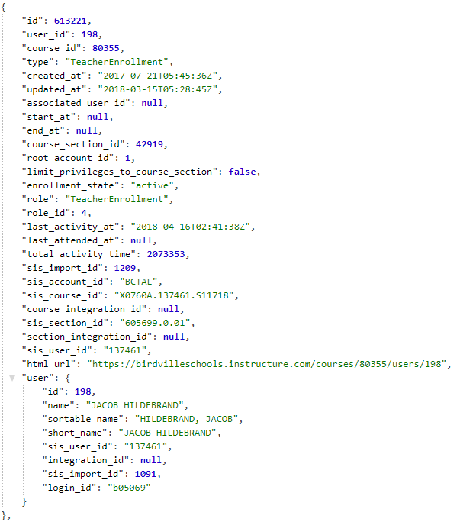
What’s it look like?
This is an example of a teacher’s enrollment data inside a course. Let’s break down the web address to the parts that are important to us.
The main difference between visiting API pages and regulars ones is the addition of “/api/v1” to the web address. This tells Canvas to show you data.
This is the part that will change from call to call:
/courses/80355/enrollments
/courses – Gives you all courses you can see
/80355 – A course number
/enrollments – A list of all enrollments in the course
https://yourschool.instructure.com/api/v1/courses/80355/enrollments

Slide 12
Why use canvas API?
Anybody can create an API token
Everybody can access exactly the same materials they can access in Canvas
Perfect for teachers, students, or campus administrators
Gives teachers a tool to pull out just their data
Easily export data from Canvas to Excel
Easily import data from Excel into Canvas

Slide 13
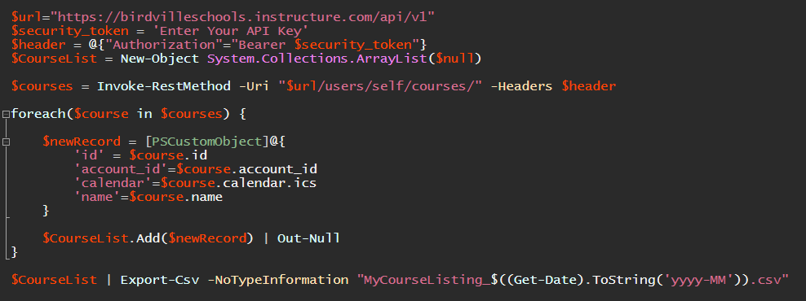
Exporting api information into excel
With only a few lines of code, it is easy to send GET calls into a spreadsheet.

Slide 14
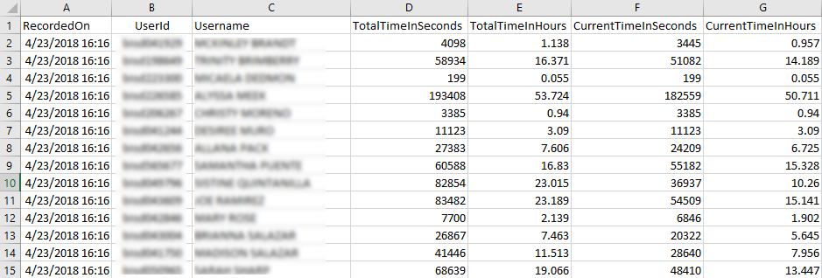
API – Track Hours
A teacher of ours needs to report the time her students spend in her Canvas course to a state reporting agency. In the past, she had a new course created every month to keep the numbers reliable.
With the API, we were able to create a script that would automatically check her numbers for last month, and then create a new file to show current activity, saving a great deal of time both for her and for us.

Slide 15
Where do I learn more?
Contact Robert:
Email: robert.leonard@birdvilleschools.net
Twitter: @RobertWLeonard
Canvas Data Portal Documentation: https://portal.inshosteddata.com/docs
Canvas API Documentation: https://canvas.instructure.com/doc/api/
Canvas Data Community: https://community.canvaslms.com/community/answers/data
Setting Up the Data CLI: https://community.canvaslms.com/docs/DOC-6600-how-to-use-the-canvas-data-cli-tool

