Slide 1
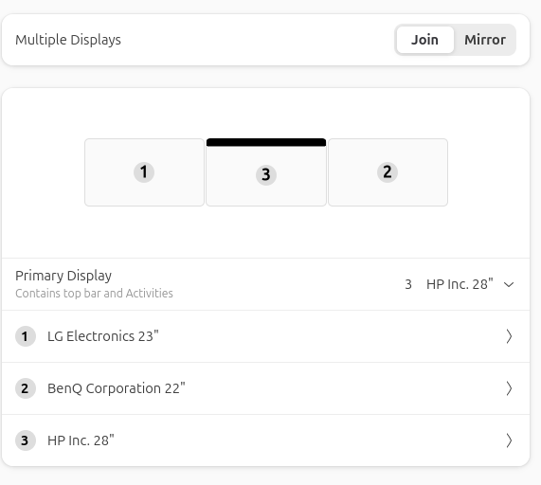
Display / Video Card configuration
bethe, 14May2026
View looking directly at the video card ports
LG
HP
BenQ
DVi
HDMI
DP

