Slide 1
A Berkeley Graphic

Slide 2
Why? Oh why?
I am not a fan but…
Industry loves powerpoint.

Slide 3
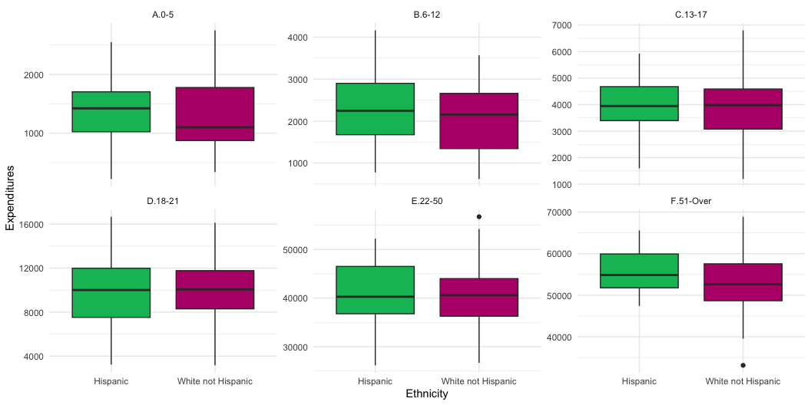
Picture

Slide 4
Multicolumns
Good morning America
I’m your native son

