Slide 1
A Berkeley Graphic

Slide 2
Why? Oh why?
I am not a fan but…
Industry loves powerpoint.

Slide 3
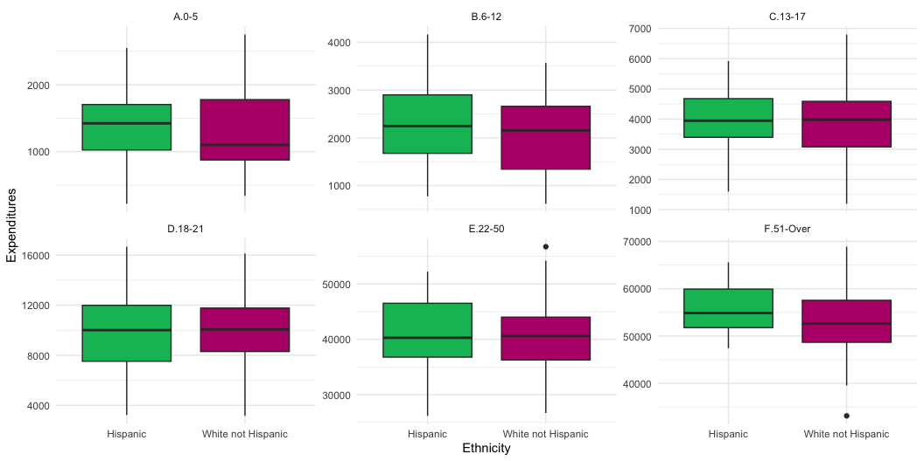
Picture

