Slide 1
Probability Distributions
Robert W. Walker

Slide 2
Probability: The Logic of Science
Jaynes presents a few core ideas and requirements for his rational system. Probability emerges as the representation of circumstances in which any given realization of a process is either TRUE or FALSE but both are possible and expressable by probabilities
that sum to one for all events
are greater than or equal to zero for any given event
General Representation of Probability
Is of necessity two-dimensional,
We have $x$ and
we have $Pr(X=x)$ in one of two forms (Pr or f).

Slide 3
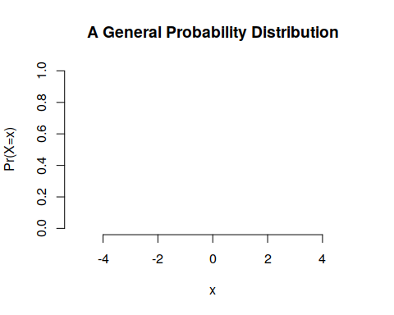

Slide 4
Probability Distributions of Two Forms
Our core concept is a probability distribution just as above. These come in two forms for two types [discrete (qualitative)] and continuous (quantitative)]:
Assumed
Derived
The Poster and Examples
Distributions are nouns. Sentences are incomplete without verbs – parameters. We need both; it is for this reason that the former slide is true. We do not always have a grounding for either the name or the parameter.
Continuous vs. Discrete Distributions
The differences are sums versus integrals. Why? - Histograms or - Density Plots
The probability of exactly any given value is zero on a true continuum.

Slide 5
Expectation
E(X)=x∈X​x⋅Pr(X=x)
E(X)=x∈X​x⋅f(x)dx
Variance
E[(X−μ)2]=x∈X​(x−μ)2⋅Pr(X=x)
E((X−μ)2)=x∈X​(x−μ)2⋅f(x)dx
The z-transform
The generic z-transformation applied to a variable $x$ centers [mean$≈$ 0] and scales [std. dev. $≈$ variance $≈$ 1] to $z_{x}$ for population parameters. $≈$ is approximately equal to.
$$z=\frac{x−μ}{σ}$$
In samples, the 0 and 1 are exact; these are features of the mean and degrees of freedom from last time.
$$z=\frac{x−\overline{x}}{s_{x}}$$
.
where $\overline{x}$ is the sample mean of $x$ and $s_{x}$ is the sample standard deviation of $x$. Take the example of earnings. Suppose earnings in a community have mean 55,000 and standard deviation 10,000. This is in dollars. Suppose I earn 75,000 dollars. First, if we take the top part of the fraction in the $z$ equation, we see that I earn 20,000 dollars more than the average (75000 - 55000). Finishing the calculation of z, I would divide that 20,000 dollars by 10,000 dollars per standard deviation. Let’s show that.
$$z=\frac{75000dollars−55000dollars}{\frac{10000dollars}{SD}}=+2SD$$
.
I am 2 standard deviations above the average (the +) earnings. All $z$ does is re-scale the original data to standard deviations with zero as the mean.
Suppose I earn 35,000. That makes me 20,000 below the average and gives me a z score of -2. I am 2 standard deviations below average (the -) earnings.
$z$ is an easy way to assess symmetry. The mean of z is always zero but the distribution of z to the left and right of zero is informative. If they are roughly even, then symmetry is likely. If the signs are uneven, then symmetry is unlikely. In R, $z$ is automated with the scale() command. The last line uses a table and the sign command to show me the positive and negative z.
# Generate random normal income Hypo.Income <- rnorm(1000, 55000, 10000) # z-transform income [mean 55000ish, std. dev. 10000ish] z.Income <- scale(Hypo.Income) # Combine them into a data.frame Income <- data.frame(Hypo.Income,z.Income) # Show the data.frame head(Income)
## Hypo.Income z.Income ## 1 33502.35 -2.20504908 ## 2 54335.80 -0.08815428 ## 3 55715.53 0.05203988 ## 4 37902.21 -1.75797724 ## 5 44020.78 -1.13626706 ## 6 63874.77 0.88110290
table(sign(z.Income))
## ## -1 1 ## 504 496

Slide 6
Probability Distributions
Distributions in R are defined by four core parts:
r, for random variables
p, for cumulative probability (given x) [counting from left] $Pr(X≤x)$
d, for density/probability that $Pr(X=x)$ or $f(x)$
q, for quantile (given p): x such that $Pr(X≤q)=p$
A Grape Escape?
A filling process is supposed to fill jars with 16 ounces of grape jelly, according to the label, and regulations require that each jar contain between 15.95 and 16.05 ounces.
Suppose that the uniform random process of filling in known to fill between 15.9 and 16.1 ounces uniformly.
Plot the histogram of 1000 simulated values. NB: unif is the noun with boundaries a (default 0) and b(default 1).
Jars <- runif(1000, 15.9, 16.1) hist(Jars)

Slide 7
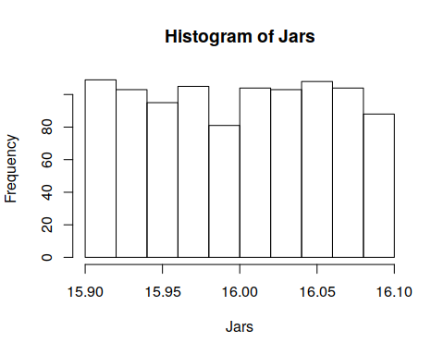

Slide 8
What is the probability that a random jar is outside of requirements?
Exactly? 50 percent because 25 percent are between 15.9 and 15.95 and 25 percent are between 16.05 and 16.1.
table(Jars < 15.95 | Jars > 16.05) # | captures or
## ## FALSE TRUE ## 489 511
Scale (z) the jars and summarise them.
summary(scale(Jars))
## V1 ## Min. :-1.69536 ## 1st Qu.:-0.88777 ## Median : 0.04985 ## Mean : 0.00000 ## 3rd Qu.: 0.85937 ## Max. : 1.73666
sd(scale(Jars))
## [1] 1
The mean of the normal random process of filling is known to be 16.004 ounces with standard deviation 0.028 ounces.
What is the probability that a random jar is outside of requirements? NB: norm is the noun with mean (default 0) and sd (default 1).
pnorm(15.95, 16.004, 0.028) + pnorm(16.05, 16.004, 0.028, lower.tail=FALSE)
## [1] 0.07709829
What is the probability that a random jar contains more than 16.1 ounces?
1-pnorm(16.1, 16.004, 0.028)
## [1] 0.0003033834
What is the probability that a random jar contains less than 16.04 ounces?
pnorm(16.04, 16.004, 0.028)
## [1] 0.9007286
95% of jars, given a normal, will contain between XXX and XXX ounces of jelly.
qnorm(c(0.025,0.975), 16.004, 0.028)
## [1] 15.94912 16.05888
The bottom 5% of jars contain, at most, XXX ounces of jelly.
qnorm(0.05, 16.004, 0.028)
## [1] 15.95794
The top 25% of jars contain at least XXX ounces of jelly.
qnorm(0.75, 16.004, 0.028)
## [1] 16.02289
Scottish Pounds
Informal surveys suggest that 15% of Essex shopkeepers will not accept Scottish pounds. There are approximately 200 shops in the general High Street square.
Draw a plot of the distribution and the cumulative distribution of shopkeepers that do not accept Scottish pounds.
plot(x=seq(0,200), y=pbinom(seq(0,200), size=200, 0.15), xlab="Refusers", ylab="Prob. of x or Less Refusers")

Slide 9
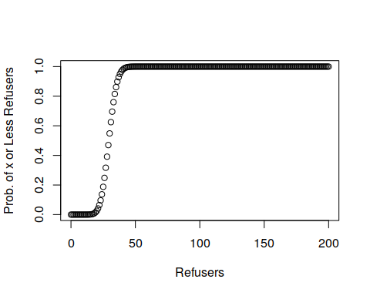

Slide 10
What is the probability that 24 or fewer will not accept Scottish pounds?
pbinom(24, 200, 0.15)
## [1] 0.1368173
What is the probability that 25 or more shopkeepers will not accept Scottish pounds?
1-pbinom(24, 200, 0.15)
## [1] 0.8631827
With probability 0.9 [90 percent], XXX or fewer shopkeepers will not accept Scottish pounds.
qbinom(0.9, 200, 0.15)
## [1] 37
[Geometric] Plot 1000 random draws of “How many vendors until one refuses my Scottish pounds?”
hist(rgeom(1000, 0.15), breaks=30)

Slide 11
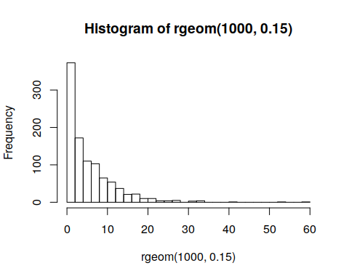

Slide 12
We could also do something like.
plot(seq(0,60), pgeom(seq(0,60), 0.15))

Slide 13
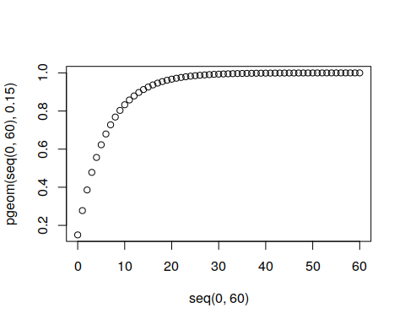

Slide 14
The Median is a Binomial with p=0.5
Interestingly, any given observation has a 50-50 chance of being over or under the median. Suppose that I have five datum. 1. What is the probability that all are under?
pbinom(0,size=5, p=0.5)
## [1] 0.03125
What is the probability that all are over?
dbinom(5,size=5, p=0.5)
## [1] 0.03125
What is the probability that the median is somewhere in between our smallest and largest sampled values?
Everything else.
This Rule of Five often credited to Hubbard is handy.
Air Traffic Controllers
FAA Decision: Expend or do not expend scarce resources investigating claimed staffing shortages at the Cleveland Air Route Traffic Control Center.
Essential facts: The Cleveland ARTCC is the US’s busiest in routing cross-country air traffic. In mid-August of 1998, it was reported that the first week of August experienced 3 errors in a one week period; an error occurs when flights come within five miles of one another by horizontal distance or 2000 feet by vertical distance. The Controller’s union claims a staffing shortage though other factors could be responsible. 21 errors per year (21/52 errors per week) has been the norm in Cleveland for over a decade.
Plot a histogram of 1000 random weeks. NB: pois is the noun with no default for $λ$ – the arrival rate.
hist(rpois(1000, 21/52))

Slide 15
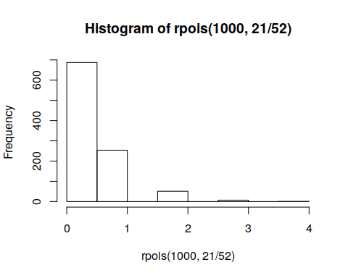

Slide 16
Plot a sequence on the x axis from 0 to 5 and the probability of that or fewer incidents along the y. seq(0,5)
plot(seq(0,5),ppois(seq(0,5), 21/52), ylim=c(0,1))

Slide 17
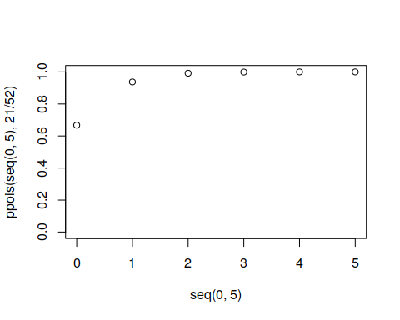

Slide 18
What would you do and why? Not impossible
After analyzing the initial data, you discover that the first two weeks of August have experienced 6 errors. What would you now decide? Well, once is 0.0081342. Twice, at random, is that squared. We have a problem.
Deaths by Horse Kick in the Prussian cavalry?
[Given time] A Less Basic Monte Carlo Simulation:
Customers arriving at a car dealership at a rate of 6 per hour.
Each customer has a 15% probability of making a purchase.
Purchasers yield [this part is harder]:
Uniform profits over the interval $1000-$3000.
Normal profits that average $1500 with standard deviation $500.
Customers <- rpois(1000, 6) # Customers ~ Poisson(6) Purchasers <- rbinom(1000, size=Customers, prob=0.15) # P ~ Binomial(Customers,0.15) # Next part needs a coding trick. For each row [of 1000], I want sum the Profits given Purchasers random draws. Profits.U <- sapply(c(1:1000), function(x) { sum(runif(Purchasers[[x]], 1000, 3000))} ) Profits.N <- sapply(c(1:1000), function(x) { sum(rnorm(Purchasers[[x]], 1500, 500))} ) plot(density(Profits.N))

Slide 19
