Slide 1
Browning Trail Camera PCB
BTC{7,8}{E, E-HP4, E-HP5}

Slide 2
BTC-7E-HP5

Slide 3
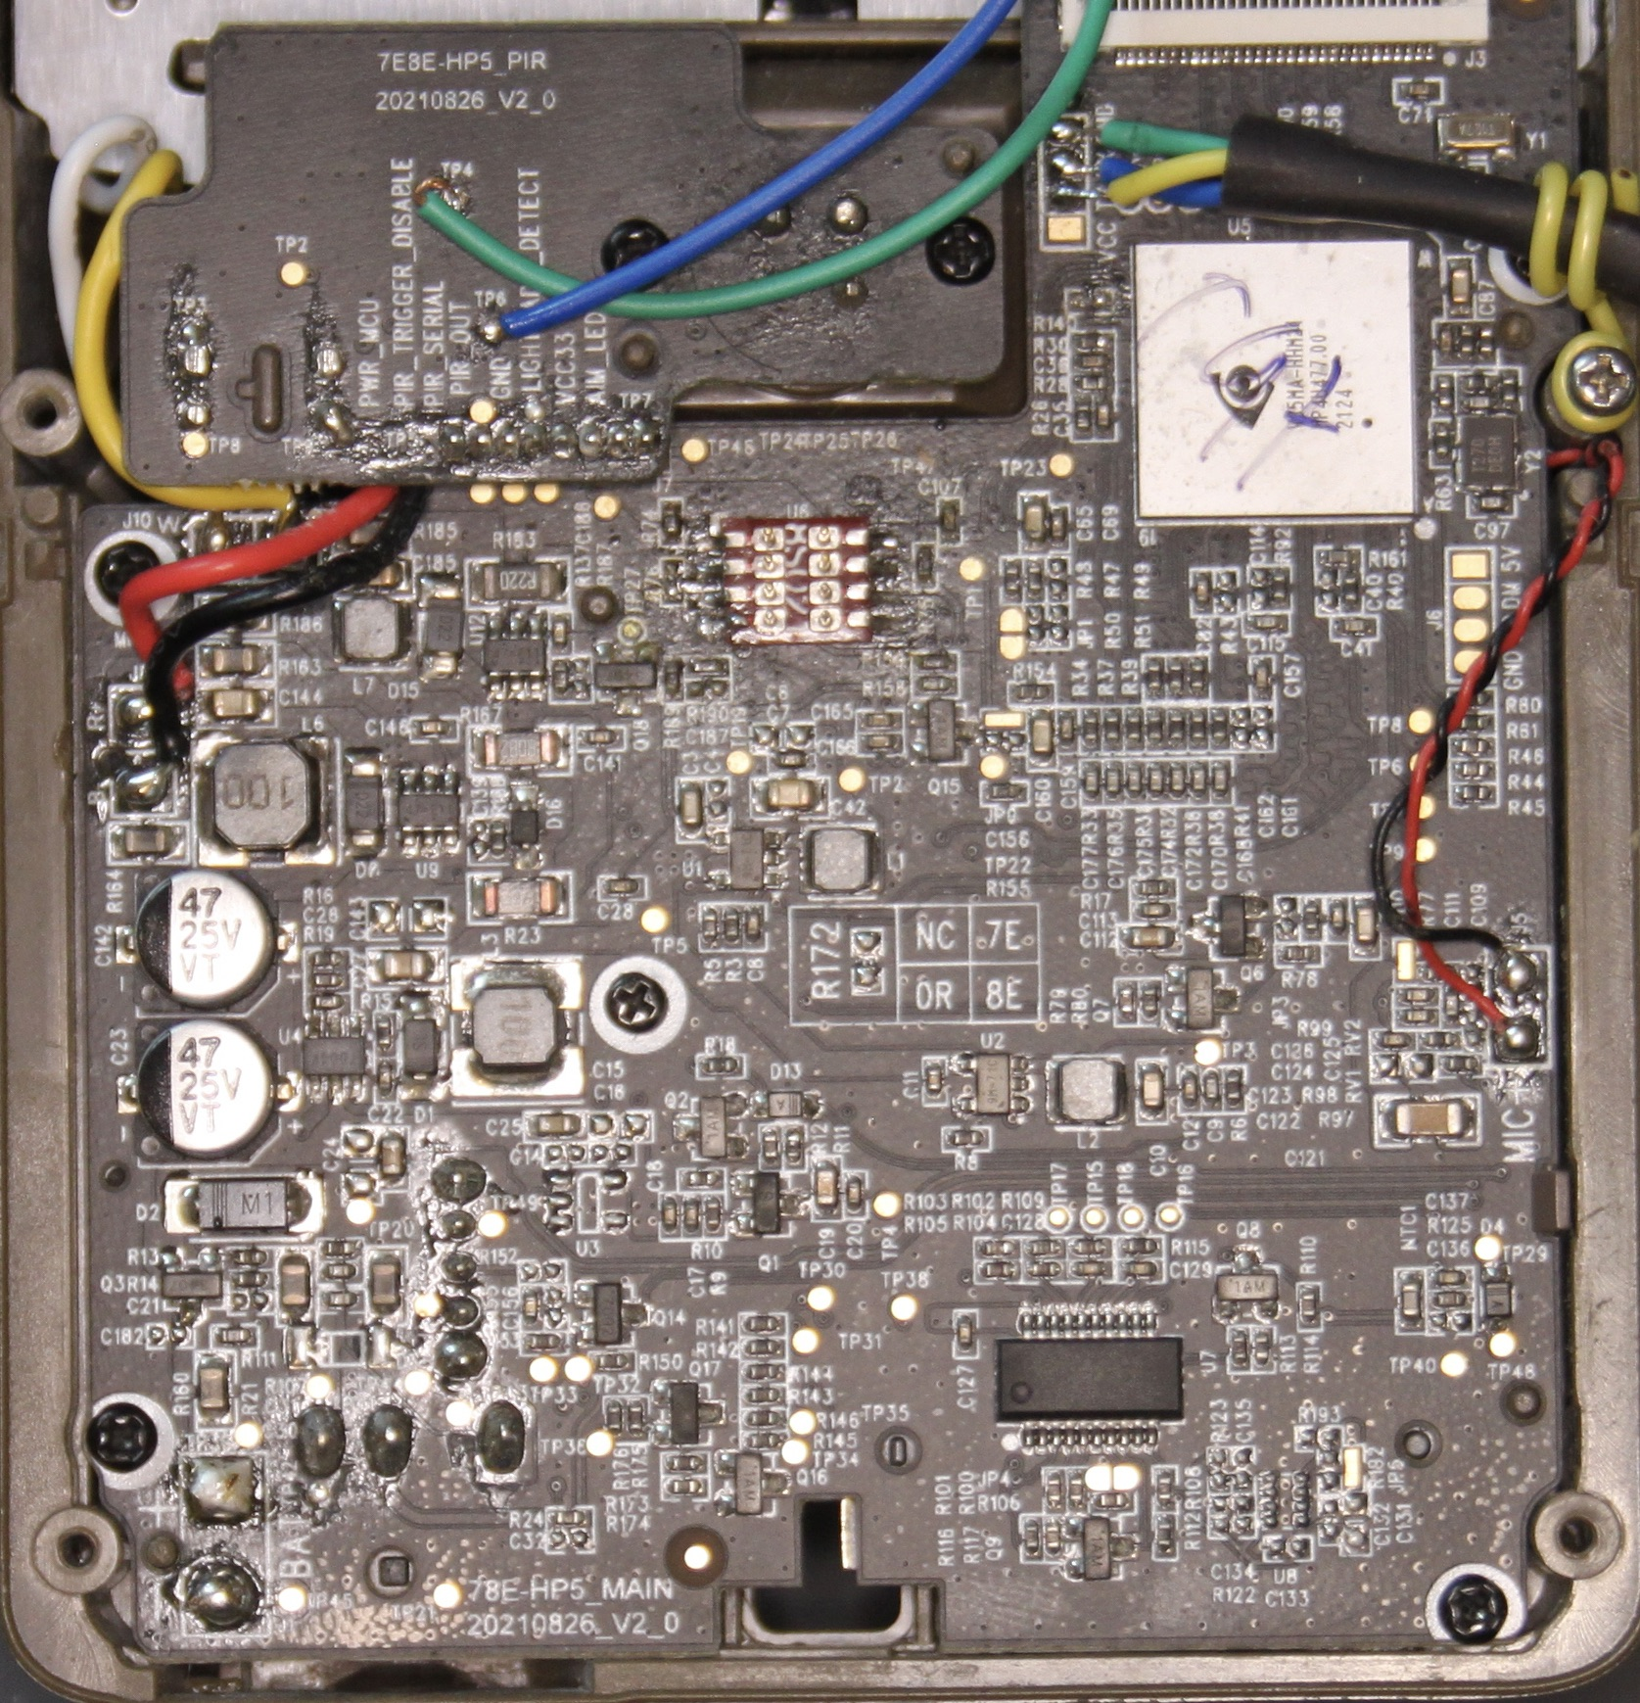
78E-HP5_MAIN 20210826_V2_0

Slide 4
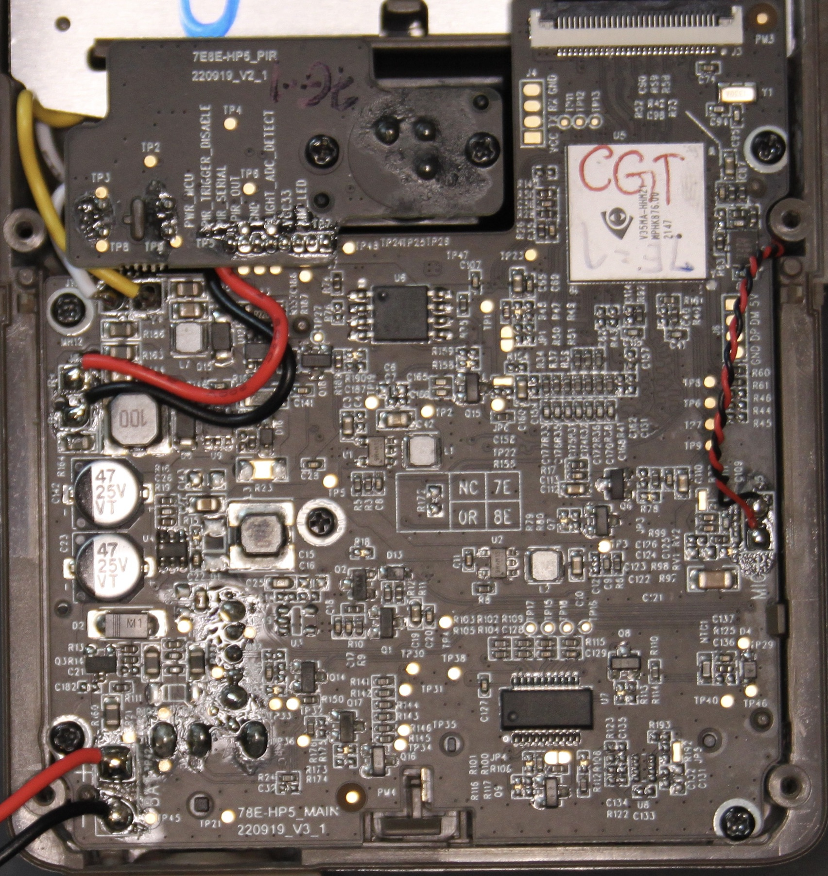
78E-HP5_MAIN 220919_V3_1

Slide 5
78E-HP5_MAIN 220919_V3_1Test Points
4

Slide 6
78E-HP5_MAIN DIFF

