Slide 1

SYBERIA: A DEVELOPMENT FRAMEWORK FOR R
Robert Krzyzanowski
Director of Data Engineering at Avant

Slide 2




syberia.io
github.com/robertzk/rfinance17
@rsyberia
rob@syberia.io

Slide 3
Our Initial Problem
R workflows are typically loosely organized collections of scripts

Slide 4
Our Initial Problem
R workflows are typically loosely organized collections of scripts
Packages work well for recording abstract solutions to problems, but not for large projects maintained by multiple users tied to solving problems in a specific domain

Slide 5
Our Initial Problem
R workflows are typically loosely organized collections of scripts
Packages work well for recording abstract solutions to problems, but not for large projects maintained by multiple users tied to solving problems in a specific domain
Test-driven development is difficult for modeling work that is intended for real-time systems

Slide 6

An Industry-wide Problem
Machine Learning: The High Interest Credit Card of Technical Debt (2014) NIPS 2014 Workshop proceedings
D. Sculley, Gary Holt, Daniel Golovin, et al
“Risk factors include boundary erosion, entanglement, hidden feedback loops, undeclared consumers, data dependencies, changes in the external world, and a variety of system-level anti-patterns.”

Slide 7
Our Initial Problem
Solution: Think like a developer

Slide 8


Inspiration from the Competition
Developers are good at simplifying work that needs to be done down to its core abstractions

Slide 9
What is Syberia?
Syberia is a framework for building complex projects in R.

Slide 10
What is Syberia?
Syberia is a framework for building complex projects in R.
The modular design unit is an engine.

Slide 11
What is Syberia?
Syberia is a framework for building complex projects in R.
The modular design unit is an engine.
Today we are releasing the modeling engine for building and deploying production-ready machine learning products in R.

Slide 12
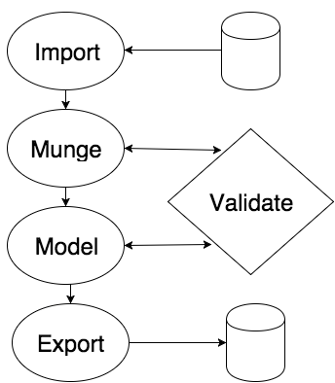
How Does It Work?

Slide 13
How Does It Work?
The modeling engine is the boss.
Mungebits package powers feature engineering.
Tundra package powers model containers.

Slide 14
How Does It Work?
The modeling engine is the boss.
Director package holds the project together.
Stagerunner package is the workflow and execution system.

Slide 15
The Basic Structure
source(“my_R_script.R”)
Script-driven workflow makes it harder to re-use components
Testing is not built in unless you move to a package

Slide 16
The Basic Structure
resource(“lib/adapters/s3”)
Basic idea: Everything is a resource
All resources must be tested (test/lib/adapters/s3)
Each resource type can have its own “grammar”

Slide 17
The Basic Structure
Task: Let’s import some data using Syberia.

Slide 18
An Example
# lib/adapters/s3.R
read <- function(name) {
s3mpi::s3read(name)
}
write <- function(object, name) { s3mpi::s3store(object, name) }
# package: github.com/robertzk/s3mpi

Slide 19
An Example
# config/routes.R list(
"config/global" = "globals",
"lib/adapters" = "adapters",
"lib/classifiers" = "classifiers",
"lib/mungebits" = "mungebits",
"models" = "models",
"test/models" = "test/models",
"data" = "data")

Slide 20
The Basic Structure
a <- resource(“lib/adapters/s3”)
a$write(iris, “tmp/iris”)
# From a new R session
a <- resource(“lib/adapters/s3”)
identical(
a$read(“tmp/iris”),
iris
)

Slide 21
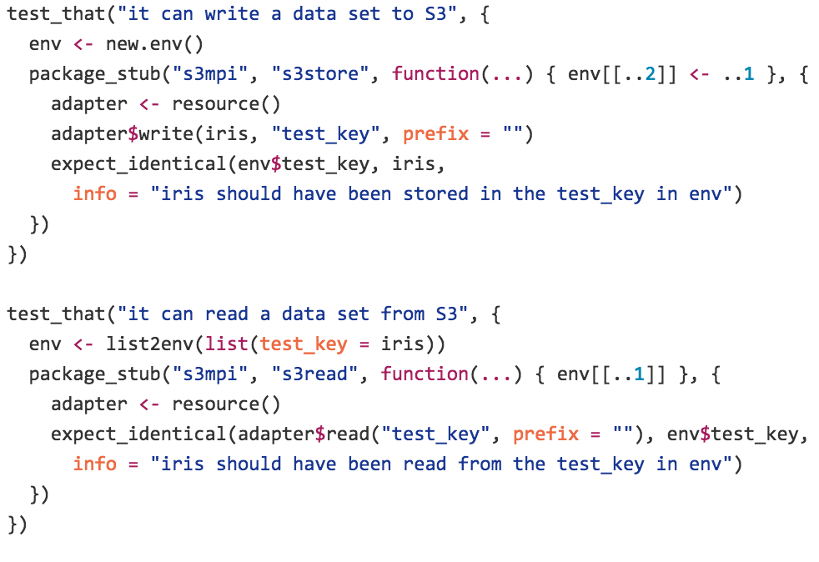
An Example
# test/lib/adapters/s3.R

Slide 22
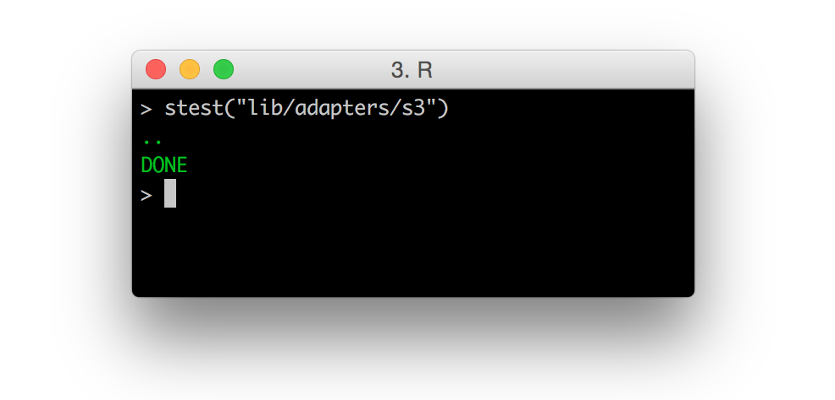
An Example

Slide 23
An Example
# config/routes.R list(
"config/global" = "globals",
"lib/adapters" = "adapters",
"lib/classifiers" = "classifiers",
"lib/mungebits" = "mungebits",
"models" = "models",
"test/models" = "test/models",
"data" = "data")

Slide 24
An Example
# lib/controllers/adapters.R
function(input) {
adapter_class <- function(r, w) {
list(read = r, write = w)
}
# Construct the adapter object.
adapter_class(
input$read,
input$write
)
})

Slide 25
An Example
# lib/adapters/s3.R
read <- function(name) {
s3mpi::s3read(name)
}
write <- function(object, name) { s3mpi::s3store(object, name) }
# package: github.com/robertzk/s3mpi

Slide 26
An Example
Think of how you might write adapters for other storage backends:
Reading from and writing to a CSV file
Reading from and writing to a database
Reading from and writing to a JSON service
Et cetera

Slide 27
An Example
Defining “adapters” abstracted away the storage backend from the underlying implementation
Each adapter has the same interface

Slide 28
An Example
Defining “adapters” abstracted away the storage backend from the underlying implementation
Each adapter has the same interface
adapter <- resource(“lib/adapters/s3”) adapter$read(“some_key”) adapter$write(object, “some_key”)

Slide 29
An Example
Defining “adapters” abstracted away the storage backend from the underlying implementation
Each adapter has the same interface
adapter <- resource(“lib/adapters/s3”) adapter$read(“some_key”) adapter$write(object, “some_key”)
adapter <- resource(“lib/adapters/file”)
adapter$read(“some_file.rds”) adapter$write(iris, “some_file.csv”)

Slide 30
The Premise of Syberia
Everything is a resource

Slide 31
The Premise of Syberia
Everything is a resource
Each resource produces a single R object

Slide 32
The Premise of Syberia
Everything is a resource
Each resource produces a single R object
Encourages finding common interfaces and abstractions

Slide 33
The Premise of Syberia
Everything is a resource
Each resource produces a single R object
Encourages finding common interfaces and abstractions
Work becomes easily re-usable instead of locked away in scripts

Slide 34
The Modeling Engine

Slide 35
The Modeling Engine
list(
# Titanic dataset is fairly popular. Here we're downloading it from a public github repo
import = list(url = "https://raw.githubusercontent.com/haven-jeon/.../master/bicdata/data/titanic.csv"),
data = list(
# The left-hand side defines the informal name of a mungebit that you will see when you run this model.
# The right-hand side is the mungebit invocation.
"Factor to character" = list(column_transformation(as.character), is.factor)
,"has paren in name" = list(multi_column_transformation(function(name) grepl("(", fixed = TRUE, name)), "name", "has_paren")
,"Name length variable" = list(new_variable, function(name) nchar(name), "name_length")
# ~40 removed
,"Restore levels" = list(restore_categorical_variables)
,"Rename dep_var" = list(renamer, c("survived" = "dep_var"))
),
model = list('gbm'
, .id_var = 'X'
, distribution = 'bernoulli'
, number_of_trees = 3000
, shrinkage_factor = 0.005
),
export = list(R = 'titanic')
)

Slide 36
The Modeling Engine
list(
# Titanic dataset is fairly popular. Here we're downloading it from a public github repo
import = list(url = "https://raw.githubusercontent.com/haven-jeon/.../master/bicdata/data/titanic.csv"),
data = list(
# The left-hand side defines the informal name of a mungebit that you will see when you run this model.
# The right-hand side is the mungebit invocation.
"Factor to character" = list(column_transformation(as.character), is.factor)
,"has paren in name" = list(multi_column_transformation(function(name) grepl("(", fixed = TRUE, name)), "name", "has_paren")
,"Name length variable" = list(new_variable, function(name) nchar(name), "name_length")
# ~40 removed
,"Restore levels" = list(restore_categorical_variables)
,"Rename dep_var" = list(renamer, c("survived" = "dep_var"))
),
model = list('gbm'
, .id_var = 'X'
, distribution = 'bernoulli'
, number_of_trees = 3000
, shrinkage_factor = 0.005
),
export = list(R = 'titanic')
)

Slide 37
Mungebits
# config/routes.R list(
"config/global" = "globals",
"lib/adapters" = "adapters",
"lib/classifiers" = "classifiers",
"lib/mungebits" = "mungebits",
"models" = "models",
"test/models" = "test/models",
"data" = "data")

Slide 38
Mungebits
Sort data in ascending order by a given column.
# lib/mungebits/orderer.R
train <- predict <- function(dataframe, col) {
dataframe[order(dataframe[[col]]), ]
}
# From R console
m <- resource(“lib/mungebits/orderer”)
stopifnot(all.equal(
m$run(iris, 1), iris[order(iris[[1]]), ]
))

Slide 39
Mungebits
Mean imputation for one column.
# lib/mungebits/simple_impute.R
train <- function(dataframe, col) {
input$col <- col
input$mean <- mean(dataframe[[col]], na.rm=T)
dataframe[is.na(dataframe[[col]]), col] <-
input$mean
dataframe
}
predict <- function(dataframe, ...) {
col <- input$col
dataframe[is.na(dataframe[[col]]), col] <-
input$mean
dataframe }

Slide 40
Mungebits
# In R console
m <- resource(“lib/mungebits/simple_impute”)
iris2 <- iris; iris2[1, 1] <- NA
m$run(iris2, 1)
stopifnot(all.equal(
m$run(iris2)[[1]],
c(mean(iris[-1, 1]), iris2[-1, 1])
))

Slide 41
Mungebits
# lib/controllers/mungebits.R
function(input) {
if (isTRUE(input$column_transformation)) {
mungebits2::mungebit$new(
mungebits2::column_transformation(input$train),
mungebits2::column_transformation(input$predict))
} else {
mungebits2::mungebit$new(
input$train, input$predict)
}
}

Slide 42
Classifiers
# lib/controllers/classifiers.R
function(input) {
force(input)
function(munge_procedure = list(), default_args = list(), internal = list()) {
input <- lapply(as.list(input), full_deflate)
container <- tundra::tundra_container$new(resource, input$train, input$predict,
munge_procedure, full_deflate(default_args), full_deflate(internal))
container$hooks <- lapply(container$hooks, function(fn) {
environment(fn) <- globalenv(); fn
})
if (!is.null(input$read) ||
!is.null(input$write)) {
attr(container, "s3mpi.serialize") <- list(read = input$read, write = input$write)
}
container
}
}

Slide 43
The Modeling Engine
list(
# Titanic dataset is fairly popular. Here we're downloading it from a public github repo
import = list(url = "https://raw.githubusercontent.com/haven-jeon/.../master/bicdata/data/titanic.csv"),
data = list(
# The left-hand side defines the informal name of a mungebit that you will see when you run this model.
# The right-hand side is the mungebit invocation.
"Factor to character" = list(column_transformation(as.character), is.factor)
,"has paren in name" = list(multi_column_transformation(function(name) grepl("(", fixed = TRUE, name)), "name", "has_paren")
,"Name length variable" = list(new_variable, function(name) nchar(name), "name_length")
# ~40 removed
,"Restore levels" = list(restore_categorical_variables)
,"Rename dep_var" = list(renamer, c("survived" = "dep_var"))
),
model = list('gbm'
, .id_var = 'X'
, distribution = 'bernoulli'
, number_of_trees = 3000
, shrinkage_factor = 0.005
),
export = list(R = 'titanic')
)

Slide 44
The Modeling Engine
list(
# Import and data stage
model = list('gbm'
, .id_var = 'X'
, distribution = 'bernoulli'
, number_of_trees = 3000
, shrinkage_factor = 0.005
)
# Export stage
)

Slide 45
The Models Controllers
# lib/controllers/models/models.R
construct_stage_runner <- Ramd::define("construct_stage_runner")[[1]](resource)
preprocessor <- Ramd::define("preprocessor")[[1]]
function(args, resource, output, director, modified, any_dependencies_modified) {
parent.env(parent.env(environment(construct_stage_runner))) <- environment()
if (is.element("raw", names(args))) return(output)
require(objectdiff)
message("Loading model: ", resource)
tests <- file.path('test', resource)
has_tests <- director$exists(tests)
has_tests <- FALSE
if (has_tests) {
testrunner <- stageRunner$new(new.env(), director$resource(tests))
testrunner$transform(function(fn) {
library(testthat); force(fn)
function(after) fn(cached_env, after)
})
}
model_version <- gsub("^\\w+/", "", resource)
if (isTRUE(args$fresh) || !identical(resource, director$cache_get("last_model"))) {
stagerunner <- construct_stage_runner(output, model_version)
} else if (modified || any_dependencies_modified) {
message(crayon::yellow("Copying cached environments..."))
stagerunner <- construct_stage_runner(output, model_version)
stagerunner$coalesce(director$cache_get("last_model_runner"))
} else if (!director$cache_exists("last_model_runner")) {
stagerunner <- construct_stage_runner(output, model_version)
} else {
stagerunner <- director$cache_get("last_model_runner")
}
if (has_tests) stagerunner$overlay(testrunner, "tests", flat = TRUE)
director$cache_set("last_model", resource)
director$cache_set("last_model_runner", stagerunner)
stagerunner
}
# ../models/preprocessor.R
preprocessor <- function(resource, director, source_env) {
source_env$extending <- function(model_version, expr) {
eval.parent(substitute(within(resource(file.path("models/", model_version), raw = TRUE), { expr })))
}
source_env$model_version <- version <- gsub("^[^/]+\\/[^/]+\\/", "", resource)
source_env$model_name <- basename(version)
source_env$output <-
function(suffix = "", create = TRUE, dir = file.path(director$root(), "tmp")) {
filename <- file.path(dir, version, suffix)
if (create && !file.exists(dir <- dirname(filename)))
dir.create(dir, recursive = TRUE)
filename
}
lexicals <- director$resource("lib/shared/lexicals")
for (x in ls(lexicals)) source_env[[x]] <- lexicals[[x]]
director$resource("lib/shared/source_mungebits")(source_env, director)
model <- source()
if (nzchar(Sys.getenv("CI"))) {
model$import <- NULL
}
}
model
}
# ../models/
construct_stage_runner.R
model_env <- function() {
if (identical(getOption("environment_type"), "environment")) {

Slide 46
Other Controller Ideas
Other useful abstractions with their own grammar:
Modules: Nested bundles of related R functions.
Indicators: y ~ x1 + x2 tied to an ETL backend
Stages: Execution tasks for our stage runner.
Jobs: Build reports, monitoring checks, etc.
Queries: “Object-relational mapper” for R

Slide 47
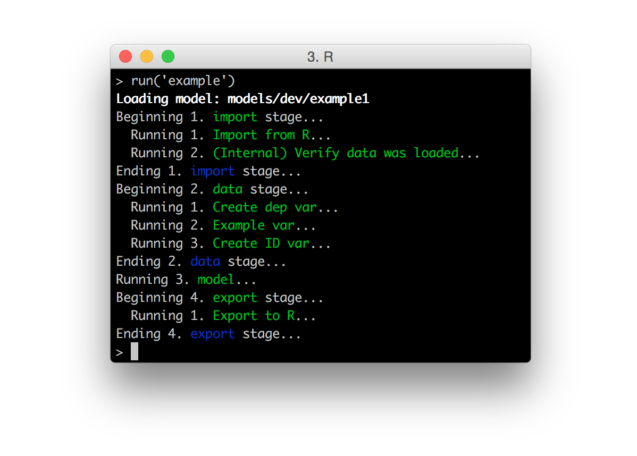
Running A Model
run(“example”) # Runs models/dev/example.R
list(
import = list(R = "iris"),
data = list(
"Create dep var" = list(renamer,
c("Sepal.Length" = "dep_var")),
"Example var" = list(example),
"Create ID var" = list(
multi_column_transformation(seq_along),
"dep_var", "id")
),
model = list("lm", .id_var = "id"),
export = list(R = "model")
)

Slide 48
Running A Model
run(“example”) # Runs models/dev/example.R
list(
import = list(R = "iris"),
data = list(
"Create dep var" = list(renamer,
c("Sepal.Length" = "dep_var")),
"Example var" = list(example),
"Create ID var" = list(
multi_column_transformation(seq_along),
"dep_var", "id")
),
model = list("lm", .id_var = "id"),
export = list(R = "model")
)
model$predict(iris) # [1] 5.005 4.757 4.890 ...

Slide 49
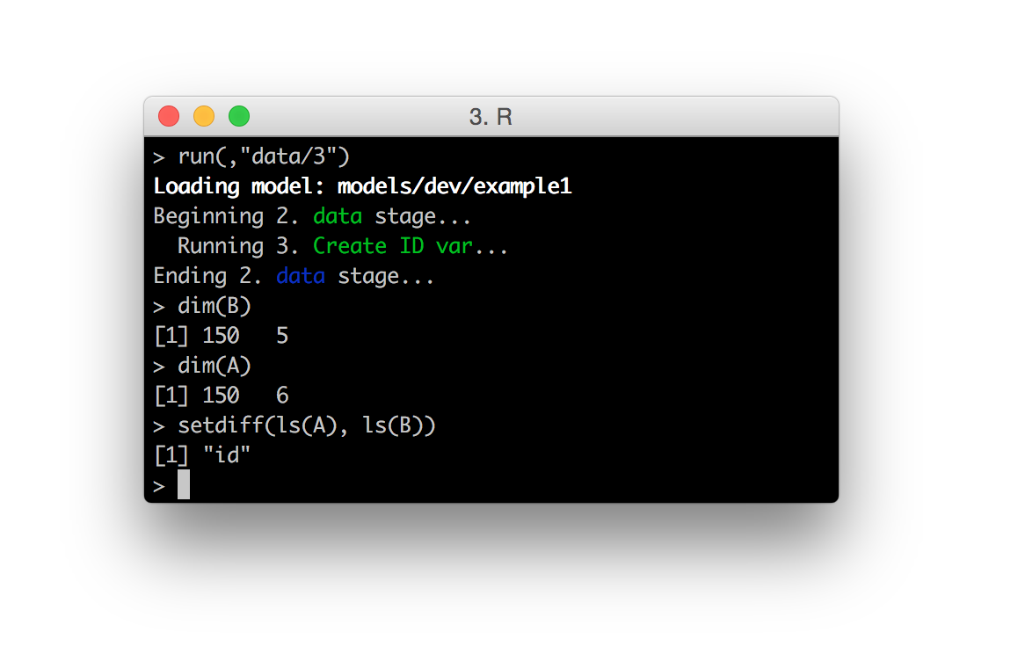
Running A Model
run(, “data/3”) # Re-runs one munge step
list(
import = list(R = "iris"),
data = list(
"Create dep var" = list(renamer
c("Sepal.Length" = "dep_var")),
"Example var" = list(example),
"Create ID var" = list(
multi_column_transformation(seq_along),
"dep_var", "id")
),
model = list("lm", .id_var = "id"),
export = list(R = "model")
)
setdiff(ls(B), ls(A)) # [1] “id”

Slide 50
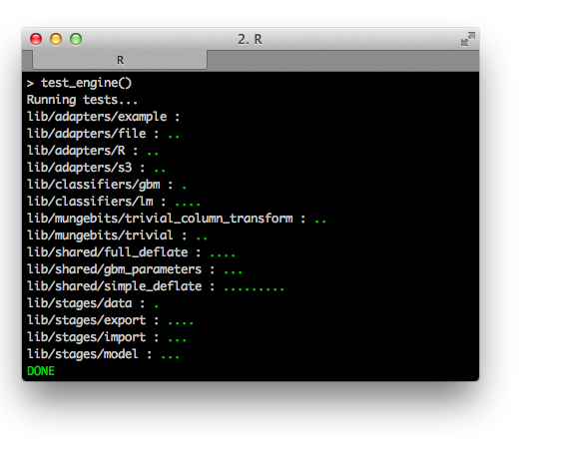
Testing Built In
Each resource requires an accompanying test
test_project()

Slide 51
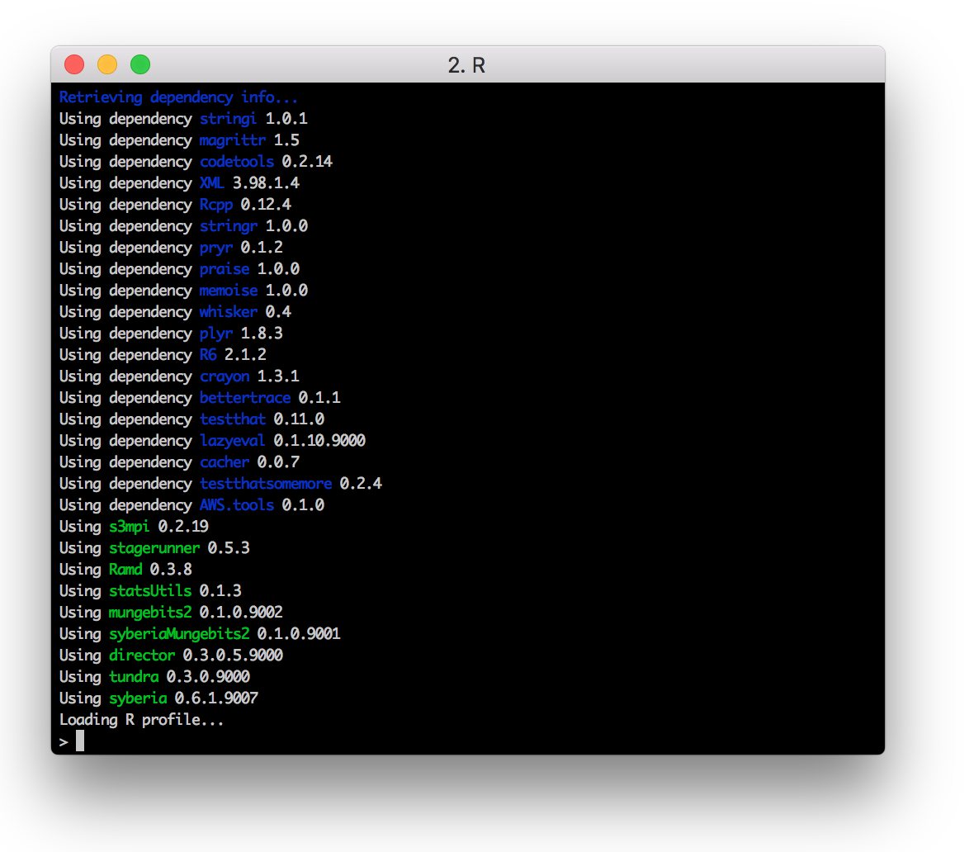
Dependency Management
Everyone working on the project has the
same set of dependencies

Slide 52
Dependency Management
syberia/lockbox
# lockfile.yml
packages:
-
name: devtools
version: 1.12.0
repo: hadley/devtools
ref: v1.12.0
-
name: checkr
version: 0.1.4
repo: syberia/checkr
-
name: Ramd
version: 0.3.8
repo: robertzk/Ramd
-
name: statsUtils
version: 0.1.4
repo: robertzk/statsUtils
-
name: mungebits2
version: 0.1.0.9014
repo: syberia/mungebits2
-
name: syberiaMungebits2
version: 0.1.2.9002
repo: syberia/syberiaMungebits2
-
name: director
version: 0.3.0.5.9000
repo: syberia/director
-
name: tundra
version: 0.3.0.9000
repo: syberia/tundra
-
name: syberia
version: 0.6.1.9009
repo: syberia/syberia
ref: 0.6.1.9009
-
name: s3mpi
version: 0.2.40
repo: robertzk/s3mpi
-
name: objectdiff
version: 0.2.3.9003
repo: robertzk/objectdiff
-
name: stagerunner
version: 0.5.6
repo: syberia/stagerunner

Slide 53


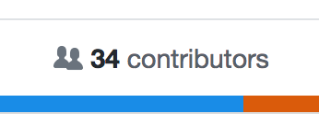
Arbitrarily Large Projects
Scales to large teams of contributors working
on thousands of R models

Slide 54
The Future
Currently 2 main engines are open sourced:
Modeling engine
Base engine (dependency of modeling engine)

Slide 55
The Future
Currently 2 main engines are open sourced:
Modeling engine
Base engine (dependency of modeling engine)
Using Syberia for HFT automation:
Define a backtesting engine & grammar (built on top of base engine)

Slide 56
The Future
Currently 2 main engines are open sourced:
Modeling engine
Base engine (dependency of modeling engine)
Using Syberia for HFT automation:
Define a backtesting engine & grammar (built on top of base engine)
Use it to visualize + test strategies in R

Slide 57
The Future
Currently 2 main engines are open sourced:
Modeling engine
Base engine (dependency of modeling engine)
Using Syberia for HFT automation:
Define a backtesting engine & grammar (built on top of base engine)
Use it to visualize + test strategies in R
Define resources to transpile R -> VHDL

Slide 58
The Future
Currently 2 main engines are open sourced:
Modeling engine
Base engine (dependency of modeling engine)
Using Syberia for HFT automation:
Define a backtesting engine & grammar (built on top of base engine)
Use it to visualize + test strategies in R
Define resources to transpile R -> VHDL
Push to FPGA arrays and trade realtime

Slide 59
Shoutouts!
A huge thank you to all Avantees that contributed to making Syberia happen:
Abel Castillo
David Feldman
Jason French
Kirill Sevastyanenko
Peter Hurford
Ryland Ely
Tong Lu

Slide 60
syberia.io
github.com/robertzk/rfinance17
@rsyberia
rob@syberia.io

