Slide 1

SAPIENZA UNIVERSITÀ DI ROMA · LAB ADVANCED PROGRAMMING 2025/2026
Mars
Automation Platform
5
Microservices
15
Sensor Sources
Distributed sensor ingestion, event-driven automation
and real-time habitat monitoring — from Mars.
4
Actuators
Hackathon Exam · 5 March 2026 · Team Submission

Slide 2



Mission Overview
Year 2036. You've been accidentally shipped to Mars while sleeping at your desk. The habitat automation stack is partially destroyed. Devices speak incompatible dialects — some stream telemetry, others respond only to polling. Your mission: rebuild the platform before thermodynamic consequences catch up.
Ingest
Automate
Monitor
Poll REST sensors & consume telemetry streams from 15 heterogeneous devices
Evaluate IF-THEN rules on every incoming event and trigger actuator commands in real time
Serve a live dashboard with sensor state, actuator status, and rule management UI
Mars Automation Platform · Lab Advanced Programming 2025/2026

Slide 3



System Architecture
Sensors
(provided)
Integration
Service
Automation
Engine
Service
Actuator
Service
Actuators
(provided)
Rulebook
Service
Kafka
Broker
Nginx
API Gateway
Frontend
Postgres
DBMS ── REST ── Kafka ── SSE ── HTTP proxy
Mars Automation Platform · Lab Advanced Programming 2025/2026

Slide 4
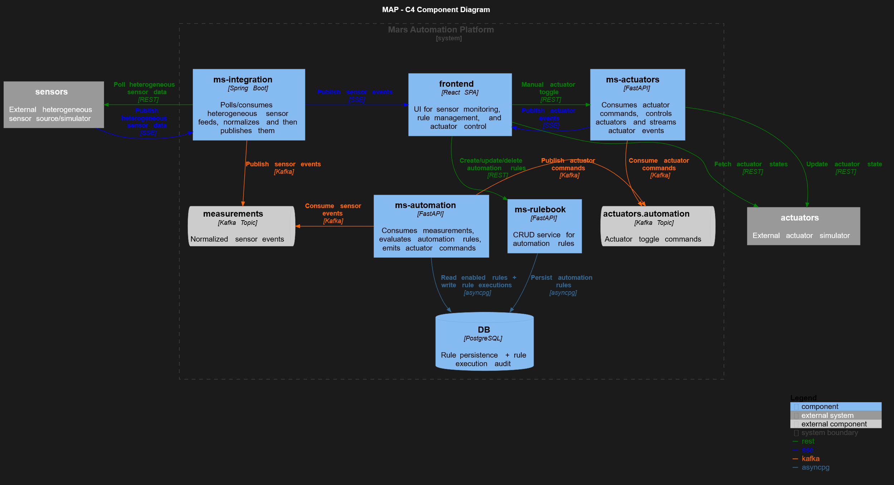
C4 Component Diagram

Slide 5

Microservices Breakdown
ms-integration :8080
Java · Spring Boot
ms-automation :8001
Python · FastAPI
Polls 8 REST sensors
Consumes Kafka sensor events
Consumes 7 SSE telemetry topics
Evaluates IF-THEN rules
Publishes normalized events
Publishes actuator commands
ms-rulebook :8003
Python · FastAPI
ms-actuators :8004
Python · FastAPI
CRUD API for automation rules
Consumes actuator commands from Kafka
Persists rules in PostgreSQL
Calls simulator REST API
Exposes SSE stream of actuator events
Mars Automation Platform · Lab Advanced Programming 2025/2026

Slide 6

Automation Engine (Python)
Rule Syntax
Supported Operators
IF <sensor>.<metric> <op> <value>
THEN SET <actuator> TO ON|OFF
< <= = >= >
e.g. IF greenhouse_temperature.temperature_c > 28 THEN SET cooling_fan TO ON
Evaluated on every sensor event arrival
Kafka Consumer
Rule Evaluation
Kafka Producer
Live Actuator Interaction
Consumes MeasurementEvents from the measurements Kafka topic
Loads rules, matches sensor and metrics, evaluates operator & threshold
Publishes ActuatorCommands to the actuators.automation Kafka topic
ms-actuators service applies actuactor commands and notifies the dashboard
Mars Automation Platform · Lab Advanced Programming 2025/2026

Slide 7

Infrastructure & DevOps
Service
Image / Stack
Notes
kafka
apache/kafka:3.9.0
KRaft mode, single broker, auto-create topics
postgres
postgres:16-alpine
Persists automation rules; init scripts in /source/postgres
simulator
mars-iot-simulator:v1
Provided — must not be modified
ms-integration
Java · Spring Boot
Polls REST + SSE telemetry → Kafka
ms-automation
Python · FastAPI
Rule engine; consumes/produces Kafka; REST + SSE out
ms-rulebook
Python · FastAPI
CRUD rules API
ms-actuators
Python · FastAPI
Kafka consumer → simulator REST; SSE stream out
frontend
Node (React build)
SPA served on :3001 internally, proxied by Nginx
nginx
nginx:1.25-alpine
API gateway on :80; routes rules/actuators/integration/SPA
Mars Automation Platform · Lab Advanced Programming 2025/2026

Slide 8

Nginx API Gateway & Routing
/api/rules/*
CRUD rule management
→ ms-rulebook:8003
Nginx
:80
/api/actuators/stream
SSE stream (buffering OFF)
→ ms-actuators:8004
Single public
entry point
gzip + SSE
buffering config
/api/actuators/*
Manual actuator control
→ ms-actuators:8004
/api/integration/*
Sensor state & polling
→ ms-integration:8080
/ (catch-all)
React SPA + WS upgrade
→ frontend:3000
Mars Automation Platform · Lab Advanced Programming 2025/2026

Slide 9

Technology Stack
Backend
Messaging & Storage
Frontend & Gateway
Java 21 + Spring Boot
Apache Kafka 3.9 (KRaft)
React SPA
Python 3.12 + FastAPI (×3)
PostgreSQL 16
nginx 1.25-alpine API gateway
Spring Kafka (Java)
In-memory sensor state cache
SSE for real-time updates
AIOKafka (Python)
SSE streams (native HTTP)
REST for rule management
Docker Compose IaC
Mars Automation Platform · Lab Advanced Programming 2025/2026

Slide 10

User Stories — Dashboard & Monitoring
Operator
Administrator
Automation Engineer
View a centralized dashboard of all habitat sensors to monitor the overall health of the Mars base.
Operator
See the most recent reading from each sensor instantly upon opening the dashboard — no waiting for the next broadcast.
Operator
Sensor data updates automatically without refreshing so I am always looking at live, real-time telemetry.
Operator
See standardized units and naming conventions for all data, regardless of which device it came from.
Operator
View a live line chart for selected sensors (e.g. greenhouse temperature) while the page is open to track trends.
Operator
Sensors are grouped by operational domain (Thermal, Power, Air Quality) for fast navigation during an emergency.
Operator
Dashboard displays the exact timestamp of the last data point received so I know if a sensor has gone offline.
Operator
A visual indicator flags sensor data older than 5 minutes so I don't mistakenly trust stale telemetry.
Operator
Mars Automation Platform · Lab Advanced Programming 2025/2026

Slide 11






User Stories — Automation Rule Management
Automation Engineer
Automation Engineer
Automation Engineer
Automation Engineer
Create new rules using a simple sentence format (IF sensor op value THEN actuator state).
Select sensors and actuators from predefined lists when creating a rule to avoid fatal typing errors.
Define rule conditions using standard operators (<, <=, =, >, >=) to set precise environmental thresholds.
View a list of all currently active rules to audit the habitat's full automated logic at a glance.
Automation Engineer
Automation Engineer
Automation Engineer
Administrator
Delete automation rules to permanently remove outdated or dangerous logic from the system.
Edit existing rules to adjust thresholds (e.g. lower heater trigger) as Martian seasons change.
Temporarily disable and re-enable specific rules without deleting them to prevent false actuations during maintenance.
Automation rules are permanently saved so they survive a system crash or power cycle.
Mars Automation Platform · Lab Advanced Programming 2025/2026

Slide 12



User Stories — System Resilience & Configuration
Dashboard displays data from ALL sensors regardless of transmission method — polling or streaming — no blind spots.
Operator
Configure global polling frequency for legacy sensors to balance network load with dashboard responsiveness.
Administratoror
System evaluates rules the exact instant new sensor data arrives so life-saving equipment activates immediately.
Operator
Manually trigger a refresh of all actuator states via a dashboard button to verify true physical status.
Operator
The monitoring dashboard stays live and responsive even if the automated rule system goes offline.
Operator
Get notified each time an actuator state changes to be aware of what’s going on in the habitat
Operator
A visual alert appears on the UI when a sensor reads out of normal bounds — even before a rule triggers.
Operator
8
Rule Management (CRUD)
7
System Resilience
24 User stories implemented
A global 'System Connection' indicator (Green/Red) shows immediately if the UI has lost its SSE/WebSocket connection.
Operator
Config & Actuators
Mars Automation Platform · Lab Advanced Programming 2025/2026

Slide 13
Mission Accomplished.
docker compose up → http://localhost
Lab Advanced Programming 2025/2026 · Sapienza Università di Roma

Slide 14
Credits
Mission Accomplished.
Annie Jain
2252767
Ebrahim Afridi 2247107
Bojan Robev 2252060
Dakshita Minocha 2247114
Emanuele Scaccia 2006749
Lab Advanced Programming 2025/2026 · Sapienza Università di Roma

