Slide 1
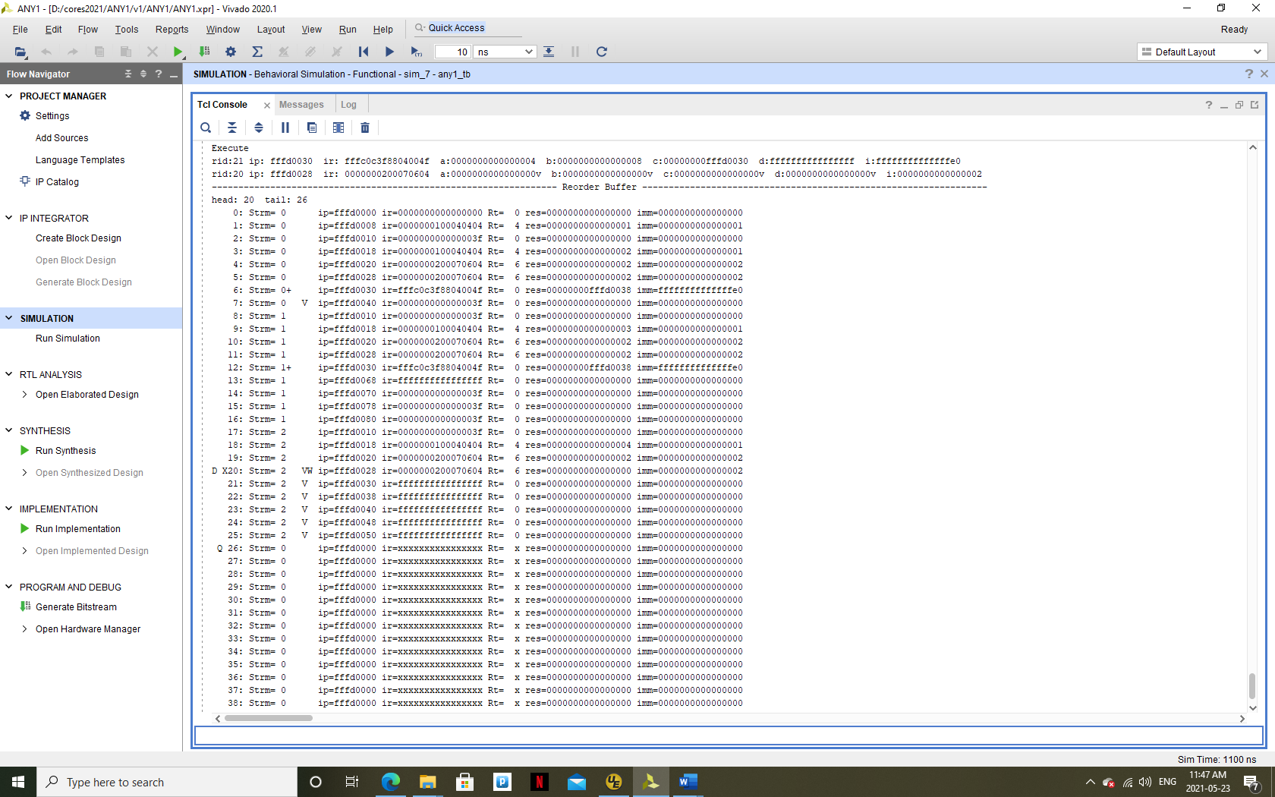
‘+’ indicates that the processing stream incremented
Instructions whose stream does not match the processing stream are ignored.
The processing stream increments as a result of a flow control change (branch miss).
Instruction queued before branch executed that are invalidated by branch (wrong execution stream)
Miss takes 4 clock cycles
FF.FFFF = instruction queued but not decoded yet
DXQ
D = instruction being dequeued (committed to machine)
X = instruction being executed
Q = instruction being queued

