Slide 1
Qupls4: Instruction Cache
System Bus 256b
Two 256b bus cycles are run by the cache controller to full-fill a 512b cache miss request.
Depending on the instruction pointer value an even, odd or odd, even pair of cache lines is selected.
On a cache miss the entire cache line is NOPed out.
A pair of cache lines is selected to allow instructions to span cache-line boundaries. Since instructions are 48-bit they do not fit evenly into a cache-line.
The instruction aligner right aligns instructions based on the IP value so that only four instruction decoders are required. Four instructions are selected plus a raw portion of the cache-line to allow for decoding immediates.
For branch miss, a set of NOPs is fed into the pipeline causing a pipeline bubble.
Cache Controller
Cache RAM
256 x 512b
Even Lines
Cache RAM
256 x 512b
Odd Lines
Even / Odd swapper
Cache miss NOPs
Instruction Aligner
Branch NOPs
Instr 4
Instr 3
Instr 2
Instr 1
4 x 2 to 1 Mux
Instr 4
Instr 3
Instr 2
Instr 1

Slide 2
Qupls4: Instruction Fetch Stage (*_fet)
Raw instruction cache output
The primary function of the fetch stage is to register the instruction cache output which is unregistered.
If there is a cache miss, NOPs are inserted into the pipeline.
Two 512-bit cache lines are fetched to allow instructions to span a cache line.
Cache miss
1024b
NOP mux
1024b
Pipeline Register

Slide 3
Qupls4: Instruction Extract Stage (*_mux)
The cache line is fed in and right aligned according to the PC value.
Four instructions are extracted from the right.
Branch instructions are decoded to feed the next PC logic
Both instructions and raw cache line data are passed to the decode stage.
Raw cache line data is to detect constant zones.
1024b cache line pair from instruction fetch stage
Cache line in 1024
PC[5:1]
Instruction Aligner
48
48
48
48
Extract
Ins #3
Extract
Ins #2
Extract
Ins #1
Extract
Ins #0
To next PC logic
Branch Decode #3
Branch Decode #2
Branch Decode #1
Branch Decode #0
48 + 240 raw
48 + 240 raw
48 + 240 raw
48 + 240
raw
Pipeline Register
Four Instructions plus cache line to decode stage

Slide 4
Qupls4: Decode Stage (*_dec)
Instruction Request
Four instructions from Extract Stage
1
1
1
1
Every clock cycle four micro-ops are decoded and sent to the rename stage.
The micro-op buffer is shifted right by four micro-ops. When the buffer has four or fewer micro-ops left in it, a request is made to the extract stage for more instructions.
Incoming instructions are mapped very quickly onto one to eight micro-ops.
Micro-ops are stored in the buffer; between four and thirty-two micro-ops will fill the buffer.
Micro-ops are packed as they are stored in the buffer so there are no “holes”.
ISA Instruction To µop map
ISA Instruction To µop map
ISA Instruction To µop map
ISA Instruction To µop map
8 max
8 max
8 max
8 max
µop Buffer
µop 31
µop 30
µop 1
µop 0
1
1
1
1
µop Decoder
µop Decoder
µop Decoder
µop
Decoder
Pipeline Register
1
1
1
1
Four decode busses to Rename Stage

Slide 5
Qupls4: Decode Stage (more)
Indexes to cache line constants are decoded from the micro-ops and the cache line.
There may be three cache line constants per micro-op.
µop Buffer
µop 31
µop 30
µop 1
µop 0
Cache line from decode (512 bits)
1
1
1
1
Constant Decoder
Constant Decoder
Constant Decoder
Constant
Decoder
Pipeline Register
3
3
3
3
µop Rd Decoder
µop Rd Decoder
µop Rd Decoder
µop Rd
Decoder
Twelve constants to Rename Stage
1
1
1
1
Name Supplier
The destination register from each micro-op decoder is fed to the name supplier which supplies a rename for the register.
1
1
1
1
Pipeline Register
Four destination names to Rename Stage

Slide 6
Qupls4: Rename Stage (*_ren)
Four pairs of destination registers and corresponding renames from decode stage.
The register alias table is updated with info from the decode stage.
An asynchronous process matches unmapped architectural registers to physical register and maps them.
Micro-op and constants are enqueued in the re-order buffer
1
1
1
1
RAT – Register Alias Table
4
Asynchronous Architectural Register to Physical Register Mapping Process
12 micro-op Window
Four micro-ops with constants from Decode Stage
Pipeline Register
1
1
1
1
4
ROB – Reordering Buffer

Slide 7
Qupls4 Rename Stage
Decode stage outputs, source register specs.
Operands looked up include:
argA – first source operand
argB – second source operand
argC – third source operand
argT – destination operand (as a source)
4
4
4
4
Rename Lookup:
16 source rename ports
Note that instructions may have three more operands:
argD – fourth source operand (fused dot-products)
argS – floating-point status register
argT2 – second destination operand (floating-point stat).
4
4
4
4
rf_reg = prn
Registe File
The second set of operands is supplied by a prefix instruction as these operands are often not needed.
Register File Output: 16 operand values
4
4
4
4
Rename Stage Pipeline Register
If the register file contained a valid value, the operand is marked valid and does not need further updates. Otherwise, the operand is not valid and will be validated by the reservation station.

Slide 8
Qupls4: Execute Stage
SAU: Simple Arithmetic Unit (integer and float)
IMUL: Integer multiplier
IDIV: Integer Divider
FMA: Floating-point multiply and add
TRIG: Floating-point trig, divide and square root
FCU: Flow control unit (branch unit)
AGEN: Address generator
DRAM: Data cache control logic
Read ports are packed into a vector containing only
source operands that need reading.
Rotating muxes change the read/write port priority every clock cycle to prevent ports from starving.
There is bypassing from register file inputs to reservation stations.
Reservation stations have three entry input queues.
Port Packing
13
Register File Read
13
Read from register file
13:52 rotating mux/demux
4
3
3
2
5
5
4
3
2
2
1
1
4
3
1
3
3
3
SAU #0
SAU #1
IMUL
IDIV
FDP #0
FDP #1
TRIG
FCU
AGEN #0
AGEN #1
DRAM #0
DRAM #1
FPU
Neural Network
16 parallel neurons
Crypto
Graphics
Capabilities
CSRs
1
1
ISQRT
2
2
FDIV
1
Lat: 1
1
1
2
1
Counts
Hardware Queues
FSQRT
Reservation Stations
1
1
2
Shift
2
2
Lat: 3
Bitfield
Lat: 1
Lat: 4
Lat: ??
Lat: 8
Lat: 8
Lat: ??
2
Lat: 1
22 Flow through result queues (32 entry)
Pipeline Register
24:4 rotating multiplex
4 results
Write to register file

Slide 9
Qupls4: Reservation Stations
A request is made to the register file to fetch values that have not been latched yet.
Operand latches are filled from either the register file or the results bypassing network as available.
Once all operands are valid for a queue entry, the instruction may be scheduled to go to the functional unit. The functional unit must also be ready to accept a new operation.
Once the queue entry has gone to the functional unit it is marked available for a new instruction.
Bypass Network
Register File
Register Read Request
Queue Entry #1
Operand Latch #1
Operand Latch #2
Operand Latch #3
Operand Latch #4
Queue Entry #2
3:1 mux
Operands
To Functional Unit
Operand Latch #1
Operand Latch #2
Operand Latch #3
Operand Latch #4
Queue Entry #3
Operand Latch #1
Operand Latch #2
Operand Latch #3
Operand Latch #4
Scheduler

Slide 10
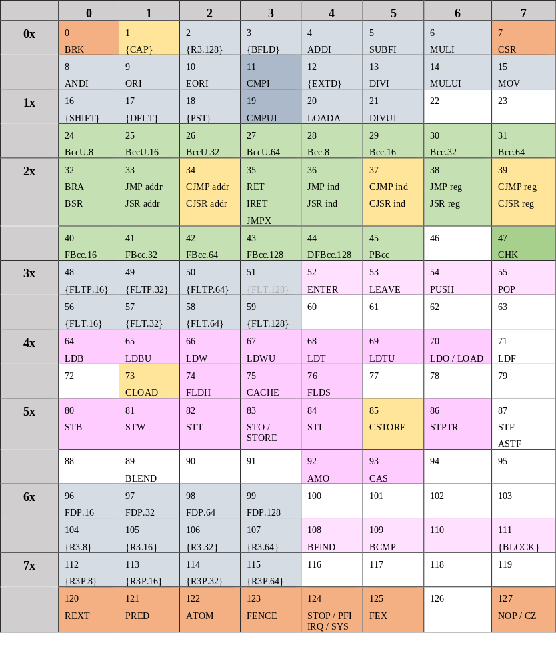
Root Opcode Map
Orange = control
Yellow = capabilities
Grey = arithmetic
Green = branch
Pink = memory
There are about 25 open opcodes and the instruction set is pretty complete. There may be some more graphics or AI instructions to be added yet.

Slide 11
Qupls4: External Interrupt Handling
The CPU chooses the deferred IRQ FIFO as the source of interrupts if there is any interrupt in the FIFO, otherwise the external interrupt feeds the branch-target buffer.
The incoming interrupt acts like a branch and directly changes the IP causing immediate fetch of ISR instructions.
However, if the IRQ should have been disabled, then it is recorded in the deferred FIFO and not immediately processed.
Incoming IRQ
Mux
Branch Target Buffer Logic
Deferred IRQ FIFO
Control Logic
Front-end: Next IP
If IRQ disabled at time of commit
The IRQ is deferred by a FIFO
Processor Pipeline

Slide 12
Qupls4: MSI Interrupt Logging
CPU
CPU
CPU
CPU
The MSI Interrupt Logger snoops the CPU response bus to detect interrupts and logs them to an area of memory.
The Logger acts as a bus master and is capable of filtering interrupts which were destined for a particular CPU.
It may also filter responses based on interrupt priority level.
Response Bus
Snoop bus
MSI Logger
Request Bus to Memory

Slide 14
Qupls4: QMSI Interrupt Controller Site
CPU
CPU
CPU
CPU
The QMSI Interrupt Controller snoops the CPU response bus from the system to detect interrupts.
Detected interrupts are queued in the controller in up to 63 priority queues.
The output of the priority queues are fed to the selected cores according to the affinity mask for the interrupt.
Up to 63 CPU cores may be connected to one QMSI IRQ controller.
Response Bus
Snoop bus
IRQ Bus
QMSI IRQ Controller

Slide 15
Qupls4: Decoding Placement
Most of the decode takes place in two places. Between micro-op translation and register rename, and in the functional units
Instruction Cache
Instruction (ISA) Align and Extract
Instruction to Micro-op Translator
Micro-op Decoder
Register Rename Stage
Instruction Queue to Re-order Buffer
Instruction Dispatcher
Reservation Stations
Functional Units
Reservation Stations
Reservation Stations
Reservation Stations
Micro-op decode
Decoding

Slide 16
Qupls4: Data Cache
Two 256b bus cycles are run by the cache controller to full-fill a 512b cache miss request.
The data aligner shifts the data into or from the proper position on the cache line.
System Bus
256b wide
Cache Controller
Cache RAM 512 x 512b x 4 way
Data Aligner
Up to 512b Data
Tag RAM
512 x 48b x 4 way

Slide 17
Qupls4: Reorder Buffer
The reorder buffer is a circular queue with at least 16 entries (not all entries shown below).
Each ROB entry contains information needed to manage the progress of the instruction (micro-op).
Instructions are added at the tail location and committed from the head location.
The head and tail rotate with the tail always behind the head.
ROB Entry
ROB Entry
ROB Entry
ROB Entry
ROB Entry
ROB Entry
ROB Entry
ROB Entry

Slide 18
Qupls4: QMSI Interrupt Cycle
QMSI interrupt cycles may occur at any point. They are ignored by a bus master and picked up by the QMSI interrupt controller instead. They are single cycle events.
The presence of a QMSI interrupt during an active bus cycle causes the master to delay negating the cycle until after the QMSI interrupt is no longer present. This is to allow the master to capture the incoming data
instead of the QMSI message.
Active cycle
Inactive bus, master ignores QMSI
Response bus acknowledge
QMSI IRQ
1 clock delay

Slide 19
Q+4 Block Diagram
System Bus
32B
L1 I-Cache
32kB – 4 way
TLB L1: 8 Entry – 8 way
TLB L2: 1024 Entry – 3 way
BTB 512 Entries
Instruction Pointers
Fetch
128B cache line pair
Align
48x4= 192 Bits = 24B
gselect
predictor
Extract x4
GP File
Arch. Regs
40 x 64b
Physical Register File
512 x 64b
Decoder x4
Rename x4
Dispatch x4
Reorder Buffer 16 to 64 Entries
Vector File
Arch. Regs
32 x 256b
Execute
Reservation Stations
SAU #0
SAU #1
IMUL
IDIV
FDP #0
FDP #1
TRIG
FPU
FCU
MEM 0
MEM 1
Neural Net
Graphics
Capabilities
CSRs
ISQRT
FDIV
Load / Store Queue
8 Entries
Count
FSQRT
Shift
Scheduling
Bitfield
Crypto
Result Queues
Rotating Mux
To Register File
TLB L1: 8 Entry – 8 way
TLB L2: 1024 Entry – 3 way
(Same TLB as above)
L1 Data Cache
64kB – 4 way
32B
System Bus

Slide 20
Qupls4: Streams
Group header
Re-order entry
Re-order entry
Re-order entry
IP
Stream #
IP Offset
Micro-op
Stream #
IP Offset
Micro-op
…
Since instructions are fetched in groups from the same instruction pointer address, the IP address is stored in the group header for the instruction group. This conserves bits over storing the IP with each instruction.
The offset from the IP is stored for each instruction of the group in the re-order entry along with the stream number and micro-op among other things. The LSB of IP offset is not stored since it is always zero. So, the IP offset field contains one of 0,3,6,9,… multiples of three up to the machine width. Currently up to six bits are stored.
The stream number is a synonym for a branch checkpoint index; five bits are allowed for which allows for 32 streams. More than 16 streams does not improve performance; however, that is for a single thread. The streams are shared between all threads.
Whenever a new stream is needed (for a conditional branch) it is allocated and added to the dependency list of the active stream. The new stream inherits all the dependencies of the active stream. An X*Y dependency map is generated with newly allocated streams added to the map. Each row of the map represents the dependencies of a given stream. When a stream is freed up the row is marked empty with no dependencies. Computing the stream dependency map can be done quickly.
The stream number is used when a branch resolves to invalidate the instructions that are not along the correct path. The stomp logic takes the ‘good’ stream as input and traces though all the dependent streams branching out from the good stream that are to be stomped on. Therefore, the stomp logic generates a list of dependent streams that are not to be taken.
The stomp logic then compares the stream in the pipeline registers and the stream in the re-order buffer for each bank of instructions to the listed entries. If a stream is found on the list it is stomped on. Doing the compare can be done fast, it is just checking a bit in a dependency list bitmap.

Slide 21
Qupls4: Read Port Selector
These ports are from the rename stage available when the instruction is queued or dispatched. (4 insn x 4 ports)
These ports are “catch up” ports from the reservation stations for when the values were not available at queue/dispatch time.
16 Ports
48Ports
Six groups of eight ports
Round-robin arbiter
Selects one group from six
16 Ports
8 Ports
These are physically statically connected to the register file.

Slide 22
Qupls4: Dispatch
Fetch
Out-of-order dispatch does not stall the pipeline when execution units are busy (queues full).
With out-of-order dispatch instructions may be dispatched again by resetting bits in the ROB.
The execute unit may need more operands than are supplied by a single micro-op. (REXT) The REXT prefix is performed out-of-order.
Extract
In-order stages
Decode
Rename
Out-of-order
Re-order buffer
Dispatch
Issue
Execute
Commit

Slide 23
Qupls4: Name Supplier
Commit stage
The name supplier uses four bitmaps, each bitmap containing flags for the physical registers.
Each bitmap represents ¼ of the physical register tags.
A register tag is chosen from each bitmap as needed to supply rename tags.
When a tag is freed, it is placed at the end of a delay line so that it may not be selected until the delay (16 cycles) expires.
Delaying the availability of free tags prevents pipelining issue resulting from a tag being reused too quickly.
Freed tag
Delay Line (16 cycles)
Bitmap1
Bitmap2
Bitmap3
Bitmap4
Tag request
(Rename)
Select
Re-order buffer

Slide 25
Q+4 Block Diagram
System Bus
32B
L1 I-Cache
32kB – 4 way
TLB L1: 8 Entry – 8 way
TLB L2: 1024 Entry – 3 way
BTB 512 Entries
Instruction Pointers
Fetch
128B cache line pair
Align
48x4= 192 Bits = 24B
gselect
predictor
Extract x4
GP File
Arch. Regs
128 x 64b
Physical Register File
512 x 64b
(12 read / 6 write)
Decoder x4
Rename x4
Dispatch x6
Reorder Buffer 16 to 64 Entries
Execution Pipelines x6
Execute
XPIPE 0
XPIPE 1
XPIPE 2
XPIPE 3
XPIPE 4
XPIPE 5
Scheduling
Load / Store Queue
8 Entries
6x Results to Register File
TLB L1: 8 Entry – 8 way
TLB L2: 1024 Entry – 3 way
(Same TLB as above)
L1 Data Cache
64kB – 4 way
32B
System Bus

Slide 26
Qupls4: Execute Stage
Port Packing
12
Register File Read
ALU: Arithmetic Logic Unit (integer and float)
IMUL: Integer multiplier
IDIV: Integer Divider
FMA: Floating-point multiply and add
TRIG: Floating-point trig, divide and square root
FCU: Flow control unit (branch unit)
AGEN: Address generator
MEM: Memory (Data cache control logic)
Read ports are packed into a vector containing only
source operands that need reading.
6 Results Bypass
12
Read from register file
4
3
4
4
4
3
Reservation Stations
Insn
Queue
Insn
Queue
Insn
Queue
Insn
Queue
Insn
Queue
Insn
Queue
ALU
ALU
ALU
ALU
ALU
ALU
Rotating muxes change the read port priority every clock cycle to prevent ports from starving.
There is bypassing from register file inputs to reservation stations.
Reservation stations have three entry input queues.
Crypto
Crypto
IMUL
IMUL
IDIV
IDIV
Branch
Branch
FMA
FMA
ISQRT
ISQRT
CSRs
CSRs
FRCPA
FRCPA
AGEN
AGEN
Counts
Counts
Graphics
Graphics
MEM
MEM
Shift
Shift
Hardware Queues
Hardware Queues
FMA
FMA
Bitfield
Bitfield
Neural Network
16 parallel neurons
Neural Network
16 parallel neurons
TRIG
TRIG
Cap.
Cap.
1
1
Lat: 1
1
Lat: 1
1
Lat: 5
1
Lat 5
1
6 Results
To regfile
Write to register file

