Slide 1
Qupls4: Instruction Cache
System Bus 256b
Two 256b bus cycles are run by the cache controller to full-fill a 512b cache miss request.
Depending on the instruction pointer value an even, odd or odd, even pair of cache lines is selected.
On a cache miss the entire cache line is NOPed out.
A pair of cache lines is selected to allow instructions to span cache-line boundaries. Since instructions are 48-bit they do not fit evenly into a cache-line.
The instruction aligner right aligns instructions based on the IP value so that only four instruction decoders are required. Four instructions are selected plus a raw portion of the cache-line to allow for decoding immediates.
For branch miss, a set of NOPs is fed into the pipeline causing a pipeline bubble.
Cache Controller
Cache RAM
256 x 512b
Even Lines
Cache RAM
256 x 512b
Odd Lines
Cache miss NOPs
Even / Odd swapper
Instruction Aligner
Branch NOPs
Instr 4
Instr 3
Instr 2
Instr 1
4 x 2 to 1 Mux
Instr 4
Instr 3
Instr 2
Instr 1

Slide 2
Qupls4: Instruction Fetch Stage (*_fet)
Raw instruction cache output
The primary function of the fetch stage is to register the instruction cache output which is unregistered.
If there is a cache miss, NOPs are inserted into the pipeline.
Two 512-bit cache lines are fetched to allow instructions to span a cache line.
1024b
Cache miss
NOP mux
1024b
Pipeline Register

Slide 3
Qupls4: Instruction Extract Stage (*_mux)
The cache line is fed in and right aligned according to the PC value.
Four instructions are extracted from the right.
Branch instructions are decoded to feed the next PC logic
Both instructions and raw cache line data are passed to the decode stage.
Raw cache line data is to detect constant zones.
1024b cache line pair from instruction fetch stage
Cache line in 1024
PC[5:1]
Instruction Aligner
48
48
48
48
Extract
Ins #3
Extract
Ins #2
Extract
Ins #1
Extract
Ins #0
To next PC logic
Branch Decode #3
Branch Decode #2
Branch Decode #1
Branch Decode #0
48 + 240 raw
48 + 240 raw
48 + 240 raw
48 + 240
raw
Pipeline Register
Four Instructions plus cache line to decode stage

Slide 4
Qupls4: Decode Stage (*_dec)
Instruction Request
Four instructions from Extract Stage
1
1
1
1
Every clock cycle four micro-ops are decoded and sent to the rename stage.
The micro-op buffer is shifted right by four micro-ops. When the buffer has four or fewer micro-ops left in it, a request is made to the extract stage for more instructions.
Incoming instructions are mapped very quickly onto one to eight micro-ops.
Micro-ops are stored in the buffer; between four and thirty-two micro-ops will fill the buffer.
Micro-ops are packed as they are stored in the buffer so there are no “holes”.
ISA Instruction To µop map
ISA Instruction To µop map
ISA Instruction To µop map
ISA Instruction To µop map
8 max
8 max
8 max
8 max
µop Buffer
µop 31
µop 30
µop 1
µop 0
1
1
1
1
µop Decoder
µop Decoder
µop Decoder
µop
Decoder
1
1
1
1
Pipeline Register
Four decode busses to Rename Stage

Slide 5
Qupls4: Decode Stage (more)
Indexes to cache line constants are decoded from the micro-ops and the cache line.
There may be three cache line constants per micro-op.
µop Buffer
µop 31
µop 30
µop 1
µop 0
1
1
1
1
Cache line from decode (512 bits)
Constant Decoder
Constant Decoder
Constant Decoder
Constant
Decoder
3
3
3
3
Pipeline Register
µop Rd Decoder
µop Rd Decoder
µop Rd Decoder
µop Rd
Decoder
Twelve constants to Rename Stage
1
1
1
1
Name Supplier
The destination register from each micro-op decoder is fed to the name supplier which supplies a rename for the register.
1
1
1
1
Pipeline Register
Four destination names to Rename Stage

Slide 6
Qupls4: Rename Stage (*_ren)
The register alias table is updated with info from the decode stage.
An asynchronous process matches unmapped architectural registers to physical register and maps them.
Micro-op and constants are enqueued in the re-order buffer
Four pairs of destination registers and corresponding renames from decode stage.
1
1
1
1
RAT – Register Alias Table
4
Asynchronous Architectural Register to Physical Register Mapping Process
12 micro-op Window
Four micro-ops with constants from Decode Stage
1
1
1
1
Pipeline Register
4
ROB – Reordering Buffer

Slide 7
Qupls4: Execute Stage
SAU: Simple Arithmetic Unit (integer and float)
IMUL: Integer multiplier
IDIV: Integer Divider
FMA: Floating-point multiply and add
TRIG: Floating-point trig, divide and square root
FCU: Flow control unit (branch unit)
AGEN: Address generator
DRAM: Data cache control logic
Read ports are packed into a vector containing only
source operands that need reading.
Rotating muxes change the read/write port priority every clock cycle to prevent ports from starving.
There is bypassing from register file inputs to reservation stations.
Reservation stations have three entry input queues.
Port Packing
16
Register File Read
16
Read from register file
16:64 rotating mux/demux
4
3
3
2
4
4
3
3
2
2
1
1
3
3
1
3
3
3
SAU #0
SAU #1
IMUL
IDIV
FDP #0
FDP #1
TRIG
FCU
AGEN #0
AGEN #1
DRAM #0
DRAM #1
FPU
Neural Network
16 parallel neurons
Crypto
Graphics
Capabilities
CSRs
1
1
ISQRT
1
1
FDIV
1
Lat: 1
1
1
1
1
Counts
Hardware Queues
FSQRT
1
1
2
2
2
Reservation Stations
Shift
Lat: 3
Bitfield
Lat: 1
Lat: 4
Lat: ??
Lat: 8
Lat: 8
Lat: ??
2
Lat: 1
16 Flow through result queues (32 entry)
Pipeline Register
20:4 rotating multiplex
4 results
Write to register file

Slide 8
Qupls4: Reservation Stations
A request is made to the register file to fetch values that have not been latched yet.
Operand latches are filled from either the register file or the results bypassing network as available.
Once all operands are valid for a queue entry, the instruction may be scheduled to go to the functional unit. The functional unit must also be ready to accept a new operation.
Once the queue entry has gone to the functional unit it is marked available for a new instruction.
Bypass Network
Register File
Register Read Request
Queue Entry #1
Operand Latch #1
Operand Latch #2
Operand Latch #3
Operand Latch #4
Queue Entry #2
3:1 mux
Operands
To Functional Unit
Operand Latch #1
Operand Latch #2
Operand Latch #3
Operand Latch #4
Queue Entry #3
Operand Latch #1
Operand Latch #2
Operand Latch #3
Operand Latch #4
Scheduler

Slide 9
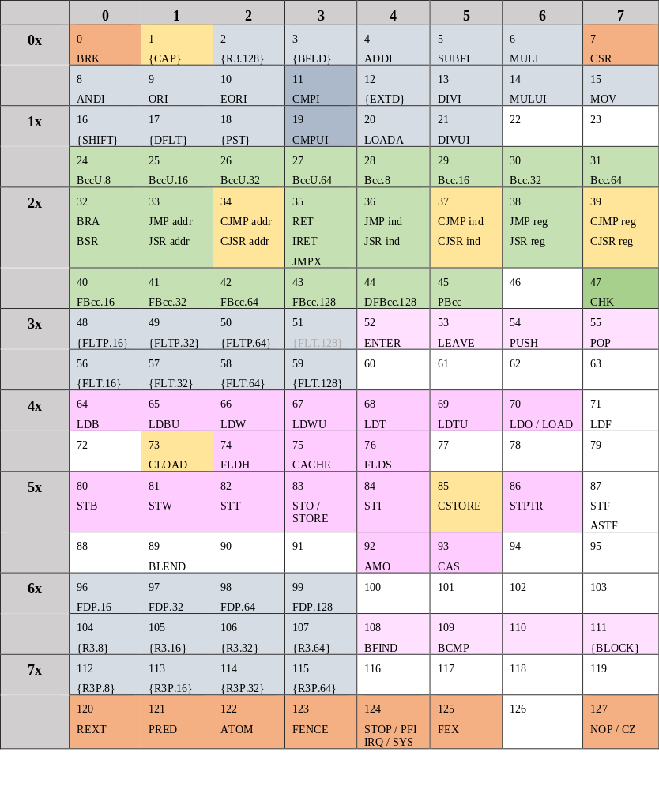
Root Opcode Map
Orange = control
Yellow = capabilities
Grey = arithmetic
Green = branch
Pink = memory
There are about 25 open opcodes and the instruction set is pretty complete. There may be some more graphics or AI instructions to be added yet.

Slide 10
Qupls4: External Interrupt Handling
The CPU chooses the deferred IRQ FIFO as the source of interrupts if there is any interrupt in the FIFO, otherwise the external interrupt feeds the branch-target buffer.
The incoming interrupt acts like a branch and directly changes the IP causing immediate fetch of ISR instructions.
However, if the IRQ should have been disabled, then it is recorded in the deferred FIFO and not immediately processed.
Incoming IRQ
Mux
Branch Target Buffer Logic
Deferred IRQ FIFO
Control Logic
If IRQ disabled at time of commit
The IRQ is deferred by a FIFO
Front-end: Next IP
Processor Pipeline

Slide 11
Qupls4: MSI Interrupt Logging
CPU
CPU
CPU
CPU
The MSI Interrupt Logger snoops the CPU response bus to detect interrupts and logs them to an area of memory.
The Logger acts as a bus master and is capable of filtering interrupts which were destined for a particular CPU.
It may also filter responses based on interrupt priority level.
Response Bus
Snoop bus
MSI Logger
Request Bus to Memory

