Slide 1
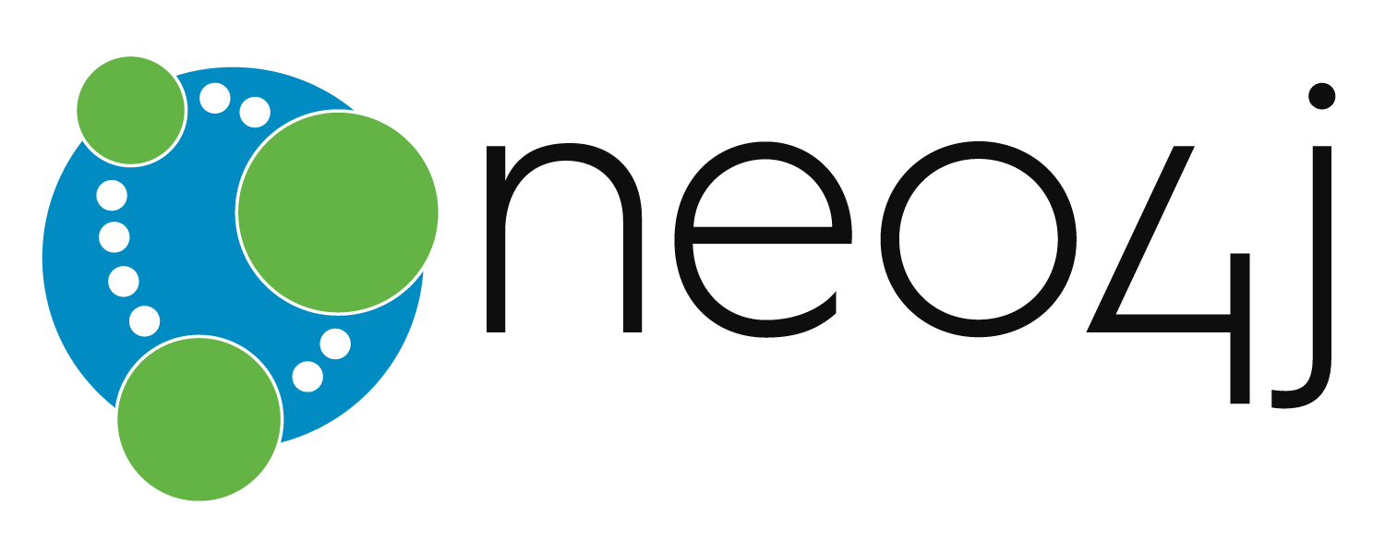
Presented by: Robert Fitzgerald
Fall 2016

Slide 2
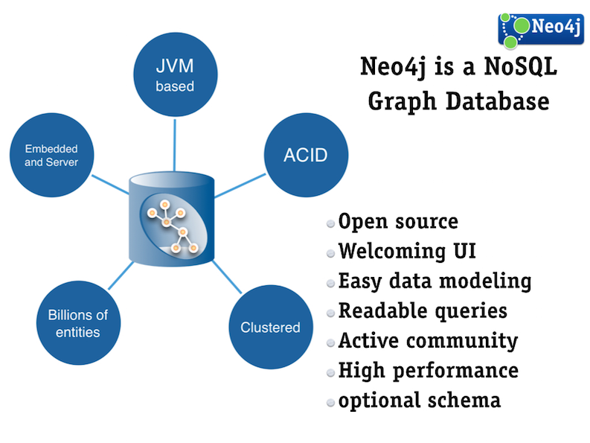
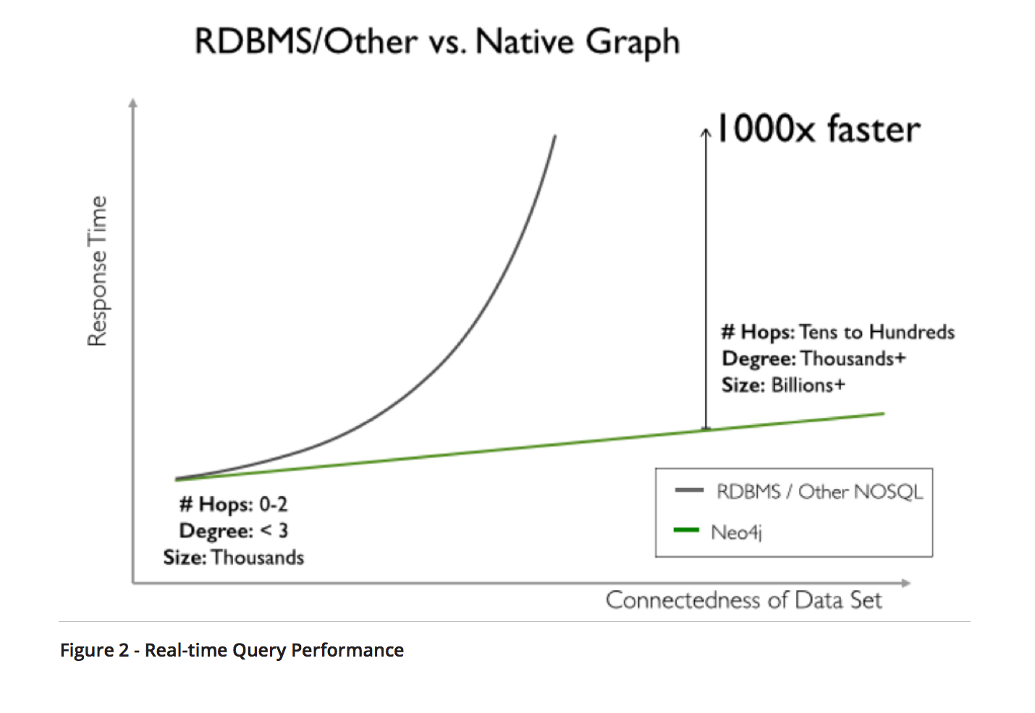
NoSQL Graph DB
Neo4j is a NoSQL database with a directed graph relationship model. Neo4j stores data as properties of the nodes and relationships of the graph.

Slide 3
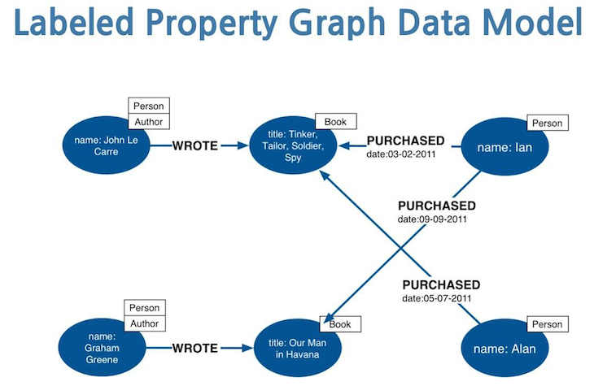

Slide 4
Two Graph Databases
Name | Type | License
Neo4j | NoSQL Graph Database | open source. GNU Public License. free community edition, commercial edition has performance & scalability features; has government edition as well w/ gov’t friendly licensing and security features.
OrientDB | Mixed Document / Graph Database | Community edition: Apache 2 License. open source. Enterprise edition: commercial license. both versions are free.

Slide 5
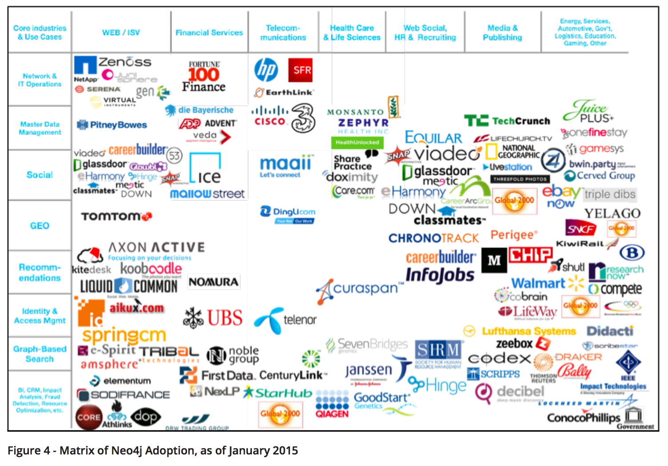
User Base

Slide 6
Features
Elastic Scalability, in-memory across clusters, in volume, reads, and writes
Built-in tooling such as Neo4j browser
Provides Cypher, an intuitive, declarative query language
Cloud-ready: AWS, Azure and others; an official Docker image and sandbox
Graph structure is native to the data storage - low latency, index optimization / index-free entity relationship lookups (references)
Version 3.03 is latest, from June 2016. Initial release was 2007.
Documented support for integration with Apache Spark, ElasticSearch, MongoDB, Cassandra, Docker: https://neo4j.com/developer/integration/

