Slide 1
Nightmare On Euler's Street:
Rob & Jeff do Graph Theory
Rob Fitzgerald
Jeff Flower

Slide 2
Non-Overlapping Triangles
Originally proposed by Fujimura Kobon
Tamura proved that the maximal upper bound is floor{(n * n-2)/3}
  Given n lines, assume each line intersects each of the remaining n-1 lines
  Then each line has n-1 intersections, which define n-2 line segments
[7]

Slide 3
A Tighter Bound
Bader & Clement proved a tighter uppoer bound is:
n(n-2)/3 if n ≡ 3 or 5 mod 6
n(n-2)/3 - 1 if n ≡ 0 or 2 mod 6
(n-1²)/3 if n ≡ 1 or 4 mod 6
[7]
An interesting reference:
  Online Encyclopedia of Integer Sequences:http://oeis.org/search?q=A006066&language=english&go=Search

Slide 4
Implementation
Tried to build a drawing tool you could use for exploring the problem
We went with paperjs since it had conveniently named methods such as 'getIntersections'

Slide 5
(Complete) Graphs on a (bi)Plane
Define cr₂(K_{n}) as the crossing number of a complete graph drawn on 2 planes
Focus of our research:
  For what values of n is cr₂(K_{n}) > 0, and why?
    That is, what complete graphs, when drawn on two planes, have at least one edge crossing?
Value of this problem: circuit design

Slide 6
A new spin on an old idea
By Euler's Formula, in a planar graph with m edges and n vertices:
m < = 3n -6
Expanding to biplanar graphs:
m <= 6n - 12
cr₂(G) >= m – (6n – 12) = m – 6n + 12

Slide 7
Example
A graph on 5 vertices and 10 edges (K₅)
  cr₁(K₅) >= 10 – (3*5) + 6 = 1
  cr₂(K₅) >= 10 – (6*5) + 12 = -8
Negative numbers aren't going to be very helpful...

Slide 8
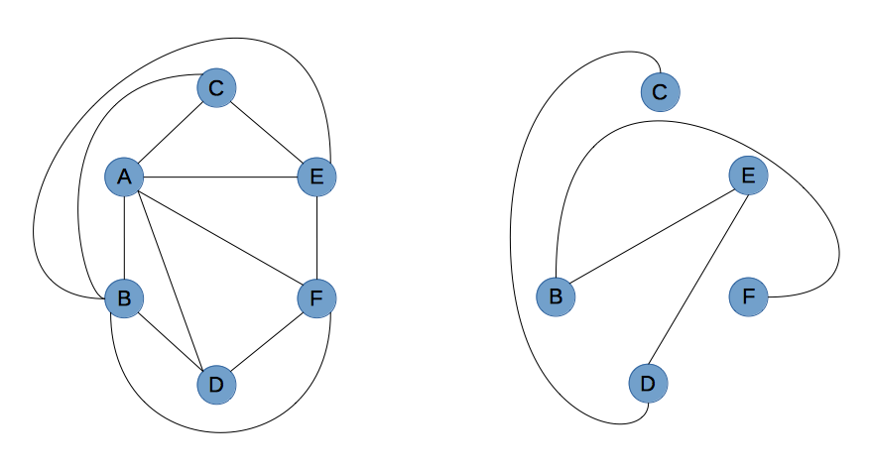
cr₂(K₆) = 0

Slide 9
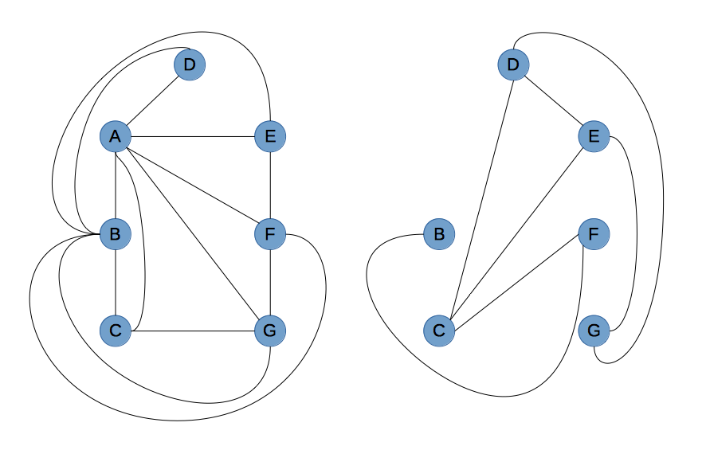
cr₂(K₇) = 0

Slide 10
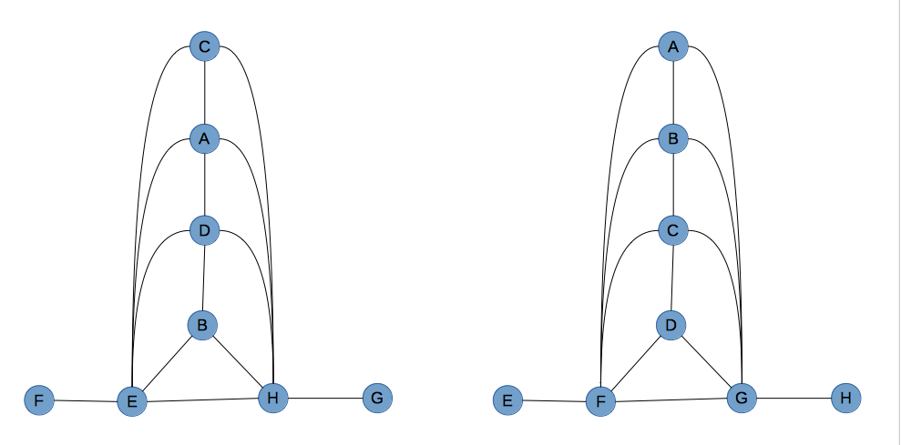
cr₂(K₈) = 0

Slide 11
Hey Rob, remember that time we tried to make a bi-planar drawing of K₉?
W.T. Tutte proves, in his aptly named essay, “The non-biplanar character of the complete 9-graph”, discusses his findings..
..which had already been proven in J. Battle, F. Harary, and Y. Kodama's “Every planar graph with nine points has a non-planar component”

Slide 12
Tutte, Tutte
Tutte shows that G, the complete 9-graph contains a separating triangle that makes it impossible to draw the graph on two planes with no edge crossings
Consequently, every complete graph on 9 or more vertices are not thickness two

Slide 13
Vertices | Edges | Thickness: Formula | Thickness: Proven | Euler Crossing
3 | 3 | 1 | 1 | -3
4 | 6 | 1 | 1 | -6
5 | 10 | 2 | 2 | -8
6 | 1 | 2 | 2 | -9
7 | 21 | 2 | 2 | -9
8 | 28 | 2 | 2 | -8
9 | 36 | 2 | 3 | -6
10 | 45 | 2 | 3 | -3
11 | 55 | 3 | 3 | 1
12 | 66 | 3 | 3 | 6
13 | 78 | 3 | 3 | 12
14 | 91 | 3 | 3 | 19
15 | 105 | 3 | 3 | 27

Slide 14
References
[1] E. Czabarka, O. Sykora, L. A. Szekely, I. Vrto, Biplanar crossing numbers II: comparing crossing numbers and biplanar crossing numbers using the probabilistic method, Random Structures & Algorithms, 12/2008, Volume 33, Issue 4
[2] P. Mutzel, T. Odenthal, M. Scharbrodt, The Thickness of Graphs: A Survey, Graphs and Combinatorics (1998) v14 : 59-73
[3] L. W. Beineke and F. Harary, The thickness of the complete graph, Canad. J. Math. 17,850- 859 (1965).
[4] A. Owens, On the Biplanar Crossing Number, IEEE Transactions on Circuit Theory, 1971, Volume 18, Issue 2
[5] E. Czabarka, O. Sykora, L. A. Szekely, and I. Vrto, Crossing numbers and biplanar crossing numbers I: a survey of problems and results, to appear in: Finite and Infinite Combinatorics, Bolyai Studies, Budapest.
[6] W. T. Tutte, The non-biplanar character of the complete 9 graph, Canad. Math Bulletin Volume 6, pages 319-330(1963)
[7] G. Clément and J. Bader. Tighter Upper Bound for the Number of Kobon Triangles. Draft Version, 2007 http://www.tik.ee.ethz.ch/sop/publicationListFiles/cb2007a.pdf.

