Slide 1
Mapping Heracles’ Communication
Matthew Kalan
Rob Fitzgerald
Nathan Justice

Slide 2
Introduction

Slide 3
Contents
The importance of communication architecture
Message Passing Interface Patterns
The Heracles Structure and the Mellanox Switch
Our plan and future work

Slide 4
Communication Architecture
Notes:
When considering a multi-core cluster it is imperative to recognize how the cores communicate with one another

Slide 5
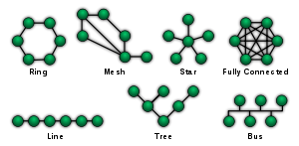
Network Topology
Logical topology of a network can affect the execution of distributed programs.
An unoptimized algorithm may be significantly hindered by logical node placement.
Notes:
The distribution of work on network can change the execution time of a program

Slide 6
Global and Local Message paths
A distributed program will exchange messages between nodes
Message paths that are compact and exchanged regularly are considered local
Global Message paths connect local paths
Notes:
In terms of analysis

Slide 7
Importance of Message Patterns
Reflect Bottlenecks
Highlight program characteristics on the system architecture
Reflects how an algorithm actually executes
Notes:
Discuss Author’s work to build an analysis tool to reveal issues in any program’s execution on any cluster system

Slide 8
MPI Patterns

Slide 9
MPI
Message Passing Interface
Standardized means of exchanging messages between computers running a parallel program across distributed memory
Synchronize, exchange data, and provide command.
Notes:
Refresh on what is MPI

Slide 10
Traces versus Profile
Profile
Inventory of performance events
Tracks execution as a whole (not chronological)
Used for load imbalances
Trace
Timestamps every event
Used to track timing issues
Notes:
When capturing metadata on how the program ran, data management tools may be necessary

Slide 11
Applications
Used to test application performance on distributed systems
Used to debug multithreaded programs

Slide 12
Heracles and Mellanox

Slide 13
Covered in this section
Summarize InfiniBand, Heracles, and Mellanox
Heracles and Mellanox architecture
Message preparation
Message passing process
Message passing systems

Slide 14
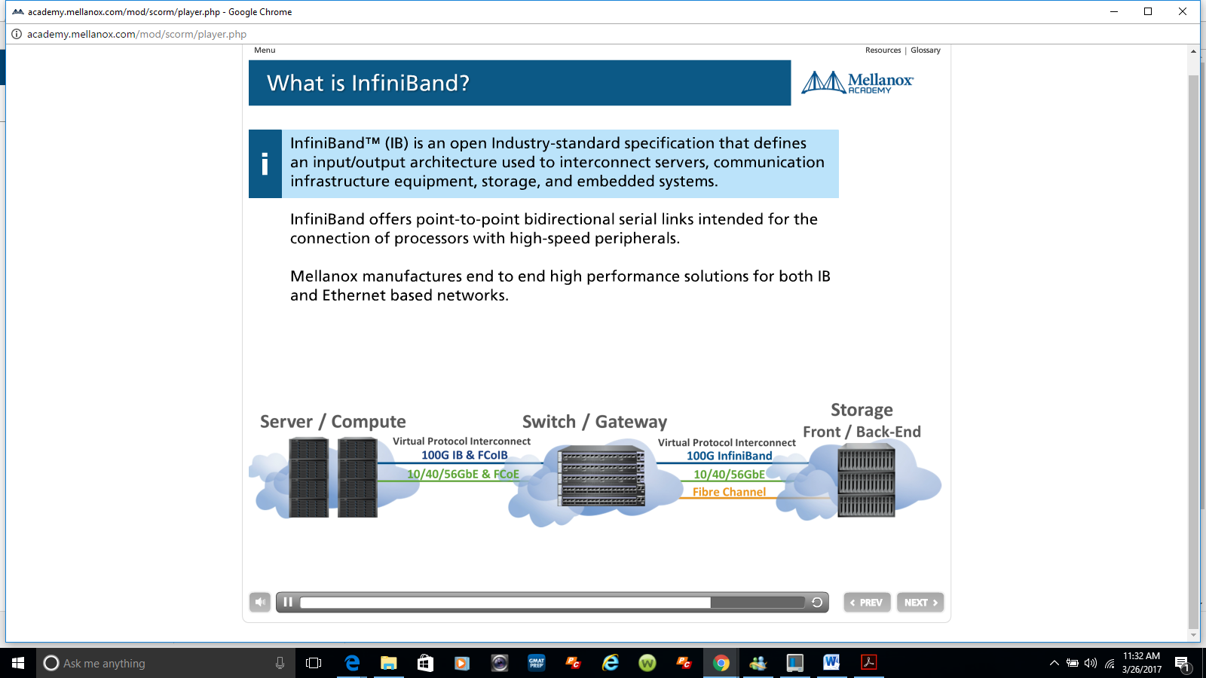
InfiniBand

Slide 15
Why InfiniBand
High Bandwidth
Result of single lane speed * number of combined lanes
Ie. 14Gb/s * 4 (width) = 56GB/s
Low Latency
Minimize the time taken to move units of data between 2 points in the network
Scalability
Enables 48,000 nodes in a single subnet

Slide 16
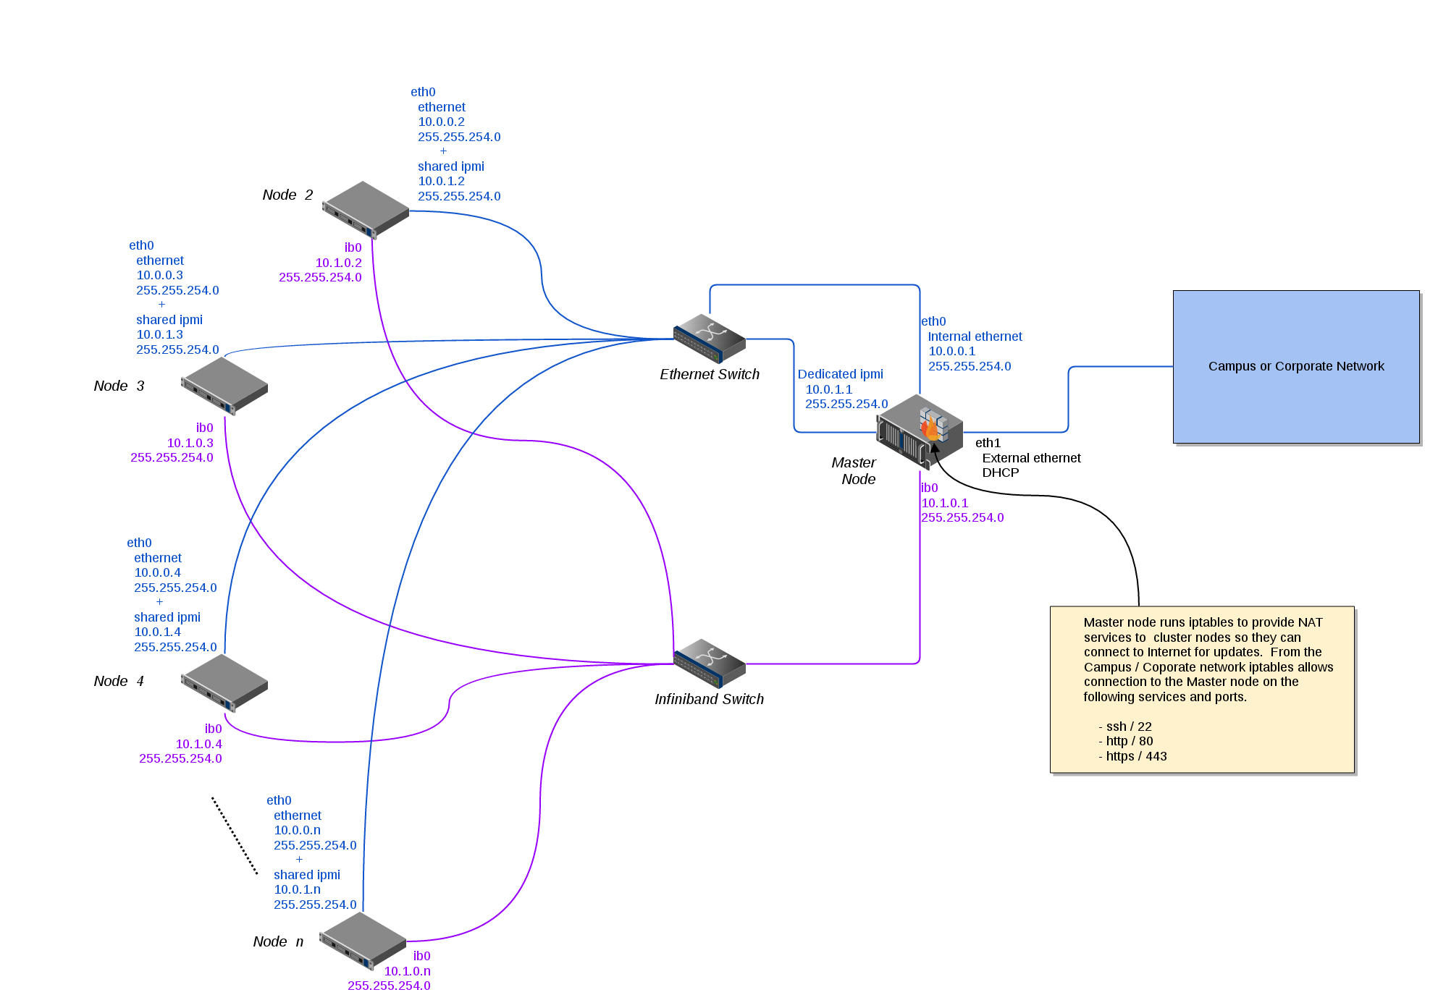
Heracles

Slide 17
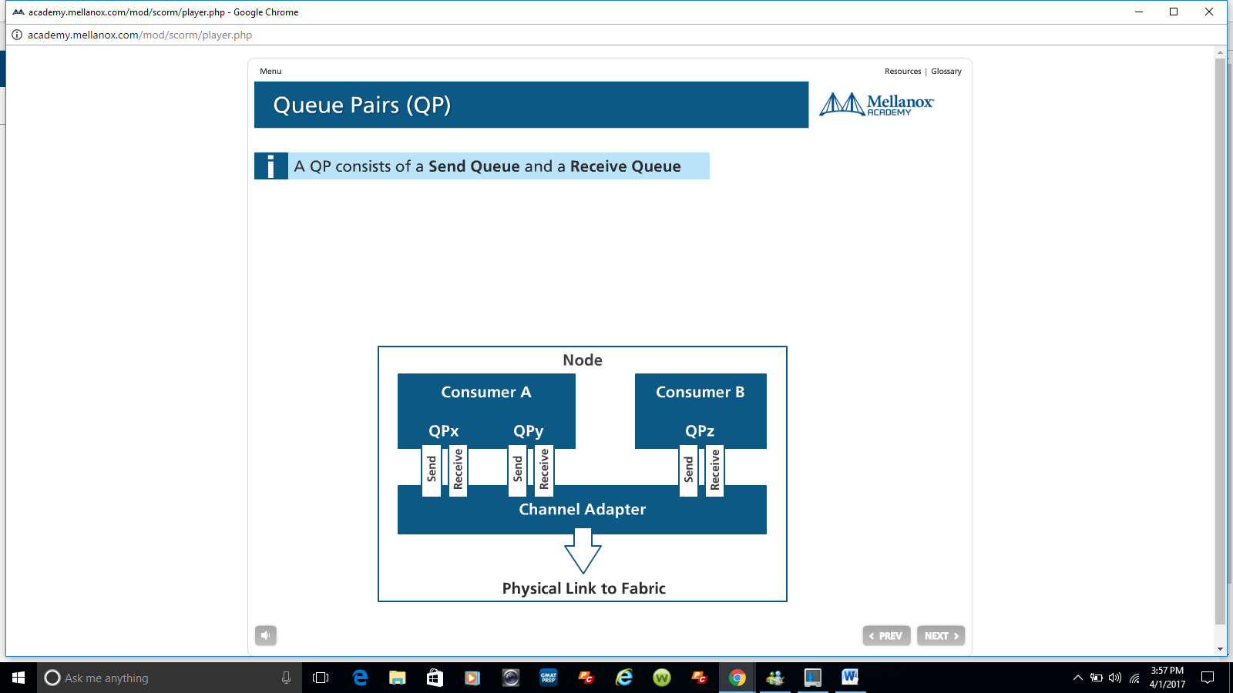
Queue Pairs (QP)
A QP consists of a Send Queue and a Receive Queue

Slide 18
RDMA
InfiniBand uses RDMA technology. RDMA allows one computer to place information directly into the memory of another computer. RDMA allows user space applications to directly access hardware and zero-copy data movement.
A combination of hardware and software allows user space applications to read and write the memory of a remote system without kernel intervention or unnecessary data copies. This feature results in lower CPU utilization per I/O operation and more efficient use of machine resources because applications place most of the messaging overheads upon the InfiniBand high-speed network hardware.

Slide 19
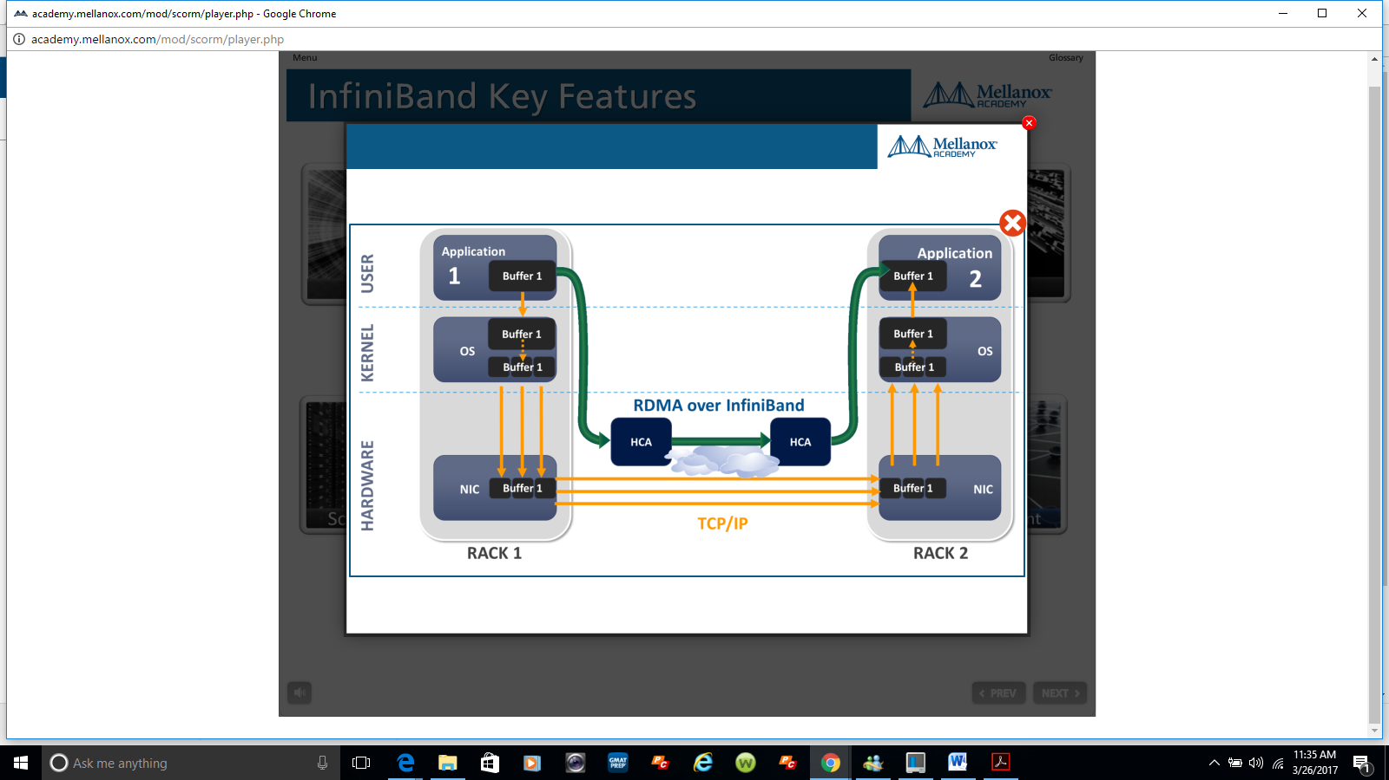
InfiniBand (cont)

Slide 20
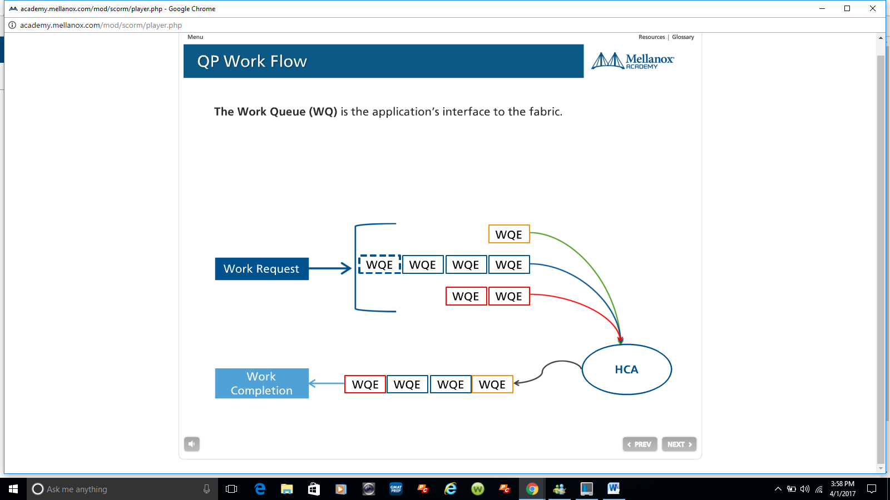
QP Work Flow
The Work Queue is the application’s interface to the fabric.
Send Operation
Memory Binding

Slide 21
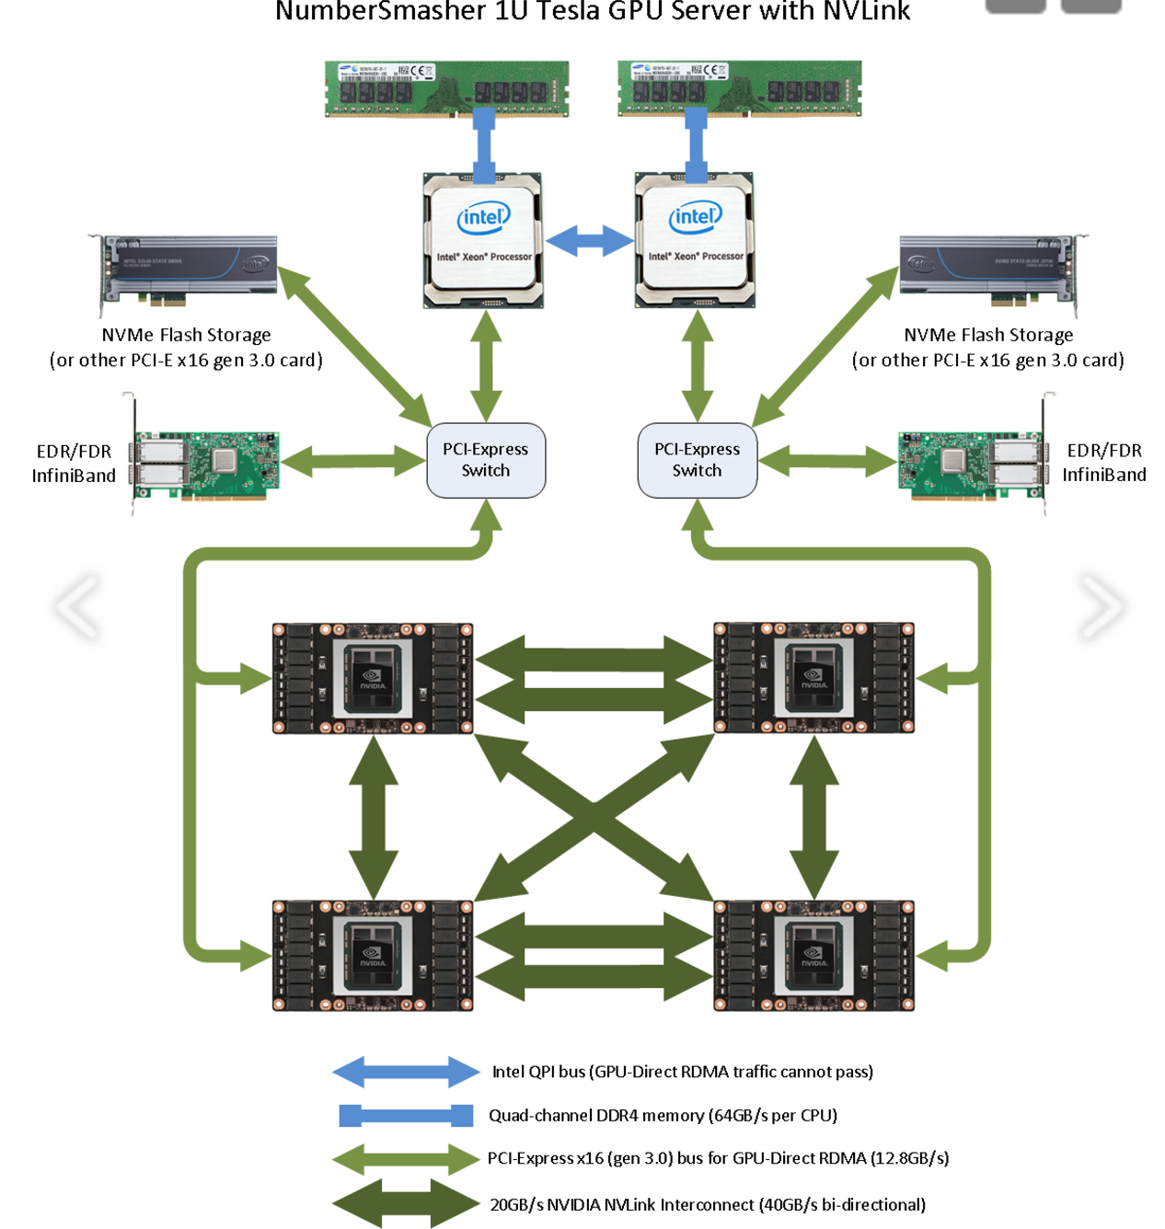
Mellanox Architecture
Notes:
QPI i.e the blue bi-directional line across the top processor allows all the components to access other components via the network.

Slide 22
Message Passing System
Let's look at a simple example. In this example we will move a buffer from the memory of system A to the memory of system B. This is what we call Message Passing semantics. The operation is a SEND, this is the most basic form of RDMA.
Step 1 System A and B have created their QP’s Completion Queue’s and registered a regions in memory for RDMA to take place. System A identifies a buffer that it will want to move to System B. System B has an empty buffer allocated for the data to be placed.
Step 2 System B creates a WQE “WOOKIE” and places in on the Receive Queue. This WQE contains a pointer to the memory buffer where the data will be placed. System A also creates a WQE which points to the buffer in it’s memory that will be transmitted.
Step 3 The HCA is always working in hardware looking for WQE’s on the send queue. The HCA will consume the WQE from System A and begin streaming the data from the memory region to system B. When data begins arriving at System B the HCA will consume the WQE in the receive queue to learn where it should place the data. The data streams over a high speed channel bypassing the kernel.
Step 4 When the data movement completes the HCA will create a CQE “COOKIE”. This is placed in the Completion Queue and indicates that the transaction has completed. For every WQE consumed a CQE is generated. So a CQE is created on System A ‘s CQ indicating that the operation completed and also on System B’s CQ. A CQE is always generated even if there was an error. The CQE will contain field indicating the status of the transaction.
The transaction we just demonstrated is an RDMA SEND operation. On Infiniband or RoCE the total time for a relatively small buffer would be about 1.3 µs. By creating many WQE’s at once we could move millions of buffers every second.

Slide 23
Implementation
... aka, the fun part.

Slide 24
Covered In This Section
A Brief MPI Introduction
Methods of Communication
A Simple MPI Example
Measurement Methods
Resources for a More Robust Trace

Slide 25
A Brief MPI Introduction
The Message Passing Interface (MPI) Standard
Originated from discussions at Supercomputing 1992 Conference, in response to the need for uniformity in scientific computing [4]
MPI v1 released in 1994; MPI-2 in 1998; MPI-3 in 2012.
Defines the interface for any MPI implementation
Notes:
“... Caltech’s N-Cube … Argonne's P4 library... PICL and PVM from Oak Ridge… The Ohio Supercomputer Center developed ... LAM” [4]

Slide 26
A Brief MPI Introduction
On Heracles: Open MPI 1.10.4, based on MPI-3 (latest: Open MPI 2.1.0, though 1.10.6 is still supported)
Open MPI is one of many implementations of the MPI standard
Open source project supported by Intel, IBM, Facebook, Amazon, Nvidia, Oracle, Mellanox, AMD, ARM, Los Almos National Laboratory… as well as members of academia
Notes:
available at https://www.open-mpi.org

Slide 27
Methods of Communication
MPI_Send / MPI_Recv: point-to-point messaging
MPI_Bcast: collective messaging (one to many)
MPI_Scatter / MPI_Gather: collective messaging (one collection to many distributed in chunks)
MPI_Comm_create_group: create organized subset of processes
MPI_Reduce: perform an aggregate reduce function over a group of processes, such as sum or max
Overall, 398 Methods defined for OpenMPI v1.10
Notes:
Excellent introduction to Open MPI is at http://mpitutorial.com/tutorials/

Slide 28
A Simple MPI Example
// Hello World MPI Program from http://mpitutorial.com/tutorials/mpi-hello-world/ [5]
#include <mpi.h>
#include <stdio.h>
int main(int argc, char** argv) {
MPI_Init(NULL, NULL);
int world_size;
MPI_Comm_size(MPI_COMM_WORLD, &world_size);
int world_rank;
MPI_Comm_rank(MPI_COMM_WORLD, &world_rank);
char processor_name[MPI_MAX_PROCESSOR_NAME];
int name_len;
MPI_Get_processor_name(processor_name, &name_len);
printf("Hello world from processor %s, rank %d out of %d processors\n", processor_name, world_rank, world_size);
MPI_Finalize();
}

Slide 29
A Simple MPI Example
[robert.fitzgerald@heracles code]$ srun --mpi=pmi2 -n6 -w "node[3,4]" /home/robert.fitzgerald/csc5593/project/sandbox/mpitutorial/tutorials/mpi-hello-world/code/mpi_hello_world
Hello world from processor node3, rank 0 out of 6 processors
Hello world from processor node4, rank 3 out of 6 processors
Hello world from processor node4, rank 4 out of 6 processors
Hello world from processor node3, rank 1 out of 6 processors
Hello world from processor node4, rank 5 out of 6 processors
Hello world from processor node3, rank 2 out of 6 processors
Notes:
srun provided by Slurm: https://slurm.schedmd.com/srun.html

Slide 30
Measurement Methods
// pseudocode for a simple MPI program with manual tracing
run(proc: Process, pat: MessagePattern, w: Work)
startTime <- time.now()
request <- receive(proc.src, patt.recv(p))
response <- w(proc, request) // do work
send(proc.dest, response, patt.send(p))
endTime <- time.now()
log(proc.info, response, startTime - endTime)
P1 | N1
P2 | N1
P3 | N2
P4 | N2
Notes:
Open MPI timing is not synchronized. Good stack overflow discussions on timing in open MPI: http://stackoverflow.com/questions/5298739/mpi-global-execution-time
http://stackoverflow.com/questions/19037189/mpi-synchronized-timing

Slide 31
Measurement Methods
Possible output
P1 | N1
P2 | N1
srcProc | destProc | msg | dur
P1-N1 | P2-N1 | “one” | 0.0001
P2-N1 | P4-N2 | “two” | 0.0013
P4-N2 | P3-N2 | “three” | 0.0002
P3-N2 | P1-N1 | “four” | 0.0015
P3 | N2
P4 | N2

Slide 32
Measurement Methods
Explore connectivity
Explore distribution
P1 | N1
P2 | N1
P1 | N1
P2 | N2
P3 | N2
P4 | N2
P3 | N3
P4 | N4

Slide 33
Measurement Methods
Explore work functions: two possible classes of process workloads
Predictable messaging patterns
Fixed message / no work function
Randomized messaging patterns
Monte Carlo Pi Estimation (stochastic ordering, predictable patterns)
Varied work duration
Fully randomized recipients (dynamic ordering and patterns)

Slide 34
Resources for a More Robust Trace
VampirTrace: (https://tu-dresden.de/zih/forschung/projekte/vampirtrace)
Compiler wrapper which generates detailed program execution logging. Comes with standard Open MPI installation (> 1.3)
Vampir: (https://vampir.eu)
Commercial software for visualizing vampirtrace outputs
Ravel: (https://github.com/LLNL/ravel)
Open source software for visualizing vampirtrace outputs
Notes:
VampirTrace user manual:
https://tu-dresden.de/zih/forschung/ressourcen/dateien/laufende-projekte/vampirtrace/dateien/VT-UserManual-5.14.4.pdf?lang=en

Slide 35
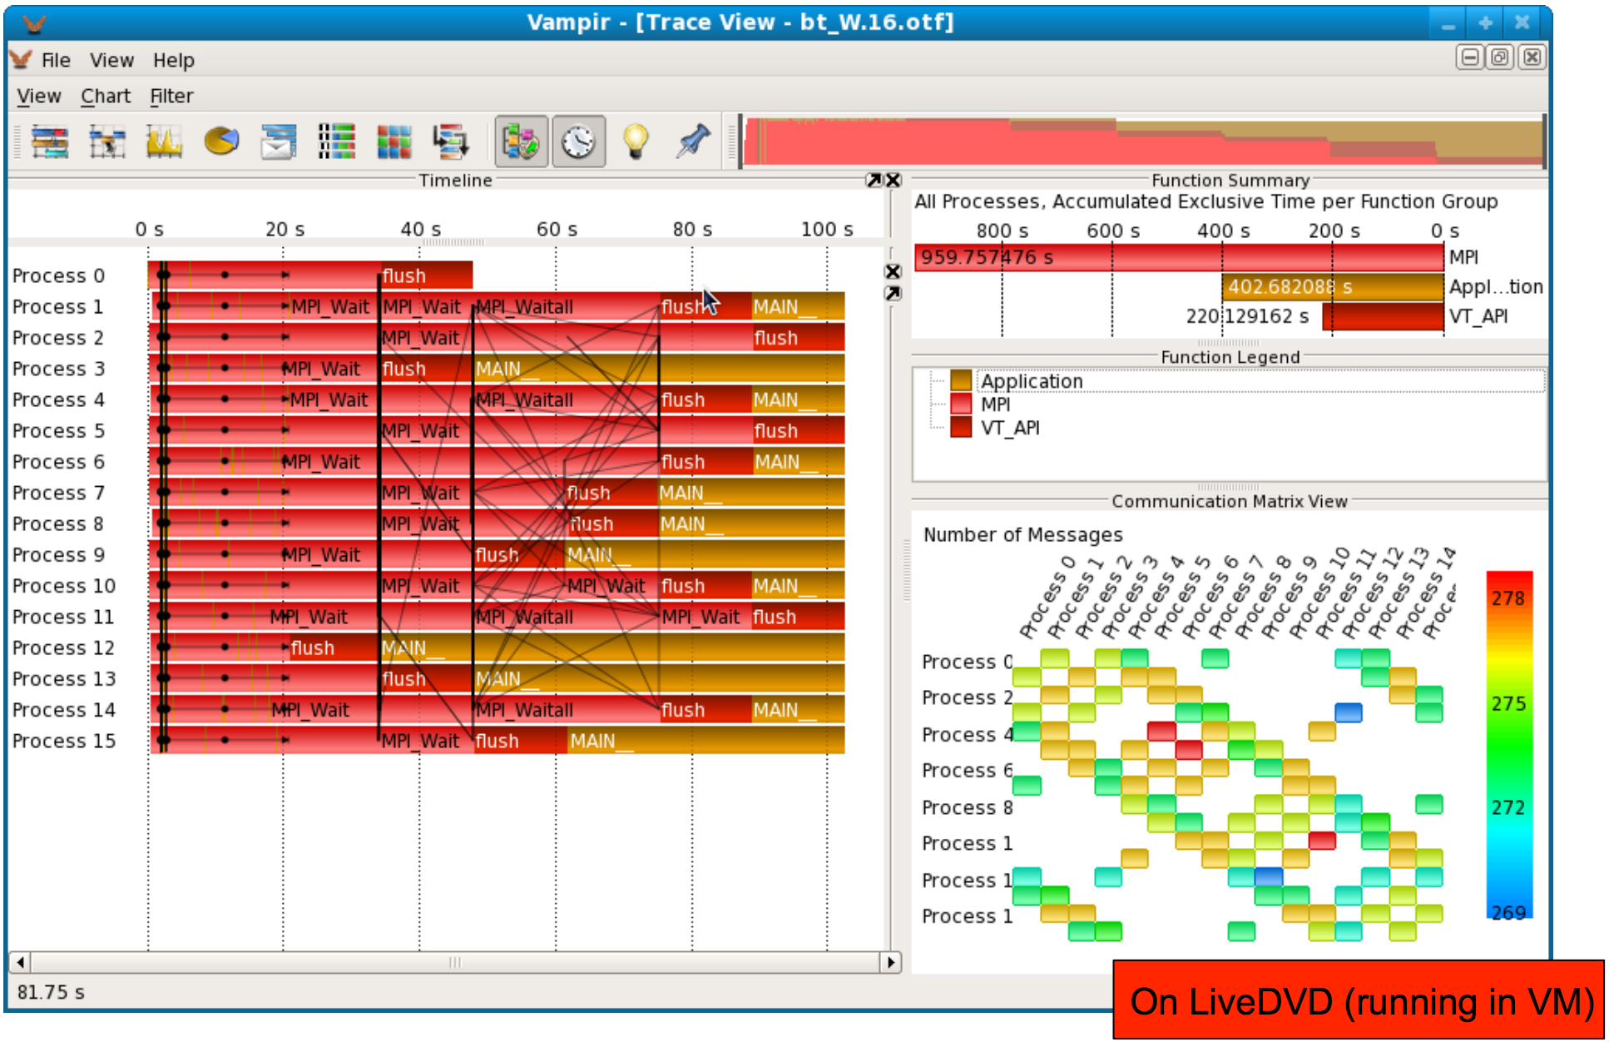
Resources for a More Robust Trace [6]

Slide 36
References
[1]R. Preissl, T. Köckerbauer, M. Schulz, D. Kranzlmüller, B. de Supinski and D. Quinlan, "Detecting Patterns in MPI Communication Traces", 2008 37th International Conference on Parallel Processing, 2008.
[2]F. Wolf and B. Mohr, "Automatic performance analysis of hybrid MPI/OpenMP applications", Journal of Systems Architecture, vol. 49, no. 10-11, pp. 421-439, 2003.
[3]F. Mietke, R. Rex, R. Baumgartl, T. Mehlan, T. Hoefler and W. Rehm, "Analysis of the Memory Registration Process in the Mellanox InfiniBand Software Stack", Euro-Par 2006: Euro-Par 2006 Parallel Processing, pp. 124-133, 2017.
[4] Z. Meglicki, ‘The History of MPI’, 2004. [Online]. Available: http://beige.ucs.indiana.edu/I590/node54.html. [Accessed: 12-Apr-2017].
[5] W. Kendall, ‘A Comprehensive MPI Tutorial’, 2017. [Online]. Available: http://mpitutorial.com. [Accessed: 12-Apr-2017].
[6] M. Weber, ‘Vampir & VampirTrace Details and Hands-On’, ZIH TU Dresden, 2010.

