Slide 1
Traffic Assignment
Rob Fitzgerald
CSCI 7551 Project Presentation
Tuesday, December 6th, 2016
Presentation originally titled “Maximization of Network Throughput Maintaining Free Flow”
All images and definitions due to [ORTUZAR] unless listed otherwise.

Slide 2
Contents
Review
Design
Implementation
Results

Slide 3
Review
Simulating the assignment of vehicle traffic to a network
A static model, depicting vehicles per hour flows based on origin/destination flows

Slide 4
Frank-Wolfe Algorithm
Iterative Linear Approximation Algorithm which uses gradient descent to find an optimal traffic assignment
A general optimization technique
Converges to Wardrop’s equilibrium

Slide 5
Frank-Wolfe Algorithm
Is a method of successive averages, recursive and with the all-or-nothing assignment as its upper bound
In each iteration, it produces a new flow on each link which is a function of the previous flow and the all-or-nothing flow (the flow assigned without consideration of congestion effects)

Slide 6
Review Addendum
Frank-Wolfe is an improved version of an approach called a Method Of Successive Averages (MSA)
Frank-Wolfe is faster than a basic MSA because it dynamically alters the step size (Φ) by minimizing an objective function at each iteration.

Slide 7
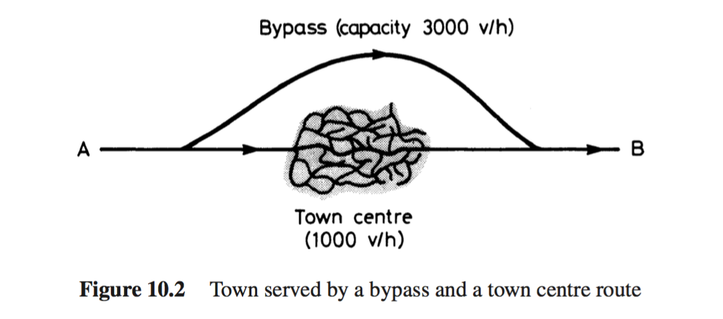
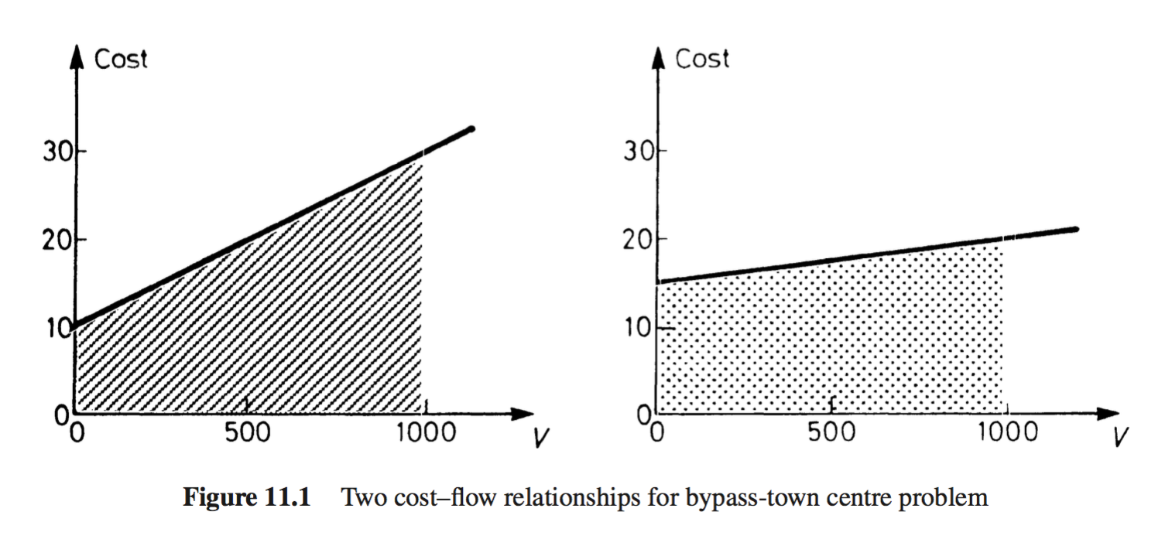
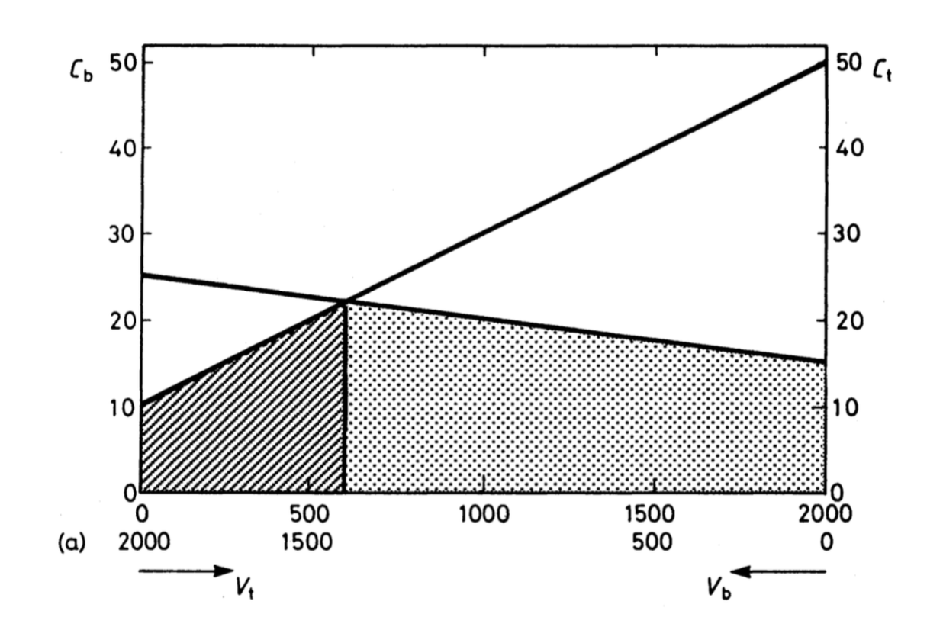
Equilibrium: a state in which opposing forces or influences are balanced.
Images: [ORTUZAR]
Equilibrium definition: [GOOGLE2]

Slide 8
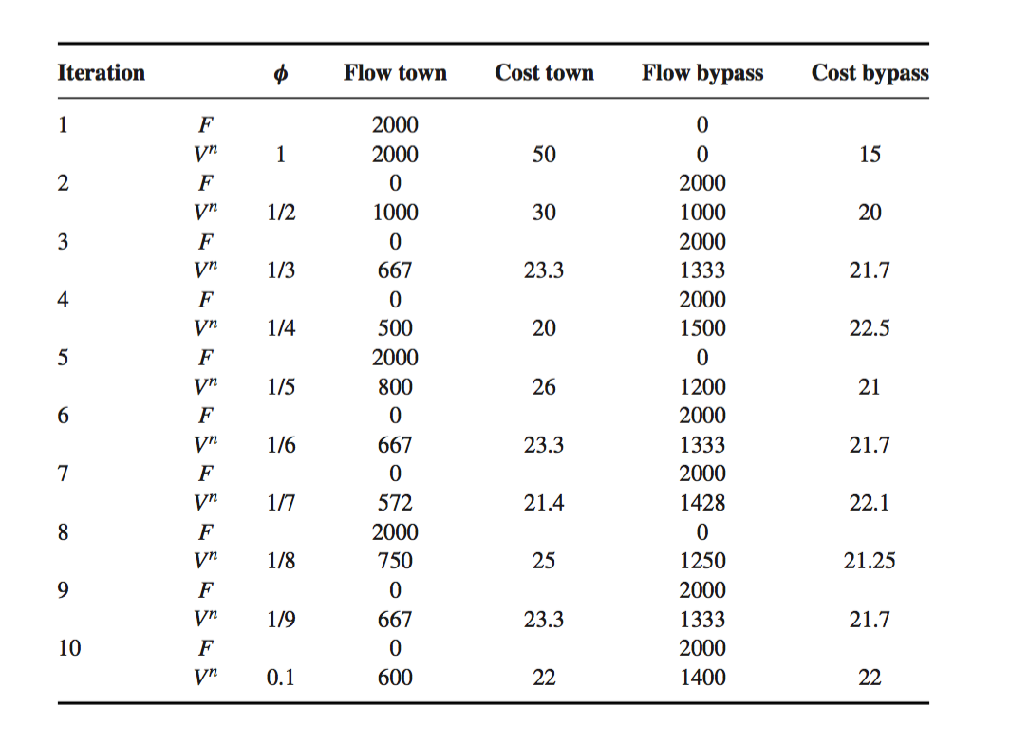
Method Of Successive Averages
[ORTUZAR]

Slide 9
Design
Simulation of MSA and Frank-Wolfe traffic assignment
Written in C++ using OpenMP (parallelized bidirectional search)

Slide 10
Which Search Algorithm?
Constraint: unable to write directly to the graph
Constraint: concurrent searches yielding many shortest paths

Slide 11
Which Search Algorithm?
Dijkstra’s: inefficient, BFS, require creating O(V) new elements in each sub-search (min cost tree). Oh, and it’s not parallel.
Bidirectional Dijkstra’s: stopping criteria is when (topf + topr > dist(o,d)). in road network, dist() cannot be purely euclidian, so it may be hard to find.
topf: node with greatest roadway distance from origin in the forward search
topr: node with greatest roadway distance from destination in the reverse search
dist(): euclidian distance function
o: trip origin node
d: trip destination node

Slide 12
Which Search Algorithm?
Bidirectional A*
selection criteria: minimize g(o,xf) + dist(xf,xr) + g(xr,d)
test selection function against cross product of all frontier nodes in both searches at each search step to find the correct choice for both forward and reverse search.
g(): roadway distance function
dist(): euclidian distance function
o: trip origin node
d: trip destination node
xf: a node on the frontier of the forward search
xr: a node on the frontier of the backward search

Slide 13
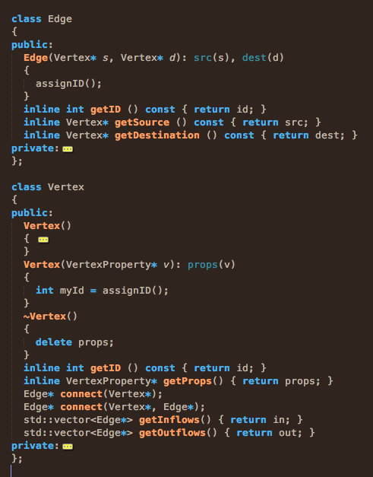
Graph
Edge
Vertex
VertexProperty

Slide 14
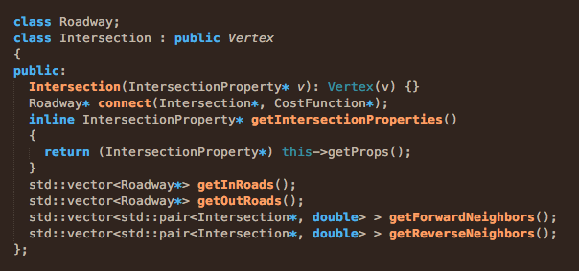
Intersection : public Vertex

Slide 15
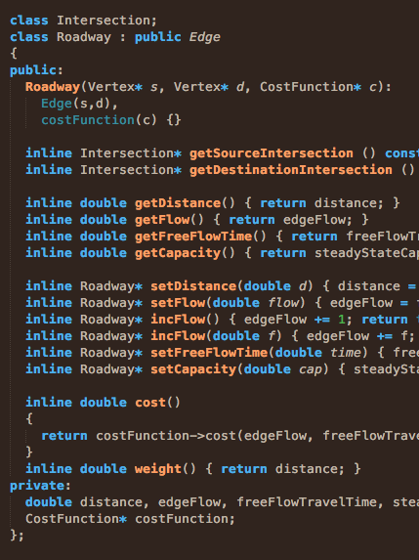
Roadway : public Edge

Slide 16
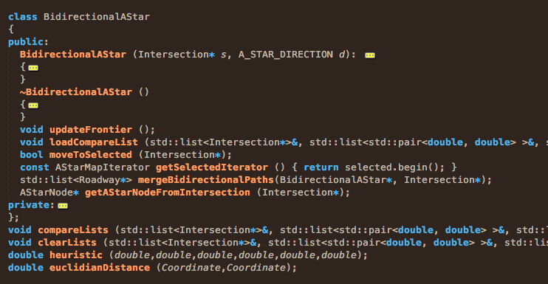
BidirectionalAStar

Slide 17
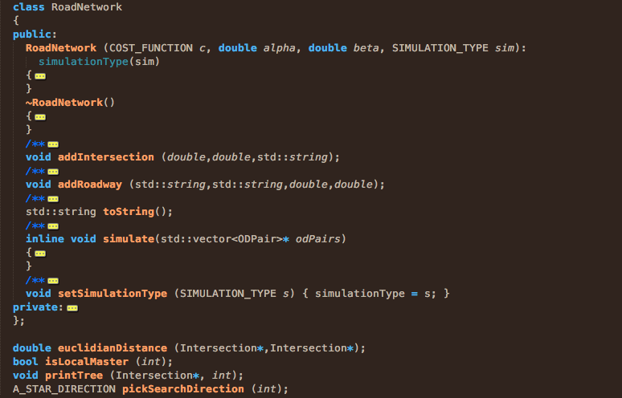
RoadNetwork

Slide 18
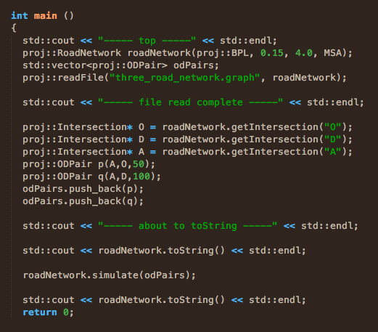
Example Test Driver

Slide 19
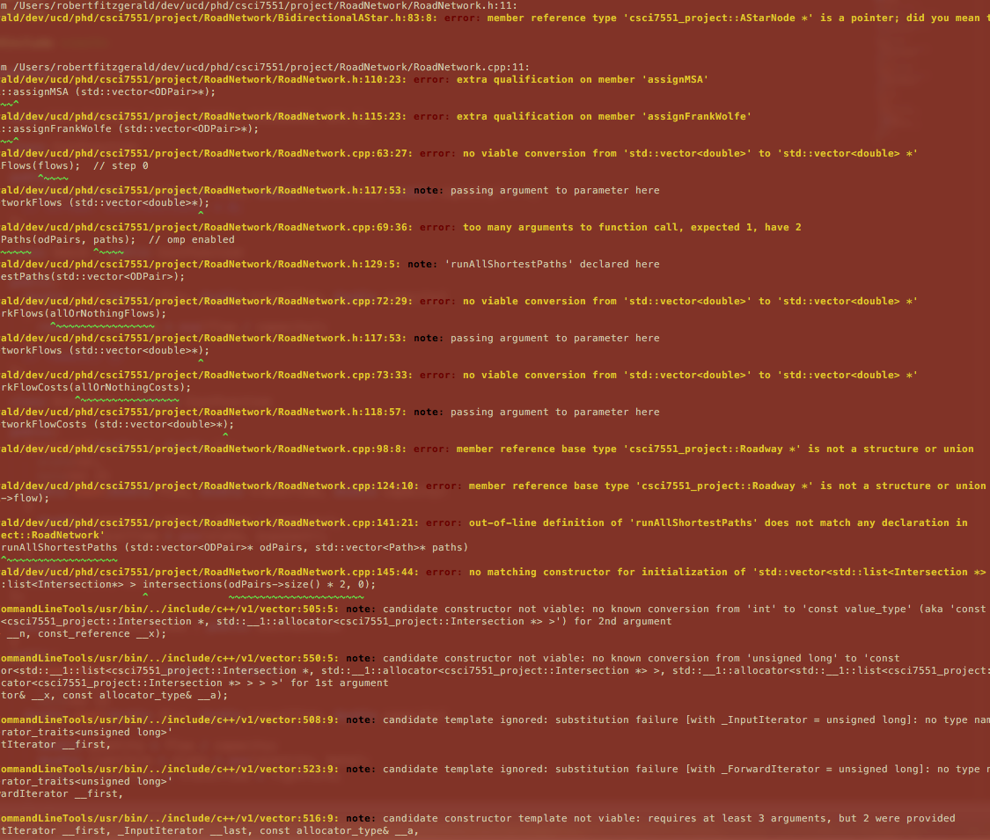
Results
:-(

Slide 20
Future Present Work
bugs
class to hold all the trip pairs, or, roll it into RoadNetwork with methods
test, compare, refine
come up with larger data sets
Frank-Wolfe: needs the “objective function” implemented, which I need to understand first.

Slide 21
References
[ORTUZAR] Juan de Dios Ortuzar, Luis G. Willumsen, “Assignment” in Modelling Transport, 4th Ed. New York: Wiley, 2011, pp. 349-390.
[AMITP] Variants of A*: Bidirectional Search. http://theory.stanford.edu/~amitp/GameProgramming/Variations.html.
[OPENMP] OpenMP Tutorial. https://computing.llnl.gov/tutorials/openMP/.

