Slide 1
Recruiting New Tor Relays with BRAIDS
Rob Jansen, Nick Hopper, Yongdae Kim
CCS 2010
University of Minnesota
jansen@cs.umn.edu
Notes:
-our system attracts new Tor relays by improving network performance

Slide 2




Anonymous Communication
Tor Network
Client
Server
Relays
Notes:
... link a cients behaviors. This can reveal private information about a client. For example, a client might reveal that he has an std by searching for related health information. If a client wishes to remain anonymous while performing these searches, he can use an anonymity network like Tor.

Slide 3
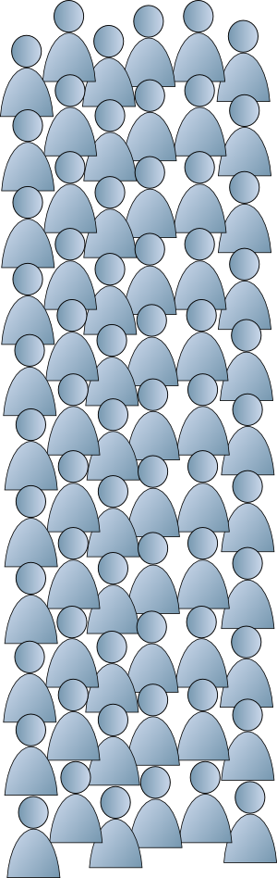
Clients Overwhelm Relays
~1900 relays
100,000 ~ 150,000
clients
~66 clients per relay
Notes:
-incentives for BitTorrent clients

Slide 4

Gold Star Incentives
[FC '10]
Gold star circuits must initiate
from gold star relays

Slide 5


Bandwidth
Reciprocity
And
Incentivized
Differentiated
Services
Bank
Tickets
Notes:
-tickets create incentives for relays
-small amount of tickets to all
-clients pay relays, relays get rich

Slide 6

Bandwidth
Reciprocity
And
Incentivized
Differentiated
Services
Bank
Tickets
Priority

Slide 7



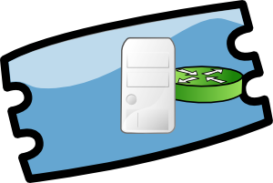

Relay-specific Tickets
Partially Blind Signatures [CRYPTO '00]
Notes:
-decentralized solution to double spending
-relays go offline -> exchange tickets -> expiration

Slide 8


Ticket Distribution
Guard relays = Ticket Distribution Agents
How to assign agents?

Slide 9
Assigning Agents
Distribute load among guards
def Test(x):
s = set()
for g in guards:
if hash(x, g.pk) < bandwidth_frac(g):
s.add(g)
return s
Notes:
-x=client.ip only enables a predecessor attack to infer a client from its agents

Slide 10











Assigning Agents
=
+
= Hash(client.ip)
=
=
+
+
Agent ⟵ Test( ) = { }
Test( ) = { }
Test( ) = { }
Test( ) = { }

Slide 11


Differentiated Services

Slide 12
Recap
Free tickets to clients (limited downloads)
Clients pay relays for priority
Relays get rich, use tickets to significantly increase performance
Epic Win!
Notes:
-transition: two things left: performance evaluation and anonymity analysis

Slide 13
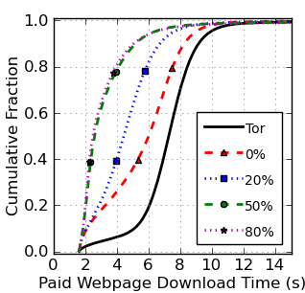
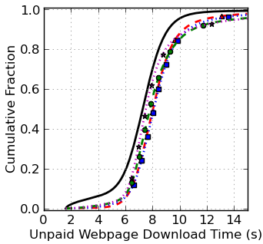
Webpage Downloads
Notes:
-explain percentages -> effect of clients converting to relays
-main point: non- participating clients dont get that much worse

Slide 14
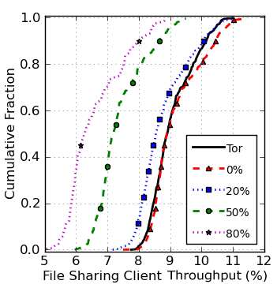
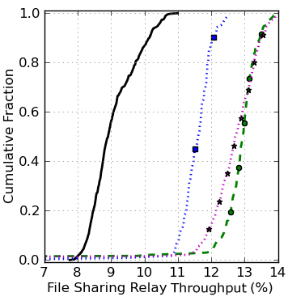
Filesharing Throughput
Notes:
-main point: hogging bandwidth means you get less priority

Slide 15





Stabilizing the Economy
Limit size of economy

Slide 16
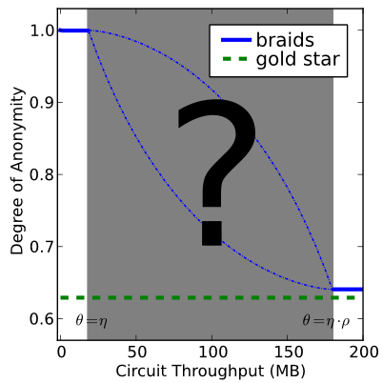
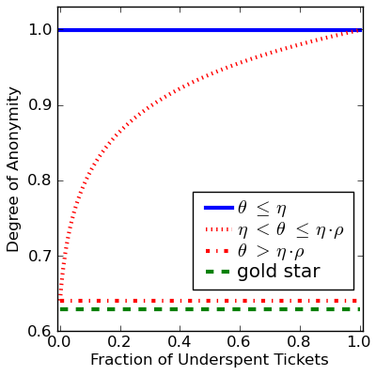
Anonymity vs Spending

Slide 17
Future Work
Client spending strategies
Auditing ticket agents
Distributed bank
...
Adoption by Tor

Slide 18
Questions?

Slide 19
Communication
1 ticket = 152 bytes (1 Tor cell = 512 bytes)
  Client sends 1 ticket for every 256 cells
1 exchange = 488 bytes
  Batch exchanges to reduce cost
Clients exchange ~1 MB per day
Bank exchanges ~100~150 GB per day, (~10Mbps~15Mbps)

Slide 20
Computation
 |  | Mean | Median | Std. Dev.
AMD Athlon (3 GHz) | AES+SHA1 | 9.139 | 8.616 | 2.493
 | PBS verify | 531.287 | 530.885 | 8.342
 | PBS bank | 413.244 | 412.069 | 7.297
Intel Core2 (2.67 GHz) | AES+SHA1 | 6.226 | 5.859 | 1.307
 | PBS verify | 1496.813 | 1496.613 | 10.844
 | PBS bank | 1193.233 | 1192.782 | 9.472
*All times in microseconds
Cryptographic benchmarks suggest tickets be worth 128 KB
  Relay upload speeds of 666 Mbps
  Bank sustains an aggregate 833 Mbps per core

Slide 21
Simulation
Discrete event simulator of Tor + BRAIDS
  Measure download times and throughput
Web client
  User clicking on web pages
File-sharing client
  BitTorrent-like downloader
File-sharing relay
  Contributes a fraction of bandwidth to Tor
Notes:
-19,400 web clients – 12/1.3 Mbps
-600 file-sharing clients – 24/3.5 Mbps
-300 relays
-Bandwidth drawn from network consensus
-Delay parameters 1:64:4096
-Varying fraction of 600 file-sharers that are clients vs relays

Slide 22
Ticket Structure
Ticket stub:
Ticket date-stamps

Slide 23
Ideal System Requirements
Functional
  Reduce impact of file-sharing
  Incrementally deployable into Tor
Security
  Do not introduce new security vulnerabilities
  Maintain client and relay anonymity
Notes:
-to be successful, an incentive system should meet these goals
+there are a few proposed incentive ideas, one of them is the gold star scheme

Slide 24
Information Leakage
Entropy
Maximum entropy
Degree of anonymity

Slide 25
Anonymity Model
Liberal clients
  Spend all tickets immediately
Conservative clients
  Stores tickets for targeted download
Relays have infinite tickets
Goal - eliminate potential initiators
  Tickets spent and time since deployment
Notes:
-In practice, some clients will consistently spend all tickets and some will consistently underspend tickets
-to model this:
liberal clients, conservative clients, relays

Slide 26
Priority Scheduling
Queuing delay q, monitoring time
Quality differentiation parameters c
Maintain proportions defined by c values
Notes:
-we borrow schedulers from the proportional differentiation model to define service classes

Slide 27
Proportional Delay Schedulers
Waiting Time Priority
Proportional Average Delay
Hybrid, for fraction f

Slide 28
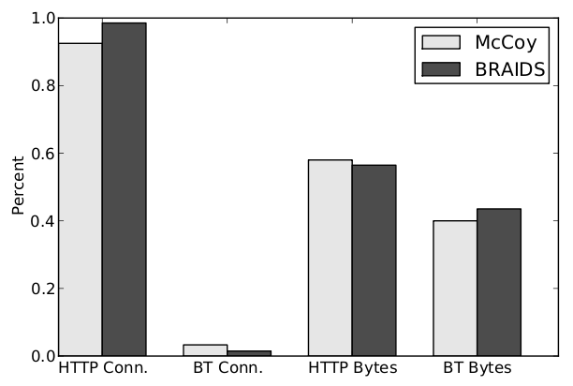
Simulated Traffic vs Empirical Measurements

