Slide 1
Shadow: Running Tor in a Box for Accurate and Efficient Experimentation
Rob Jansen and Nick Hopper
University of Minnesota
U.S. Naval Research Laboratory
rob.g.jansen@nrl.navy.mil
Notes:
Whats the point about talking about shadow – why people will care

Slide 2



Anonymity with Tor
Client
Relays
Server

Slide 3
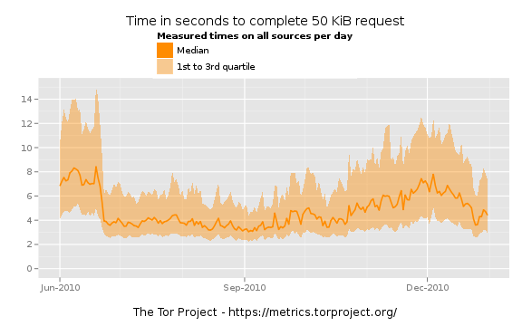

Slide 6
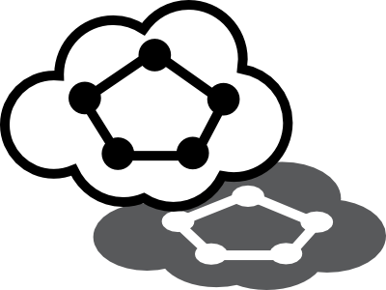

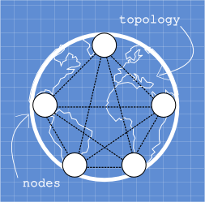

Tor in a Box with Shadow
Discrete event network simulator
  Natively executes real applications
  Simulates time, network, crypto, CPU
  Model latency and bandwidth
Efficient, accurate, controlled
Single Linux-box without root
Linux

Slide 7
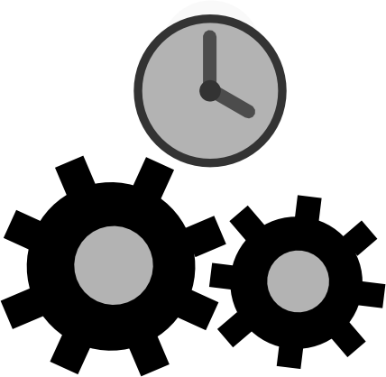

Shadow's Design I
Simulation blueprint
Discrete time events
Notes:
The effect of these techniques is: precise control over the experiment and repeatability (XML specification), scalability (no real time requirement)

Slide 8

Shadow's Design II
Node management
Function interposition
Shadow Memory
Space
A
B
Context
Switch
Tor Memory
Space
Notes:
Effects: memory efficiency (minimize state overhead), run real applications (emulates/simulates linux kernel)
Scalability depends on application

Slide 9
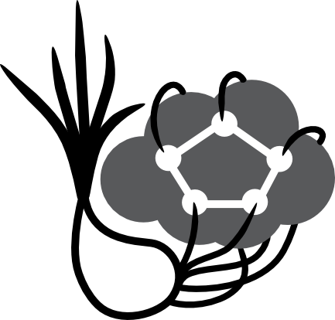
Scallion – A Plug-in Running Tor
Integrates Tor into Shadow
Scalability
  1250 nodes in 10 GB RAM,
  5x* - 10x** slowdown
  5750 nodes in 60 GB RAM,
  40x** slowdown
* 3.3 GHz AMD Phenom II X6 1100T ** 2.2 GHz AMD Opteron 6174

Slide 10
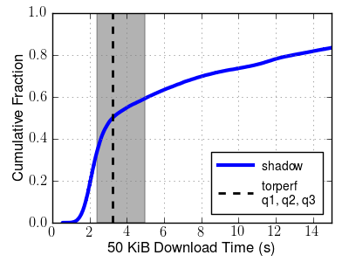
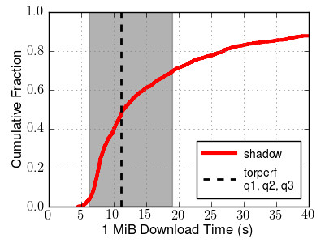
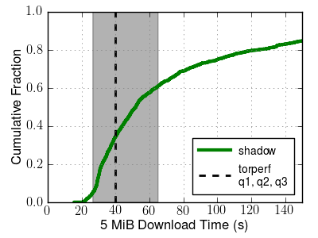
Accuracy Shadowing Tor

Slide 11
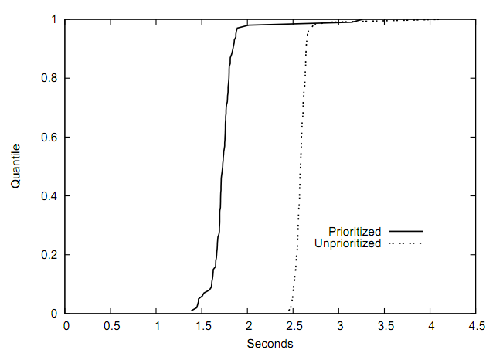
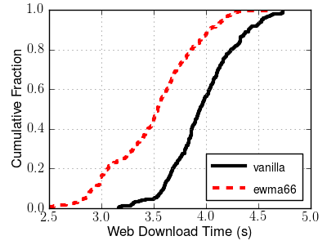
Demonstrating Shadow's Utility
Tang & Goldberg [CCS 10]
Shadow
Notes:
Replacement for Round Robin
Prioritize bursty web traffic over bulk traffic
Shadow agrees with 3 node PlanetLab tests

Slide 12
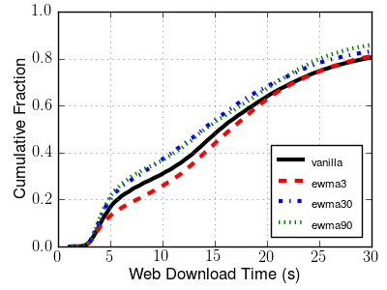
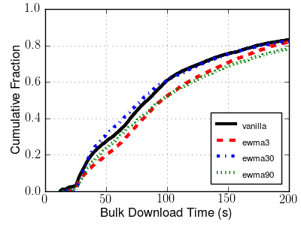
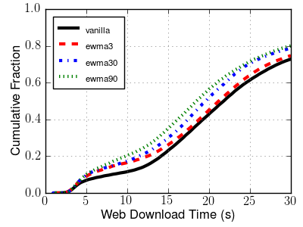
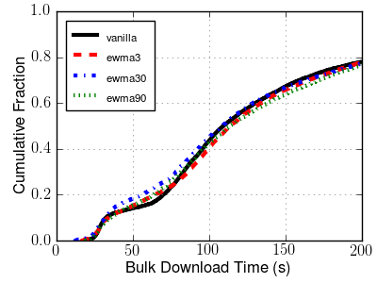
Web
Bulk
Lightly
Loaded
Tor
Heavily
Loaded
Tor
Notes:
Top row: normal load of 50 relays, 950 web, 50 bulk
Bottom row: double bulk load of 50 relays, 950 web, and 100 bulk
New results were something that they were not able to gather on planetlab
They did the best they could with the tools they had, and Tor uses it because it seemed like it is a win – now we can look at things at better scale, and the results not clear

Slide 13
Conclusion
Efficient, accurate, controllable, repeatable
Tor experiments on one machine
  Larger scale than previously possible
  New results from new capabilities
Able to run many applications
Freely available and usable software
Notes:
Several people already using shadow

Slide 14

Questions?
rob.g.jansen@nrl.navy.mil
cs.umn.edu/~jansen
shadow.cs.umn.edu
github.com/shadow

