Slide 1
Throttling Tor Bandwidth Parasites
Rob Jansen, Paul Syverson, Nick Hopper
U.S. Naval Research Laboratory
University of Minnesota
rob.g.jansen@nrl.navy.mil
Notes:
Explain what we are doing
Explain what the problem is on a new slide (small fraction of users consuming most of the bandwidth)
Explicitly make it clear that this is not scheduling and why (difference between throttling and scheduling)
Make sure not to imply that we hate bulk users – only because it helps the majority of users (explain why we throttle bulk)

Slide 2



Anonymity with Tor
Client
Relays
Server

Slide 3
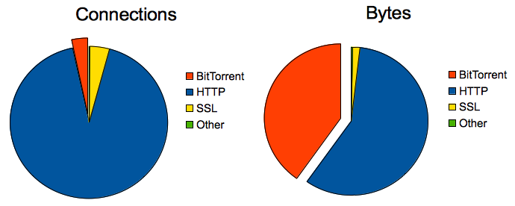
Bandwidth Parasites
[McCoy et al. PETS 2008]

Slide 4

Tor Guard Relays
Guard
Client
Relays
Server

Slide 5
Multiplexing Circuits

Slide 6

Throttling Clients

Slide 7
Throttling Algorithms
Criteria:
  Which connections?
  At what rate?
Constraints:
  Use only local information
?

Slide 8


Our Approaches: Bit-splitting
Adaptively adjust throttle rate
  Each client allocated fair bandwidth share
1200 KiB/s
300 KiB/S
29 KiB/s
29 KiB/s
29 KiB/s
∞

Slide 9
Our Approaches: Flagging
Adaptively select connections
  Flag connections that use too much, throttle aggressively
50 KiB/S
29 KiB/s
29 KiB/s
29 KiB/s
∞

Slide 10
Our Approaches: Threshold
Adjust both throttle rate and selected connections
  Threshold: throttle the loudest connections
Threshold = 50%
29 KiB/S
29 KiB/s
29 KiB/s
29 KiB/s
∞

Slide 11
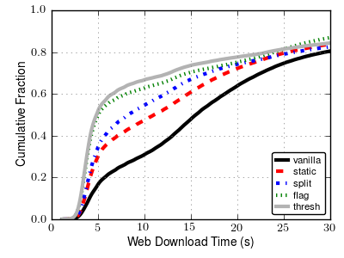
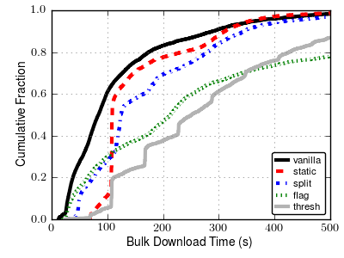
Performance Results
Web-client Performance
Bulk-client Performance

Slide 12
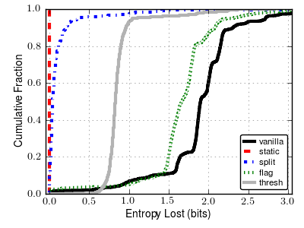
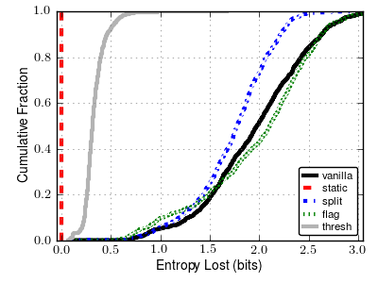
Anonymity Results
Learn Circuit Throughput
Learn Throttle Rate

Slide 13
Conclusions
Goal: throttle bandwidth parasites
Proposed and analyzed three throttling algorithms for Tor
Tor patches publicly available

Slide 14

Questions?
rob.g.jansen@nrl.navy.mil
cs.umn.edu/~jansen
github.com/robgjansen
github.com/shadow
shadow.cs.umn.edu

