Slide 1
Throttling Tor Bandwidth Parasites
USENIX Security, 2012
Rob Jansen, U.S. Naval Research Laboratory
Paul Syverson, U.S. Naval Research Laboratory
Nick Hopper, University of Minnesota
Notes:
Explain what we are doing
Explain what the problem is on a new slide (small fraction of users consuming most of the bandwidth)
Explicitly make it clear that this is not scheduling and why (difference between throttling and scheduling)
Make sure not to imply that we hate bulk users – only because it helps the majority of users (explain why we throttle bulk)

Slide 2



Anonymity with Tor
Client
Server

Slide 3
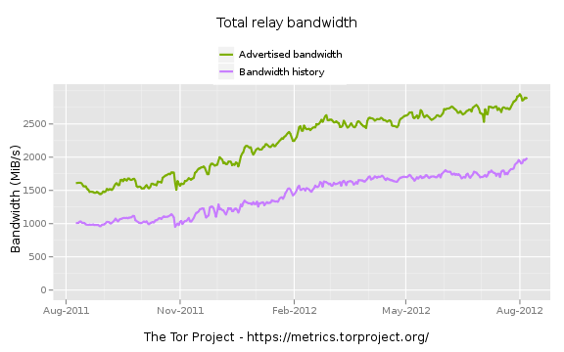
Tor is Efficient: ~65% utilization!

Slide 4
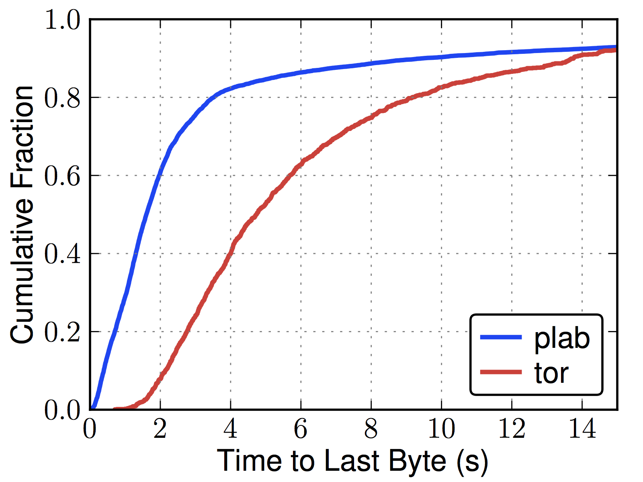
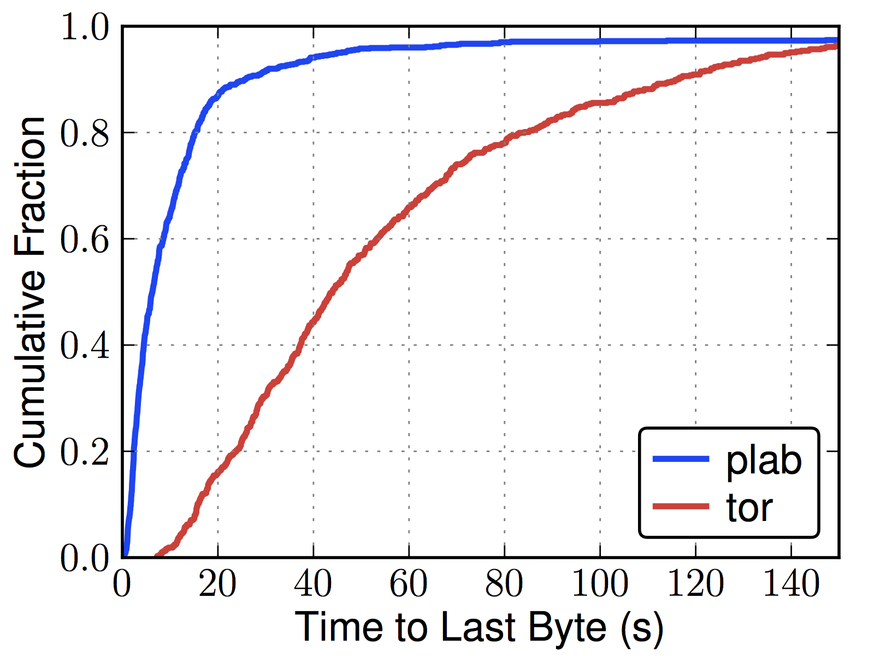
Tor is Slow[er]
Web (320 KiB)
Bulk (5 MiB)

Slide 5
Bytes
Flows
3%
40%
2008'
58%
92%
11%
2010''
52%
36%
69%
' McCoy et al. PETS 2008, '' Chaabane et al. NSS 2010

Slide 6


Bandwidth Parasites
BitTorrent is leaching Tor's capacity!
Throttle BitTorrent
  Improve client performance
  Support more users → improve anonymity
=
Notes:
Actually, of the 745.5 flows, only 27% download data over Tor (as opposed to only tracker over Tor)

Slide 7
Outline
Problem and Motivation
More Tor Details
  Circuits, Guards, Multiplexing
  “Static Throttling”
Adaptive Throttling
Performance Evaluation
Anonymity Evaluation

Slide 8
Anonymity with Tor
Client
Server

Slide 9

Anonymity with Tor
Client
Relays
Server

Slide 10

Tor Guard Relays
Guard
Client
Relays
Server

Slide 11
Multiplexing Circuits

Slide 12

“Statically” Throttling Clients

Slide 13
Outline
Problem and Motivation
More Tor Details
  Circuits, Guards, Multiplexing
  “Static Throttling”
Adaptive Throttling
Performance Evaluation
Anonymity Evaluation

Slide 14
Throttling Algorithms
Criteria:
  Which connections?
  At what rate?
Constraints:
  Use only local information
  Unsupervised
?

Slide 15
Our Approaches: Bit-splitting
Adaptively adjust throttle rate
  Each client allocated fair bandwidth share
1200 KiB/s
300 KiB/s
29 KiB/s
29 KiB/s
29 KiB/s
∞

Slide 16
Our Approaches: Flagging
Adaptively select connections
  Flag connections that use too much, throttle aggressively
50 KiB/s
29 KiB/s
29 KiB/s
29 KiB/s
∞

Slide 17
Our Approaches: Threshold
Adjust both throttle rate and selected connections
  Threshold: throttle the loudest connections
Threshold = 50%
29 KiB/s
29 KiB/s
29 KiB/s
29 KiB/s
∞

Slide 18
Outline
Problem and Motivation
More Tor Details
  Circuits, Guards, Multiplexing
  “Static Throttling”
Adaptive Throttling
Performance Evaluation
Anonymity Evaluation

Slide 19
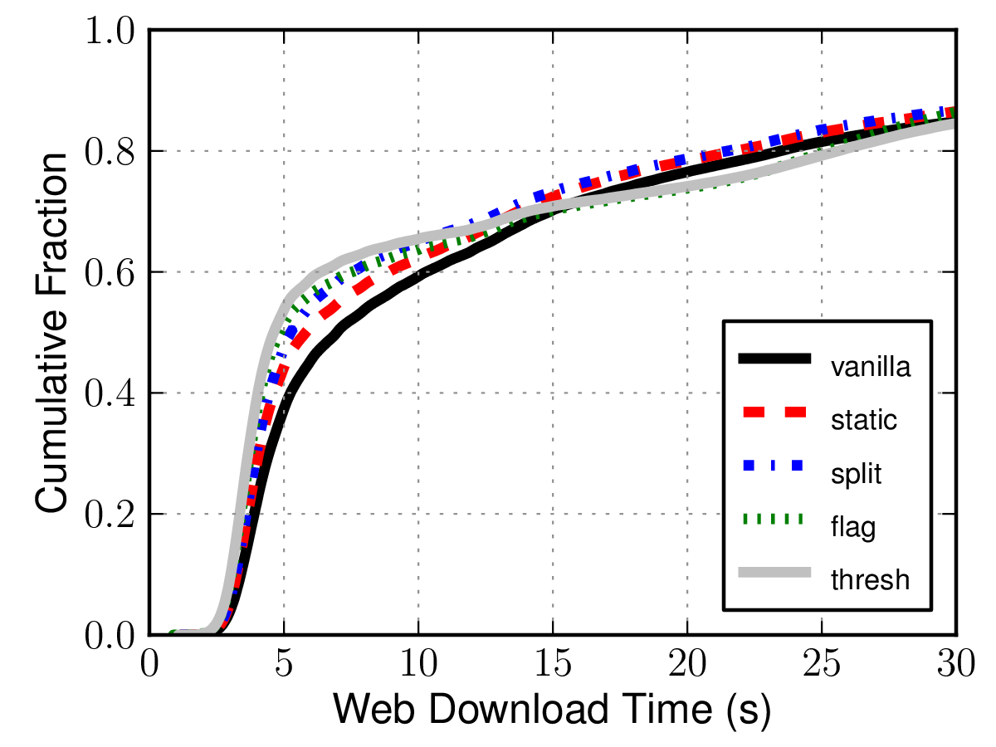
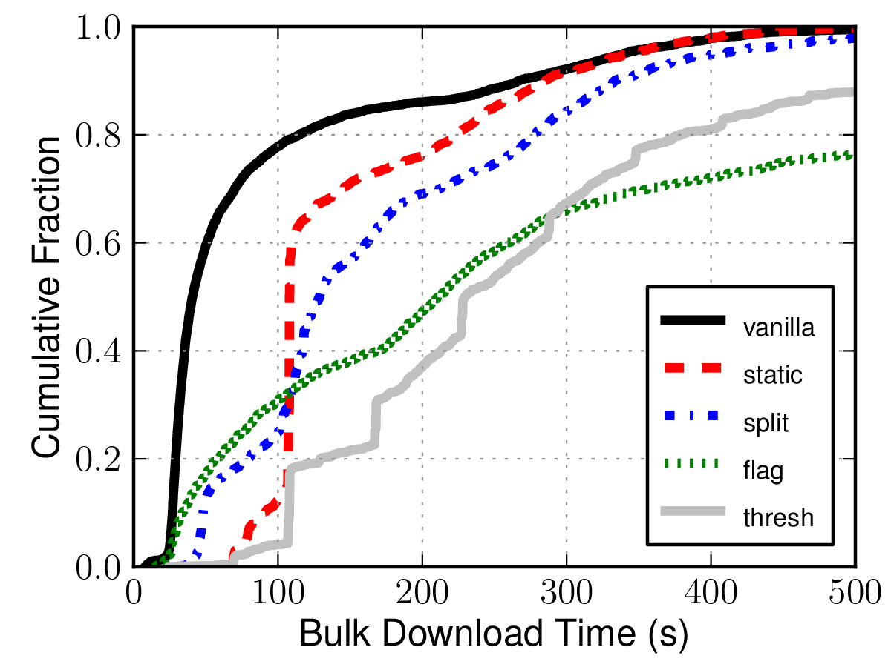
Performance, Lighter Load
Web (320 KiB)
Bulk (5 MiB)

Slide 20
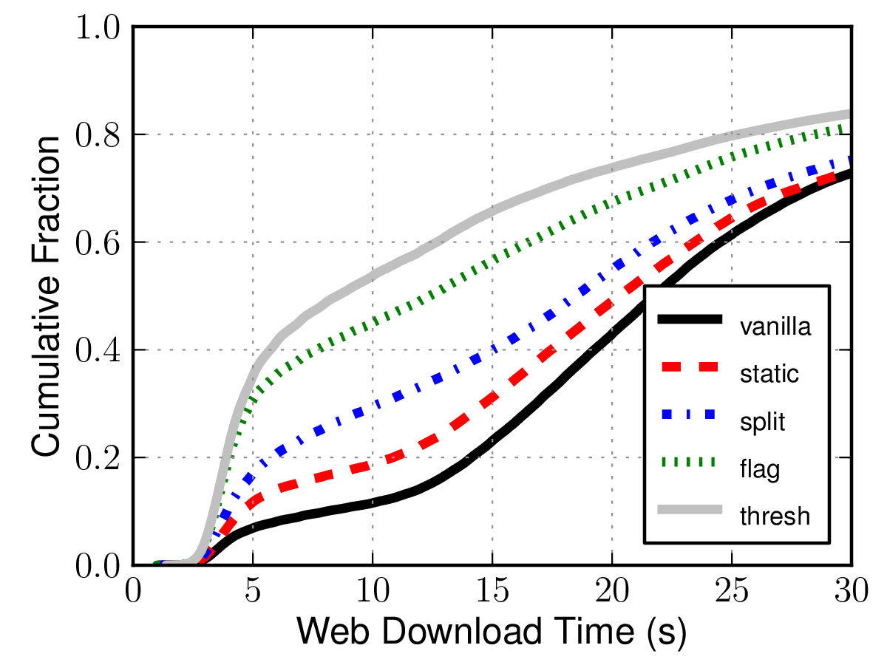
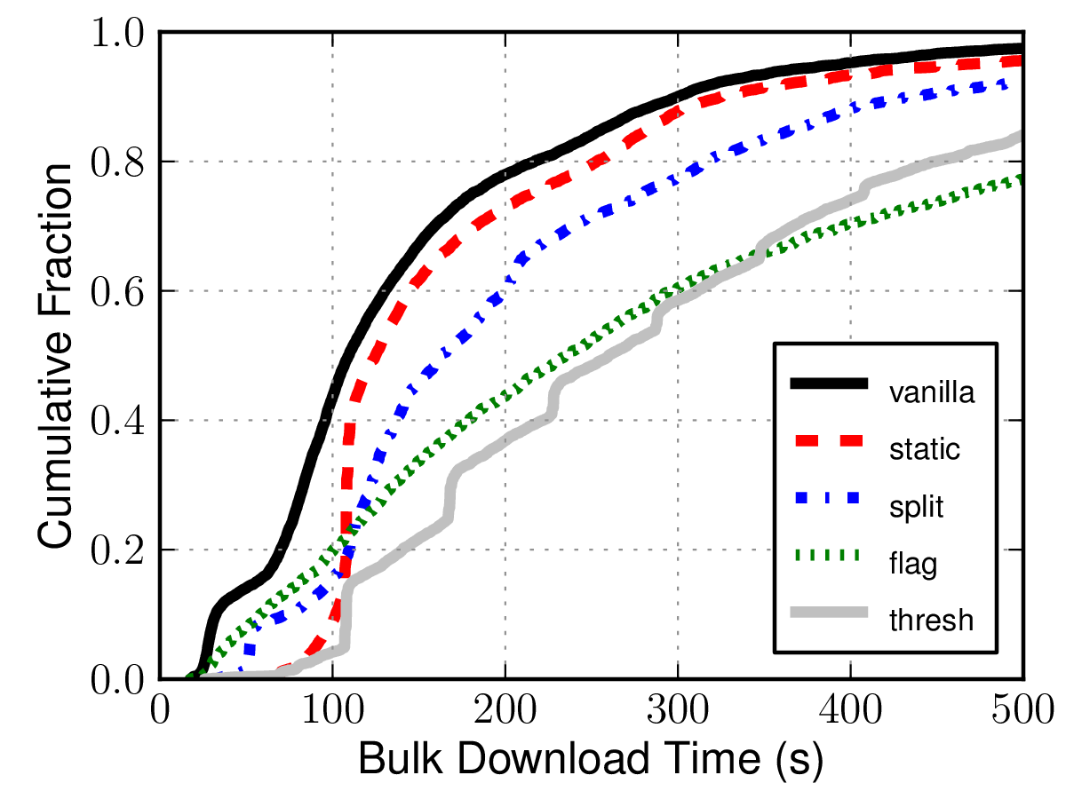
Performance, Heavier Load
Web (320 KiB)
Bulk (5 MiB)

Slide 21
Outline
Problem and Motivation
More Tor Details
  Circuits, Guards, Multiplexing
  “Static Throttling”
Adaptive Throttling
Performance Evaluation
Anonymity Evaluation

Slide 22


Attacking Anonymity:
Learning Circuit Throughput
Request
Client
Server

Slide 23

Attacking Anonymity:
Learning Circuit Throughput
Request
Garbage Response
Client
Server

Slide 24
Attacking Anonymity:
Learning Circuit Throughput
Request
Garbage Response
Re-request
Client
Server

Slide 25
Attacking Anonymity:
Learning Throttle Rate
High Bandwidth Nodes

Slide 26
Attacking Anonymity:
Learning Throttle Rate
High Bandwidth Nodes

Slide 27
Attacking Anonymity:
Learning Throttle Rate
Measure the Rate
High Bandwidth Nodes

Slide 28
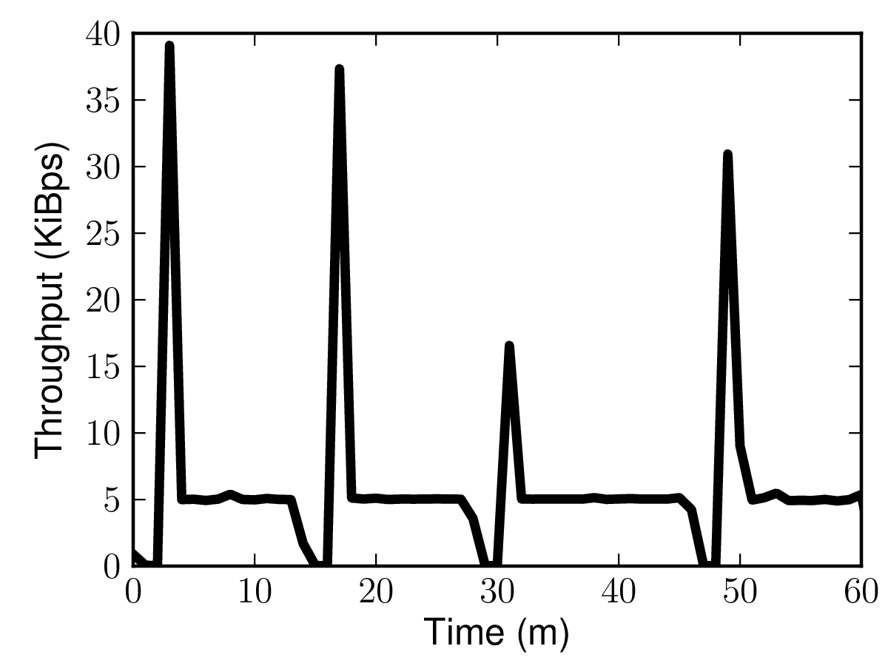
Attacking Anonymity:
Learning Throttle Rate
5 KiB/s

Slide 29
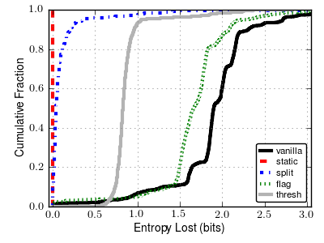
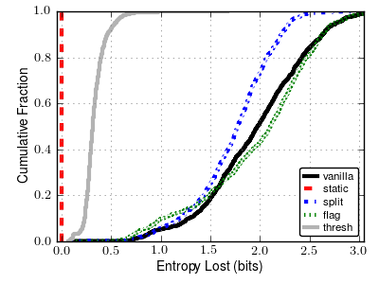
Anonymity Results
Learn Circuit Throughput
Learn Throttle Rate

Slide 30
Conclusions
Goal: throttle bandwidth parasites
  Throttling improves web client performance, anonymity
  Tor patches publicly available
Open question:
  How to deal with 'cheaters'?

Slide 31
Questions?
rob.g.jansen@nrl.navy.mil
cs.umn.edu/~jansen
github.com/robgjansen
github.com/shadow
shadow.cs.umn.edu

Slide 32
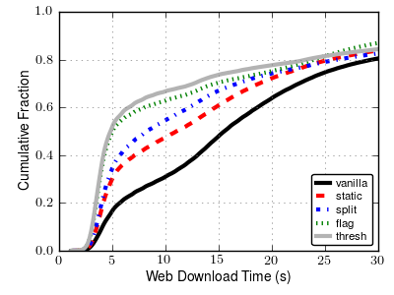
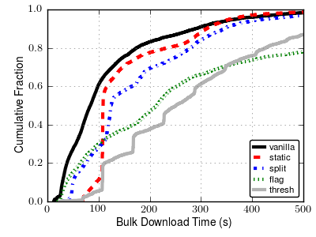
Performance, Medium Load
Web-client Performance
Bulk-client Performance

