Slide 1
Methodically Modeling the Tor Network
Workshop on
Cyber Security Experimentation and Test
2012
Rob Jansen - U.S. Naval Research Laboratory
Kevin Bauer – University of Waterloo
Nick Hopper – University of Minnesota
Roger Dingledine – The Tor Project
Notes:
Thanks for being here. The point of this proposal is to give a broad overview of the work I have done so far toward completion of my degree. I will be giving high-level overviews for each project while explaining how it fits in with my overall research objective.

Slide 2
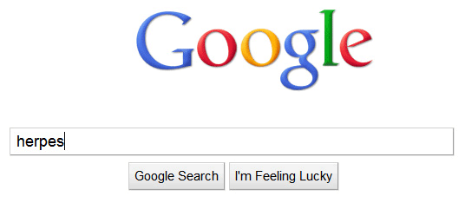
Notes:
-Shamelessly ripped off from donttrack.us
-when you search google

Slide 3
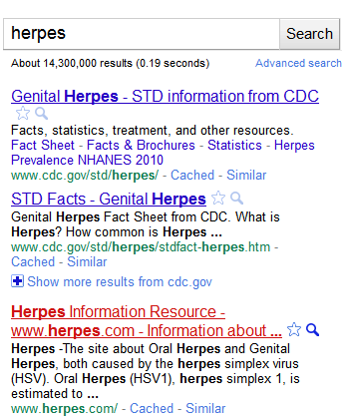
Notes:
-and click on a link

Slide 4
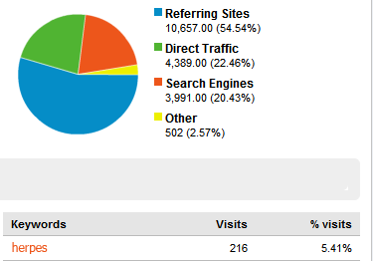
Notes:
-that search term is sent to the site

Slide 5
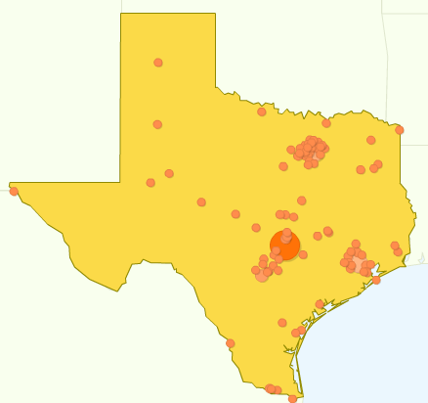
Notes:
-along with your browser and computer info

Slide 6

Notes:
-often this information can be used to uniquely identify you

Slide 7

Notes:
-those sites also have 3rd party advertisements

Slide 8
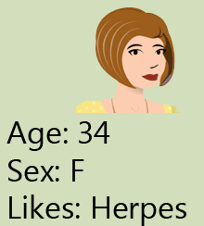
Notes:
-they build a profile of you

Slide 9

Notes:
-and thats why those ads follow you everywhere

Slide 10

Notes:
-they can sell your profiles

Slide 11

Notes:
-which can be used against you on background checks, or when applying for insurance or loans
-theres more

Slide 12
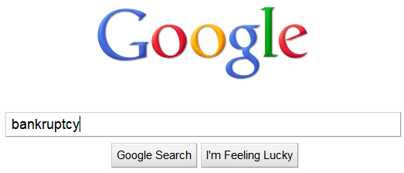
Notes:
-remember your searches?

Slide 13
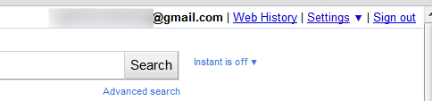
Notes:
-google also saves them

Slide 14

Notes:
-they can be legally requested, and come back to bite you later

Slide 15
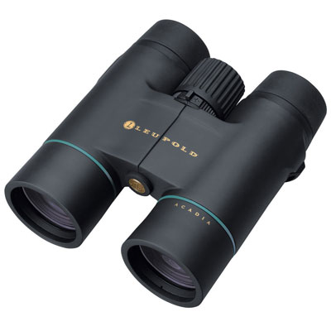
Notes:
-or a google employee could go snooping in the records

Slide 16

Notes:
-or google get get hacked and your data stolen

Slide 17

Notes:
-these reasons are why we need anonymity

Slide 18
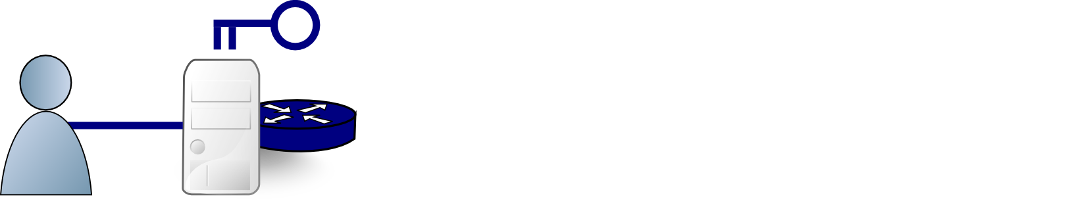
Onion Routing with Tor
Client
Relays

Slide 19
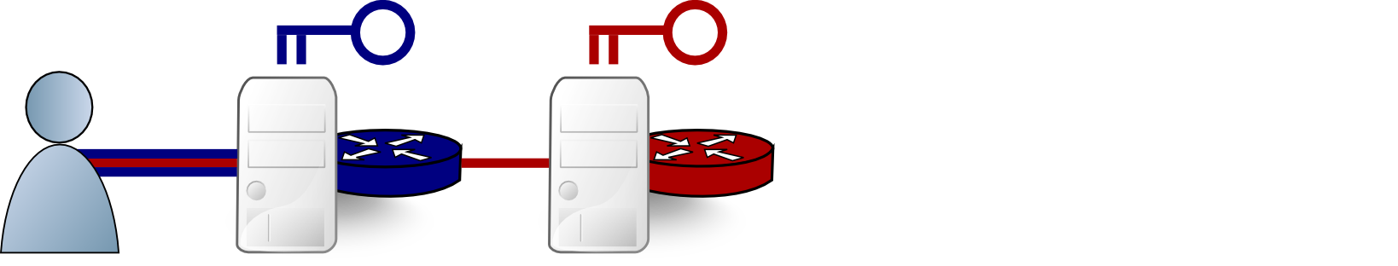
Onion Routing with Tor
Client
Relays

Slide 20
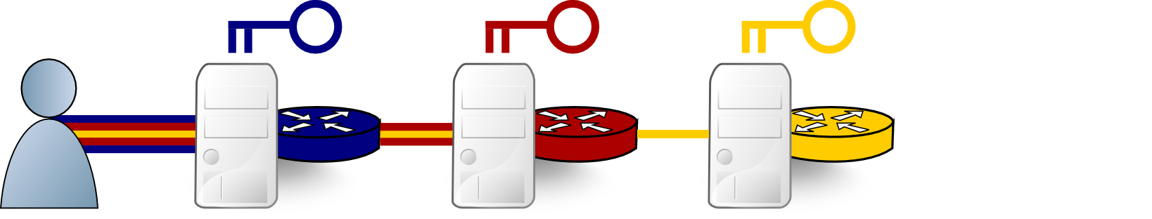
Onion Routing with Tor
Client
Relays

Slide 21

Onion Routing with Tor
Client
Relays
Server

Slide 22
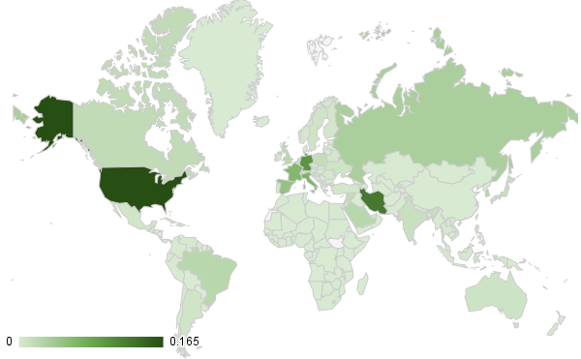
Tor Experimentation
 | Pros | Cons
Live Tor | Realistic, accurate | Hard to manage, privacy risks, lengthy deployment

Slide 23
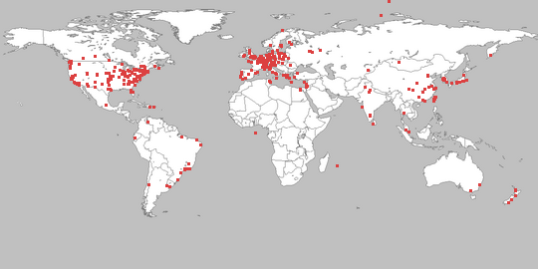
Tor Experimentation
 | Pros | Cons
Live Tor | Realistic, accurate | Hard to manage, privacy risks, lengthy deployment
PlanetLab | Realistic | Hard to manage, not scalable, inaccurate

Slide 24
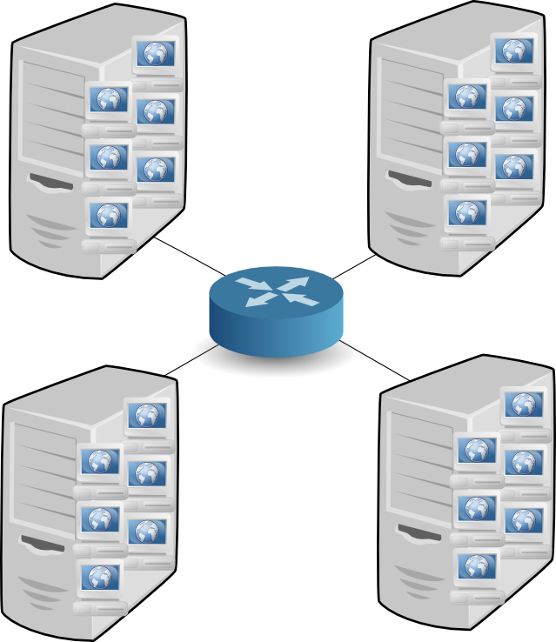
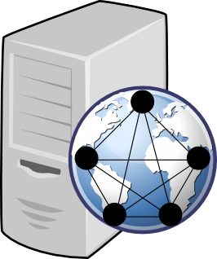
Tor Experimentation
Shadow and ExperimenTor
  Both run real Tor software
  Network simulation (discrete events)
  vs emulation testbed (ModelNet)

Slide 25

Modeling Choices
?

Slide 26

Internet Routers
Edges
  Latency
  Jitter
  Packet loss
Vertices
  Bandwidth

Slide 27

Tor Relays
Sample
Location
Capacity
Configuration

Slide 28



Tor Clients and Servers
Location
Bandwidth
Behavior

Slide 29
Modeling Decisions
Network topology → clustering by country
Network latency → iPlane trace-routes
Node bandwidth capacity → Net Index
Tor relay sample → bin-median sampling
Tor relay bandwidth rates → Tor metrics
Tor web clients → 320 KiB, think [1,20] seconds
Tor bulk clients → 5 MiB, no thinking
Client, server placement → Tor metrics

Slide 30
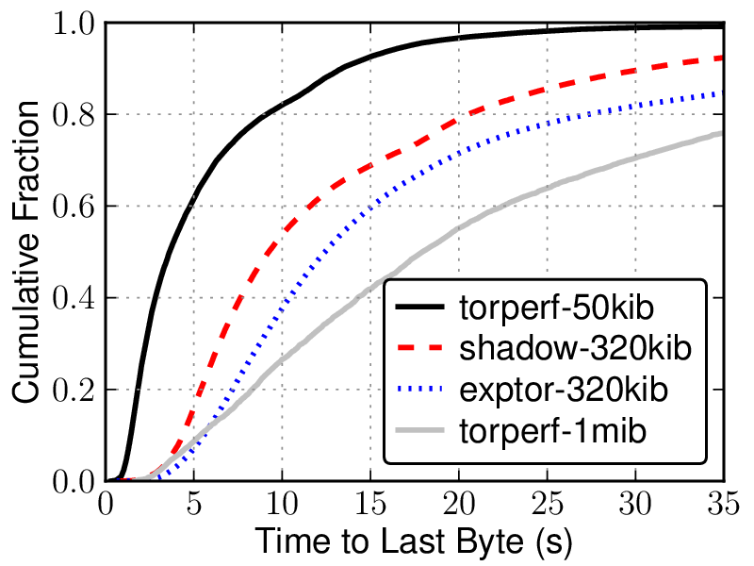
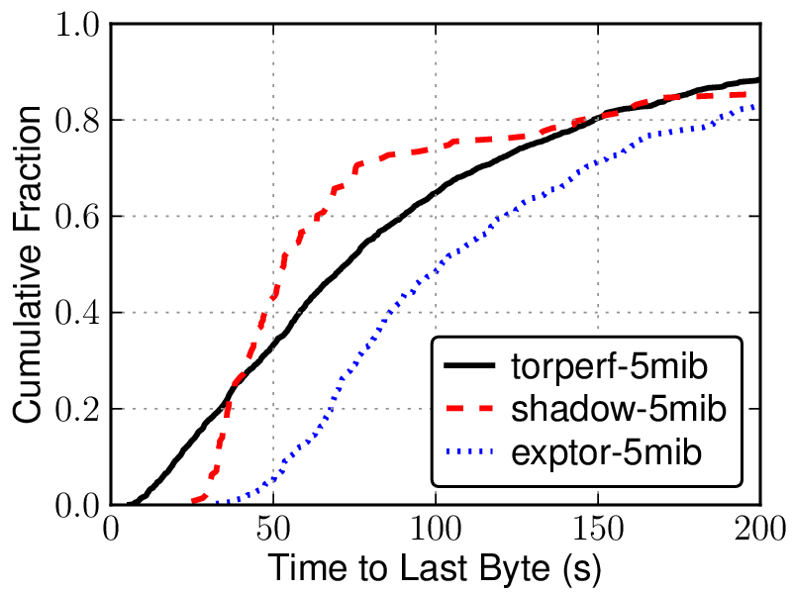
Metrics for Accuracy
Web Performance
Bulk Performance

Slide 31
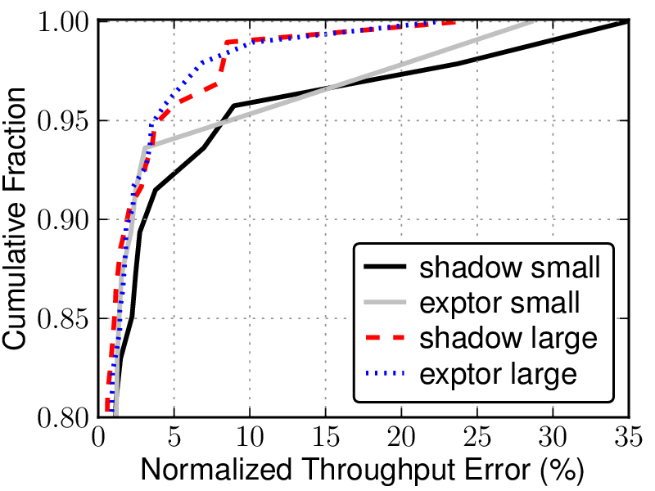
Metrics for Accuracy
Relay Load Error

Slide 32

Questions?
How much does faithfulness to Tor matter?
How can we tell when experiments have
“enough rigor” to produce meaningful results?

Slide 33
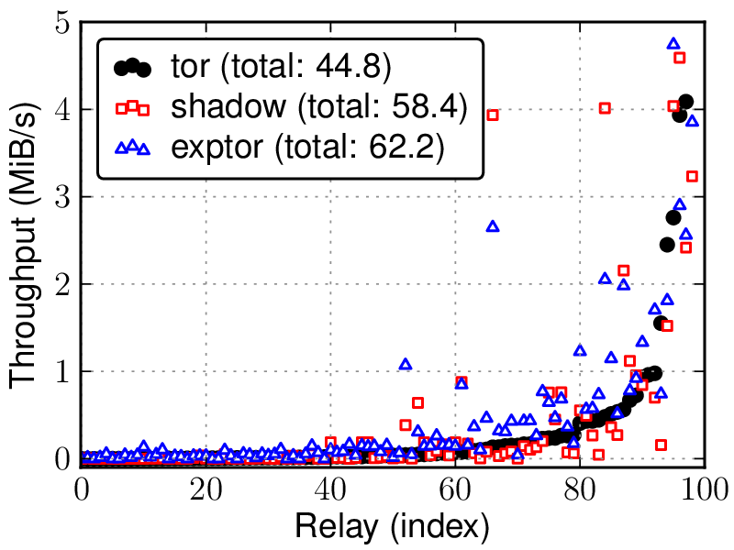
Metrics for Accuracy
Relay Load
Relay Load Error

