Slide 1
Performance Enhancements for Tor
DC Anonymity, Privacy, Security Seminar
October 26, 2012
Rob Jansen
U.S. Naval Research Laboratory
rob.g.jansen@nrl.navy.mil

Slide 2
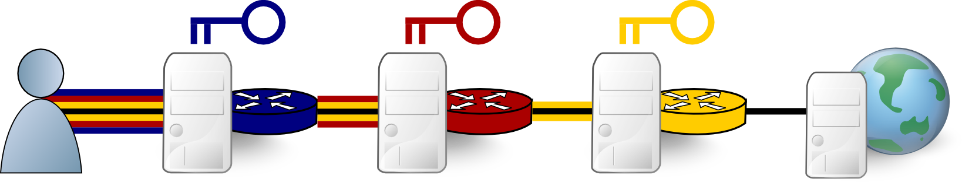
Tor: The Onion Router
Client
Relays
Server

Slide 3
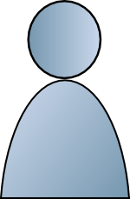

Tor is Slow!
~300,000 clients
~3000 relays

Slide 4
Tor is Slow!

Slide 5
Research Question
How can we improve Tor client performance while preserving privacy?
  Reduce load: throttling
  Improve utilization: scheduling
  Increase capacity: incentives for new relays

Slide 6
Bytes
Flows
3%
40%
2008'
58%
92%
11%
2010''
52%
36%
69%
' McCoy et al. PETS 2008, '' Chaabane et al. NSS 2010

Slide 7


Throttling Clients
Guard

Slide 8

Throttling Clients
Guard

Slide 9
Throttling Algorithms
Criteria:
  Which connections?
  At what rate?
Constraints:
  Use only local information
?

Slide 10


Adapt Rate
Bit-split: fair bandwidth allocation
1200 KiB/s
300 KiB/S
20 KiB/s
30 KiB/s
40 KiB/s
∞

Slide 11
Adapt Connections
Flag: aggressively throttle bulk connections
50 KiB/S
20 KiB/s
30 KiB/s
40 KiB/s
∞

Slide 12
Adapt Rate and Connections
Threshold: throttle the loudest connections
Threshold = 50%
40 KiB/S
20 KiB/s
30 KiB/s
40 KiB/s
∞

Slide 13
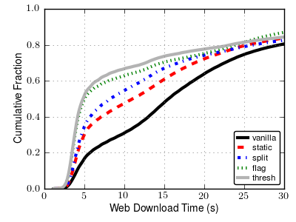
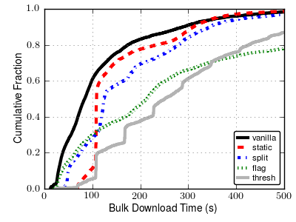
Performance Results
Web
Bulk

Slide 14
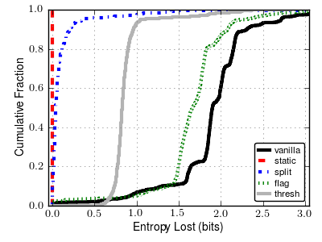
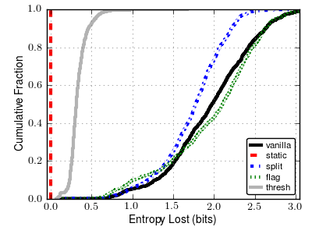
Anonymity Results
Learn circuit throughput
Learn throttle rate

Slide 15
Tor Circuit Scheduling
Circuit Inputs
Output
?
Relay

Slide 16
Tor Circuit Scheduling
Round-robin
?
Relay

Slide 17
Tor Circuit Scheduling
Round-robin
Exponentially-weighted Moving Average (EWMA)
?
Relay

Slide 18
Tor Circuit Scheduling
Round-robin
Exponentially-weighted Moving Average (EWMA)
Proportional Differentiation (DiffServ)
?
Relay

Slide 19
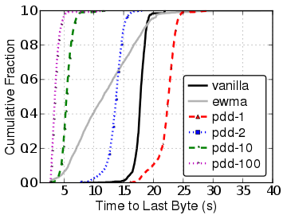
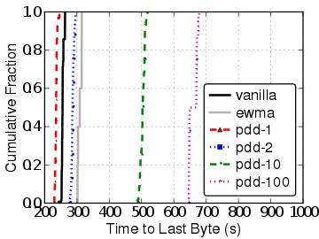
DiffServ, Single-Circuit:
Proportional Delay
Web
Bulk

Slide 20
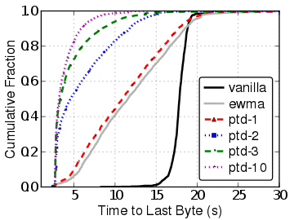
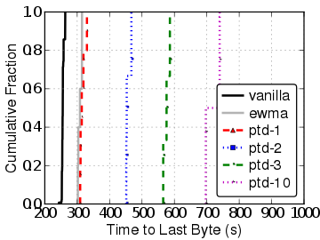
DiffServ, Single-Circuit:
Proportional Throughput
Web
Bulk

Slide 21
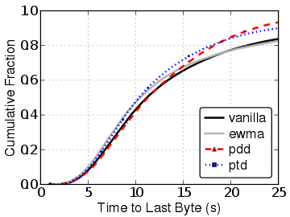
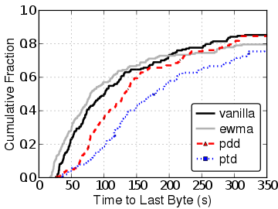
Full-Network Results
Web
Bulk

Slide 22
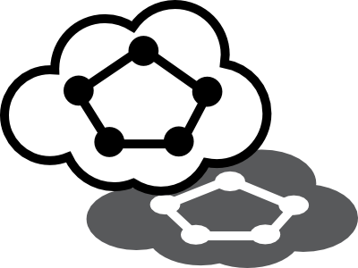



Shadow
Model the Internet
Manage virtual nodes
  time, network, cpu, crypto
Real applications
  Function interposition
  Context switching
Shadow Memory
Space
Tor Memory
Space

Slide 23

Questions?

