Slide 1
Repositioning Real-World Website Fingerprinting on Tor with a Measurement of Genuine Tor Traces
Rob Jansen, U.S. Naval Research Laboratory
Ryan Wails, U.S. Naval Research Laboratory and Georgetown University
Aaron Johnson, U.S. Naval Research Laboratory
Rob Jansen, PhD
Computer Scientist
Center for High Assurance Computer Systems
U.S. Naval Research Laboratory
Cyber Security Seminar University of Edinburgh
March 10th, 2025

Slide 2







Anonymous Communication with Tor
Separates identification from routing
Provides unlinkable communication
Promotes user safety and privacy online

Slide 3
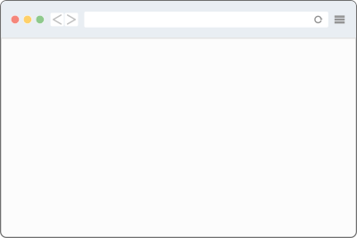


Website Fingerprinting (WF) Threat Model
WF Attacks:
Observe client-side traffic patterns
Predict website visited by user, breaking Tor’s anonymity
foo.com
Use ML to
predict website
foo.com

Slide 4
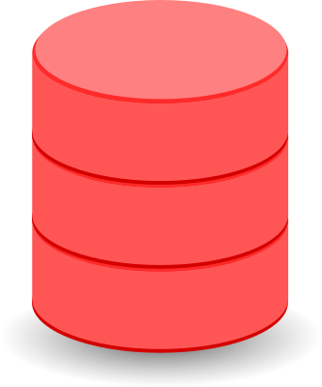
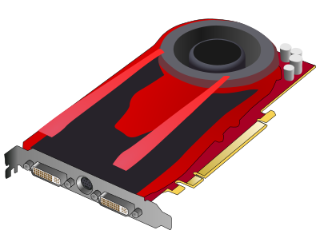
How Might an Adversary Train its ML Models?
labeled data
ML model
training
Traffic is onion-encrypted, so labels are unavailable
foo.com

Slide 5

How Might an Adversary Train its ML Models?
Traditional method?
Use automated browser (selenium)
Crawl sites, collect traces+labels
labeled data
ML model
training
foo.com

Slide 6
How Might an Adversary Train its ML Models?
Traditional method?
Problems:
Use automated browser (selenium)
Crawl sites, collect traces+labels
labeled data
ML model
Too many variables to accurately model [Juarez’14, Cherubin’22]
Browser version, config
URL choice, fetch order, parallel tabs
Geo-location, concept drift
Static, small, closed world
Relay churn, version, congestion, etc.
training
foo.com

Slide 7

How Might an Adversary Train its ML Models?
Emerging exit method?
Traffic from regular users
Collect traces+labels from exit relay
labeled data
ML model
training
foo.com

Slide 8
How Might an Adversary Train its ML Models?
Emerging exit method?
Problems:
Traffic from regular users
Collect traces+labels from exit relay
labeled data
ML model
Training data is collected on exit, but testing must be done on entry
Trace “distortion” reduces performance by 5-18% [Cherubin’22]
training
foo.com

Slide 9

Research Direction
Research Question:
How can we mitigate trace distortion so that we can utilize real-world traces to better estimate the threat of WF against Tor?
Training
Mitigate distortion between traces from
entry and exit
positions
Testing

Slide 10
Outline
1. Trace transduction with Retracer
2. Retracer evaluation
3. Real-world WF evaluation

Slide 11
Cell Trace Transduction
Cell Trace Transduction
Cell trace:
a sequence of n (timestamp, direction) pairs
timestamp: when cell was observed, relative to start of connection
direction: +1 if forwarded toward server, -1 if toward client
Example cell trace:
[
(0.1, +1),
(0.5, -1),
(0.9, +1),
(1.3, -1),
(1.3, -1),
(1.3, -1),
…
]

Slide 12
Cell Trace Transduction
Cell Trace Transduction
Cell trace:
a sequence of n (timestamp, direction) pairs
timestamp: when cell was observed, relative to start of connection
direction: +1 if forwarded toward server, -1 if toward client
Transducer:
a function T(I, M, p_{in}, p_{out}) → [O]_{M}
transforms an input cell trace I in position p_{in} into M output cell traces O in position p_{out}
we want p_{in}=exit, p_{out}=entry
Example cell trace:
[
(0.1, +1),
(0.5, -1),
(0.9, +1),
(1.3, -1),
(1.3, -1),
(1.3, -1),
…
]

Slide 13
Retracer: A Cell Trace Transducer
Key Insights
A cell trace has the metadata needed to reproduce it
Network simulation tools (Shadow) model Tor with high fidelity
We can replay an exit trace in Shadow and extract its entry trace

Slide 14
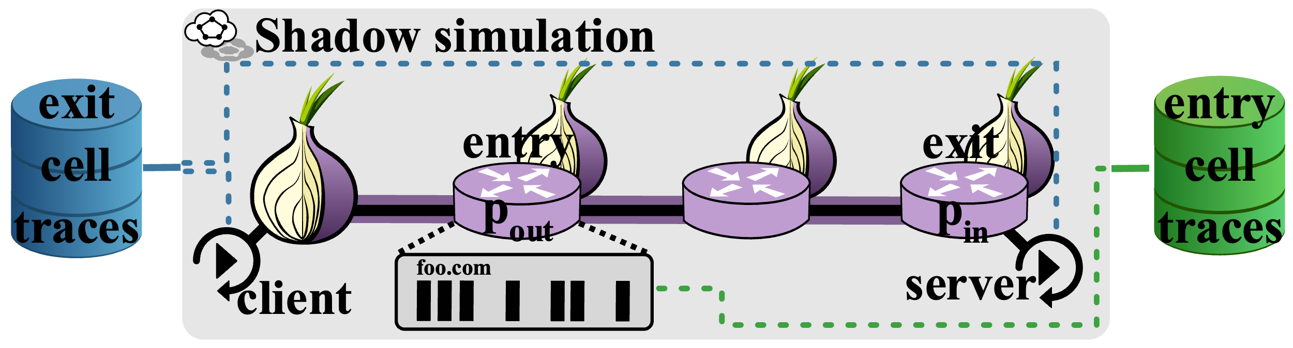
Retracer: A Cell Trace Transducer
Key Insights
A cell trace has the metadata needed to reproduce it
Network simulation tools (Shadow) model Tor with high fidelity
We can replay an exit trace in Shadow and extract its entry trace
Retracer
Replays cells traces in large-scale Tor simulations with Shadow
Uses cell trace timing and directions as a transcript for replay
Adjusts for latency between client and exit during replay

Slide 15
Outline
1. Trace transduction with Retracer
2. Retracer evaluation
3. Real-world WF evaluation

Slide 16
Retracer Evaluation Plan
Goal: evaluate how well Retracer transduces exit to entry traces
Real Tor labeled traces
Evaluate similarity

Slide 17



Collecting datasets for Retracer evaluation
Tor Dataset Collection
Patch Tor relay to record cell traces (only those from our client)
Select some Wikipedia pages
Fetch each page multiple times through our Tor relay, record traces
Repeat through Tor exit and entry positions
Client
Patched Relay
Client
Patched Relay

Slide 18
Retracer Evaluation Methodology
We measure Retracer’s efficacy using a downstream WF classification task

Slide 19
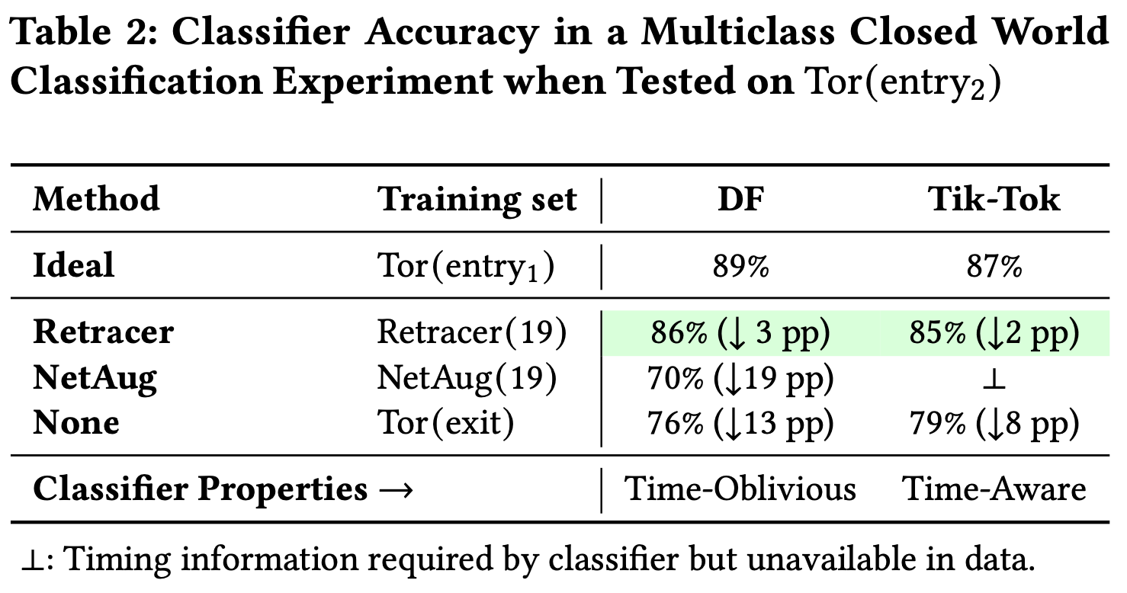
Retracer Evaluation Results

Slide 20
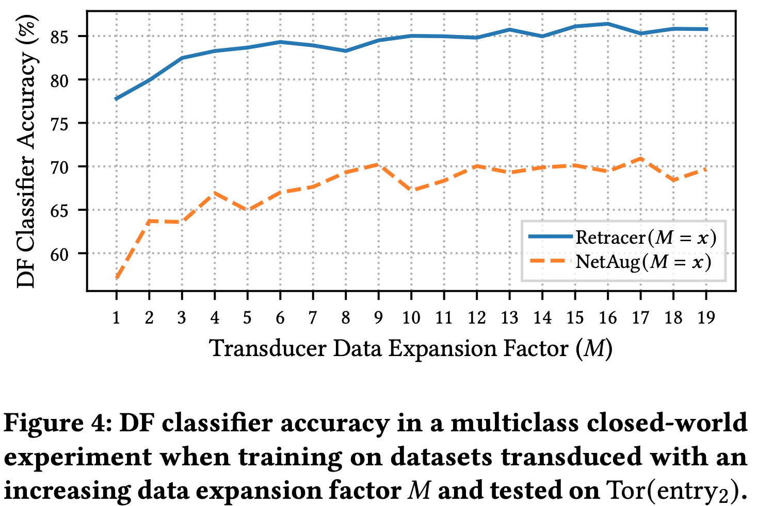
Retracer Evaluation Results

Slide 21
Outline
1. Trace transduction with Retracer
2. Retracer evaluation
3. Real-world WF evaluation

Slide 22
Real-World Evaluation Goals
We consider an adversary that uses real-world traces
Real: traces from normal Tor users
Testing must be against real traces
Training on real traces is thus superior
We want to estimate WF performance as realistically as possible
Considering multiple training strategies
We need a source of real-world data!
Train
Test

Slide 23
A Measurement of Genuine Tor Traces
Measurement from Tor exit relays
Measure normal Tor users at natural base rates
Sampling to limit data volume
No PII is recorded, metadata is protected with HMAC
Measurement plan reviewed by Tor Research Safety Board
GTT23 Genuine Tor Traces

Slide 24
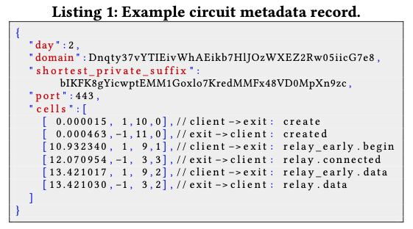
A Measurement of Genuine Tor Traces
Measurement from Tor exit relays
Measure normal Tor users at natural base rates
Sampling to limit data volume
No PII is recorded, metadata is protected with HMAC
Measurement plan reviewed by Tor Research Safety Board
GTT23 Genuine Tor Traces

Slide 25
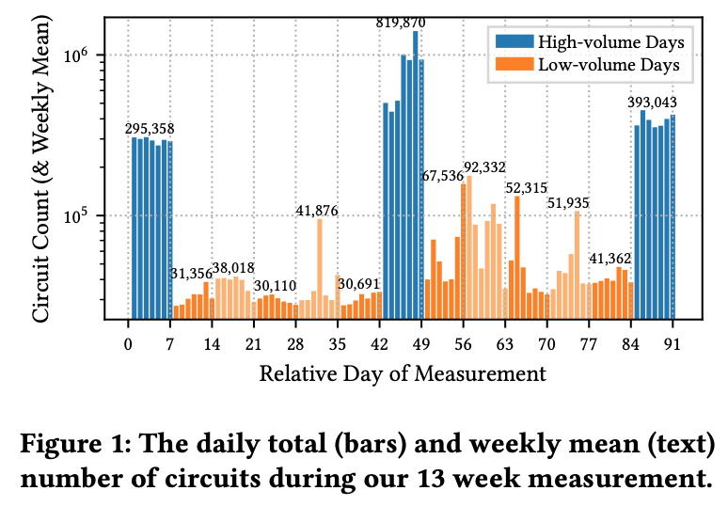
GTT23 Characteristics 1

Slide 26
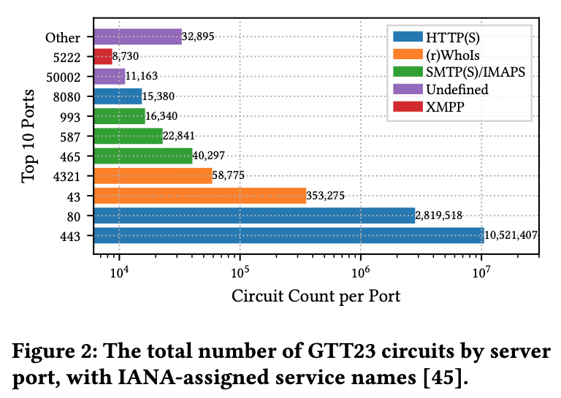
GTT23 Characteristics 2

Slide 27
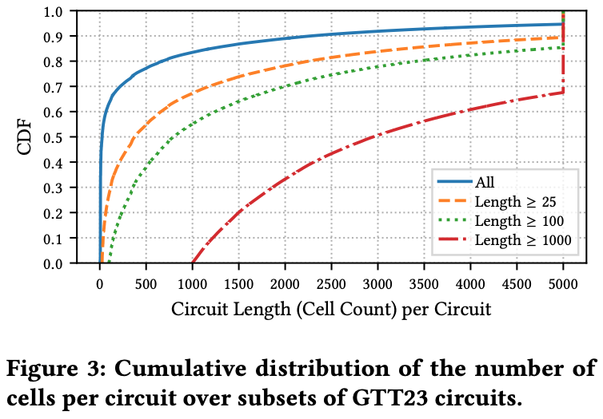
GTT23 Characteristics 3

Slide 28
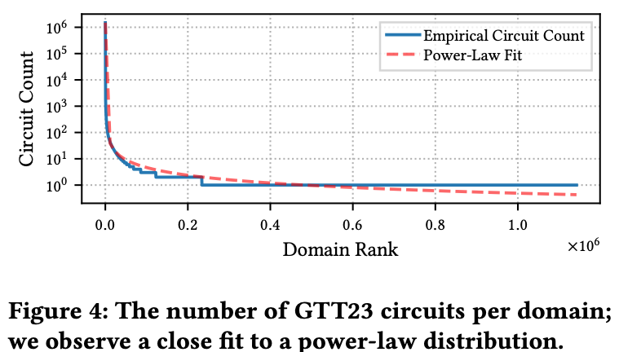
GTT23 Characteristics 4

Slide 29
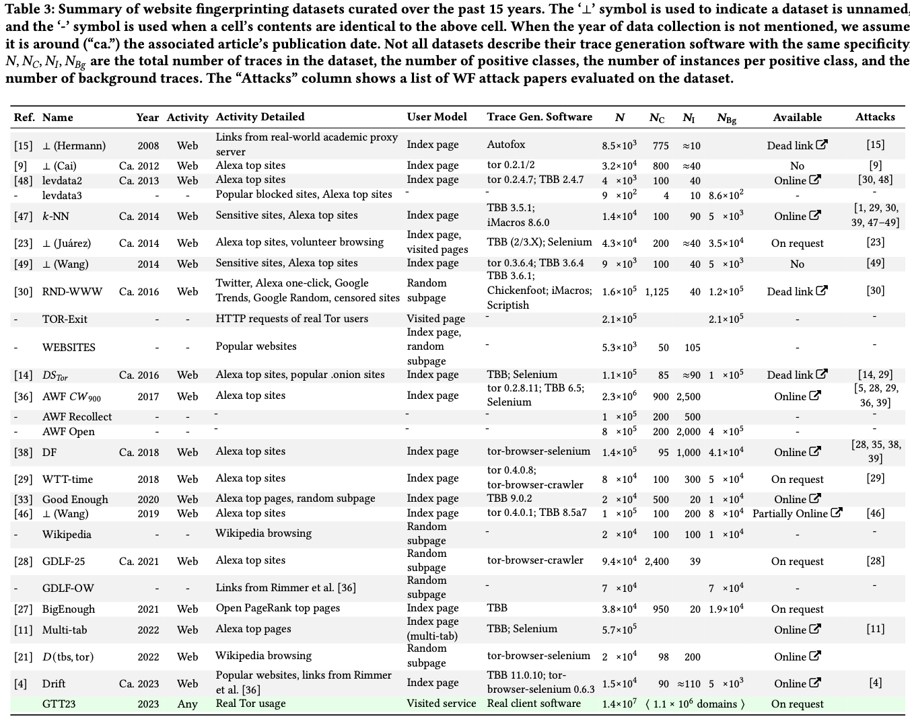
Comparisons to Synthetic Datasets

Slide 30
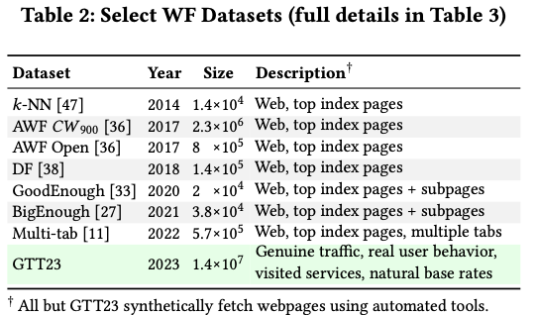
Comparisons to Synthetic Datasets
Most synthetic datasets are focused on website index (front) pages
There was a trend at considering larger datasets, GTT23 is still larger
No other dataset contains “genuine” traces naturally created from real Tor users

Slide 31
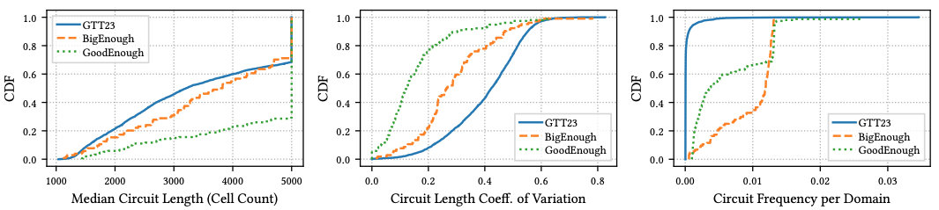
Disparities between GTT23 and synthetic datasets

Slide 32

WF Methodology Considering Genuine Tor Traces
GTT23:
Contains >13M traces from real users
Collected over 13 weeks on Tor exits
Training:
Use Deep Fingerprinting (DF) model
Week 1 traces with ≥ 1000 cells
1 model for each of the ~400 most popular websites
Testing
Traces from weeks >1
Open world: some sites not trained on
GTT23 is available online: Paper: https://doi.org/10.48550/arXiv.2404.07892
Dataset: https://doi.org/10.5281/zenodo.10620519

Slide 33
Methodology Considering Genuine Tor Traces
GTT23:
Contains >13M traces from real users
Collected over 13 weeks on Tor exits
Training:
Use Deep Fingerprinting (DF) model
Week 1 traces with ≥ 1000 cells
1 model for each of the ~400 most popular websites
Testing
Traces from weeks >1
Open world: some sites not trained on
GTT23 is available online: Paper: https://doi.org/10.48550/arXiv.2404.07892
Dataset: https://doi.org/10.5281/zenodo.10620519
GTT train
GTT test

Slide 34
WF Performance when Testing on Entry Traces
OnlineWF Train: (Cherubin’22)
GTT train
exit
train

Slide 35
WF Performance when Testing on Entry Traces
OnlineWF Train: (Cherubin’22)
Retracer Train:
GTT train
exit
train
GTT train
retracer
exit
entry
train

Slide 36
WF Performance when Testing on Entry Traces
OnlineWF Train: (Cherubin’22)
Retracer Train:
Both Test:
GTT train
exit
train
GTT train
retracer
exit
entry
train
GTT test
retracer
entry
entry
test

Slide 37
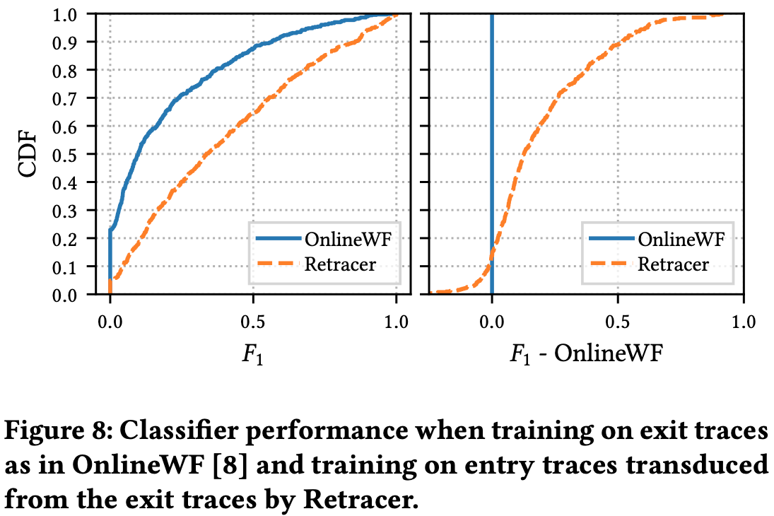
WF Performance when Testing on Entry Traces
OnlineWF Train: (Cherubin’22)
Retracer Train:
Both Test:
0.1 → 0.34 for the median website
GTT train
exit
train
GTT train
retracer
exit
entry
train
GTT test
retracer
entry
entry
test

Slide 38
Synthetic Datasets Overestimate WF Performance
Retracer: trained & tested as before
Uses Retracer to transduce the GTT23 train and test sets
Synthetic datasets → previous work
BigEnough: ~100,000 traces
GoodEnough: ~10,000 traces
Multiple pages per site
Use analogous per-site training/testing methodology

Slide 39
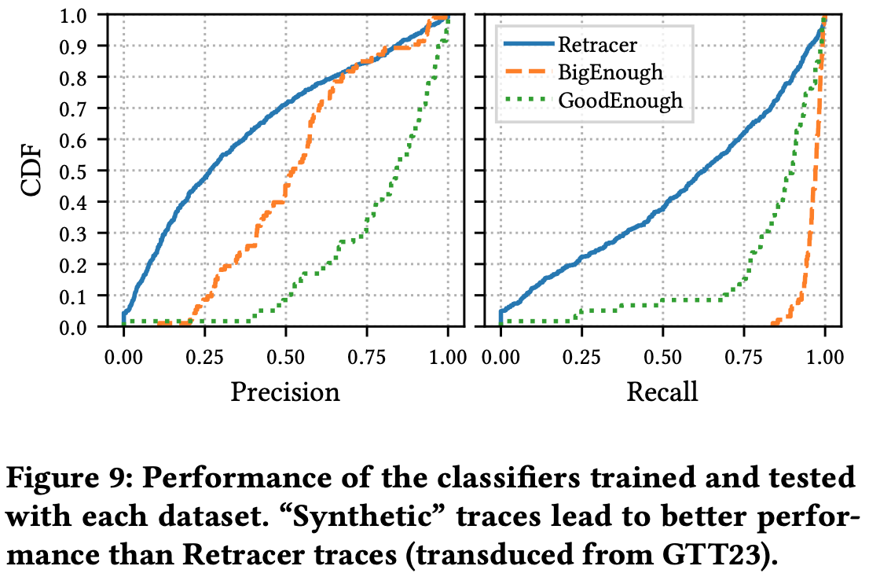
Synthetic Datasets Overestimate WF Performance
Retracer: trained & tested as before
Uses Retracer to transduce the GTT23 train and test sets
Synthetic datasets → previous work
BigEnough: ~100,000 traces
GoodEnough: ~10,000 traces
Multiple pages per site
Use analogous per-site training/testing methodology
WF performs better with synthetic traces

Slide 40
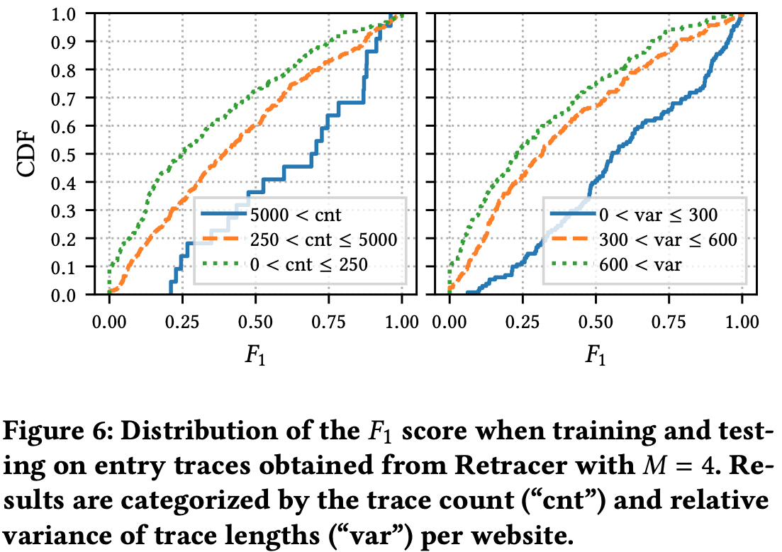
What are the important features for performance?
Feature importance analysis –
features predicting performance
Trace count
Median F₁ increased by 0.45 when 20x as many traces were available
Variance of trace lengths
Median F₁ increased by 0.33 when half as much variance is observed
20x traces
0.45 increase
½ variance
0.33 increase

Slide 41

Repositioning Real-World Website Fingerprinting on Tor
Read the paper!
Contributions
Retracer for transducing cell traces across positions
Retracer evaluation using Tor datasets
Real-world WF evaluation that tests on entry traces
Individual website fingerprintability methodology
Feature importance analysis
Future Work
Use Retracer to evaluate WF in new scenarios
Traffic splitting with Conflux
Apply WF defenses on top of genuine data
New methods for transduction
Contact: robert.g.jansen7.civ@us.navy.mil robgjansen.com

