Slide 1
Shadow: Scalable and Deterministic Network Experimentation
Cybersecurity Experimentation of the Future Community Engagement Event
Marina Del Rey, CA
May 15th, 2018
Dr. Rob Jansen
U.S. Naval Research Laboratory
Center for High Assurance Computer Systems

Slide 2
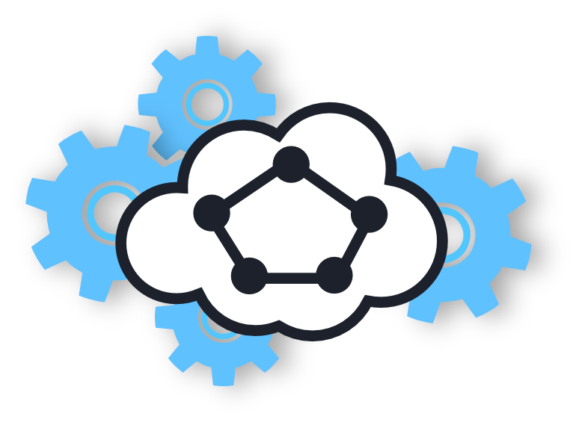
The Science of Cybersecurity
The most important property of experiments:
Experimental control – isolate important factors
Easily achievable with deterministic experimentation
Determinism yields repeatable / reproducible experiments
Requirements for large distributed systems (e.g., Tor)
Realistic – execute system software (not an abstraction)
Scalable – can run studied system at scale
Shadow
Network simulator with above design goals

Slide 3
Tor Experimentation

Slide 4



Tor Overview
Tor: a censorship resistant, privacy-enhancing anonymous communication system
~6500 Relays, 100 Gbit/s
Estimated ~2 M. Users/Day (metrics.torproject.org)

Slide 5
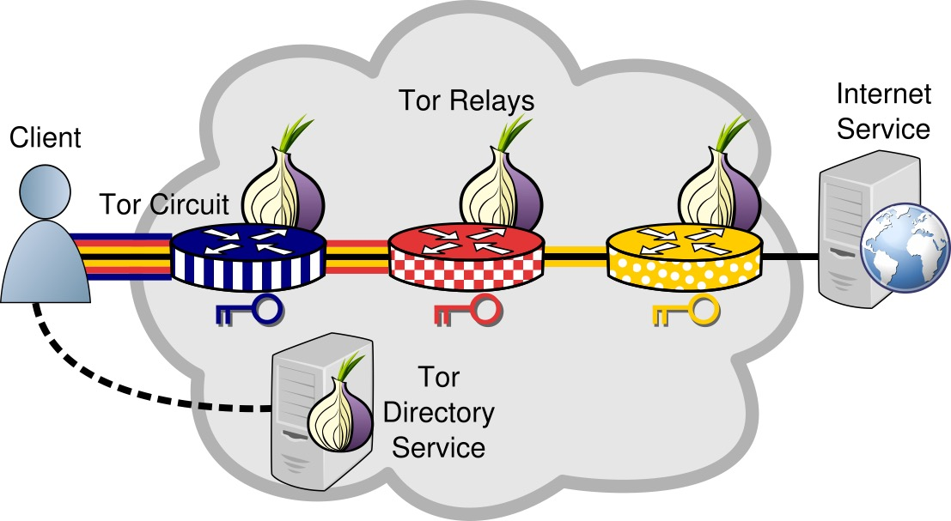
Onion Routing

Slide 6
Tor Experimentation Options
Approach | Notes
Live Network | Target environment, most “realistic” Lengthy deployment, security risks
Testbed | Target OS, uses Internet protocols Requires significant hardware investment
Emulation | Target OS, uses Internet protocols Large VM overhead
Simulation | Deterministic, scalable, decoupled from real time Abstractions reduce realism
More Realistic, Costly
More Control, Scalable

Slide 7
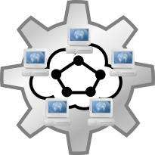

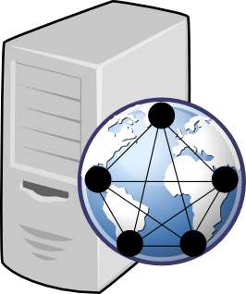
Simulation vs. Emulation: Realism
Simulation | Emulation
Abstracts away most system components | Runs the real OS, kernel, protocols, applications
Simulator is generally only internally consistent | Software is interoperable with external components
Less resource intensive | More resource intensive

Slide 8
Simulation vs. Emulation: Time
Simulation | Emulation
“As-fast-as-possible” | Real time
Control over clock, can pause time without issue | Time must advance in synchrony with wall-clock
Weak hardware extends total experiment runtime | Weak hardware causes glitches that are difficult to detect and diagnose

Slide 9
Shadow Design

Slide 10
What is Shadow?
Deterministic, parallel discrete-event network simulator
Directly executes apps as plug-ins (e.g., Tor, Bitcoin)
Models routing, latency, bandwidth
Simulates time, CPU, OS
TCP/UDP, sockets, queuing, threading
Emulates POSIX C API on Linux

Slide 11
How does Shadow Work?
Shadow - OS emulation and network simulation
App
OS Kernel
TCP IP
Internet
App
OS Kernel
TCP IP
App
OS Kernel
TCP IP

Slide 12
App Memory Management
Apps loaded in independent namespaces, “copy-on-write”
Namespace 1
Namespace 2
Namespace 3
Library Code (read-only)
Library Data 1
Library Data 2
Library Data 3
Plug-in Code (read-only)
Plug-in Data 1
Plug-in Data 2
Plug-in Data 3

Slide 13
Direct Execution in a Simulator
Namespace 1
Namespace 2
Namespace 3
libc
libc
libc
Shadow – Simulated Linux Kernel Libraries and Network Transport
Function Interposition
Function Interposition
Function Interposition
libc API (send, write, etc.)
libc API
(send, write, etc.)
libc API
(send, write, etc.)
Application
Application
Application

Slide 14
Shadow Uses Cases
Tor
Latency and throughput correlation attacks
Denial of Service attacks (sockets, RAM, bandwidth)
Changes to path selection algorithms
Traffic admission control algorithms
Traffic scheduling and prioritization algorithms
Network load balancing algorithms
Process RAM consumption and optimization
Network and memory attacks in Bitcoin
Distributed secure multiparty computation algorithms
Software debugging

Slide 15
Questions
Dr. Rob Jansen
Center for High Assurance Computer Systems
U.S. Naval Research Laboratory
rob.g.jansen@nrl.navy.mil
robgjansen.com, @robgjansen
The Shadow Simulator
shadow.github.io
github.com/shadow

