Slide 1
Inside Job: Applying Traffic Analysis to Measure Tor from Within
*Rob Jansen, U.S. Naval Research Laboratory
*Marc Juarez, imec-COSIC KU Leuven
Rafael Gálvez, imec-COSIC KU Leuven
Tariq Elahi, imec-COSIC KU Leuven
Claudia Diaz, imec-COSIC KU Leuven
*equally credited authors
Rob Jansen
Center for High Assurance Computer Systems
U.S. Naval Research Laboratory
25th Symposium on Network and Distributed System Security
San Diego, CA
February 21st, 2018

Slide 2







Tor Website Fingerprinting
Adversary’s goal: use website fingerprinting to deanonymize client (link client to destination)
Use traffic patterns to guess specific webpage accessed

Slide 3

Onion Service Fingerprinting
Tor website fingerprinting on onion services
Destination also runs Tor software
Use traffic patterns to guess specific webpage accessed

Slide 4
Onion Service Fingerprinting
All prior work considers adversary in an entry position

Slide 5
Onion Service Fingerprinting
All prior work considers adversary in an entry position
Limitations of the entry
Client-to-entry path is an unrealistic privileged position for most
Entry guard relays must be stable and have high up-time
Clients choose and pin 1 entry guard for 2-3 months before switching
It takes entry guards 3 months to reach steady state and be fully utilized by the network

Slide 6
This work: fingerprinting from middle relays
Onion service fingerprinting from an internal, middle relay position

Slide 7
This work: fingerprinting from middle relays
Onion service fingerprinting from an internal, middle relay position
Advantages of the middle
Clients choose a new middle for every circuit (choice is weighted by bandwidth)
No special relay requirements
Fully utilized almost immediately
Statistical sampling of all clients

Slide 8
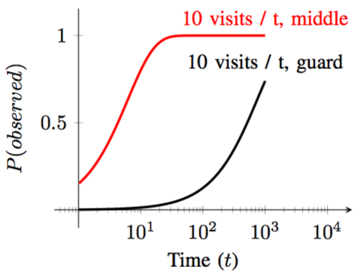
This work: fingerprinting from middle relays
Onion service fingerprinting from an internal, middle relay position
Middles will observe a client two orders of magnitude more quickly than guards
Advantages of the middle
Clients choose a new middle for every circuit (choice is weighted by bandwidth)
No special relay requirements
Fully utilized almost immediately
Statistical sampling of all clients

Slide 9
This work: fingerprinting from middle relays
The middle identifies the destination… and then what?
Onion service popularity measurement [this work]
Client geolocation attack using latency
[Hopper et al. 2007,2010]
Fingerprint protocols instead of websites [future work]
Targeted attacks on guards that are used to access websites of interest [Jaggard and Syverson, 2017]

Slide 10
Outline
Background, Motivation: Why the middle relay?
Circuit fingerprinting
Onion Service Fingerprinting
Onion Service Popularity Measurement
Conclusion / Questions

Slide 11
Circuit Fingerprinting
Collect circuit traces, extract features, train classifiers
Identify circuit purpose and position

Slide 12
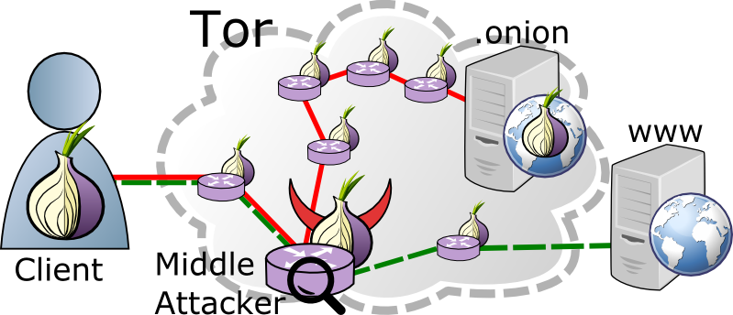
Circuit Fingerprinting
Predict circuit type and relay position
Binary classification
Circuit purpose: rendezvous (onion service)
Circuit position: middle (adj. to guard)

Slide 13
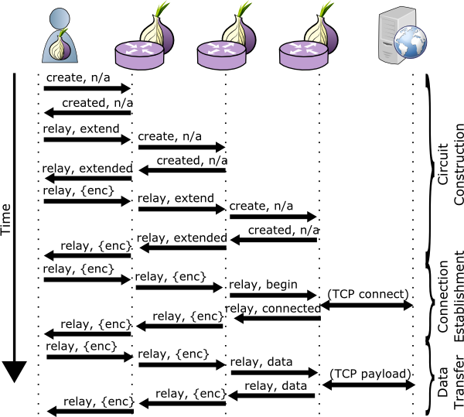
Data Set, Features, and Training
Generate samples using Shadow
Use the Shadow Tor simulator to generate 1.85 million circuits
Label circuits with purpose and position
Extract features and train random- forest classifiers
Use as features:
Previous/next node type
Counts of cell type/relay command (recv/sent inside/outside)

Slide 14
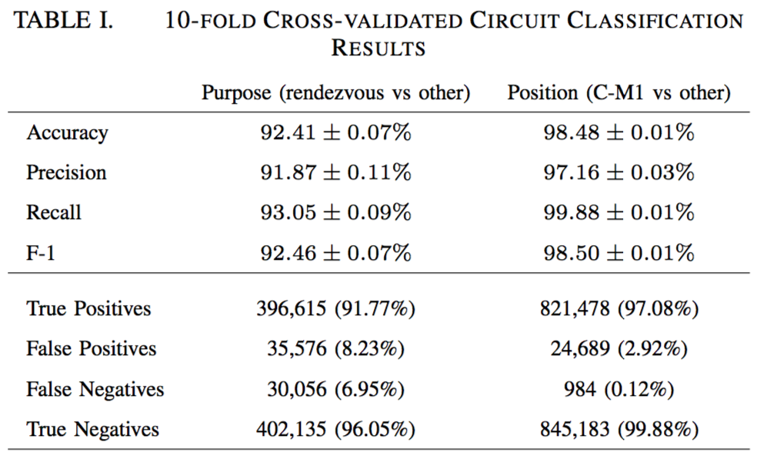
Circuit fingerprinting results

Slide 15
Onion Service Fingerprinting
Collect webpage traces, train and evaluate classifiers
Identify onion service

Slide 16

Onion Service Fingerprinting
Given a rendezvous circuit, can we identify the destination?
Run modified Tor to identify circuits that we originate!
Crawl known and online onion sites
Capture TCP trace with tshark
Capture cell trace with onionperf
2,500 onion sites, 80 crawls per front page

Slide 17
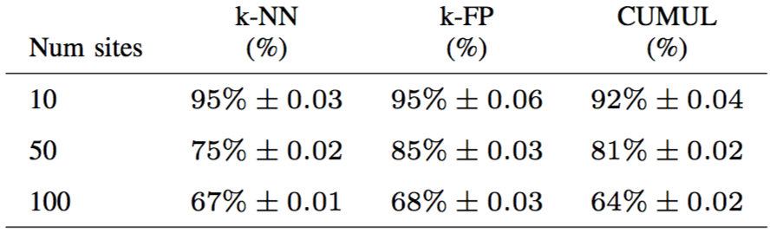
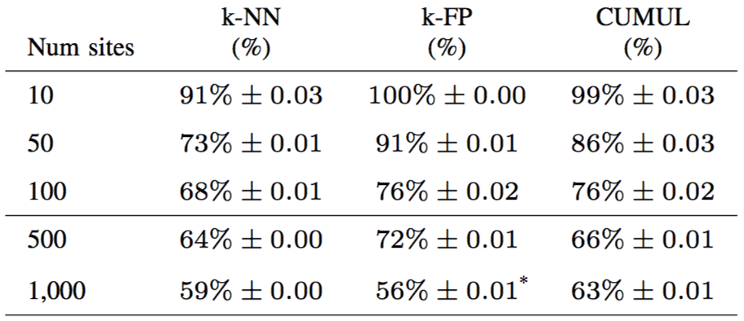
Closed World Onion Site Fingerprinting Results
True Positive Rates
Entry model
Classify using client-to-guard packet traces
Middle relay model
Classify using middle relay cell traces

Slide 18
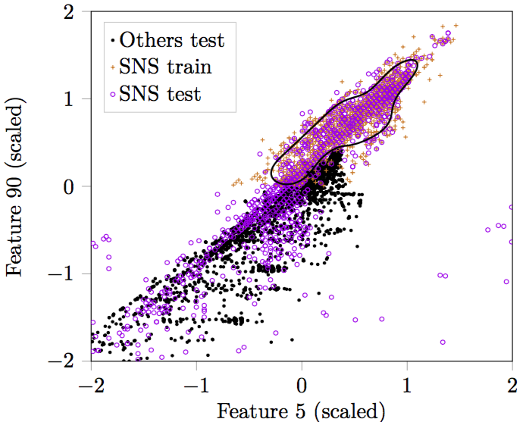

Open World Onion Site Fingerprinting Results
One-class classification problem
Site is the monitored site or other
We used a popular social networking site ( ) as the monitored site
Projection shows boundary that minimizes false positives
80% of all errors were from 12 sites

Slide 19
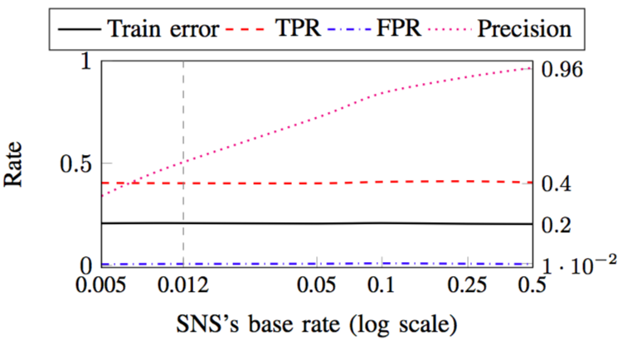
Open World Onion Site Fingerprinting Results
Base Rate Performance
Precision is 50% at a base rate of 1%
Precision decreases exponentially with the base rate

Slide 20
Onion Service Popularity Measurement
Train classifiers on a social networking site front-page
Apply trained classifiers to measure onion service popularity using privacy-preserving Tor measurement tool (PrivCount)

Slide 21
Classifying Circuits and Sites in Tor
Measured popular social network site that runs a single onion service
Enhanced PrivCount to classify circuit purpose, relay position, and site
Three measurements:
Classify circuits from real Tor users
Classify circuits from ground truth crawler
Measure direct accesses to the ASN of (in the cases that we are the 3rd hop)
facebookcorewwwi.onion

Slide 22
Classifying Circuits and Sites in Tor
Measured popular social network site that runs a single onion service
Enhanced PrivCount to classify circuit purpose, relay position, and site
Three measurements:
Classify circuits from real Tor users
Classify circuits from ground truth crawler
Measure direct accesses to the ASN of (in the cases that we are the 3rd hop)
Ethical research:
PrivCount provides differential privacy and secure aggregation of results
No information is stored on disk
Circuit-specific information is stored only for the life of the circuit (10 minutes)
Consulted with Tor Research Safety Board to get feedback on methodology
facebookcorewwwi.onion

Slide 23
Classification Results
Classifier | True Positives | False Negatives
Purpose | 100% | 0%
Position | 96.5% | 3.4%
Site | 60.0% | 40.0%
Crawler results (ground truth)
Popularity | Direct | Classified
Purpose (onion service) | 1.28% | 4.48%
Site | 0.52% | 0.02%
Measurement pipeline results
Results include noise!

Slide 24
Conclusion
Circuit and website fingerprinting is at least as accurate from middle relays as it is from the entry position
The number of Facebook onion site visits was indistinguishable from noise
More work needed to better understand middle relay threats
All code is open-source:
github.com/onionpop
github.com/privcount
github.com/shadow
Contact:
Rob Jansen
U.S. Naval Research Laboratory
rob.g.jansen@nrl.navy.mil
robgjansen.com, @robgjansen

Slide 25
Onion Service Fingerprinting Classifiers
Train and test well known classifiers using packet and cell traces
k Nearest Neighbors (kNN) [Wang et al., 2014]
Averages over k closest instances according to Euclidean distance
CUMUL [Panchenko et al., 2016]
Support vector machine (SVM) with radial basis function
k-Fingerprinting (KFP) [Hayes and Danezis, 2016]
Random forest + kNN (with Hamming distance)

