Slide 1

Point Break: A Study of Bandwidth Denial-of-Service Attacks against Tor
Rob Jansen, U.S. Naval Research Laboratory
Tavish Vaidya, Georgetown University
Micah Sherr, Georgetown University
Rob Jansen
Center for High Assurance Computer Systems
U.S. Naval Research Laboratory
28th USENIX Security Symposium
Hyatt Regency, Santa Clara, CA, USA
August 16th, 2019

Slide 2



Most Exciting Contribution
Explore the costs and effects of bandwidth denial-of-service attacks on Tor
3 Gbit/s
47% Slower
$140 - $1.6K / mo.

Slide 4
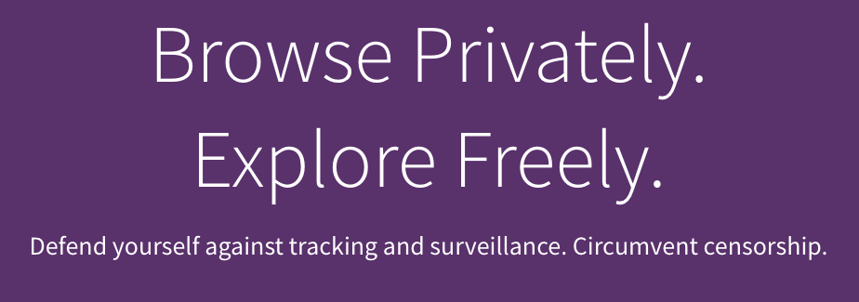




Tor Protects Users
Anonymous Communication
Separates identification from routing
Provides unlinkable communication
Protects user privacy and safety online
Tor is Popular
~2-8 million daily active users
~6,500 volunteer relays
Transferring ~200 Gbit/s

Slide 5


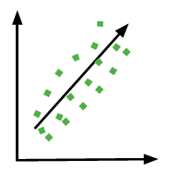
Anonymity Attacks against Tor
Website fingerprinting attacks
CCSW’09, WPES’11, CCS’12, WPES’13, Sec’14, NDSS’16, Sec’16, NDSS’18, CCS’18
Traffic correlation attacks
S&P’05, PET’07, Sec’09, CCS’09, TISSEC’10, CCS’11, PETS’13, CCS’13, CN’13, NDSS’14, CCS’18,
Routing attacks
WPES’07, CCS’07, Sec’15, PETS’16, S&P’17, PETS’18

Slide 6

Anonymity Attacks against Tor
Website fingerprinting attacks
CCSW’09, WPES’11, CCS’12, WPES’13, Sec’14, NDSS’16, Sec’16, NDSS’18, CCS’18
Traffic correlation attacks
S&P’05, PET’07, Sec’09, CCS’09, TISSEC’10, CCS’11, PETS’13, CCS’13, CN’13, NDSS’14, CCS’18,
Routing attacks
WPES’07, CCS’07, Sec’15, PETS’16, S&P’17, PETS’18

Slide 7

Our Focus: Denial-of-Service Attacks

Slide 8
Our Focus: Denial-of-Service Attacks
2007
2008
2009
2013
2014
2019

Slide 9
Our Focus: Denial-of-Service Attacks
Borisov et al. CCS’07
Selective service refusal
Geddes et al. WPES’14
Socket Exhaustion
2007
2008
2009
2013
2014
2019

Slide 10
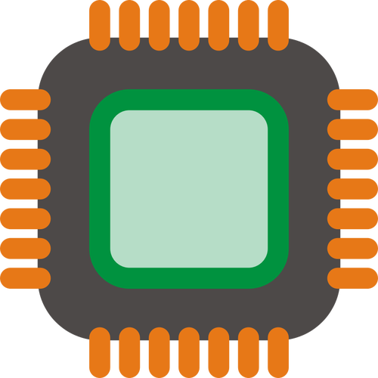
Our Focus: Denial-of-Service Attacks
Borisov et al. CCS’07
Selective service refusal
Geddes et al. WPES’14
Socket Exhaustion
Pappas et al. InfoSec’08
Packet Spinning
Barbera et al. ESORICS’13
Cell Flood
2007
2008
2009
2013
2014
2019

Slide 11

Our Focus: Denial-of-Service Attacks
Borisov et al. CCS’07
Selective service refusal
Geddes et al. WPES’14
Socket Exhaustion
Evans et al. Sec’09
Long Paths
Pappas et al. InfoSec’08
Packet Spinning
Barbera et al. ESORICS’13
Cell Flood
2007
2008
2009
2013
2014
2019

Slide 12

Our Focus: Denial-of-Service Attacks
Borisov et al. CCS’07
Selective service refusal
Geddes et al. WPES’14
Socket Exhaustion
Evans et al. Sec’09
Long Paths
Pappas et al. InfoSec’08
Packet Spinning
Barbera et al. ESORICS’13
Cell Flood
Jansen et al. NDSS’14 Sniper Attack
2007
2008
2009
2013
2014
2019

Slide 13
Our Focus: Denial-of-Service Attacks
Borisov et al. CCS’07
Selective service refusal
Geddes et al. WPES’14
Socket Exhaustion
Evans et al. Sec’09
Long Paths
This Work
Long Paths + Sniper
Pappas et al. InfoSec’08
Packet Spinning
Barbera et al. ESORICS’13
Cell Flood
Jansen et al. NDSS’14 Sniper Attack
2007
2008
2009
2013
2014
2019

Slide 14
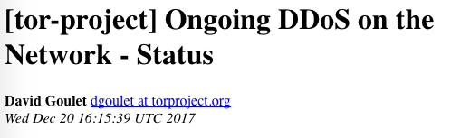
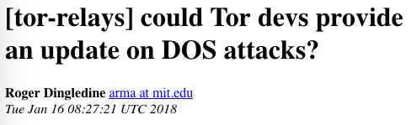
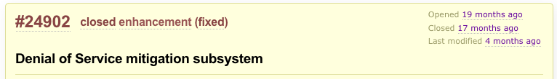
DoS against Tor – A Realistic Threat
https://trac.torproject.org/projects/tor/ticket/24902

Slide 15


Research Questions and Summary of Results
Component | Cost | Effect
Bridges | $17,000 / mo. | 44% slower
TorFlow BW Scanners | $2,800 / mo. | 80% slower
Relays | $140 - $1,600 / mo. or $6,300 / mo. | 47% slower or 120% slower
Notes:
RQ1: How is Tor vulnerable to bandwidth-based DoS (BW DoS) attacks?
RQ2: How costly are BW DoS attacks to carry out?
RQ3: What effects does BW DoS have on Tor performance and reliability?

Slide 16
Research Questions and Summary of Results
Component | Cost | Effect
Bridges | $17,000 / mo. | 44% slower
TorFlow BW Scanners | $2,800 / mo. | 80% slower
Relays | $140 - $1,600 / mo. or $6,300 / mo. | 47% slower or 120% slower
Ethical research:
No attacks on the public Tor network
Analyzed performance effects with Shadow
Conducted some Tor measurements as client, stored no information about users
Notes:
RQ1: How is Tor vulnerable to bandwidth-based DoS (BW DoS) attacks?
RQ2: How costly are BW DoS attacks to carry out?
RQ3: What effects does BW DoS have on Tor performance and reliability?

Slide 17
Research Questions and Summary of Results
Component | Cost | Effect
Bridges | $17,000 / mo. | 44% slower
TorFlow BW Scanners | $2,800 / mo. | 80% slower
Relays | $140 - $1,600 / mo. or $6,300 / mo. | 47% slower or 120% slower
Notes:
RQ1: How is Tor vulnerable to bandwidth-based DoS (BW DoS) attacks?
RQ2: How costly are BW DoS attacks to carry out?
RQ3: What effects does BW DoS have on Tor performance and reliability?

Slide 18
Attack

Slide 19





How Tor Works
= Circuit
= Stream

Slide 20
The Relay Congestion Attack
Step 1: Build 8-hop circuit

Slide 21
The Relay Congestion Attack
Step 1: Build 8-hop circuit
Can be targeted or indiscriminate

Slide 22
The Relay Congestion Attack
Step 1: Build 8-hop circuit
Step 2: GET large files

Slide 23
The Relay Congestion Attack
Step 1: Build 8-hop circuit
Step 2: GET large files
Step 3: Stop reading

Slide 24
The Relay Congestion Attack
Step 1: Build 8-hop circuit
Step 2: GET large files
Step 3: Stop reading
Step 4: Send flow control cells

Slide 25
The Relay Congestion Attack
Step 5: Repeat!!!
New entry relays
New sockets

Slide 26
Evaluation

Slide 27

Evaluation Setup
Use Shadow for evaluation
Private Tor network for safety
634 relays (10% size, capacity of Tor)
15,000 clients and 2,000 servers generating traffic through Tor
Explore network effects
Attack strength (num. attack circuits)
Network load, attacker resource usage, client performance
https://github.com/shadow/shadow

Slide 28
Bandwidth Used by Attacker and Tor Network

Slide 29
Bandwidth Used by Attacker and Tor Network
Bandwidth
Amplification
Factors:
20k Circuits
6.7

Slide 30
Bandwidth Used by Attacker and Tor Network
Bandwidth
Amplification
Factors:
20k Circuits
6.7
Stop Reading
26

Slide 31
Effect on Client Performance

Slide 32
Effect on Client Performance
20k Circuits
TTFB: +138%
20k Circuits
TTLB: +120%

Slide 33
Effect on Client Performance
20k Circuits
TTFB: +138%
20k Circuits
TTLB: +120%
Stop Reading
TTFB: +48%
Stop Reading
TTLB: +47%

Slide 34
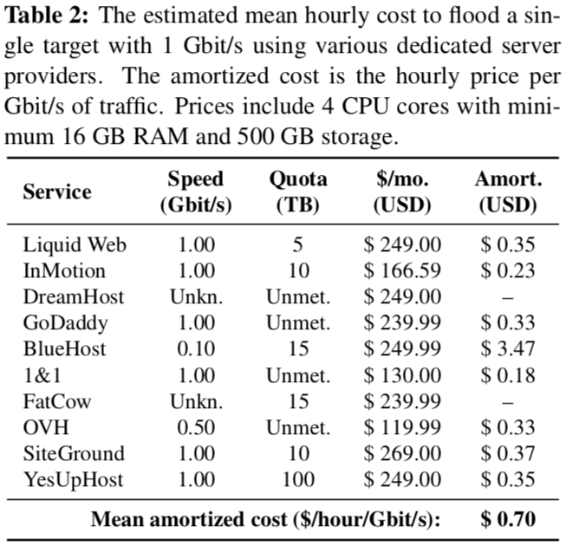
Cost to Conduct Relay Congestion Attack
Requirements for “stop reading” attack
200,000 circuits
3 Gbit/s, 20 IP addresses
Cost of Bandwidth and IP addresses
3 dedicated servers at 1 Gbit/s each, amortized cost of 0.70 $/hour/Gbit/s
17 additional IPs at $5 each, $85 total
Total Cost Estimates
Conservative: $1,647 per month
Optimistic: $140 per month ($7 * 20 VPSes)

Slide 35
Comparison to Sybil Attacks
Comparison to relay Sybil attacks with the same bandwidth budget (3 Gbit/s)
Sybil DoS Attack
Sybil Deanonymization Attack

Slide 36
Comparison to Sybil Attacks
Comparison to relay Sybil attacks with the same bandwidth budget (3 Gbit/s)
Sybil DoS Attack
Goal: drop all circuits containing Sybil relays
Exit BW is scarcest and gives highest probability of selection
3 Gbit/s = 4.5% dropped circuits
Sybil Deanonymization Attack

Slide 37
Comparison to Sybil Attacks
Comparison to relay Sybil attacks with the same bandwidth budget (3 Gbit/s)
Sybil DoS Attack
Goal: drop all circuits containing Sybil relays
Exit BW is scarcest and gives highest probability of selection
3 Gbit/s = 4.5% dropped circuits
Sybil Deanonymization Attack
Goal: appear on both ends of circuits to compromise anonymity
5:1 guard-to-exit BW allocation
2.8% guard * 0.8% exit = 0.02% total circuits compromised

Slide 38
Mitigation

Slide 39
Mitigations to Relay Congestion Attack
Ability to stop reading from circuits
Authenticated SENDMEs, Tor Proposal 289, implemented in 0.4.1.1-alpha
Inject nonce in every 50 cells
Must read and return nonce in SENDME cell

Slide 40
Mitigations to Relay Congestion Attack
Ability to stop reading from circuits
Authenticated SENDMEs, Tor Proposal 289, implemented in 0.4.1.1-alpha
Ability to build 8 hop circuits
Reduce to 4 hops to reduce BW amplification factor

Slide 41
Mitigations to Relay Congestion Attack
Ability to stop reading from circuits
Authenticated SENDMEs, Tor Proposal 289, implemented in 0.4.1.1-alpha
Ability to build 8 hop circuits
Reduce to 4 hops to reduce BW amplification factor
Ability to use any relay as entry
Privacy-preserving defense against Sybil attacks
Detect, measure, and prevent such attacks

Slide 42
Summary
Contributions
Bridge congestion attack: $17K/mo., 44% slower
Bandwidth authority attack: $2.6K/mo., 80% slower
Relay congestion attack: $140-$1.6K/mo., 47% slower (or $6.3K/mo., 120% slower)
Future Work
Deploy simple mitigation techniques in short term
Need research in Sybil attack detection, measurement, and prevention
Contact
<rob.g.jansen@nrl.navy.mil>, robgjansen.com, @robgjansen

