Slide 1
Privacy-Preserving Dynamic Learning of Tor Network Traffic
Rob Jansen, U.S. Naval Research Laboratory
Matthew Traudt, U.S. Naval Research Laboratory
Nicholas Hopper, University of Minnesota
Rob Jansen
Center for High Assurance Computer Systems
U.S. Naval Research Laboratory
25th Conference on Computer and Communication Security
Beanfield Centre, Toronto, Canada
October 18th, 2018

Slide 2
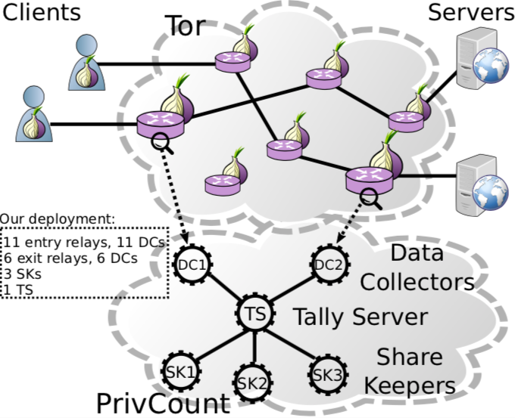
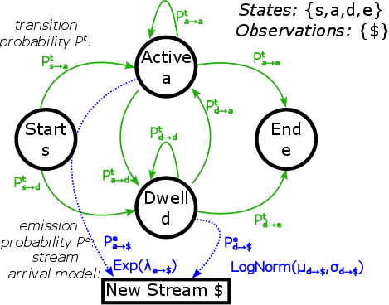



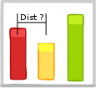


Main Contributions
Safely Measure Tor
Learn Tor Traffic w/ HMMs
Evaluate Traffic Models
Build Traffic Models
Protocol
PrivCount
Single File

Slide 3
Motivation

Slide 4









Tor is Popular
The most popular deployed anonymous comm. system
~2*-8** million daily users
~6,400 volunteer relays*
Transferring ~125 Gbit/s*
Onion service adoption:
https://metrics.torproject.org
*as of 2018-10-14
**IMC’18

Slide 5







Tor Protects User Privacy
Anonymous Communication
Tor separates identification from routing to provide unlinkable communication
Protects user privacy and safety online
= Circuit
= Stream

Slide 6








Tor is Open and Transparent
Tor follows an open & transparent development process
Open source
Open communication
Anyone can contribute
A significant body of research
> 4k citations
A major research area for many prominent universities
Many masters and doctoral theses focus on a Tor or a Tor-related research topic

Slide 7

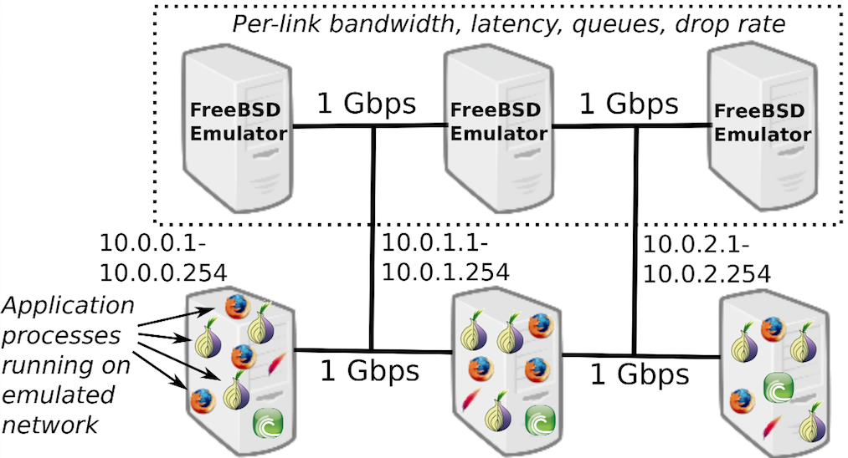
Tor Experimentation
Tor research depends on Tor experimentation tools to:
Evaluate research design changes and trade-offs
Test effects across a range of deployment scenarios and network conditions
Reproduce research results
Shadow:
Network Simulation
Chutney/NetMirage/ExpTor:
Network Emulation

Slide 8
How to Generate Tor Traffic
How do we currently produce traffic in private Tor networks?
Standard: download single file (static webpage size)
Using a single file model fails to capture:
Content length distribution
Website structural dependencies (embedded objects)
Temporal dynamics (async and bidirectional protocols)
Destination diversity (CDNs, third party content)
Tor protocol dynamics (processing of circuits and streams)
Single File

Slide 9
Research Question and Contributions
How can we generate more accurate traffic flows for use in Tor experimentation tools and research?
In this work, we:
Use PrivCount to safely measure “ground truth” Tor statistics
Learn generative models of Tor traffic (packets and streams) using hidden Markov modeling and iterative measurement
Create traffic generation tools for private Tor networks
Evaluate new traffic generation models against ground truth

Slide 10
Tor Measurement

Slide 11
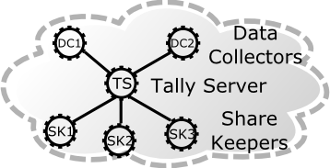
PrivCount Measurement System
PrivCount: a privacy-preserving counting system
Designed to safely collect useful Tor statistics [CCS’16]
Based on the PrivEx secret sharing protocol [CCS’14]
PrivCount security goals:
Forward privacy: adversary cannot learn state of measurement before time of compromise
Secure aggregation across all measurement nodes
Measurement results are differentially private to protect user actions

Slide 12
PrivCount Deployment
We deployed PrivCount on the public Tor network

Slide 13
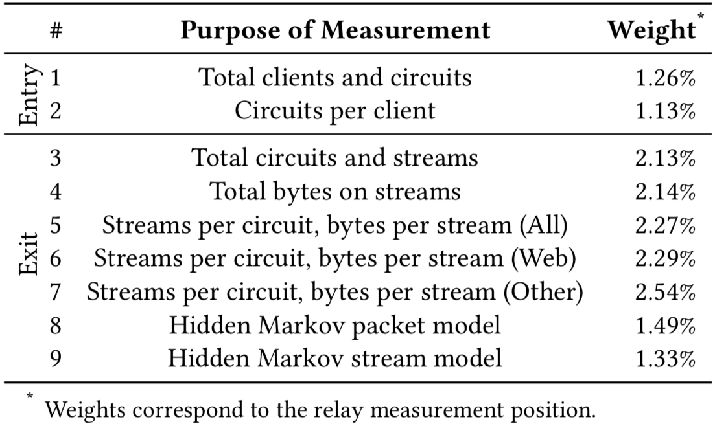
PrivCount Measurement Types
We used PrivCount to safely measure various Tor statistics

Slide 14
Results: Streams per Circuit

Slide 15
Learning Tor Traffic

Slide 16
Learn Traffic with Hidden Markov Modeling
Use exit relay observations and PrivCount to safely learn HMM stream and packet models of live Tor traffic
Exits can observe:
Stream model events
Circuit opened, stream created, circuit closed
Packet model events
Stream opened, packet transferred (directional), stream closed
Both models
Inter-event timing (relative time since previous observed event)

Slide 17
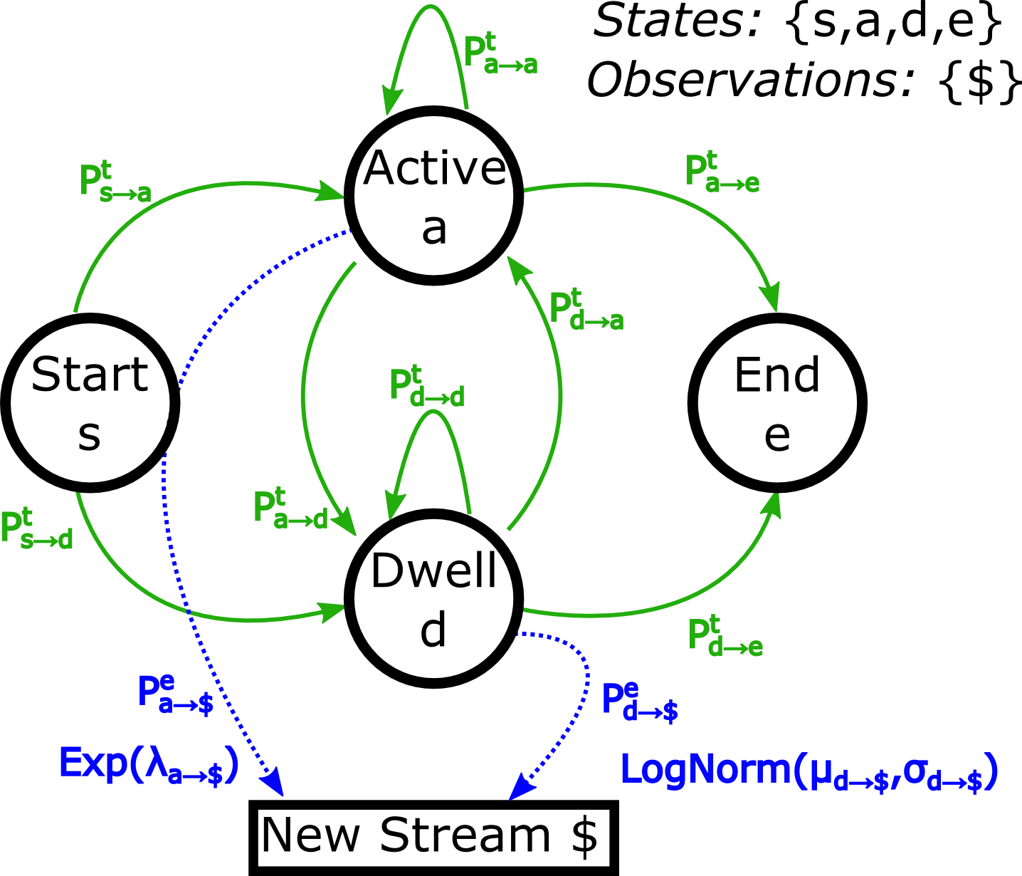
Hidden Markov Modeling: Overview
HMM: encode delay distributions on emission edges
State-to-state
transitions
(circuit opened)
(circuit closed)
State-to-observation
emissions

Slide 18

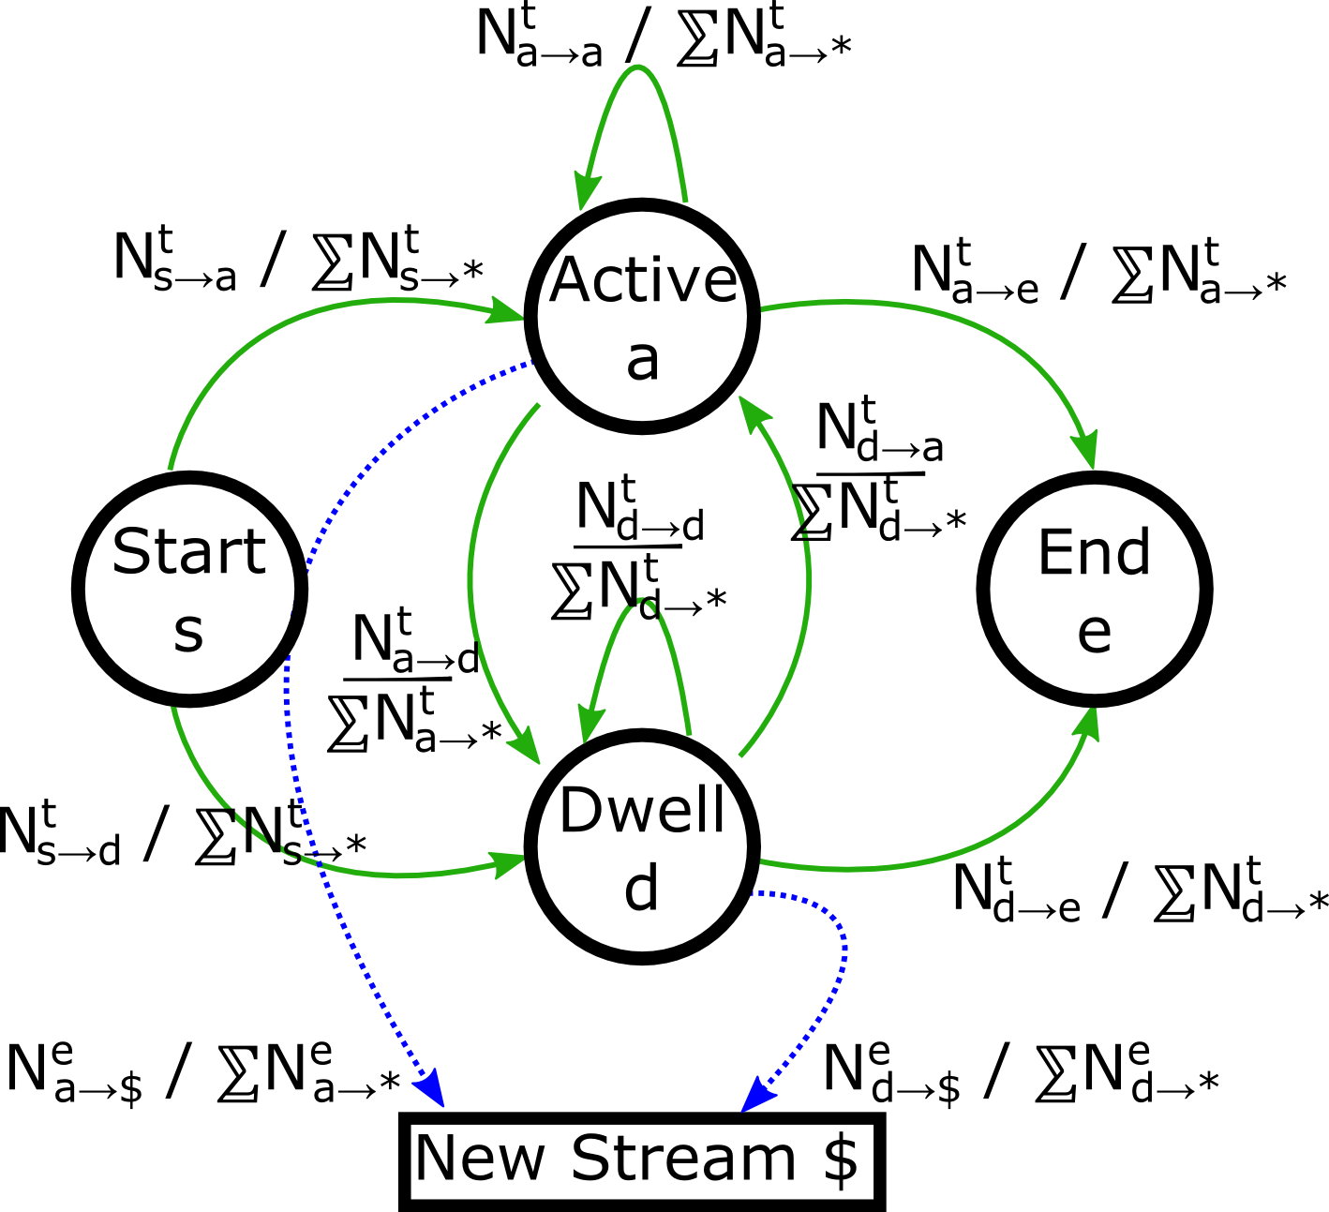
Hidden Markov Modeling: Process
Bootstrap HMM
Safely measure HMM path
frequencies with PrivCount
Observe inter-stream delays
Most likely HMM path (Viterbi)
Count HMM frequencies
Update HMM probs. using weight parameter
AS 2500
TCP
Flow
TCP
Flow
Cluster flows, train initial HMM
TCP
Flow
TCP
Flow

Slide 19
Hidden Markov Modeling: Results
Fraction of observed sequences more likely under model x than under model y

Slide 20
Evaluation

Slide 21
Traffic Generator and Models
Build traffic generator (tgen)
Based on action-dependency graph
Creates TCP connections and transfers data
Create tgen model configs (dependency graphs)
Single file model (standard)
PrivCount model (HMM results)
Protocol model (HTTP archive, BitTorrent)

Slide 22
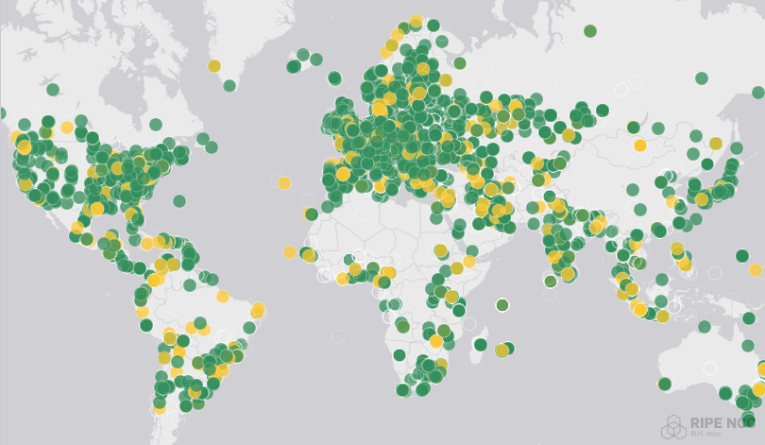


Model Evaluation
Use Shadow (private Tor network)
Created Internet latency model
Used RIPE Atlas, ~5 million pings
Est. latency between 1,813 cities
Run all 3 tgen models in Shadow
Use our PrivCount version of Tor, record PrivCount events
Run event traces through local PrivCount deployment
Compare to previously collected “ground truth”

Slide 23
Model Comparison Results
Compared PrivCount stats across models and public Tor
Used earth mover’s distance as a metric, cumulative dist.: Single: 703%, Protocol: 1001%, PrivCount: 408%

Slide 24
Talk Summary
Contributions
Safely measure Tor, learn Tor traffic using HMMs, build traffic models, evaluate traffic models in Shadow
All code merged into PrivCount and Shadow
Data, code, and details at https://tmodel-ccs2018.github.io
Extensions and future work
Measure traffic models over longer timescales
Create and measure a circuit creation model
Further explore effect of traffic fidelity on research results
Contact
rob.g.jansen@nrl.navy.mil, robgjansen.com, @robgjansen

Slide 25
Backup Slides

Slide 26
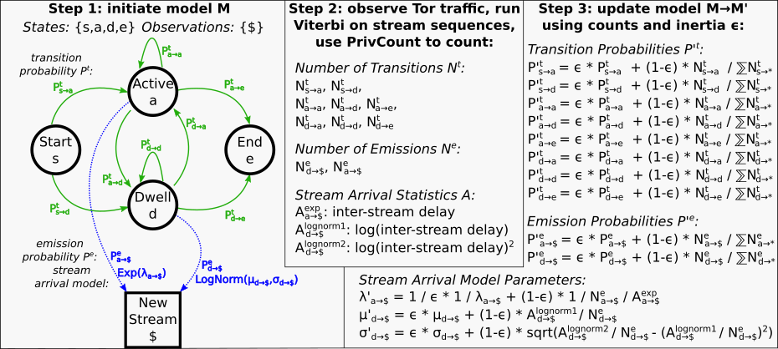
HMM Process

Slide 27
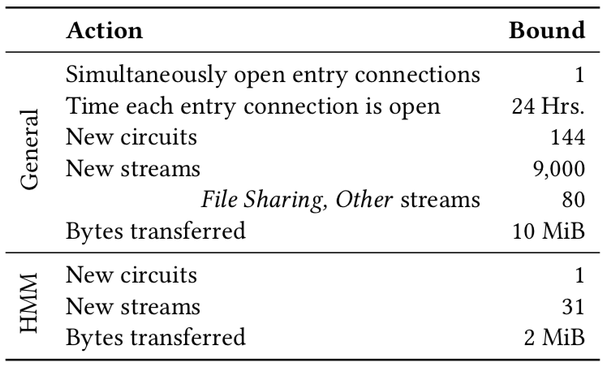
Action Bounds

Slide 28
Overhead

